Slide 1




BENZENE: A Practical Root Cause Analysis System with an Under-Constrained State Mutation
Younggi Park, Hwiwon Lee, Jinho Jung,
Hyungjoon Koo, Huy Kang Kim

Slide 2
Software Crash?

Slide 3
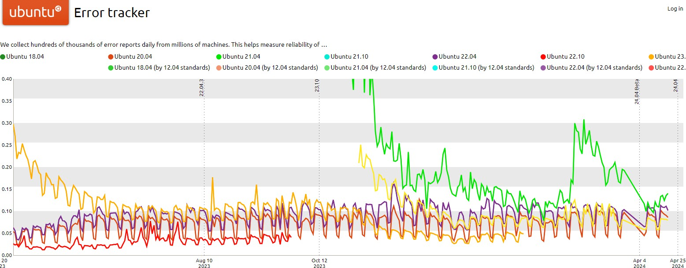
Software Crash

Slide 4

Software Crash

Slide 5
Predicate-based Fault Localization

Slide 6



Predicate-based Fault Localization
① Behavior Collection
Collect both crashing and
non-crashing behaviors

Slide 7



Predicate-based Fault Localization
len > 0x10
① Behavior Collection
② Difference Observation
Collect both crashing and
non-crashing behaviors
Extract predicates that statistically
describe a crashing condition

Slide 8

Predicate-based Fault Localization
len > 0x10
len > 0x10
① Behavior Collection
② Difference Observation
③ Predicate Ranking
Collect both crashing and
non-crashing behaviors
Extract predicates that statistically
describe a crashing condition
Rank the extracted predicates by their suspiciousness

Slide 9
BENZENE Overview
We implement a root cause analysis system, BENZENE

Slide 10

BENZENE Overview
We implement a root cause analysis system, BENZENE
Crash
Target
Program

Slide 11





BENZENE Overview
We implement a root cause analysis system, BENZENE
Crash
Target
Program
Dynamic Binary Analysis

Slide 12


BENZENE Overview
We implement a root cause analysis system, BENZENE
Crash
Target
Program
Dynamic Binary Analysis
Program Behavior Collection

Slide 13

BENZENE Overview
We implement a root cause analysis system, BENZENE
𝒑_{𝟏}
𝒑_{𝟐}
𝒑_{𝟑}
...
Crash
vs.
Target
Program
Dynamic Binary Analysis
Program Behavior Collection
Root Cause Analysis

Slide 14

BENZENE Overview
We implement a root cause analysis system, BENZENE
𝒑_{𝟏}
𝒑_{𝟐}
𝒑_{𝟑}
...
Crash
vs.
Report
Target
Program
Dynamic Binary Analysis
Program Behavior Collection
Root Cause Analysis

Slide 15
Motivating Example: PHP
CVE-2019-6977: A heap buffer overflow due to the insufficient size allocation
int gdImageColorMatch (...) {
...
buf = malloc(0x28 * colorsTotal);
for (x=0; x < sx; x++) {
for ( y=0; y < sy; y++ ) { bp = buf + (color * 5); (*(bp++))++;
...
}
※ For the explanation, the original source is simplified.
15

Slide 16
Motivating Example: PHP
Program Memory
Crashing Input
int gdImageColorMatch(...)
{
...
buf = malloc(0x28 * colorsTotal);
for (x=0; x < sx; x++) {
for ( y=0; y < sy; y++ ) { bp = buf + (color * 5); (*(bp++))++;
...
colorsTotal is 0x1
}

Slide 17
Motivating Example: PHP
Program Memory
Crashing Input
buf 0x28 byte
int gdImageColorMatch(...)
{
...
allocates 0x28 size memory
buf
= malloc(0x28 * colorsTotal);
for (x=0; x < sx; x++) {
for ( y=0; y < sy; y++ ) { bp = buf + (color * 5); (*(bp++))++;
...
colorsTotal is 0x1
}

Slide 18
Motivating Example: PHP
Program Memory
Crashing Input
int gdImageColorMatch(...)
{
...
buf = malloc(0x28 * colorsTotal);
buf 0x28 byte
for (x=0; x < sx; x++) {
for ( y=0; y < sy; y++ ) {
color is 0x80
bp = buf + (color * 5); (*(bp++))++;
...
}

Slide 19
Motivating Example: PHP
Program Memory
Crashing Input
int gdImageColorMatch(...)
{
...
buf = malloc(0x28 * colorsTotal);
buf 0x28 byte
for (x=0; x < sx; x++) {
for ( y=0; y < sy; y++ ) {
color is 0x80
bp = buf + (color * 5);
(*(bp++))++;
...
0x80 * 5 = 0x280
}
bp := buf + 0x280

Slide 20
Motivating Example: PHP
Program Memory
Crashing Input
int gdImageColorMatch(...)
{
...
buf = malloc(0x28 * colorsTotal);
buf 0x28 byte
for (x=0; x < sx; x++) {
for ( y=0; y < sy; y++ ) {
color is 0x80
bp = buf + (color * 5);
(*(bp++))++;
...
0x80 * 5 = 0x280
}
bp := buf + 0x280
points to

Slide 21
Motivating Example: PHP
Program Memory
Crashing Input
int gdImageColorMatch(...)
{
...
buf = malloc(0x28 * colorsTotal);
buf 0x28 byte
CRASH!!
for (x=0; x < sx; x++) {
for ( y=0; y < sy; y++ ) {
color is 0x80
0x280
bytes
bp = buf + (color * 5);
(*(bp++))++;
...
0x80 * 5 = 0x280
}
bp := buf + 0x280
points to

Slide 22
int gdImageColorMatch(...)
{
...
developer
patched here
buf = malloc(0x28 * colorsTotal);
for (x=0; x < sx; x++) {
for ( y=0; y < sy; y++ ) { bp = buf + (color * 5); (*(bp++))++;
...
}

Slide 23
Let’s locate
the root cause of this example

Slide 24
Root Cause Analysis Example
colorsTotal : Observed values for colorsTotal
Collected Behaviors
int gdImageColorMatch(...) {
...
buf = malloc(0x28 * colorsTotal);
for (x=0; x < sx; x++) {
for ( y=0; y < sy; y++ ) { bp = buf + (color * 5); (*(bp++))++;
...
}
Behavior Sample | colorsTotal | Crash?

Slide 25
Root Cause Analysis Example
Crash? (Yes/No) denotes whether the program has crashed for a given behavior
Collected Behaviors
int gdImageColorMatch(...) {
...
buf = malloc(0x28 * colorsTotal);
for (x=0; x < sx; x++) {
for ( y=0; y < sy; y++ ) { bp = buf + (color * 5); (*(bp++))++;
...
}
Behavior Sample | colorsTotal | Crash?

Slide 26
Root Cause Analysis Example
First, we have the behavior of the given input that (obviously) crashes
Collected Behaviors
int gdImageColorMatch(...) {
...
Behavior Sample | colorsTotal | Crash?
Crash | 0x1 | Yes
0x1
buf = malloc(0x28 * colorsTotal);
for (x=0; x < sx; x++) {
for ( y=0; y < sy; y++ ) { bp = buf + (color * 5); (*(bp++))++;
...
}

Slide 27
Root Cause Analysis Example
Suppose behavior #1 is collected (colorsTotal is 0x400)
Collected Behaviors
int gdImageColorMatch(...) {
Behavior Sample | colorsTotal | Crash?
Crash | 0x1 | Yes
#1 | 0x400 | No
...
0x400
buf = malloc(0x28 * colorsTotal);
for (x=0; x < sx; x++) {
for ( y=0; y < sy; y++ ) { bp = buf + (color * 5); (*(bp++))++;
...
}

Slide 28
Root Cause Analysis Example
Suppose behavior #1 is collected (colorsTotal is 0x400)
Behavior #1 allocates
Collected Behaviors
int gdImageColorMatch(...) {
sufficient m
_{e}B_{m}eh_{o}a_{r}v_{y}ior Sample | colorsTotal | Crash?
Crash | 0x1 | Yes
#1 | 0x400 | No
...
0x400
buf = malloc(0x28 * colorsTotal);
for (x=0; x < sx; x++) {
for ( y=0; y < sy; y++ ) { bp = buf + (color * 5); (*(bp++))++;
...
}

Slide 29
Root Cause Analysis Example
Suppose behavior #1 is collected (colorsTotal is 0x400)
Behavior #1 allocates
Collected Behaviors
int gdImageColorMatch(...) {
sufficient m
_{e}B_{m}eh_{o}a_{r}v_{y}ior Sample | colorsTotal | Crash?
Crash | 0x1 | Yes
#1 | 0x400 | No
...
0x400
buf = malloc(0x28 * colorsTotal);
for (x=0; x < sx; x++) {
for ( y=0; y < sy; y++ ) { bp = buf + (color * 5); (*(bp++))++;
...
}
Program Exit!! (without crash)

Slide 30
Root Cause Analysis Example
Similarly, suppose we additionally collected 4 program behaviors...
Collected Behaviors
int gdImageColorMatch(...) {
...
buf = malloc(0x28 * colorsTotal);
for (x=0; x < sx; x++) {
for ( y=0; y < sy; y++ ) { bp = buf + (color * 5); (*(bp++))++;
...
Behavior Sample | colorsTotal | Crash?
Crash | 0x1 | Yes
#1 | 0x400 | No
#2 | 0x60 | Yes
#3 | 0x80 | No
#4 | 0x79 | Yes
#5 | 0x20 | Yes
}
Four behaviors are collected!

Slide 31
Extracting Crashing Condition
Observe a difference between crashing and non-crashing behaviors
Collected Behaviors
Behavior Sample | colorsTotal | Crash?
Crash | 0x1 | Yes
#1 | 0x400 | No
#2 | 0x60 | Yes
#3 | 0x80 | No
#4 | 0x79 | Yes
#5 | 0x20 | Yes
Crash
Non-Crash

Slide 32
Extracting Crashing Condition
Observe a difference between crashing and non-crashing behaviors
Collected Behaviors
Behavior Sample | colorsTotal | Crash?
Crash | 0x1 | Yes
#1 | 0x400 | No
#2 | 0x60 | Yes
#3 | 0x80 | No
#4 | 0x79 | Yes
#5 | 0x20 | Yes
Crash
Non-Crash
0x1
0x60
0x20
0x79

Slide 33
Extracting Crashing Condition
Observe a difference between crashing and non-crashing behaviors
Collected Behaviors
Behavior Sample | colorsTotal | Crash?
Crash | 0x1 | Yes
#1 | 0x400 | No
#2 | 0x60 | Yes
#3 | 0x80 | No
#4 | 0x79 | Yes
#5 | 0x20 | Yes
Crash
Non-Crash
0x1
0x60
0x80
0x20
0x79
0x400

Slide 34
Crash
Non-Crash
0x1
0x60
0x80
0x20
0x79
0x400

Slide 35
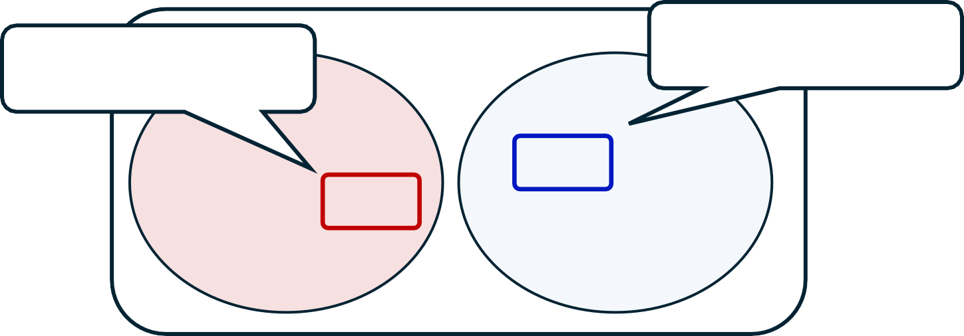
_{Non-Crash}Minimum value for
non-crash
Maximum value ^{C}fo^{r}r^{ash}
crash
0x1
0x60
0x80
0x20
0x79
0x400

Slide 36

So, the crash is triggered when:
[colorsTotal < 0x80]
_{Non-Crash}Minimum value for
non-crash
Maximum value ^{C}fo^{r}r^{ash}
crash
0x1
0x60
0x80
0x20
0x79
0x400

Slide 37
Extracting Crashing Condition
Extract the predicates for the rest of the variables using the same method
int gdImageColorMatch(...) {
[sx > 0x0]
...
buf = malloc(0x28 * colorsTotal);
for (x=0; x < sx; x++) {
for ( y=0; y < sy; y++ ) { bp = buf + (color * 5); (*(bp++))++;
...
[sy > 0x0]
}
extract predicates using the same method

Slide 38
Crashing condition that consists of three predicates
Crashing Condition
𝑝₁ := colorsTotal < 0x80
𝑝₂ := sx > 0x0
𝑝₃ := sy > 0x0

Slide 39
Crashing condition that consists of three predicates
Crashing Condition
𝑝₁ := colorsTotal < 0x80
𝑝₂ := sx > 0x0
𝑝₃ := sy > 0x0
pinpoints the root cause!

Slide 40
Essentials of root cause analysis?
“𝑝₁ := colorsTotal < 0x80“

Slide 41
What if the behaviors were not enough
Suppose non-crashing behavior #1 and #3 were not collected...
Collected Behaviors
Behavior Sample |  | colorsTotal | Crash?
Crash |  | 0x1 | Yes
 | #1
 |  | 0x400 | No
#2 |  | 0x60 | Yes
 | #3
 |  | 0x80 | No
#4 |  | 0x79 | Yes
#5 |  | 0x20 | Yes
Two behaviors
not collected

Slide 42
What if the behaviors was not enough
Then, no behavioral difference exists for colorsTotal...
Crash Non-Crash
0x1
0x60
0x80
0x20
0x79
0x400
They are NOT included anymore

Slide 43

What if the behaviors was not enough
Then, no behavioral difference exists for colorsTotal...
Crash Non-Crash
0x1
0x60
0x80
0x20
0x79
0x400
... It seems colorsTotal is
irrelevant to the crash

Slide 44
What if the behaviors was not enough
Our synthesized crashing condition will not contain the root cause
Crash Non-Crash
0x1
0x60
0x80
0x20
0x79
0x400
Crashing Condition
𝑝₁ := colorsTotal < 0x80
𝑝₂ := sx > 0x0
𝑝₃ := sy > 0x0

Slide 45
What if the behaviors was not enough
Our synthesized crashing condition will not contain the root cause
Crash Non-Crash
0x1
0x60
0x80
0x20
0x79
0x400
Crashing Condition
The root cause 𝒑_{𝟏} is
not extracted!!
𝑝₁
𝑝₂
𝑝₃
:=
:=
:=
colorsTotal < 0x80
sx > 0x0 sy > 0x0

Slide 46
What if the behaviors was not enough
Our synthesized crashing condition will not contain the root cause
Crash Non-Crash
0x1
0x60
0x80
0x20
0x79
0x400
These behaviors are essential!!
Crashing Condition
The root cause 𝒑_{𝟏} is
not extracted!!
𝑝₁
𝑝₂
𝑝₃
:=
:=
:=
colorsTotal < 0x80
sx > 0x0 sy > 0x0

Slide 47
Behavior Dataset Requirement
Behaviors with the following two conditions at the same time

Slide 48
Behavior Dataset Requirement
Behaviors with the following two conditions at the same time
① Non-crashing behaviors
We should observe the behavioral differences comparing to crashing ones

Slide 49
Behavior Dataset Requirement
Behaviors with the following two conditions at the same time
① Non-crashing behaviors
We should observe the behavioral differences comparing to crashing ones
② Similar behaviors with the original crash
If not, the observed differences would not be relevant to the root cause

Slide 50
Behavior Dataset Requirement
Behaviors with the following two conditions at the same time
① Non-crashing behaviors
We should observe the behavioral differences comparing to crashing ones
② Similar behaviors with the original crash
If not, the observed differences would not be relevant to the root cause
Crash-similar *AND* non-crashing behavior!

Slide 51
How do we get such key behaviors?

Slide 52
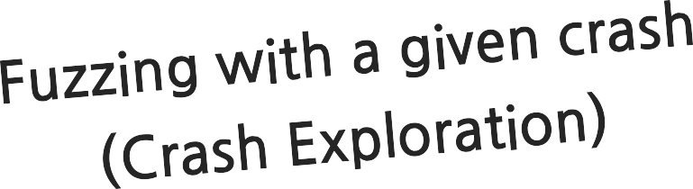

Slide 53


Finding *Proper* Behaviors is Not Easy
Input Handlers
Complex
Branches
Buggy Code
* Parsing
* Syntax Check
* Format Check...
if (...)
Root Cause
Program Inputs

Slide 54
Finding *Proper* Behaviors is Not Easy
Input Handlers
Complex
Branches
Buggy Code
* Parsing
* Syntax Check
* Format Check...
if (...)
Root Cause
Program Inputs
Parse Failure

Slide 55
Finding *Proper* Behaviors is Not Easy
Input Handlers
Complex
Branches
Buggy Code
* Parsing
* Syntax Check
* Format Check...
if (...)
Root Cause
Program Inputs
This is a non-crashing behavior,
but not crash-similar!
Parse Failure

Slide 56
Finding *Proper* Behaviors is Not Easy
Unsupported Format
Input Handlers
Complex
Branches
Buggy Code
* Parsing
* Syntax Check
* Format Check...
if (...)
Root Cause
Program Inputs
Bug-Unrelated
Paths
Parse Failure

Slide 57
But, they exhibit *NO* behavioral differences associated with the root cause
Buggy Code
Root Cause

Slide 58
Root Cause Revealing Behavior
CVE-2019-6977 requires...
<?php
$img1 = imagecreatetrucolor(0xfff, 0xfff);
$img2 = imgcreate(0xfff, 0xfff); imagecolorallocate($img2, 0, 0, 0);
imagesetpixel($img2, 0, 0, 0x80); imagecolormatch($img1, $img2);
?>
<?php
$img1 = imagecreatetrucolor(0xfff, 0xfff);
$img2 = imgcreate(0xfff, 0xfff); for ($i = 0; $i < 255; $i+=1) {
imagecolorallocate($img2, 0, 0, 0);
}
imagesetpixel($img2, 0, 0, 0x80); imagecolormatch($img1, $img2);
?>
NOT
easy

Slide 59
Our Idea:
Under-Constrained State Mutation
We forcefully mutate a program state
in the middle of execution!

Slide 60
Intuition of State Mutation
Input Handlers
Complex
Branches
Buggy Code
Parsing
Syntax Check
Format Check...
if (...)
Root Cause
Mutation
here

Slide 61
Intuition of State Mutation
It must pass through complex constraints
Input Handlers
Complex
Branches
Buggy Code
Parsing
Syntax Check
Format Check...
if (...)
Root Cause
Mutation
here

Slide 62
Intuition of State Mutation
Input Handlers
Complex
Branches
Buggy Code
Parsing
Syntax Check
Format Check...
if (...)
Root Cause
Mutation here
Skip difficult-to-pass constraints!

Slide 63
Intuition of State Mutation
It can easily reach the buggy code!
Input Handlers
Complex
Branches
Buggy Code
Parsing
Syntax Check
if (...)
* Format Check...
Root Cause
Crash
Mutation here

Slide 64
Under-Constrained State Mutation
Source Code
int gdImageColorMatch(...)
{
...
buf = emalloc(0x28 * colorsTotal);
for (x=0; x < sx; x++) {
for ( y=0; y < sy; y++ ) {
bp = buf + (color * 5); (*(bp++))++;
...
}

Slide 65
Under-Constrained State Mutation
Source Code
Machine Code
int gdImageColorMatch(...)
{
...
buf = emalloc(0x28 * colorsTotal);
for (x=0; x < sx; x++) {
for ( y=0; y < sy; y++ ) {
bp = buf + (color * 5); (*(bp++))++;
...
}
...
jle 0x555555800bc9
lea esi, [rax+rax*4] xor edx, edx
...

Slide 66
Under-Constrained State Mutation
Source Code
Machine Code
int gdImageColorMatch(...)
{
...
...
jle 0x555555800bc9
lea esi, [rax+rax*4]
buf = emalloc(0x28 * colorsTotal);
corresponds to
xor edx, edx
...
for (x=0; x < sx; x++) {
for ( y=0; y < sy; y++ ) {
bp = buf + (color * 5); (*(bp++))++;
...
}

Slide 67
Under-Constrained State Mutation
Source Code
Machine Code
int gdImageColorMatch(...)
{
...
buf = emalloc(0x28 * colorsTotal);
for (x=0; x < sx; x++) {
for ( y=0; y < sy; y++ ) {
bp = buf + (color * 5); (*(bp++))++;
...
}
...
jle 0x555555800bc9
①
lea esi, [rax+rax*4]
xor edx, edx
...
suspend
RAX: 0x1
RBX: 0x555556332ff0
RCX: 0x0
...
Program State at ①

Slide 68
Under-Constrained State Mutation
Source Code
Machine Code
int gdImageColorMatch(...)
{
...
buf = emalloc(0x28 * colorsTotal);
for (x=0; x < sx; x++) {
for ( y=0; y < sy; y++ ) {
bp = buf + (color * 5); (*(bp++))++;
...
jle 0x555555800bc9
①
lea esi, [rax+rax*4]
xor edx, edx
...
0x1 ⇨ 0xff
suspend
...
State Mutation!!
}
RAX: 0xff
RBX: 0x555556332ff0
RCX: 0x0
...
Program State at ①

Slide 69
Under-Constrained State Mutation
Source Code
Machine Code
int gdImageColorMatch(...)
{
...
buf = emalloc(0x28 * colorsTotal);^{execute}
for (x=0; x < sx; x++) {
for ( y=0; y < sy; y++ ) {
bp = buf + (color * 5); (*(bp++))++;
...
}
...
jle 0x555555800bc9
① lea esi, [rax+rax*4]
xor edx, edx
...
suspend
RAX: 0xff
RBX: 0x555556332ff0
RCX: 0x0
...
resume
Program Exit!! (without a crash)
Program State at ①

Slide 70
State mutation can obtain the root cause revealing behavior
<?php
$img1 = imagecreatetrucolor(0xfff, 0xfff);
$img2 = imgcreate(0xfff, 0xfff); imagecolorallocate($img2, 0, 0, 0);
imagesetpixel($img2, 0, 0, 0x80); imagecolormatch($img1, $img2);
?>
<?php
$img1 = imagecreatetrucolor(0xfff, 0xfff);
$img2 = imgcreate(0xfff, 0xfff);
for ($i = 0; $i < 255; $i+=1) {
imagecolorallocate($img2, 0, 0, 0);
}
imagesetpixel($img2, 0, 0, 0x80); imagecolormatch($img1, $img2);
?>

Slide 71
Is the discovered behavior valid?

Slide 72
Validity Problem
Typical Fuzzing (e.g., AFL, libfuzzer, ...)
It is for the bug (vulnerability) discovery
It must *validate* the reachability of the discovered behaviors

Slide 73
Validity Problem
Typical Fuzzing (e.g., AFL, libfuzzer, ...)
It is for the bug (vulnerability) discovery
It must *validate* the reachability of the discovered behaviors
Unfortunately, our state mutation does not guarantee reachability

Slide 74
Validity Problem
Typical Fuzzing (e.g., AFL, libfuzzer, ...)
It is for the bug (vulnerability) discovery
It must *validate* the reachability of the discovered behaviors
Crash Exploration (for root cause analysis)
The bug (i.e., crash) is already given
What we need is to extract the crashing condition

Slide 75
Validity Problem
Typical Fuzzing (e.g., AFL, libfuzzer, ...)
It is for the bug (vulnerability) discovery
It must *validate* the reachability of the discovered behaviors
Crash Exploration (for root cause analysis)
The bug (i.e., crash) is already given
What we need is to extract the crashing condition
preserved even with our state mutation!!

Slide 76
Which state should we mutate?
There are tons of states even in a single (crashing) execution

Slide 77
Design Choices for a State Mutation
State mutation in a function granularity
Similar to LibFuzzer and in-memory fuzzing techniques
Speed acceleration using fork()

Slide 78
Design Choices for a State Mutation
State mutation in a function granularity
Similar to LibFuzzer and in-memory fuzzing techniques
Speed acceleration using fork()
Target Function!!
int gdImageColorMatch(...) {
...
buf = malloc(0x28 * colorsTotal);
for (x=0; x < sx; x++) {
for ( y=0; y < sy; y++ ) { bp = buf + (color * 5); (*(bp++))++;
...
}

Slide 79
Design Choices for a State Mutation
State mutation in a function granularity
Similar to LibFuzzer and in-memory fuzzing techniques
Speed acceleration using fork()
fork()
int gdImageColorMatch(...) {
...
buf = malloc(0x28 * colorsTotal);
for (x=0; x < sx; x++) {
for ( y=0; y < sy; y++ ) { bp = buf + (color * 5); (*(bp++))++;
...
}
int gdImageColorMatch(...) {
...
buf = malloc(0x28 * colorsTotal);
for (x=0; x < sx; x++) {
for ( y=0; y < sy; y++ ) {
bp = buf + (color * 5);
(*(bp++))++;
...
}
int gdImageColorMatch(...) {
...
buf = malloc(0x28 * colorsTotal);
for (x=0; x < sx; x++) {
for ( y=0; y < sy; y++ ) { bp = buf + (color * 5); (*(bp++))++;
...
}
int gdImageColorMatch(...) {
...
buf = malloc(0x28 * colorsTotal);
for (x=0; x < sx; x++) {
for ( y=0; y < sy; y++ ) { bp = buf + (color * 5); (*(bp++))++;
...
}
int gdImageColorMatch(...) {
...
buf = malloc(0x28 * colorsTotal);
for (x=0; x < sx; x++) {
for ( y=0; y < sy; y++ ) { bp = buf + (color * 5); (*(bp++))++;
...
}

Slide 80
Design Choices for a State Mutation
State mutation in a function granularity
Similar to LibFuzzer and in-memory fuzzing techniques
Speed acceleration using fork()
fork()
int gdImageColorMatch(...) {
...
buf = malloc(0x28 * colorsTotal);
for (x=0; x < sx; x++) {
for ( y=0; y < sy; y++ ) { bp = buf + (color * 5); (*(bp++))++;
...
}
int gdImageColorMatch(...) {
...
buf = malloc(0x28 * colorsTotal);
for (x=0; x < sx; x++) {
for ( y=0; y < sy; y++ ) {
bp = buf + (color * 5);
(*(bp++))++;
...
}
int gdImageColorMatch(...) {
...
buf = malloc(0x28 * colorsTotal);
for (x=0; x < sx; x++) {
for ( y=0; y < sy; y++ ) { bp = buf + (color * 5); (*(bp++))++;
...
}
int gdImageColorMatch(...) {
...
buf = malloc(0x28 * colorsTotal);
for (x=0; x < sx; x++) {
for ( y=0; y < sy; y++ ) { bp = buf + (color * 5); (*(bp++))++;
...
}
int gdImageColorMatch(...) {
...
buf = malloc(0x28 * colorsTotal);
for (x=0; x < sx; x++) {
for ( y=0; y < sy; y++ ) { bp = buf + (color * 5); (*(bp++))++;
...
}
Select a state within the function

Slide 81
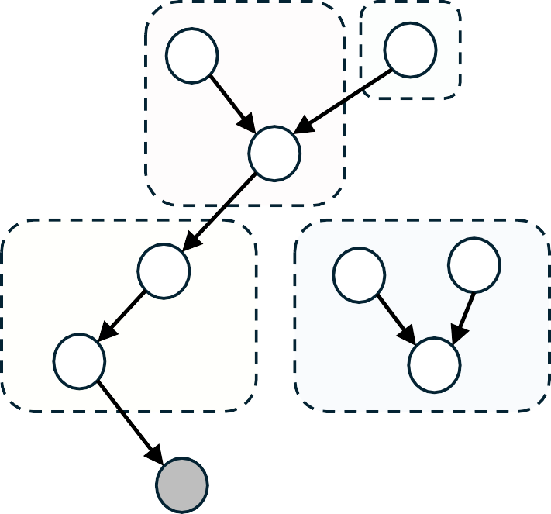
Design Choices for a State Mutation
State mutation in a function granularity
Similar to LibFuzzer and in-memory fuzzing techniques
Speed acceleration using fork()
func1
func2
Target function extraction
Focusing on crash-related functions
Following data-flow & derefence edges
func3
func4
:= mov rcx, [rax]

Slide 82
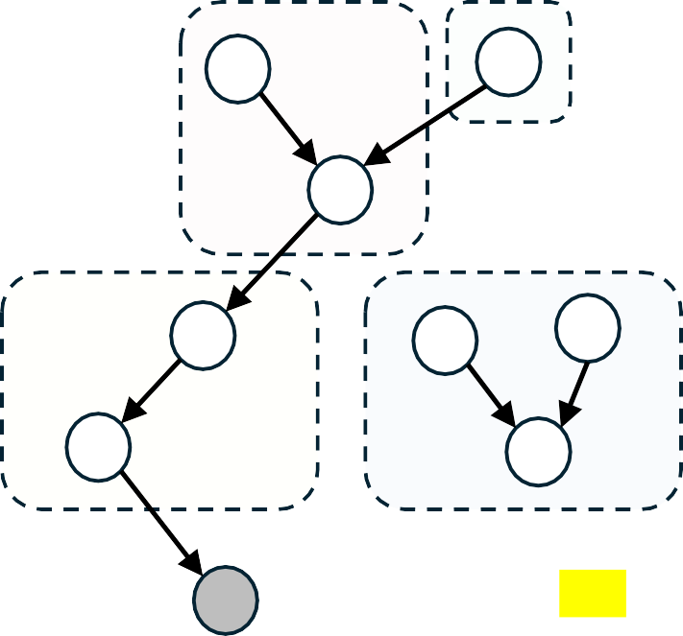
Design Choices for a State Mutation
State mutation in a function granularity
Similar to LibFuzzer and in-memory fuzzing techniques
Speed acceleration using fork()
func1
func2
Target function extraction
func3
func4
Focusing on crash-related functions
Following data-flow & derefence edges
:= mov rcx, [rax]
crash here!
RAX : 0x41414141

Slide 83
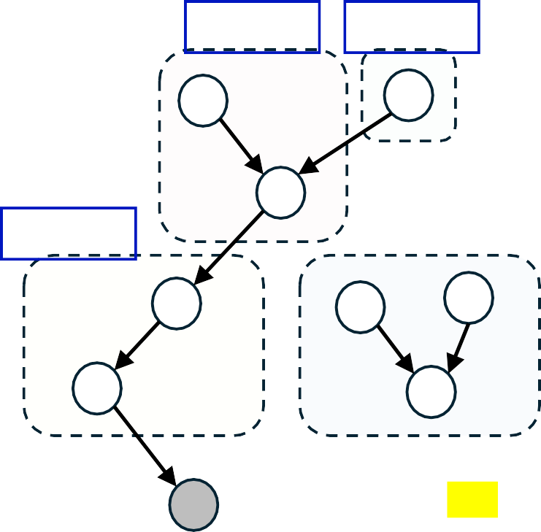
Design Choices for a State Mutation
State mutation in a function granularity
Similar to LibFuzzer and in-memory fuzzing techniques
Speed acceleration using fork()
: Target functions
func1
func2
Target function extraction
func3
func4
Focusing on crash-related functions
Following data-flow & derefence edges
:= mov rcx, [rax]
crash here!
RAX : 0x41414141

Slide 84
Design Choices for a State Mutation
State mutation in a function granularity
Similar to LibFuzzer and in-memory fuzzing techniques
Speed acceleration using fork()
Target function extraction
Focusing on crash-related functions
Following data-flow & derefence edges
Target Function
Focusing on instructions that use the values from outside of a function
Parameters, global variables, ...

Slide 85
Design Choices for a State Mutation
State mutation in a function granularity
Similar to LibFuzzer and in-memory fuzzing techniques
Speed acceleration using fork()
Target function extraction
Focusing on crash-related functions
Following data-flow & derefence edges
Target Function
Focusing on instructions that use the values from outside of a function
Parameters, global variables, ...

Slide 86
Design Choices for a State Mutation
State mutation in a function granularity
Similar to LibFuzzer and in-memory fuzzing techniques
Speed acceleration using fork()
Target function extraction
Focusing on crash-related functions
Following data-flow & derefence edges
Function behaviors are (solely) decided
by entry nodes!!
Target Function
Focusing on instructions that use the values from outside of a function
Parameters, global variables, ...

Slide 87
Evaluation

Slide 88
Evaluation
We collect 60 bugs from real-world applications
Targets include PHP, Python, SQLite, PDF reader, ...

Slide 89
Evaluation
We collect 60 bugs from real-world applications
Targets include PHP, Python, SQLite, PDF reader, ...
Our dataset spans 11 bug classes
heap overflow, integer overflow, UAF, ...

Slide 90
Evaluation
In our evaluation, BENZENE outperforms the SOTA tools
BENZENE
ARCUS AURORA

Slide 91
Evaluation
In our evaluation, BENZENE outperforms the SOTA tools
BENZENE
ARCUS
Accuracy
AURORA
93%
63%
32%
56/60
12/34
29/46

Slide 92
Evaluation
In our evaluation, BENZENE outperforms the SOTA tools
BENZENE
ARCUS
Accuracy
Elapsed Time (sec)
AURORA
93%
63%
32%
56/60
12/34
29/46
1,567
12,762

Slide 93
Evaluation
In our evaluation, BENZENE outperforms the SOTA tools
BENZENE
ARCUS
Accuracy
Elapsed Time (sec)
AURORA
93%
8× faster!
63%
32%
56/60
12/34
29/46
1,567
12,762

Slide 94
Conclusion
Finding crash-similar but non-crashing behaviors for RCA is difficult

Slide 95
Conclusion
Finding crash-similar but non-crashing behaviors for RCA is difficult
Under-constrained state mutation can efficiently discover the desired behaviors

Slide 96
Conclusion
Finding crash-similar but non-crashing behaviors for RCA is difficult
Under-constrained state mutation can efficiently discover the desired behaviors
We introduce BENZENE, a root cause analysis system based on the under-constrained state mutation

Slide 97
Conclusion
Finding crash-similar but non-crashing behaviors for RCA is difficult
Under-constrained state mutation can efficiently discover the desired behaviors
We introduce BENZENE, a root cause analysis system based on the under-constrained state mutation
We evaluate BENZENE on 60 real-world bugs, successfully locating 93.3% root causes

Slide 98
Things Not Covered in This Talk
Automatic predicate extraction
Justification of validity problem for non-crashing behaviors
Crashing behavior handling
Detailed state mutation strategies
Similarity-based ranking algorithm

Slide 99
Things Not Covered in This Talk
Automatic predicate extraction
Justification of validity problem for non-crashing behaviors
Crashing behavior handling
Detailed state mutation strategies
Similarity-based r
anking algorithm
If interested,
we encourage you to read our paper!!

Slide 100
Thank you!
grill66@korea.ac.kr
https://github.com/zer0fall/BENZENE

