Slide 1

B. Tech. Project Phase I
Clickbait Spoiling
Under the supervision of
Dr. Sanasam Ranbir Singh
Submitted by
Aditya Sinha 190101004

Slide 2
CONTENTS
INTRODUCTION
Motivation
Clickbait
Clickbait Spoiling
Problem Statement
LITERATURE REVIEW
Clickbait and Journalism
Clickbait Detection
Question Answering and Passage Retrieval
OBJECTIVES AND DATASET ANALYSIS
BASELINE MODELS
FUTUREWORK
REFERENCES

Slide 3
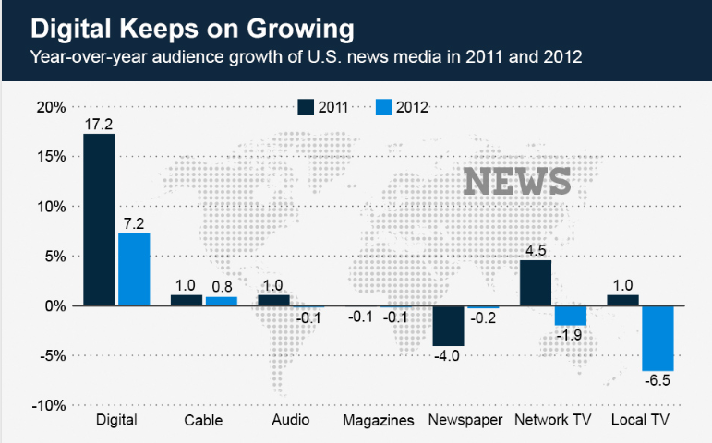
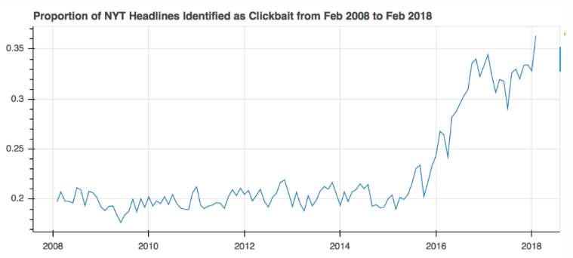
INTRODUCTION: Motivation
GROWTH IN DIGITAL AND ONLINE MEDIA
HOW CLICKBAIT HEADLINES INCREASED IN RECENT TIMES

Slide 4
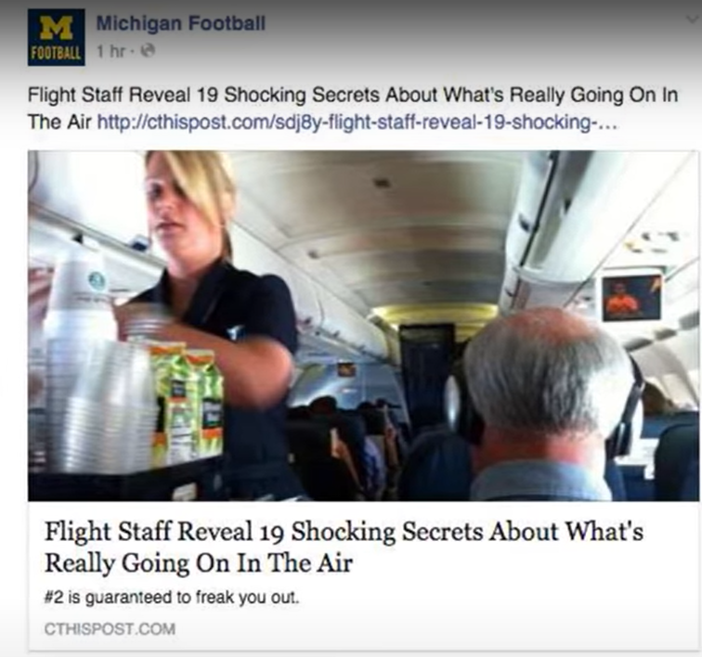
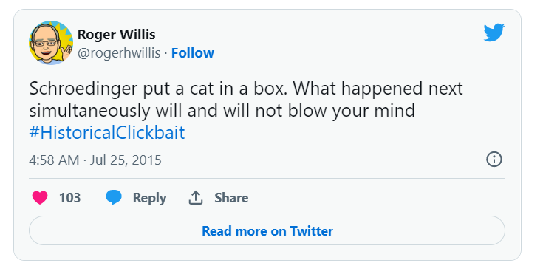

INTRODUCTION: Clickbait and its harms
molecular mass – 14kDa
CATCHY WORDS – YOU WON’T BELIEVE, SEE HOW!, IT WILL SHOCK YOUT MIND
predominantly expressed in neurons
FRAUDERY DISTRUST IN JOURNALISM
WASTAGE OF TIME
encoded by the gene SNCA

Slide 5
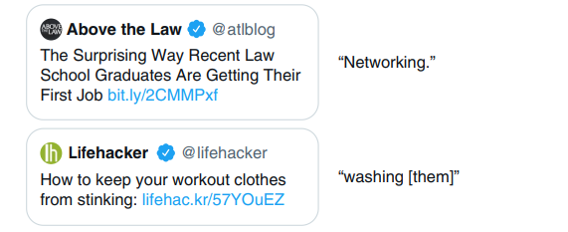
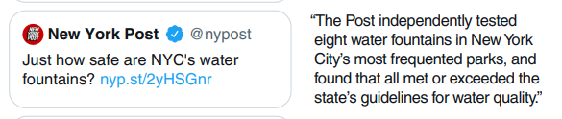
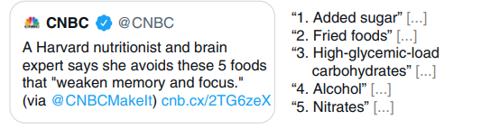
INTRODUCTION: Spoiler Types and Problem Statement
CLICKBAIT SPOILER - Clickbait spoiling generates a phrase, paragraph single or multiple paragraphs which can curb our curiosity by answering the question
PHRASE-BASED
PASSAGE-BASED
MULTI-BASED
Given, different kinds of click-baits we intend to find appropriate spoilers for them. We have to spoil the clickbait for the ease of users.
PROBLEM STATEMENT:

Slide 6

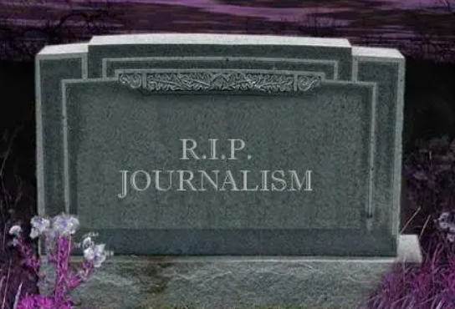
LITERATURE REVIEW
The curiosity gap is the space between what we know and what we want or even need to know
Dvorkin wrote a column discussing how clickbait will lead to the eventual demise of journalism.

Slide 7
CLICKBAIT DETECTION
Clickbait Detection
Non Feature/DL Based like Facebook, Downworthy
DL Based Models like CNN
Feature Based Models like Blackmer, Biyani
Botstein et al., 1997;
Cervelli et al., 2021;
Franssens et al., 2013

Slide 8
LITERATURE REVIEW: Clickbait Spoiling-Question Answering
Information Retrieval Technique
Open Domains Closed Domains Structured Unstructured
Two Approaches :
LSTM Based
BERT Based
Two Types:
Text Based
Knowledge Based
Generally, trained on SQUAD Dataset

Slide 9
LITERATURE REVIEW: Clickbait Spoiling-Passage Retrieval
Techniques:
Multi-text
Short Passages and high idf values
Window adjusts itself
IBM
Matching Words measure
Dispersion measure
Cluster-words measure
Generally, trained on MARCO-MS DATASET

Slide 10
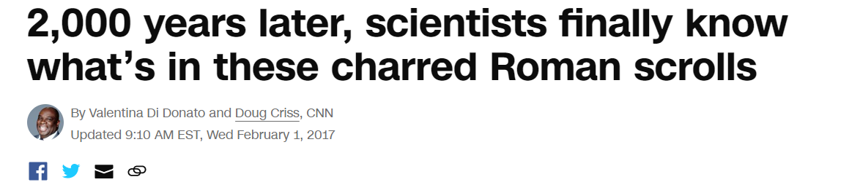
OBJECTIVES
Clickbait Spoiler Type Identification
Clickbait Spoiler Generation based on types
Study of dependence of Spoiler Type on Spoiler Generation
Can be phrase or multi-part both. That’s here that the dependency comes into play.

Slide 11
DATASET ANALYSIS
Attributes | Descriptions
uuid | 32-digit Universal Unique Identifier which uniquely labels each clickbait
postId | Post ID of the clickbait from the respective platform
postText | The Clickbait Text
postPlatform | The Platform on which clickbait is posted
targetParagraphs | All content of the post URL stored as array of strings seperated by a delimiter
targetTitle | The tirle of the article in the post URL
targetDescription | Starting few sentences of the post article
targetKeywords | Important relevant words present in the article along with tags(if available)
targetMedia | An array of links containing media present in the article
targetUrl | URL of the article
provenance | Contains information about the source of clickbait, handle which manually spoiled and the subsequent manual spoiler in JSON format
spoiler | A phrase, a passage or multiple phrases/passages, present in the article which answers the question without clicking the link
spoilerPositions | This is a 2D array. The inner array consists of starting position and ending position of spoiler in the article.
tags | An appropriate label is given to the spoiler from these words-'Phrase','Passage','Multi'

Slide 12
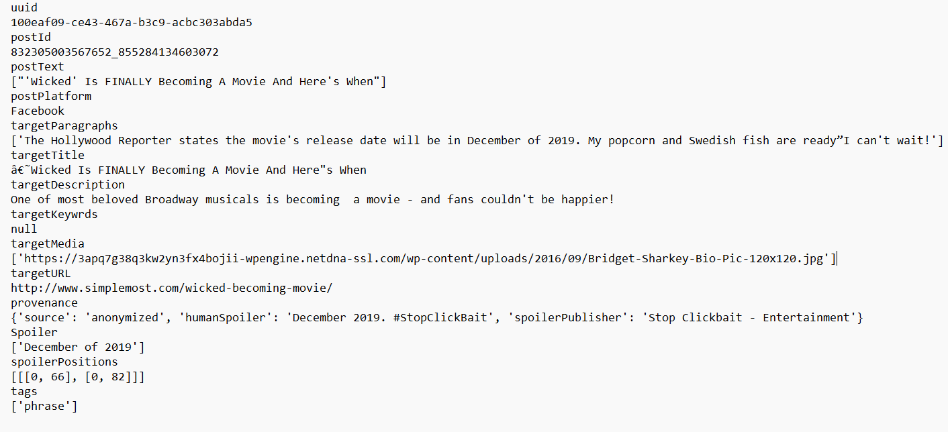
DATASET ANALYSIS

Slide 13


METHODOLOGY AND RESULT: Baseline Methods
1. Naïve Baseline Task – Features as TF, TF-IDF and POS-Tagging 2. Transformer Baseline Task- The Clickbait text was concatenated with the linked document
Bleu-4: Generally, focues on Syntax of the referene and candidates. Focuses on n-gram overlap. Bleu-4 indicates the cumulative - gram Bleu score
BertScore : Focuses on semantics and the paraphrasing of words in reference and candidate. Based on contextual embeddings.

Slide 14
FUTURE WORK
We need to propose a model which improves the accuracy over baseline models.
Ranking Models can be beneficial in improving these things. So, we will explore in the field of ranking models.
By ”ranking,” we imply arranging documents by relevance in order to identify relevant material in relation to a query.
We will also explore in the Summarisation models as they will also deliver the same objective.
The task of summarisation is to create a shorter version of a document while retaining its significant content.

Slide 15
REFERENCES
Jason Brownlee. A gentle introduction to calculating the bleu score for text in python, Nov 2017.
Abhijnan Chakraborty, Bhargavi Paranjape, Sourya Kakarla, and Niloy Ganguly. Stop clickbait: Detecting and preventing clickbaits in online news media. In 2016 IEEE/ACM International Conference on Advances in Social Networks Analysis and Mining (ASONAM), pages 9–16, 2016.
Jiafeng Guo, Yixing Fan, Liang Pang, Liu Yang, Qingyao Ai, Hamed Zamani, Chen Wu, W. Bruce Croft, and Xueqi Cheng. A deep look into neural ranking models for information retrieval. Information Processing Management, 57(6):102067, 2020.
Vladimir Karpukhin, Barlas O˘guz, Sewon Min, Patrick Lewis, Ledell Wu, Sergey Edunov, Danqi Chen, and Wen-tau Yih. Dense passage retrieval for open-domain question answering, 2020.
Fandong Meng, Zhengdong Lu, Hang Li, and Qun Liu. Interactive attention for neural machine translation. 10 2016.
Hariom A. Pandya and Brijesh S. Bhatt. Question answering survey: Directions, challenges, datasets, evaluation matrices, 2021.
Tianyi Zhang, Varsha Kishore, Felix Wu, Kilian Q. Weinberger, and Yoav Artzi. Bertscore: Evaluating text generation with bert, 2019.
Munazza Zaib, Dai Hoang Tran, Subhash Sagar, Adnan Mahmood, Wei E. Zhang, and Quan Z. Sheng. Bert-coqac: Bert-based conversational question answering in context, 2021.

