Slide 1

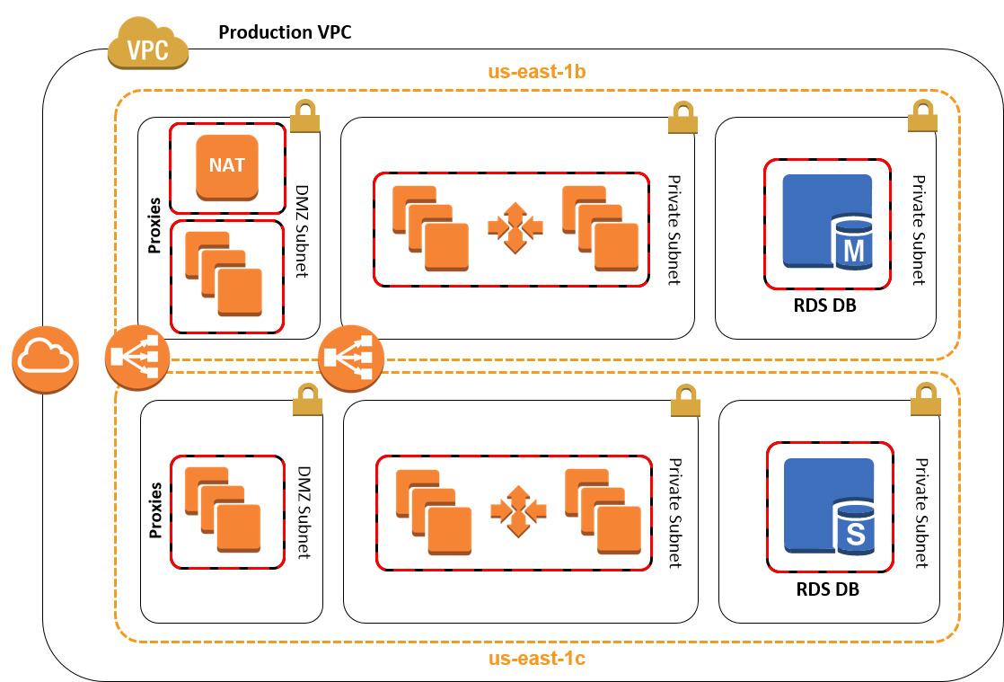





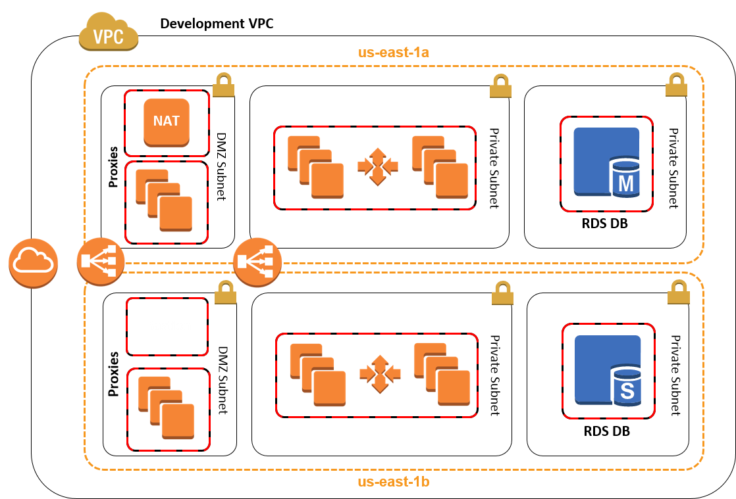


Quick Start Design with Management, Production, and Notional Development VPCs
Archive Logs Bucket
S3 Lifecycle Policies to Glacier
Users
Management VPC
us-east-1b
VPC Peer
NAT
Bastion
VPC Peer
Potential use for security appliances for monitoring, logging, etc.
NOTIONAL
us-east-1c
AWS Config Rules
CloudTrail
CloudWatch Alarms

Slide 2




Standard Architecture Deployed by AWS Quick Start
AWS Account
Production VPC
us-east-1b
DMZ Subnet
Private Subnet
Private Subnet
NAT
CloudTrail
Proxies
RDS DB
CloudWatch Alarms
DMZ Subnet
Private Subnet
Private Subnet
AWS Config
Proxies
RDS DB
Archive Logs Bucket
S3 Lifecycle Policies to Glacier
us-east-1c

