Slide 1
Smart Energy Aware Systems (SEAS) Outsourcing Electric Vehicle Smartcharging on the web of Data
EUREKA Innovation Week, 27/04/2016
Maxime Lefrançois (École Nationale Supérieure des Mines) Guillaume Habault (IMT/TELECOM Bretagne)
Caroline Ramondou (CNR)
14/03/2016

Slide 2


Smart Energy Aware Systems (SEAS) project:
Aims at developing an ecosystem to help entities better manage, coordinate and optimize energy consumption, production and storage.
This presentation reports a joint work between SEAS partners and particularly focuses on Compagnie Nationale du Rhône (CNR) Electric Vehicle (EV) Smart Charging Use Case (UC), which tackles the emerging need for electric mobility.
submitted to:
Maxime Lefrançois, Guillaume Habault, Caroline Ramondou and Eric Françon, 2016,
Outsourcing Electric Vehicle Smart Charging on the Web of Data, The First Int. Conf. on Green Communications, Computing and Technologies (GREEN'16), July 24-28, Nice, France

Slide 3
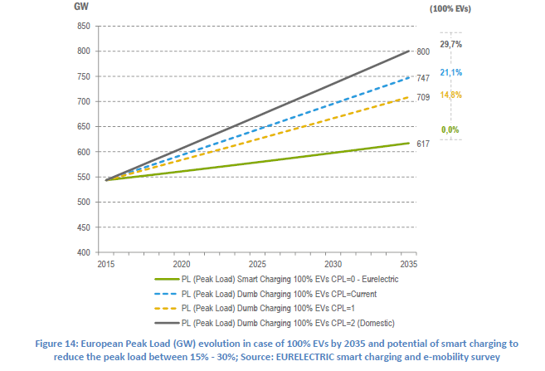
1 – Context : the need of EV smartcharging
EV are charged instantly
No external control is involved in the charging process.
Without smart charging
Consequences
With the expected growth of EV:
Uncontrolled charging introduces fluctuation in energy consumption
Impact on the electricity system:
Distribution grids congestions due to power peaks and voltage drops,
Increased costs of electricity,
Expensive generation and grid reinforcements.
With smart charging
Smartcharging is a solution to integrate EV in power system in a user-friendly way
Notes:
Currently, Electric Vehicles (EV) are charged instantly when plugged into a charging station and no external control is involved in the charging process.
With the increase of EV expected for the coming years, this uncontrolled charging introducing fluctuation in energy consumption will have an impact on the electricity system.

Slide 4
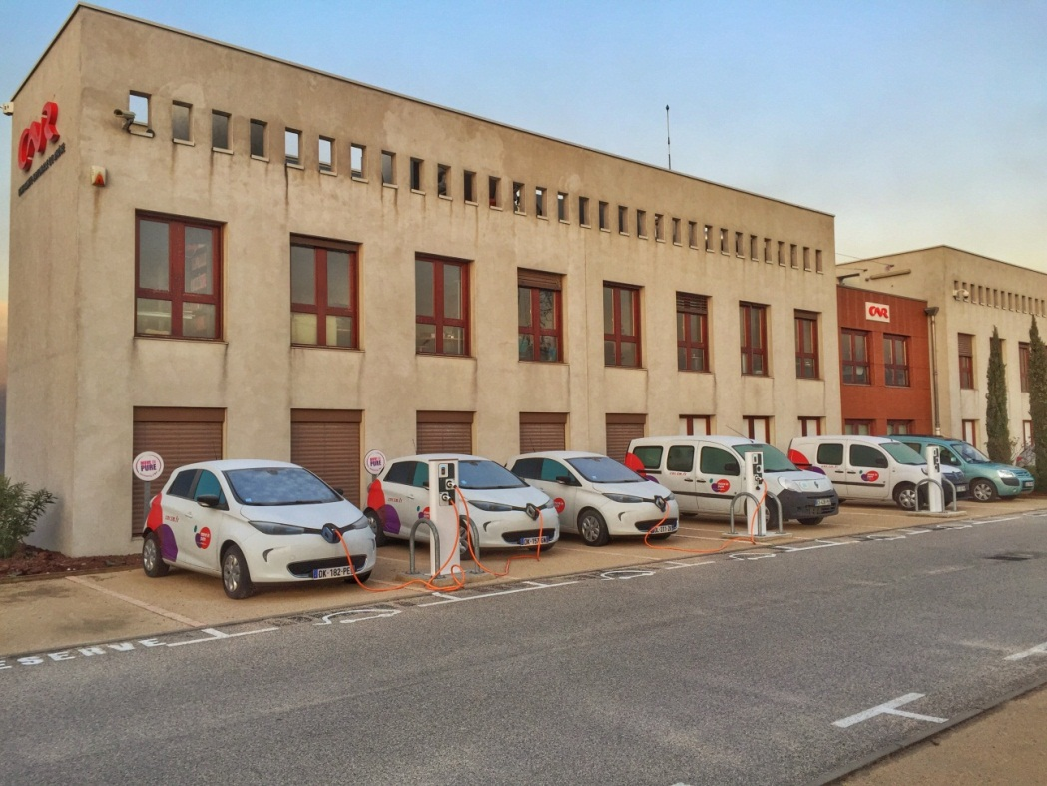
2 – Smart charging solutions
90% of EV charging is expected to occur at home or at the office :
in most cases, these EVs stay parked for several hours
Smartcharging solutions:
Shifting EV charging from peak periods to off-peak periods;
Allow to reduce load peaks.
Benefits
Customer: it might reduce their Electricity costs
DSO : it could assist grid management with control signals
The society: it could avoid grid and generation investments
The environment: it may facilitate integration of renewable energies (e.g. self-consumption of electricity with solar power and electric vehicles);

Slide 5
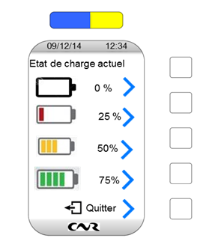
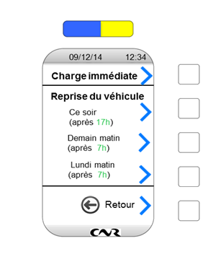
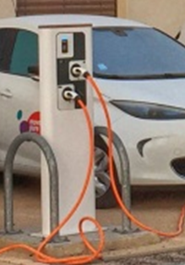
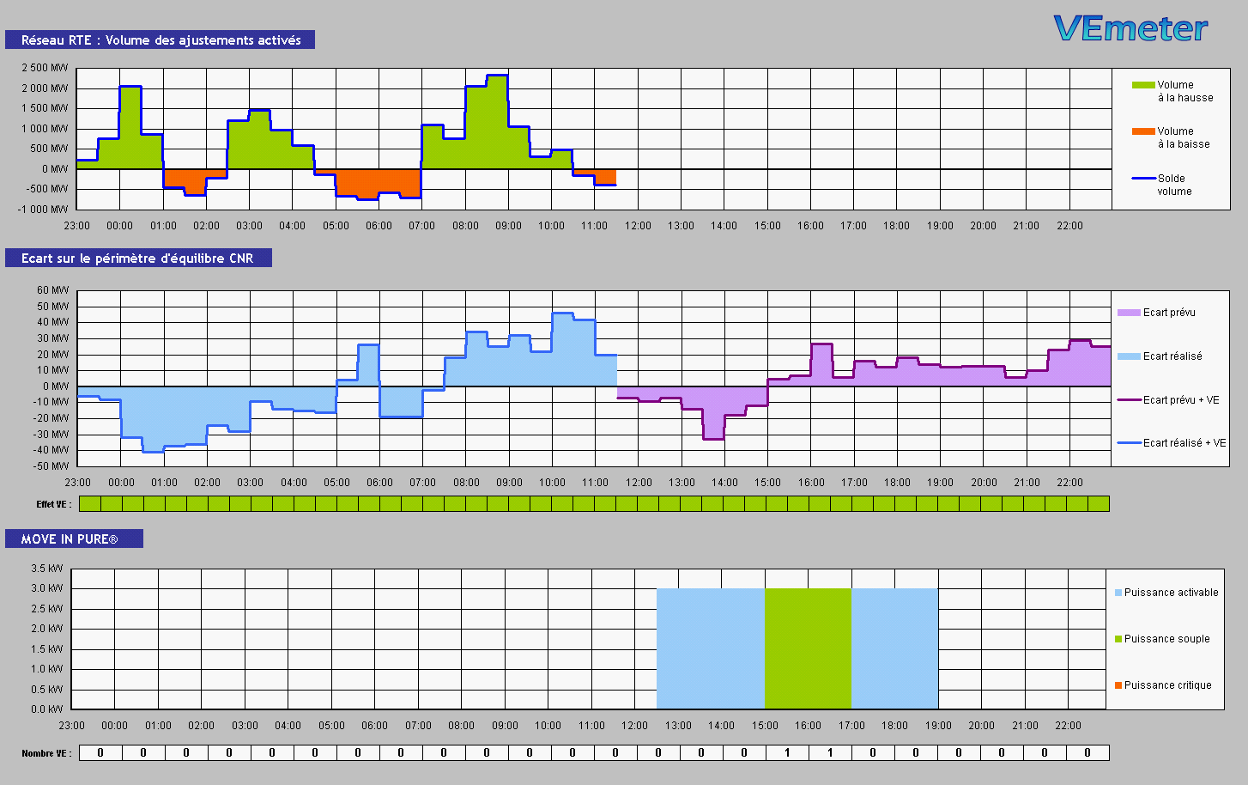
3 – A Smart charging Use case in SEAS project
CNR works on a smart charging solution that can address all types of electrical vehicle, charging points, and optimization strategies.
1 - EV Driver
Reports its charging needs
2 - Charging Station Operator
Monitors charging stations and applies optimized chargeplans.
3 - Smart Charging Provider
Provides an optimal chargeplan for each EV based on several inputs (EV Driver requirements, available power, prices signals…)
Battery charge level = Energy (kWh)
Time of departure
= Delay (h)

Slide 6
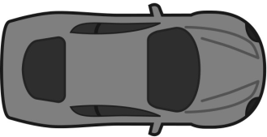
4 – The Smart charging process
Energy Markets
Contract (based on dynamic pricing)
Customer
Energy Retailer
Metering Point
DSO
Metering data
sourcing
Charging station
Charging station
Energy Producer
EVSE
EVSE
EVSE
EVSE
meter
meter
meter
meter
Prices
Charging requests
Monitoring
Charging Station Operator
Charge needs
Smart Charging Provider
EV Driver
Charge plans
At any time, the charge plan may be re-optimized by the SCP on CSO requests, especially if new EV charging events occurs (plug/unplug), if an EV Driver modify its requirements, or in case of modification of available power.
Notes:
EV Driver is authorized to use a charging station connected to the grid, and managed by a Charging station Operator (CSO). He communicates directly – via his smartphone or a web application – or through the charging station, his requirements : energy needs (related to battery state of charge) and preferences (parking time).
CSO takes these information into account along with several other parameters such as power constraints (limitation of maximum instantaneous power at the delivery point, energy requested by other EV drivers connected to the same area) and asks to the Smart Charging Provider (SCP) for an optimized charge plan.
SCP combines the received information with other data such as prices information (e.g. dynamic hourly price of energy) and control signals (e.g. maximum power demand). It then runs optimization algorithm to settle the EV charge plan, which is a series of consecutive blocks of maximal power value (Pmax) for defined time periods.
CSO, receiving the resulting charge plan from SCP, applies this plan and monitors the charging station in accordance.
EV controls the actual power delivered by the charging station to the battery, which should be lower than the Pmax defined by the charge plan.

Slide 7



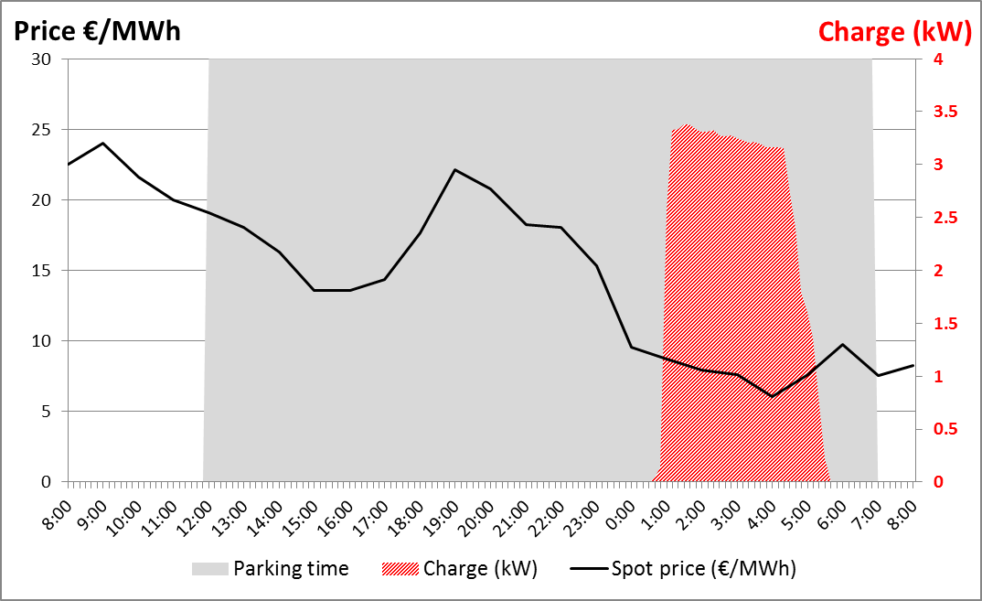
5 – Smartcharging algorithms
CNR is an hydroelectricity producer
Has developed an electricity mixed production (wind, solar, small hydro-power);
Becomes an expert in managing an intermittent energy, by forecasting, optimizing, marketing and supervising production;
Uses its own algorithm to optimize EV consumption according to several strategies.
The smartcharging strategy tested in this UC is based on:
EV requirements;
Available power at Metering Point;
Forecast and day)ahead prices;
Real-time connection of EV at a charging station.
Example of an optimized EV charging session
The goal of this optimization approach is to minimize the charging cost without negotiating the charging needs, as the customer satisfaction and the reliability of the charging service have higher priority than the system operating cost.

Slide 8
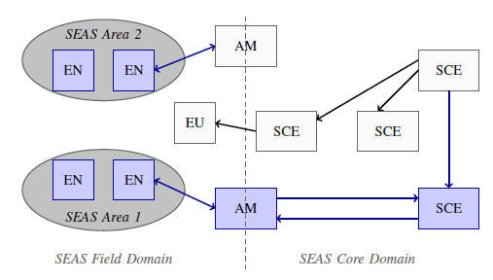
7 – Architecture
SEAS has to define an architecture enabling real-time interconnection of any energy actors.
This interconnection helps:
Actors offer energy dedicated services to other SEAS entities;
Coordinate microgeneration with grid needs and production;
Any entities better manage energy consumption, production and storage.
This architecture should meet some general requirements such as:
Being scalable, adaptable and dynamic;
Offering plug-and-play solutions (having as less manual configuration as possible);
Providing secure communications and privacy of information.
Illustration of SEAS Reference Architecture Model
CNR scenario
End Node (EN) : EVSE’s meter
End User (EU) : Customer, EV Driver
Area Manager (AM) : CSO
Seas Core Entity (SCE) : SCP, Energy Retailer, Energy Producer, DSO

Slide 9
8 – Implementation
CNR smart charging service implementation is:
(step 1) A RESTful web service
Charging Station Operator
Smart Charging Provider
Station info
EVSEs
Charge needs
REQ: "Here is a new charge need"
(in legacy XML format)
RES: 202 Accepted,
"content will be available at location xyz"
REQ: "Give me charge plan xyz"
RES: 200 OK, "here is optimized charge plan xyz"
(in legacy XML format)
Available for testing - http://cnr-seas.cloudapp.net/scp/

Slide 10
8 – Implementation + Semantic interoperability
We want to use the W3C Resource Description Framework to enable semantic interoperability
BUT 100% adopting this formalism is (1) sometimes costly, (2) sometimes impossible
we introduce SPARQL Protocol and RDF Generation Language that enables to:
- declaratively write a rule to interpret a document as RDF
- when serving a document with the legacy CNR API, add a link to such a rule
e.g. REQ: "Give me charge plan xyz", response contains Link in HTTP Header:
Link: <http://cnr-seas.cloudapp.net/scp/query/ChargingPlan>;rel="sparql-query";var="message"
(demo)
Hence, legacy APIs can enter the realm of the Semantic Web at drastically lowered costs
Notes:
REQ: "Give me charge plan xyz"

Slide 11
8 – Implementation + Semantic interoperability
CNR smart charging service implementation is:
(step 1) A RESTful web service
(step 2), uses SPARQL-Generate protocol and is deployed as a RESTful Web Service.
Charging Station Operator
Smart Charging Provider
Station info
EVSEs
Charge needs
REQ: "Here is a new charge need"
(in legacy XML format)
RES: 202 Accepted,
"content will be available at location xyz"
REQ: "Give me charge plan xyz"
RES: 200 OK, "here is optimized charge plan xyz"
(in legacy XML format + Link to SPARQL-Generate query)
Demo http://cnr-seas.cloudapp.net/scp/form.html

Slide 12
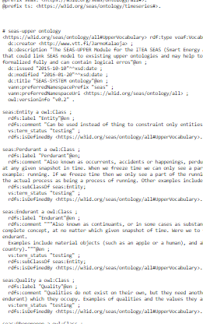
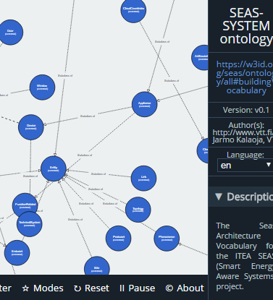
9 – Ontology
This work uses the SEAS ontologies, https://w3id.org/seas/ontology/all#
And the MDQ energy vocabulary https://w3id.org/multidimensional-quantity/resource/EnergyVocabulary
These ontologies are online and follow the best practices of the web of linked vocabularies
-> each resource in the ontology is described at its own URL in different formats for machines and humans
https://w3id.org/seas/ontology/all#System
Accept: text/html
Accept: text/turtle
Notes:
Pour la démo,

Slide 13
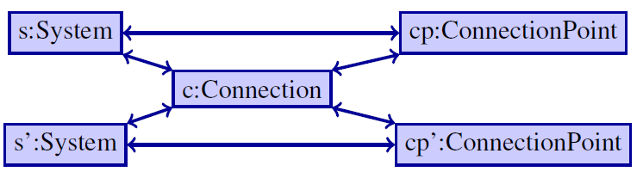
9 – Ontology
At its core, we describe and quantify Systems, Connections between these systems, and ConnectionPoints at which connections occur
example:
Grid, EV, Ch. Station, are Systems
There is a connection between Grid and Ch Station, Ch. Station and EV
This connection occurs at a connection point of the Ch Station (the EVSE), and of the EV (the plug)
Notes:
Pour la démo,

Slide 14
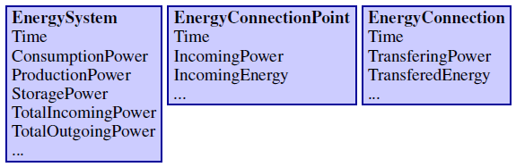
9 – Ontology
The Multidimensional Quantities (MDQ) ontology enables to represent and reason with physical quantities, time-series, simple aggregations.
The MDQ Energy Vocabulary
- describes quantities for the energy domain,
- is automatically generated from a JSON configuration file using SPARQL-Generate

Slide 15
Thank you
Maxime Lefrançois, Guillaume Habault, Caroline Ramondou and Eric Françon, 2016, Outsourcing Electric Vehicle Smart Charging on the Web of Data, The First Int. Conf. on Green Communications, Computing and Technologies (GREEN'16), July 24-28, Nice, France (submitted)
Links:
The Demo website - http://cnr-seas.cloudapp.net/scp/
The SEAS project - https://w3id.org/seas
The SEAS ontologies - https://w3id.org/seas/ontology/all# (collaboration with WP2)
The MDQ project - https://w3id.org/multidimensional-quantity
The MDQ ontology - https://w3id.org/multidimensional-quantity/resource/Ontology
The MDQ energy vocabulary- https://w3id.org/multidimensional-quantity/resource/EnergyVocabulary
The SPARQL-Generate project - https://w3id.org/sparql-generate
This presentation - http://cnr-seas.cloudapp.net/scp/presentation.pptx

