Slide 1
The Value of Cloudera on VAST Data
AI-powered fraud inference, proven on a running application — not slideware
Thursday, July 9, 2026

Slide 2
Fraud Moves Faster Than Silos
Why point solutions keep losing ground
Fraud teams don't lack models — they lack a platform
  The pattern we keep seeing in financial services:
    Signals live in the warehouse, GPUs live somewhere else — every retrain starts with a data export
    Every extra copy of transaction data adds cost, delay and governance risk
    Rules score fast but shallow; offline ML scores deep but late
    History ages into cold storage, so models learn from a fraction of the truth

Slide 3
Why Cloudera on VAST Data
Three pillars, proven by a working fraud application
One open lakehouse
  Parquet on S3-compatible storage — no proprietary formats
    Impala queries the very objects your applications write
    External tables let storage and compute scale independently
AI where the data lives
  GPU training and inference inside Cloudera AI
    Data never leaves governance to reach a GPU
    Foundation-model scoring on a single, modest L4
Exabyte-scale economics
  VAST all-flash keeps hot and historical data on one tier
    Train on full history, not a sampled window
    S3 semantics your teams already operate

Slide 4

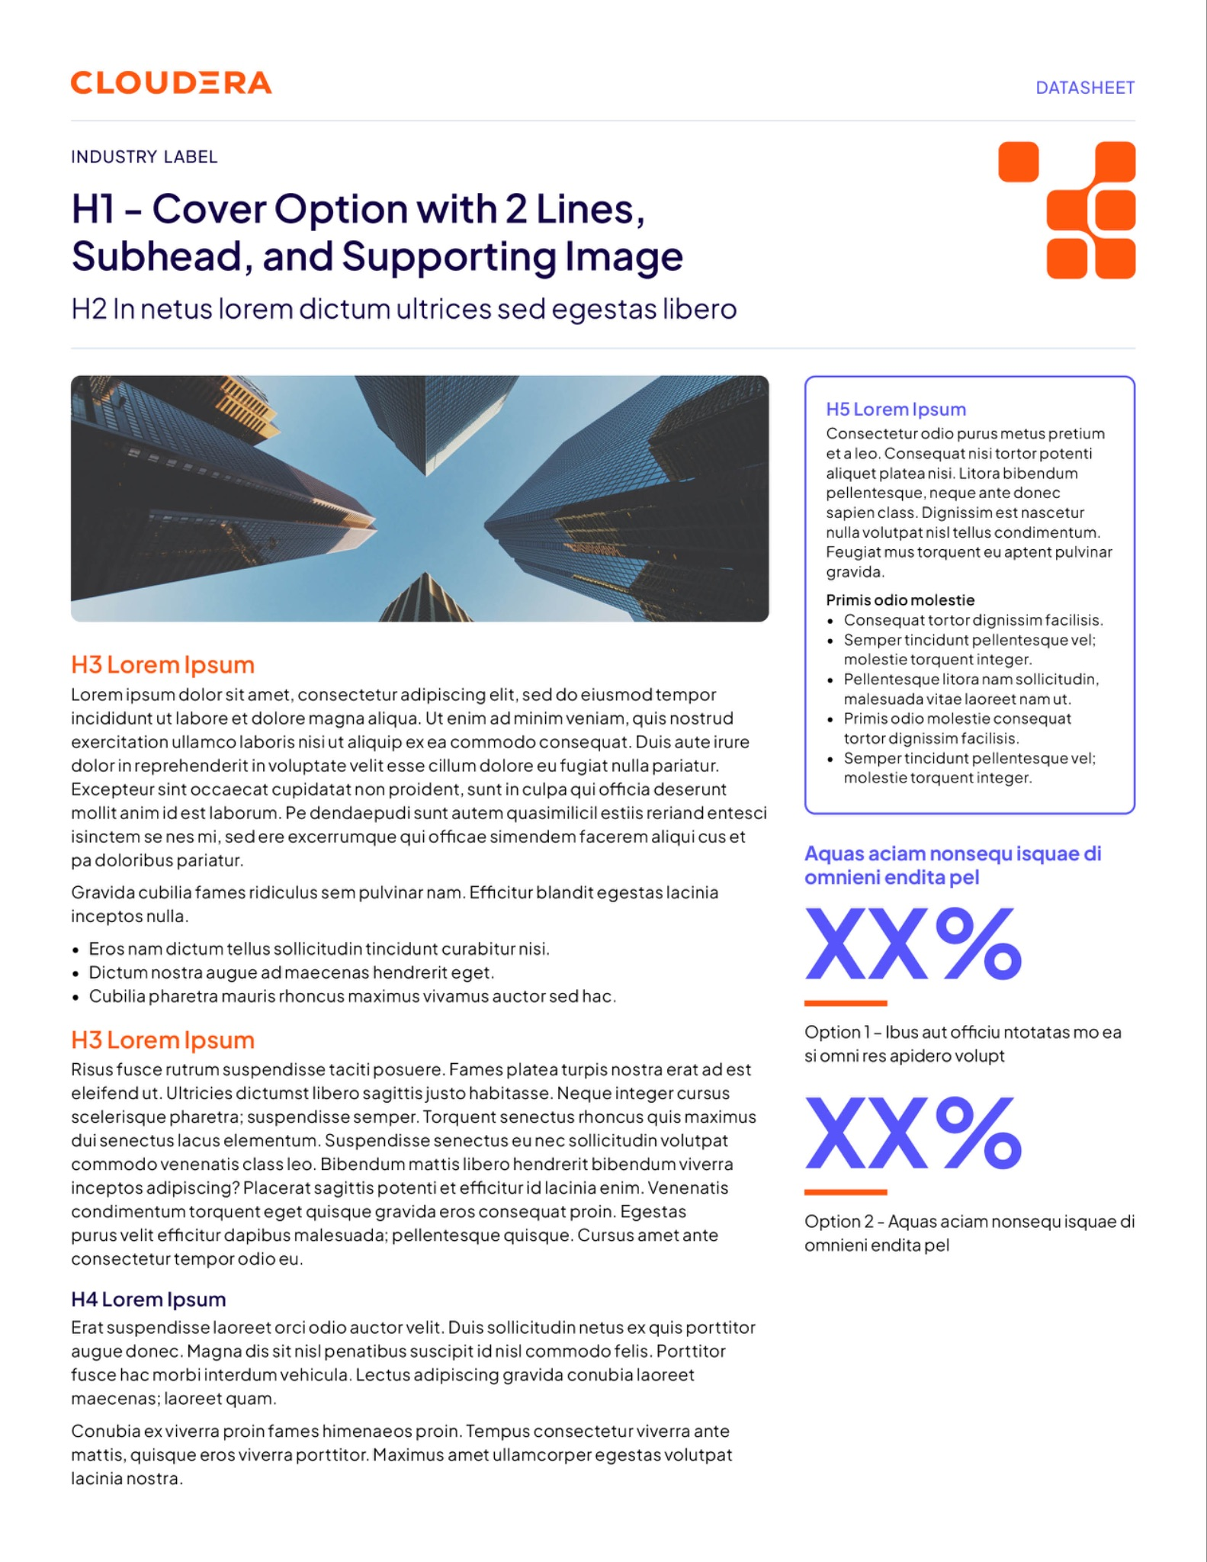
What This Unlocks
From a demo pattern to a production fraud program
Real-time decisions with context
  Foundation-model embeddings see behavior that rules and point features miss — and score it in milliseconds
    Faster iteration: prepare → embed → retrain is a repeatable platform job
    One governed copy of the data serves warehouse SQL, GPU training and BI simultaneously
    The same stack generalizes: AML, credit risk, payments abuse, churn
    Commodity GPU footprint — the entire pipeline fits one NVIDIA L4

Slide 5
Proof Points from the Running Application
Measured on Cloudera AI over VAST Data S3
24M
Transactions, one platform
TabFormer card transactions prepared, split and governed entirely inside Cloudera — no copies leaving the lakehouse.
512-d
Context per transaction
Every transaction is scored with a 512-dimension foundation-model embedding — behavioral context rules never see.
3
Models, one verdict
Raw-feature, embedding and combined XGBoost heads run side by side, so the lift from AI is measured, not asserted.

Slide 6
One Copy of the Data
Written once to VAST, used everywhere
0
extra copies to move, stage or reconcile
Transactions land on VAST once and serve every workload in place: Impala SQL for analysts, GPU training for data science, live inference for the fraud desk. No exports, no staging buckets, no reconciliation debt — and governance follows the one copy, not the sprawl.

Slide 7
Value, by Audience
The same platform wins on both sides of the house
For the fraud & risk team
  Catch more, prove it faster
    Foundation-model context on every transaction, scored in real time
    Three model heads compared live — the lift from AI is measured, not asserted
    Retrain on fresh behavior weekly, not quarterly
For the platform & data team
  Open, governed, right-sized
    Open formats end to end: Parquet on S3 — no lock-in
    One governed copy; storage and compute scale independently
    A single L4 GPU runs the whole pipeline — no exotic infrastructure

Slide 8


Getting Started
A working pattern, not a paper architecture
Prove it on your data in days
  The application deploys as a Cloudera AI prototype:
    Stand up the AMP in Cloudera AI
    Point it at your VAST S3 namespace
    Connect your Impala virtual warehouse — external tables do the rest
    Retrain on your own transactions and measure the lift

Slide 9
Thank You

