Slide 1
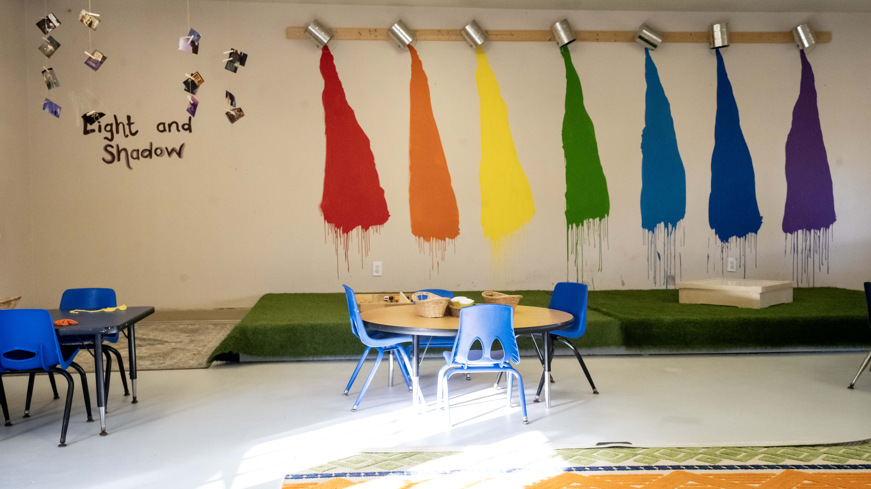

BRAND GUIDELINES & OVERVIEW
Garden Montessori Schools
Brand Guidelines & Overview
A warm, nature-led identity for confident children, connected families, and growing communities.
Garden Montessori Schools • August 2026
GARDEN MONTESSORI SCHOOLS
01

Slide 2
02 • BRAND GUIDELINES
A rooted Houston brand, growing forward
20+
6
500+
4
years nurturing learners
campus communities
families served
core age programs
Five active campuses. Spring Valley is the next bloom.
CURRENT WEBSITE RECORD
GARDEN MONTESSORI SCHOOLS
02

Slide 3
03 • BRAND GUIDELINES
The garden is the model
MISSION
VISION
PHILOSOPHY
Nurture curiosity, independence, and a lifelong love of learning.
Children grow into confident, capable people through freedom within a prepared environment.
Respect, freedom, trust, nature, and purposeful work shape the whole child.
“Every child develops at an individual pace. The environment should meet them there.”
GARDEN MONTESSORI SCHOOLS
03

Slide 4
04 • BRAND GUIDELINES
Six campuses, one nurturing philosophy
LAUNCHING
Oak Forest
Spring Valley
Heights
Central
Memorial
West
Local communities united by one warm, consistent family experience.
GARDEN MONTESSORI SCHOOLS
04

Slide 5
05 • BRAND GUIDELINES
A continuous journey of growth
1
2
3
4
Infant
Transition
Primary
Kindergarten
6 weeks–18 months
18 months–3 years
3–6 years
5–6 years
Security & sensory discovery
Language & independence
Purposeful work & community
Mastery & leadership
Enrichment and summer experiences extend the journey beyond the core classroom.
GARDEN MONTESSORI SCHOOLS
05

Slide 6

06 • BRAND GUIDELINES
Families choose with head and heart
1
Safety
A calm, secure environment
2
Quality
Authentic Montessori practice
THE GMS PARENT
3
Belonging
Warm teachers and community
Houston families seeking a trusted first-school experience grounded in warmth, purpose, and respect for each child.
4
Growth
Visible confidence and independence
5
Practicality
Location, hours, and continuity
GARDEN MONTESSORI SCHOOLS
06

Slide 7
07 • BRAND GUIDELINES
Accessible-premium Montessori, grounded in nature
1
Nature-based learning
2
Authentic foundation
Gardens and outdoor classrooms make discovery tangible.
Purposeful work, choice, and prepared environments.
3
Personal attention
4
Multi-campus continuity
Low ratios and individualized guidance.
A consistent promise across Houston communities.
Not daycare. A thoughtfully prepared Montessori beginning.
GARDEN MONTESSORI SCHOOLS
07

Slide 8
08 • BRAND GUIDELINES
The brand personality is calm, capable, and alive
1
Nurturing
2
Curious
Meet families with warmth and genuine care.
Celebrate discovery, questions, and purposeful exploration.
3
Grounded
4
Confident
Use natural forms, honest language, and practical guidance.
Speak with clarity without sounding rigid or institutional.
Values in action: respect, independence, belonging, growth, and trust.
GARDEN MONTESSORI SCHOOLS
08

Slide 9
09 • BRAND GUIDELINES
A voice that feels like a trusted guide
USE
AVOID
INSTEAD OF
““Best-in-class educational solutions””
• Warm and specific
• Corporate jargon
• Child-centered
• Fear-based urgency
SAY
• Calmly confident
• Overclaiming outcomes
““A prepared place to explore, practice, and grow.””
• Plainspoken and visual
• Calling Montessori “daycare”
Sound welcoming and assured. Let real classroom detail carry the proof.
GARDEN MONTESSORI SCHOOLS
09

Slide 10
10 • BRAND GUIDELINES
Messaging turns growth into something families can feel
USE
AVOID
HEADLINE
““A place to explore, practice, and bloom.””
• Explore at your own pace
• Rush to enroll
• Grow confidence through practice
• One-size-fits-all claims
CTA
• Belong to a caring community
• Guaranteed outcomes
““Schedule a visit””
• Discover through purposeful work
• An invented formal tagline
Formal tagline: TBD. “Where Bright Futures Begin” and “Where Every Child Blooms” are current website messaging only.
GARDEN MONTESSORI SCHOOLS
10

Slide 11
11 • BRAND GUIDELINES
A palette borrowed from the garden
Primary leaf
Deep canopy
Evergreen
Moss
#A4BE7B
#2D4A22
#384933
#4A5D44
Soft sage
Mist
Warm paper
Outer stone
#C1CFA1
#E1EBE1
#FAF8F5
#F2EFEB
DEPRECATED #74C222 — DO NOT USE
GARDEN MONTESSORI SCHOOLS
11

Slide 12

12 • BRAND GUIDELINES
Typography creates warmth, clarity, and rhythm
DISPLAY
Libre Baskerville
Titles, section openers, and short editorial statements
BODY
DM Sans
Paragraphs, labels, navigation, and practical information
HIERARCHY
Clear contrast
Make headings visibly larger and body copy comfortably readable
CASE
Natural sentence case
Reserve all caps for short labels and eyebrows
RHYTHM
Generous spacing
Let type breathe; avoid crowded lines and dense blocks
Use no more than these two type families. Keep line lengths concise and hierarchy unmistakable.
GARDEN MONTESSORI SCHOOLS
12

Slide 13
13 • BRAND GUIDELINES
The logo system stays clear, calm, and recognizable
PRIMARY
Full logo
Preferred for covers, headers, signage, and first impressions
COMPACT
Icon mark
Use only when the full mark cannot remain comfortably legible
SPACE
One icon width
Keep a clear field around every side of the mark
SIZE
Legibility first
Do not reduce the full logo below 1.5 inches in presentations
AVOID
Protect the form
Never stretch, recolor, rotate, crop, outline, or add effects
Use on white, warm ivory, or deep forest with enough contrast. Never place over busy photography.
GARDEN MONTESSORI SCHOOLS
13

Slide 14
14 • BRAND GUIDELINES
Photography should feel observed, not staged
LIGHT
Bright and natural
Favor soft daylight, balanced warmth, and true-to-life color
SUBJECT
Purposeful learning
Show real materials, hands at work, gardens, and classroom discovery
FRAMING
Child-height view
Create intimacy with candid, close, respectful perspectives
PRIVACY
Use approved imagery
Choose official, consented photographs and avoid sensitive details
ART
Botanical accents
Pair imagery with organic crops, seed forms, and subtle natural texture
Photography is evidence of the learning environment, not decorative filler.
GARDEN MONTESSORI SCHOOLS
14

Slide 15
15 • BRAND GUIDELINES
Bring the garden system into every application
1
Cards
2
Buttons
Soft corners, thin sage borders, and content-led height.
Pill shapes with direct, welcoming action language.
3
Layouts
4
Surfaces
Editorial asymmetry balanced by generous breathing room.
Warm ivory and paper tones, with forest text for contrast.
Repeat a small set of organic shapes so every touchpoint feels related.
GARDEN MONTESSORI SCHOOLS
15

Slide 16
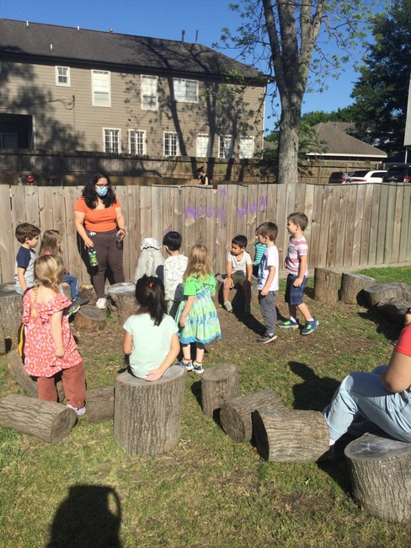
THE BRAND ESSENCE
One brand, ready to grow
Warm. Child-centered. Nature-led. Calmly confident. Every touchpoint should feel like a prepared environment for families.
NEXT PRIORITIES
1 Libre Baskerville + DM Sans only
2 Primary leaf #A4BE7B; never #74C222
3 Full logo first; icon only when constrained
4 Real, approved imagery with natural light
Garden Montessori Schools · Brand Guidelines & Overview
GARDEN MONTESSORI SCHOOLS
16

