Slide 1
Universal Ground Station Receiver for Hubsan X4 PDR
Johns Hopkins
Engineering for Professionals
Kyle Mercer – 02/12/18

Slide 2
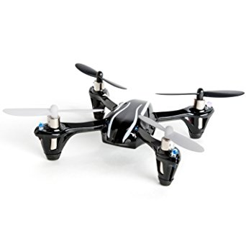
Description
Universal Ground Station Receiver
Listens for incoming Bluetooth© signals
Re-broadcasts controls in Hubsan’s format
Virtually any Bluetooth slave can become a transmitter, including:
Your PC
Your smartphone
Corrie’s glove controller project
Hubsan X4

Slide 3

Description (cont.)
Capabilities
Command translation and relay for Quadcopter control
Any Bluetooth slave may pair
Universal control packet scheme
“Training” Mode for new users
Limitations
Only Bluetooth protocol support
Single Quadcopter brand supported
Single transmitter per session (feature?)
Only A7105 RF chip support (Quadcopter comms)
Ground Station

Slide 4
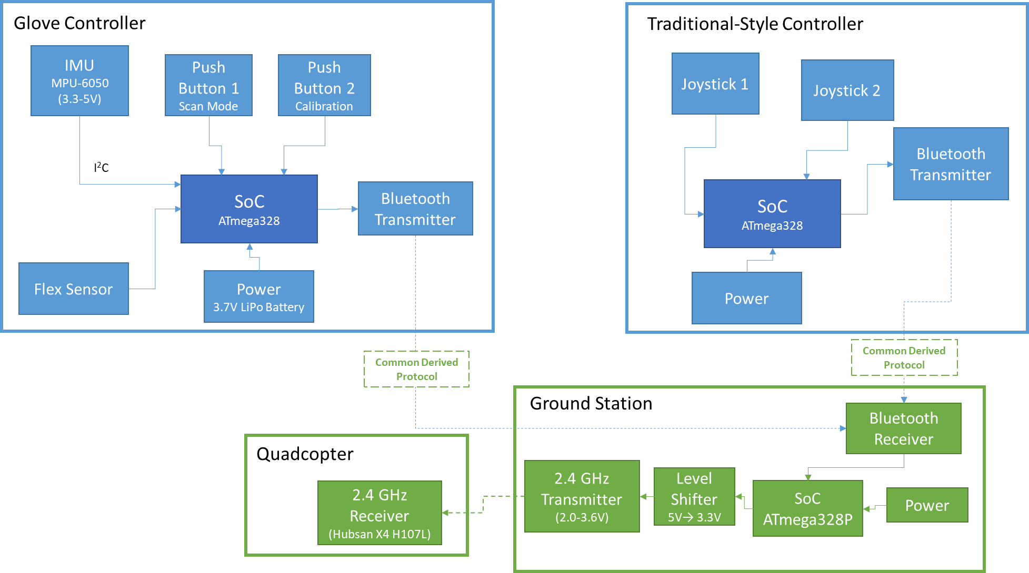
Functional Description (Overall)

Slide 5
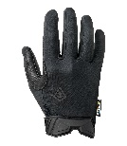

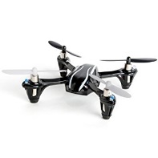
Functional Description (Ground Station)
Ground Station
Common Derived Protocol
Bluetooth
Receiver
5V
…
Training Mode
Btn
Common Derived Protocol
2
/
UART
(RX/TX)
115200 baud
5V
RST
ATmega328P (16 MHz)
Hubsan X4 (H107L)
Bluetooth UART Interface
Protocol Parser
Translation Layer
A7105 SPI Interface
4
/
A7105 2.4 GHz Receiver
(Hubsan X4 H107L)
3.3V
SPI
(SCK, MISO, MOSI, SS)
8 Mbps
3.7V
A7105
2.4 GHz Transmitter
(2.0-3.6V)
4
/
Level Shifter
5V→ 3.3V
Wireless
Wired

Slide 6
Materials & Resources
Hardware | Software | Test Equipment
ATmega328P AVR MCU COTS Hubsan X4 (H107L) Quadcopter 9V/3.7V LiPo batteries 5V regulator Capacitors/Resistors Prototyping board Insulated proto wires A7105 Wireless RF 2.4GHz Transceiver Module Bluesmirf Bluetooth modem (RN-42) 5V to 3.3V level shifter | Linux dev environment Arduino CLI toolchain AVR compiler SPI UART Collaboration tools Git Google cloud | Arduino Uno/Mega FTDI AVR programmer Volt meter Oscilloscope Breadboard Prototyping wires LiPo battery charger
Lead-time on hardware
A7105 RF module: 7–20 days (already obtained from eBay)
Everything else: 2–5 days (Thanks Amzn!)

Slide 7
Materials & Resources (cont.)
Group project logistics
Project Partner: Corrie Russell
Expected from me
Common (Bluetooth) protocol ICD
Ground station deliverable to be used with controllers
Expected from Corrie’s project
Traditional style transmitter (double joystick)
Glove controller transmitter
Both controllers implement common protocol

Slide 8
Schedule
Task # | Objective
1 | Design and finalize Common Bluetooth Protocol ICD for handoff
2 | Implement Bluetooth receiver interface
3 | Implement common protocol processing interface
4 | Create A7105 SPI interface for Hubsan comms
5 | Establish communication with Hubsan Quadcopter (binding phase)
6 | Implement translation layer
7 | Implement “training mode” feature
8 | Integrate tasks 2 through 7 into higher level system
9 | Test full system with Glove/traditional controller driving control data
10 | Final ruggedized hardware assembly
*Meeting point with Corrie’s project

Slide 9
Risks & Mitigation Plan
Risk | Mitigation Plan
Development of Common Protocol | Protocol development task 1st in schedule Allocate more time task if risk is realized.
Binding to COTS Hubsan Quadcopter with A7105 RF module | Move binding task up on schedule Use existing transmitter as surrogate for binding procedure with MCU if risk fully realized
Program flash memory of ATmega328P (32KB) insufficient | Move to ATmega2560 (256KB) Low impact if risk is realized

Slide 10
References
Hubsan X4 reversed protocol specification
http://www.jimhung.co.uk/wp-content/uploads/2014/11/HubsanX4_ProtocolSpec_v1.txt
http://www.jimhung.co.uk/?p=1349
Deviation10 firmware (targets 32-bit ARM)
https://bitbucket.org/PhracturedBlue/
Bluetooth modem RN-42 AT command set
https://cdn.sparkfun.com/datasheets/Wireless/Bluetooth/bluetooth_cr_UG-v1.0r.pdf
Atmel’s AVR documentation
http://www.microchip.com/wwwproducts/en/ATmega328p
ATmega328P standalone assembly
https://www.arduino.cc/en/Main/Standalone

Slide 11
BACKUP SLIDES

Slide 12
Interfaces
Standard Interfaces
Bluetooth interface
Universal Async RX/TX (UART)
TX & RX
115200 baud
A7105 IC interface
Serial Peripheral Interface (SPI)
SCK, MISO, MOSI, SS
8 Mbps (10Mbps max)
Derived Interface
Universal wireless protocol

Slide 13
Materials & Resources (cont.)
Lead-time on hardware
A7105 RF module: 7–20 days (already obtained from eBay)
Everything else: 2–5 days (Thanks Amzn!)
Knowledge Base
AVR documentation
Hubsan X4 reversed protocol specification
http://www.jimhung.co.uk/wp-content/uploads/2014/11/HubsanX4_ProtocolSpec_v1.txt
Bluetooth modem RN-42 AT command set
https://cdn.sparkfun.com/datasheets/Wireless/Bluetooth/bluetooth_cr_UG-v1.0r.pdf

Slide 14
Development Plan & Schedule
Approach
Design common Bluetooth protocol
Design ground station prototype on breadboard
Breakout board modules (Bluetooth and A7105)
Implement software unit tests for all interfaces
Integrate elements into overall system
Transition hardware over to ruggedized prototyping board

