Slide 1

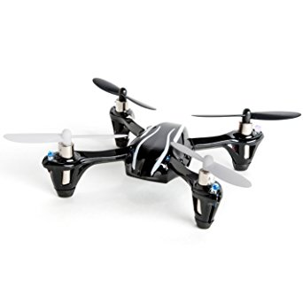
Ground Station

Slide 2
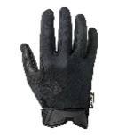
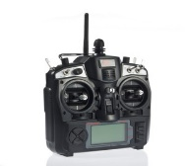
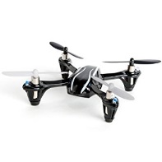
Ground Station
QoBUP
Bluetooth
Receiver
5V
…
Training Mode
Btn
Training Mode
LED
QoBUP
2
/
UART
(RX/TX)
115200 baud
Bind LED
RST
ATmega328P (16 MHz)
Hubsan X4 (H107L)
Bluetooth UART Interface
Protocol Parser
Translation Layer
A7105 SPI Interface
4
/
A7105 2.4 GHz Receiver
(Hubsan X4 H107L)
3.3V
SPI
(SCK, MISO, MOSI, SS)
8 Mbps
3.7V
A7105
2.4 GHz Transmitter
(2.0-3.6V)
4
/
Level Shifter
5V→ 3.3V
Wireless
Wired

