Slide 1
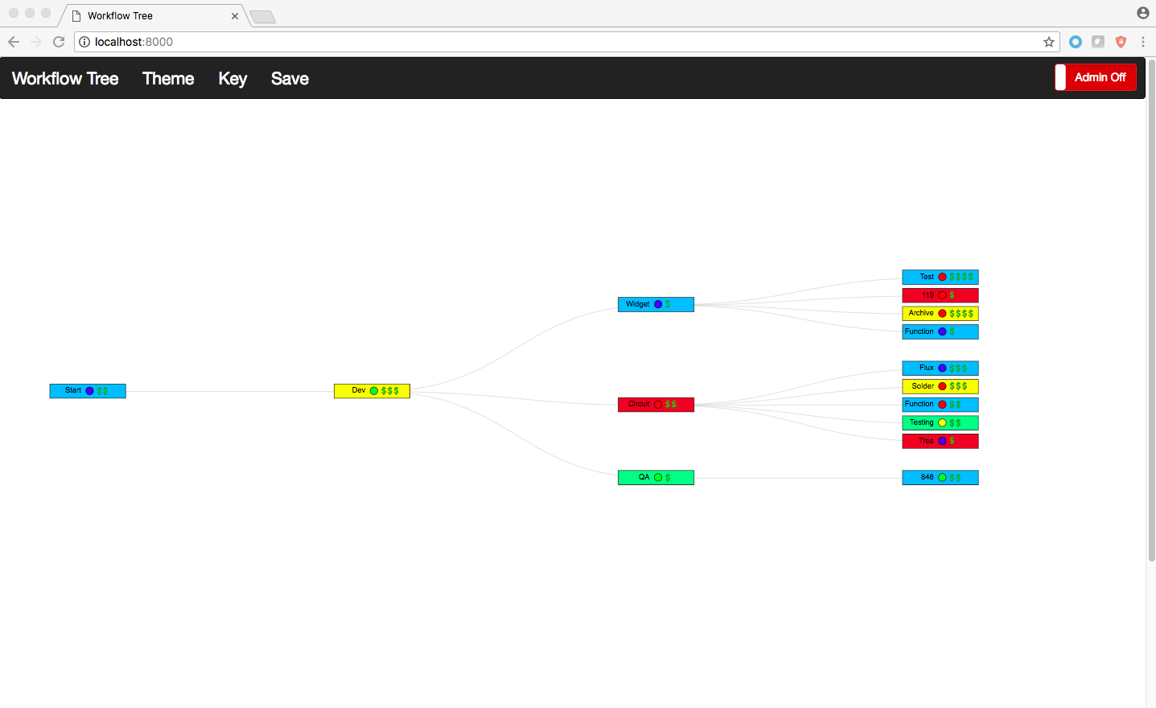
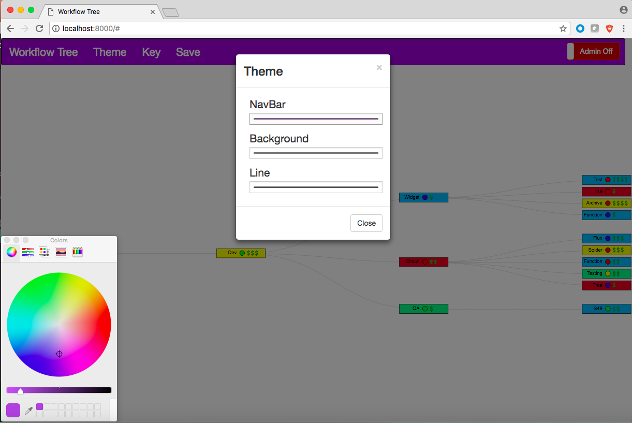
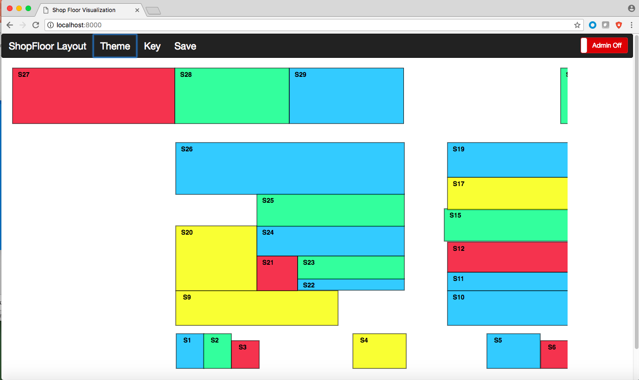

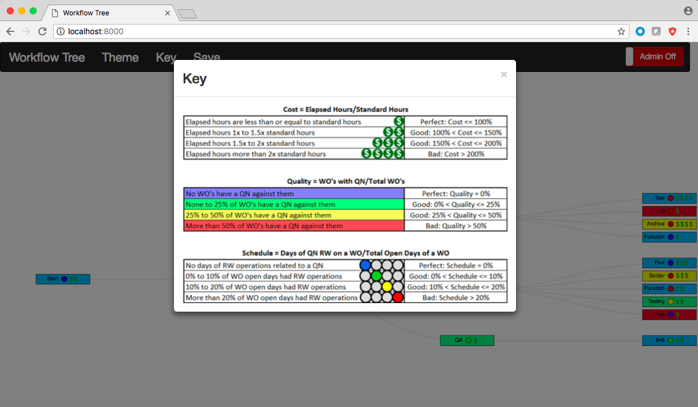
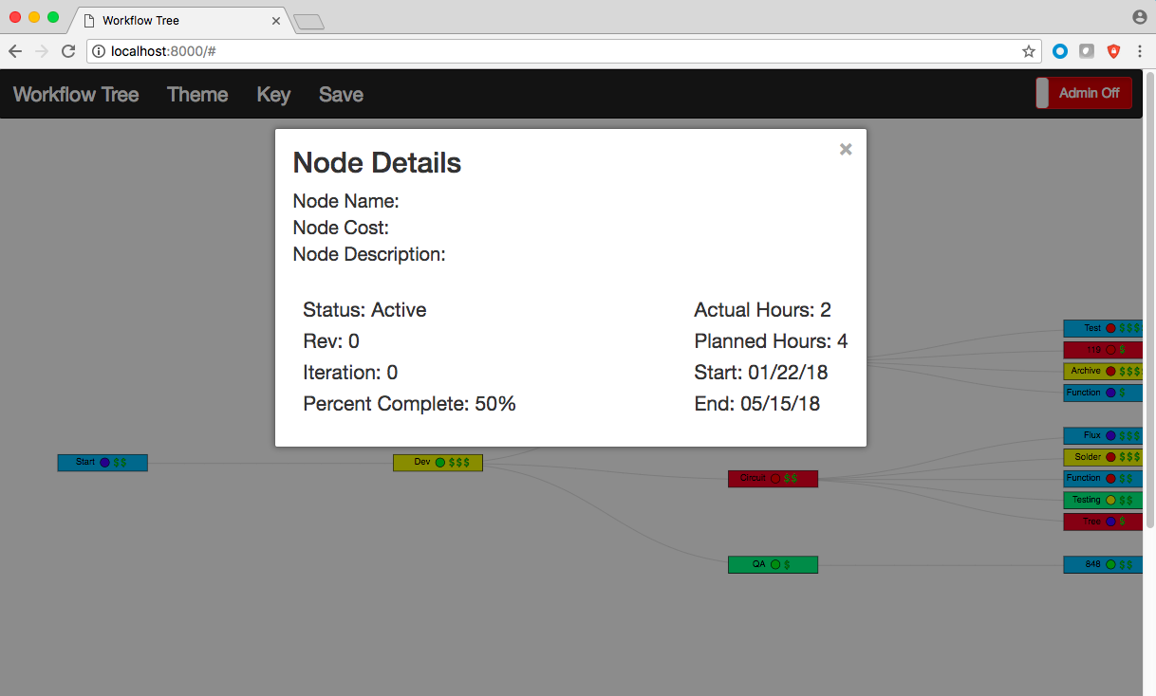
Final Presentation

Slide 2
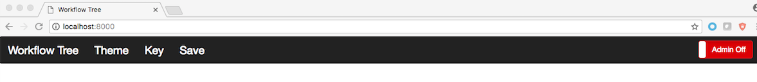
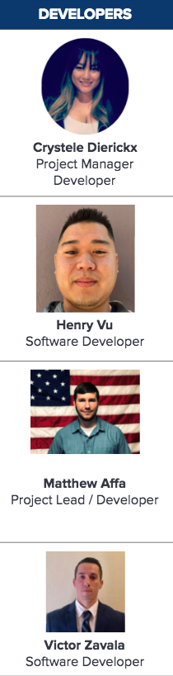
Team Members

Slide 3
Agenda
Project Background
Requirements
Progress Overview
Phases
Hours
Cost
Accomplishments
Documentation and SRS
User and SRS documentation
Project Development
Technology Research and Decision Matrix
Libraries Implemented
Recommendations for Future Development
Project Demo

Slide 4

1.
Project Management

Slide 5
Requirements
Browsers
The widgets need to run on IE 11+, FireFox 45+, ad Edge
Widgets will be interactive to the browsers
JSON
Widgets will receive JSON data from source,including incomplete data. Must save in the same format as received
Theme
Workflow Widget theme can be style with CSS
Widget will display a Shop Floor Visualization
Features
Workflow widget will have an admin mode(edit, add, delete, and drag node)
Workflow widget will have Zoom. Node Collapse/Expand
Features
Widgets will render data in a Workflow Diagram
Shop Floor Visualization widget will render JSON data
Widget will self contain D3 objects

Slide 6
Phase Overview
Phase I
Obtained and Reviewed previous semesters code
Reviewed & Researched technologies used in previous project such as Angular 2
Phase II
Researched and understood last semesters source code
Reviewed Angular 2
Developed basic wireframes
Phase III
Met with one of the team members from last semester to further understand code.
Implemented Angular 2 code and improved / enhanced features and functionalities
Drafted SRS
Decided to move away from Angular 2 and use D3 Library and Python

Slide 7

Phase Overview
Phase IV
Researched rendering D3 library and other technologies
Rebuilt product
Implemented node collapse/expansion feature
Implemented Zoom feature
Implemented Drag feature
Implemented Admin Mode
Phase V
Implemented edit node feature for workflow widget
Implemented custom themes for workflow widget
Implemented Shop Floor Visualization Widget including drag, edit, create node features
QA/ Testing
SRS documentation
Finalize report and documents

Slide 8

Visual Requirements

Slide 9
Phase Work Overview
Actual Cost
Phases | Actual Hours | Rate | Total Actual Cost
Phase 1 | 72 | 29 | $2,088.00
Phase 2 | 29 | 29 | $841.00
Phase 3 | 138 | 29 | $4,002.00
Phase 4 | 200 | 29 | $5,800.00
Phase 5 | 149 | 29 | $4,321.00
Total | 588 | 29 | $17,052.00

Slide 10
$17,052.00
588 hrs
Completion
Total Cost
Total Hours
success!

Slide 11
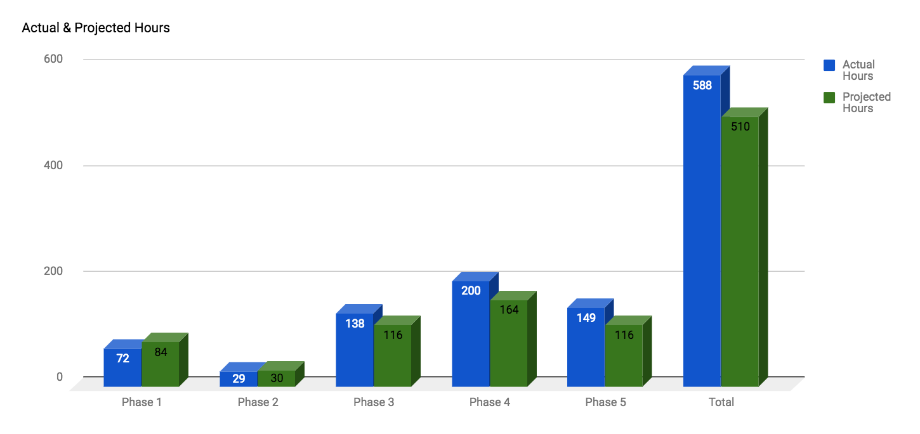
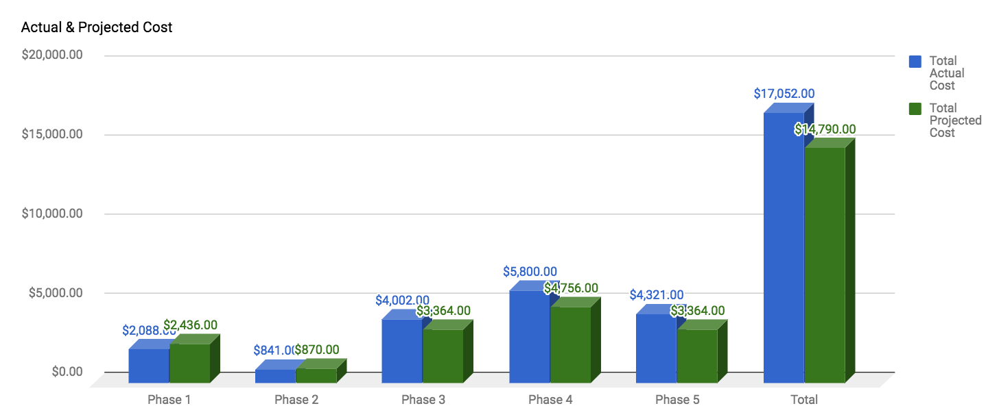
Project Progress

Slide 12

3.
Documentation and SRS

Slide 13
Project Documentation
User Manual
Standard / Basic layout
Shows users how to use the Workflow Widget and Shop Floor Visualization Widget
Development Manual
Thorough details
Developer level instructions on the widgets
Source code is documented in the according folder
SRS
Describes the requirements for the widgets
Defines the purpose, environment, and how it is expected to work

Slide 14
4.
Project Development

Slide 15
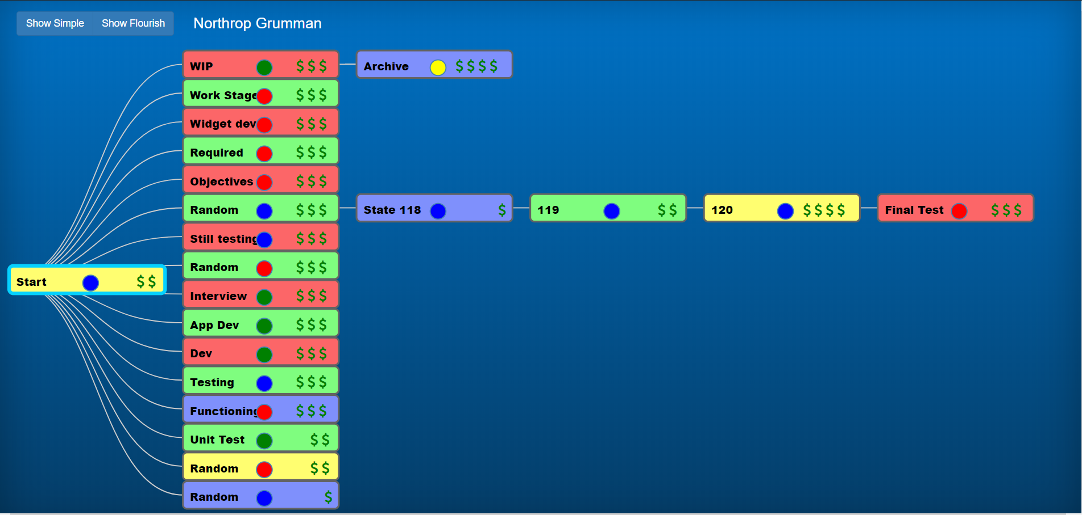
Development
Initially development started with researching last semesters source code and successfully running the code in our environments.
After several attempts and errors running the code we realized the hardship in learning Angular 2 and switched to using just D3.js, JavaScript, and JQuery.

Slide 16
Transition
Switched from Angular backend framework to Python http.Server
Kept D3.js Tree Library
Kept Node Design and Details
Redesigned the UI
Much more simple to manage, run, and modify code

Slide 17
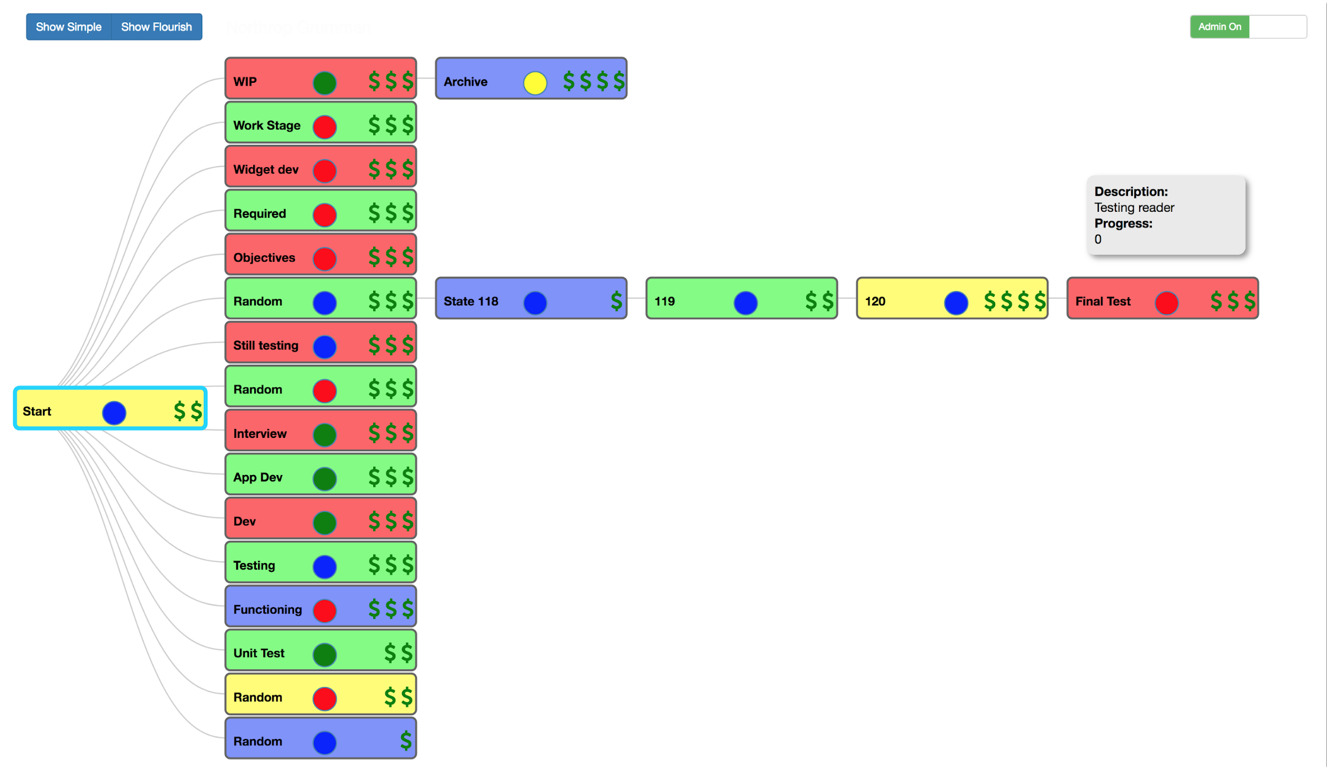
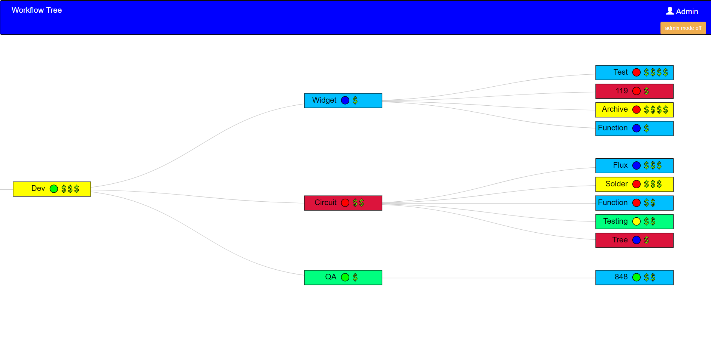
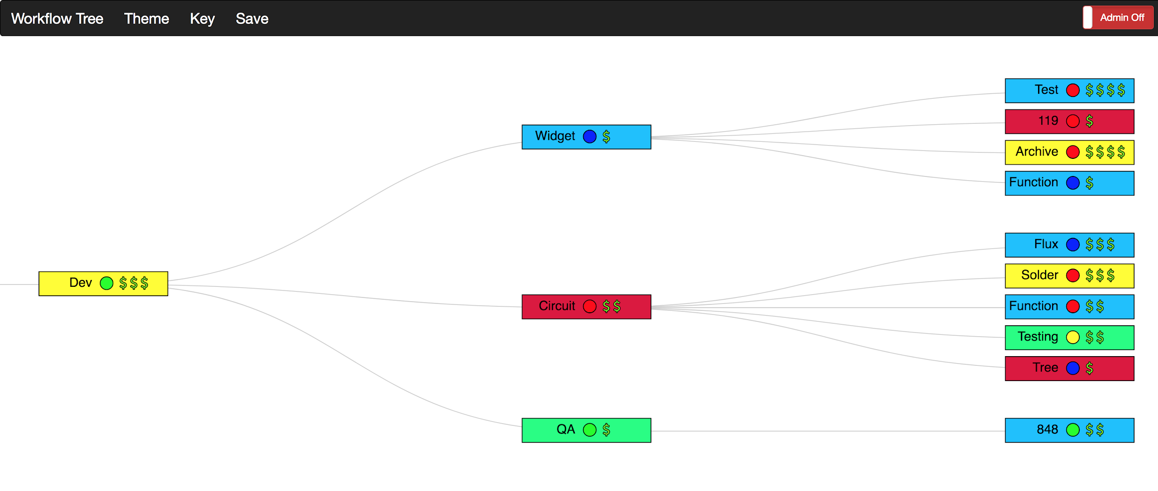
Prototype 1 -> Protoype 2 -> Final Product

Slide 18
Recommendations
WorkFlow Widget
Should not be restricted to a certain amount of distance between nodes
Shop Floor Visualization
Nodes should be customizable in shape and size
Should have the ability to group or collect together
Implement Delete Node
Add Zoom
Admin restrictions for dragging nodes

Slide 19
5.
Widget Styling and Design

Slide 20
Widget Styling and Design
D3.js Tree Library
Used Bootstrap for the navigation bar and admin toggle switch.
Customizable NavBar, Background, and Lines using CSS and JQuery.
Features:
Admin Mode
Key/Legend
Save Changes (WIP)
Context Menu
VIew/Edit Node Details
Collapse/Expand
Zoom In/Out
Drag Feature
Create/Delete Child Nodes
WorkFlow Tree

Slide 21
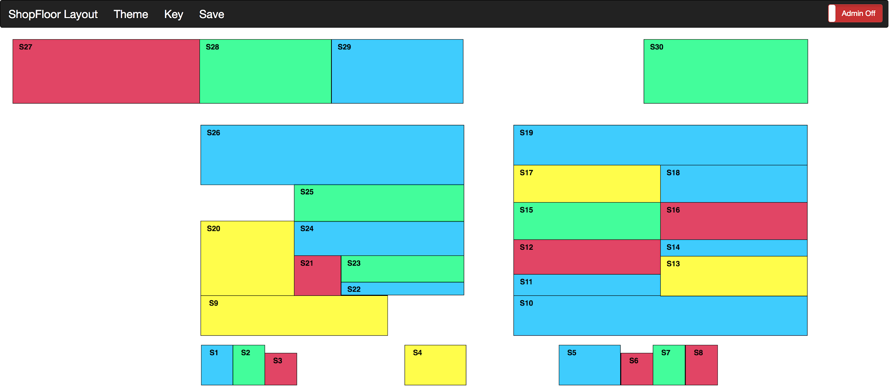
Widget Styling and Design
Shop Floor Visualization
D3.js Library.
Used Bootstrap for the navigation bar and admin toggle switch.
Features:
Customizable NavBar
Key/Legend
View Node Details
Context Menu
Drag
Create Nodes
Features (Work-in-Progress)
Save Changes
Edit Nodes
Delete Nodes
Zoom In/Out

Slide 22
5.
Demo

Slide 23
Thank You!
Any questions?

