Slide 1

MCA320
Amrutha C M
Assistant Professor
SJCE, JSSSTU
Mysuru
Amrutha C M
Assistant Professor
SJCE, JSSSTU

Slide 2

UNIT - 01

Slide 3
Benefits of .NET Framework
Consistent Programming Model:
Net Framework provides a consistent object oriented programming model across different languages. This model is used to create programs for performing different tasks connecting to and retrieving data from databases and reading from and writing to files.

Slide 4
Cross Platform support:
Any Windows platform that supports CLR can execute .Net application. .Net application enables interoperability between different multiple windows operating system.
Language interoperability:
Language interoperability enables code written in different languages to interact with each other. This allows reusability of code and improves the efficiency of the development process. Example :visual basic class can be inherited in c# and vice versa. CLR has built in support for Language interoperability. To ensure multi language code interoperability, a set of language features and rules for using them called Common Language specification(CLS) is defined.

Slide 5
Automatic Management of Resources : .NET Framework provides a feature called CLR that automatically tracks the resource(files, memory, database connection) usage and relieves the users from the tasks of manual resource management.
Ease of Deployment : .NET Framework makes the task of deployment easier. In .NET , applications are deployed in the form of assemblies. Registry entries are not required to store information about components and applications. Assemblies also store information about different versions of a single component used by an application.

Slide 6
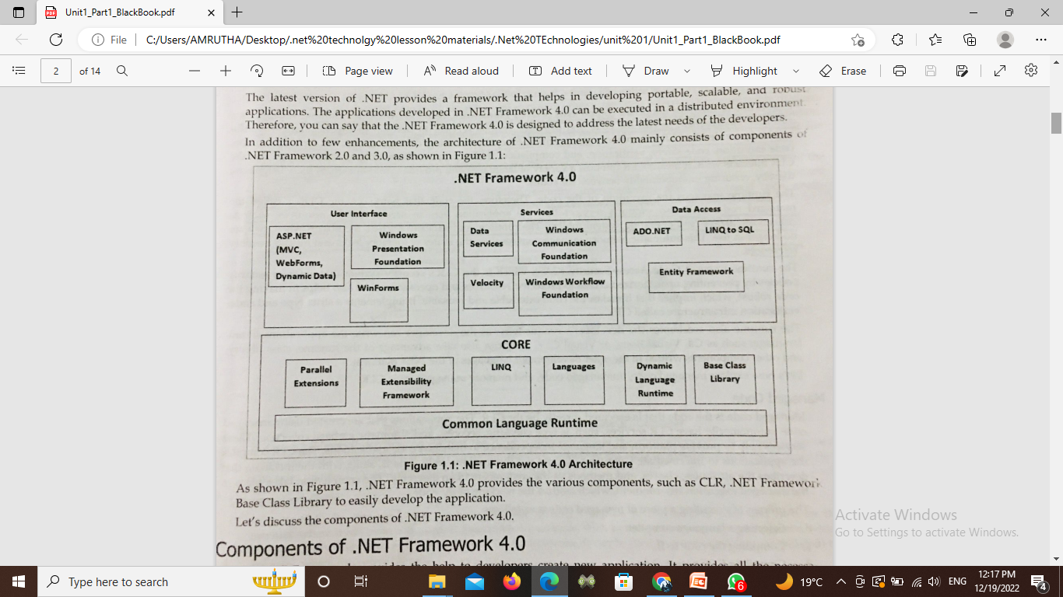
Architecture of .Net Framework

Slide 7
The two major components of .NET Framework are
Common Language Runtime
.NET Framework Class Library.

Slide 8
Common Language Runtime (CLR).
Net Framework provides runtime environment called Common Language Runtime (CLR).
It provides an environment to run all the .Net Programs.
The code which runs under the CLR is called as Managed Code.
Programmers need not to worry on managing the memory if the programs are running under the CLR as it provides memory management and thread management.
Programmatically, when our program needs memory, CLR allocates the memory for scope and de-allocates the memory if the scope is completed. Language Compilers (e.g. C#, VB.Net, J#) will convert the Code/Program to Microsoft Intermediate Language (MSIL) intern this will be converted to Native Code by CLR.

Slide 9
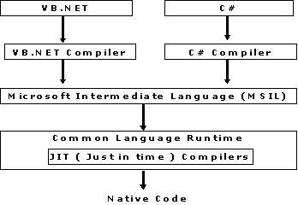
Common Language Runtime (CLR). Continued……

Slide 10
Net Framework Class Library (FCL)
This is also called as Base Class Library and it is common for all types of applications i.e. the way you access the Library Classes and Methods in VB.NET will be the same in C#, and it is common for all other languages in .NET.
The following are different types of applications that can make use of .net class library.
1. Windows Application.
2. Console Application
3. Web Application.
4. XML Web Services.
5. Windows Services.

Slide 11
Net Framework Class Library (FCL) Continued……
In short, developers just need to import the BCL in their language code and use its predefined methods and properties to implement common and complex functions like reading and writing to file, graphic rendering, database interaction, and XML document manipulation.

Slide 12
Common Type System (CTS)
It describes set of data types that can be used in different .Net languages in common. (i.e), CTS ensures that objects written in different .Net languages can interact with each other.
For Communicating between programs written in any .NET complaint language, the types have to be compatible on the basic level.

Slide 13
The common type system supports two general categories of types:
1. Value types: Value types directly contain their data, and instances of value types are either allocated on the stack or allocated inline in a structure. Value types can be built-in (implemented by the runtime), user-defined, or enumerations.

Slide 14
2.Reference types:
Reference types store a reference to the value's memory address, and are allocated on the heap. Reference types can be self-describing types, pointer types, or interface types. The type of a reference type can be determined from values of self-describing types. Self-describing types are further split into arrays and class types. The class types are user-defined classes, boxed value types, and delegates.

Slide 15
Metadata
Metadata in .Net is binary information which describes the characteristics of a resource. This information include Description of the Assembly , Data Types and members with their declarations and implementations, references to other types and members, Security permissions etc. A module's metadata contains everything that needed to interact with another module.

Slide 16
Metadata Continued……..
During the compile time Metadata created with Microsoft Intermediate Language (MSIL) and stored in a file called a Manifest.
Both Metadata and Microsoft Intermediate Language (MSIL) together wrapped in a Portable Executable (PE) file.
During the runtime of a program Just In Time (JIT) compiler of the Common Language Runtime (CLR) uses the Metadata and converts Microsoft Intermediate Language (MSIL) into native code.
When code is executed, the runtime loads metadata into memory and references it to discover information about your code's classes, members, inheritance, and so on. Moreover Metadata eliminating the need for Interface Definition Language (IDL) files, header files, or any external method of component reference.

Slide 17
Assemblies
Assemblies are the fundamental units of deployment, version control, reuse, activation scoping, and security permissions for .NET-based applications. An assembly is a collection of types and resources that are built to work together and form a logical unit of functionality.

Slide 18
Windows forms
Windows Forms is a Graphical User Interface(GUI) class library which is bundled in .Net Framework. Its main purpose is to provide an easier interface to develop the applications for desktop, tablet, PCs. It is also termed as the WinForms.
The applications which are developed by using Windows Forms or WinForms are known as the Windows Forms Applications that runs on the desktop computer. WinForms can be used only to develop the Windows Forms Applications not web applications. WinForms applications can contain the different type of controls like labels, list boxes, tooltip etc.

Slide 19
ASP .NET
ASP.NET is a free web framework for building great websites and web applications using HTML, CSS, and JavaScript.
ASP.NET Web Pages provide a fast, approachable, and lightweight way to combine server code with HTML to create dynamic web content. Connect to databases, add video, link to social networking sites, and include many more features that help you create beautiful sites that conform to the latest web standards.

Slide 20
Ajax.NET Framework
The Ajax.NET Framework dynamically creates proxy objects that act as the communication mechanism between the browser and server. When a developer creates a method in code behind, that method may be decorated with an attribute to tell the Ajax.NET engine to create the necessary JavaScript proxy.

Slide 21
ADO.NET
ADO.NET separates data access from data manipulation into discrete components that can be used separately.
ADO.NET includes .NET Framework data providers for connecting to a database, executing commands, and retrieving results. Those results are either processed directly, placed in an ADO.NET DataSet object in order to be exposed to the user in an ad hoc manner, combined with data from multiple sources, or passed between tiers.

Slide 22
Windows Workflow Foundation
A workflow is a set of elemental units called activities that are stored as a model that describes a real-world process. Workflows provide a way of describing the order of execution and dependent relationships between pieces of short- or long-running work. This work passes through the model from start to finish, and activities might be executed by people or by system functions.

Slide 23
Windows Presentation Windows
WPF provides a comprehensive set of application-development features that include Extensible Application Markup Language (XAML), controls, data binding, layout, 2D and 3D graphics, animation, styles, templates, documents, media, text, and typography.
WPF is part of .NET, so you can build applications that incorporate other elements of the .NET API.

Slide 24
Windows Communication Foundation
Windows Communication Foundation (WCF) is a framework for building service-oriented applications. Using WCF, you can send data as asynchronous messages from one service endpoint to another. A service endpoint can be part of a continuously available service hosted by IIS, or it can be a service hosted in an application. An endpoint can be a client of a service that requests data from a service endpoint.

Slide 25
Windows Card Space
Windows Card Space is a Microsoft .NET Framework version 3.0 component that provides the consistent user experience required by the identity meta system. Specially Windows Card Space works to protect the user identity. Windows Card Space provides the security to our ASP.NET application. Windows Card Space basically a digital identity. In networked world-identity is currently a much more muddled thing.
The Windows Card Space Provides four aspects :
1. It support any digital identity system
2. Consistent user control of digital identity
3. Replacement of password-based Web login
4.On remote application it improves the user confidence

Slide 26
LINQ
The beauty of LINQ is it provides the ability to .NET languages (like C#, VB.NET, etc.) to generate queries to retrieve data from the data source.
For example, a program may get information from the student records or accessing employee records, etc. In, past years, such type of data is stored in a separate database from the application, and you need to learn different types of query language to access such type of data like SQL, XML, etc. And also you cannot create a query using C# language or any other .NET language.
To overcome such type of problems Microsoft developed LINQ. It attaches one, more power to the C# or .NET languages to generate a query for any LINQ compatible data source.

Slide 27
Need of C#
C# is an object-oriented, component-oriented programming language.
C# provides language constructs to directly support these concepts, making C# a natural language in which to create and use software components.
Since its origin, C# has added features to support new workloads and emerging software design practices. At its core, C# is an object-oriented language.

Slide 28
Need of C# Continued……
Several C# features help create robust and durable applications.
Garbage collection automatically reclaims memory occupied by unreachable unused objects.
Nullable types guard against variables that don't refer to allocated objects.
Exception handling provides a structured and extensible approach to error detection and recovery.
Lambda expressions support functional programming techniques.

Slide 29
C# Pre Processor Directives
Preprocessor Directives in C# tell the compiler to process the given information before actual compilation of the program starts. It begins with a hash tag symbol (#) and since these preprocessors are not statements so no semi-colon is appended at the end. The C# compiler does not have a separate preprocessor, yet the directives are processed as if there was one. There cannot be anything else in a line other than the preprocessor directive.

Slide 30
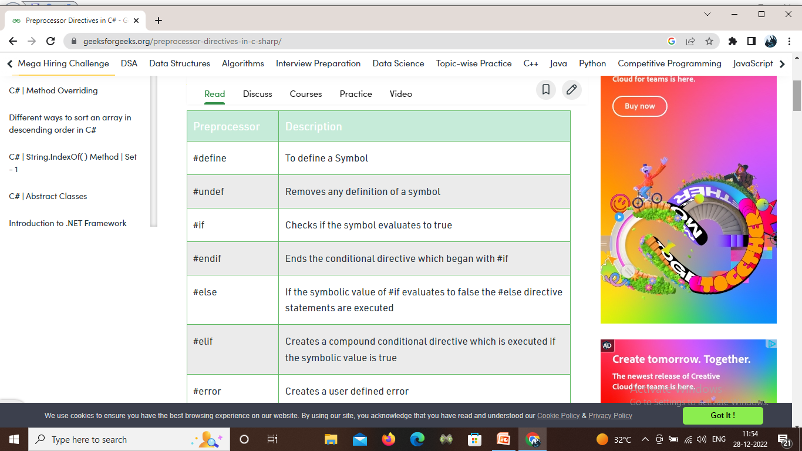
Pre Processor Continued…….

Slide 31
C# Keywords and Identifiers
C# Keywords
Keywords are predefined sets of reserved words that have special meaning in a program. The meaning of keywords can not be changed, neither can they be directly used as identifiers in a program.
For example: long mobileNum;
here, long is a keyword and mobileNum variable (identifier).
long has a special meaning in C# i.e. it is used to declare variables of type long and this function cannot be changed.

Slide 32
Keywords
C# has a total of 79 keywords. All these keywords are in lowercase.
Although keywords are reserved words, they can be used as identifiers if @ is added as prefix.
For example: int @void;
The above statement will create a variable @void of type int.

Slide 33
Identifiers
Identifiers are the name given to entities such as variables, methods, classes, etc. They are tokens in a program which uniquely identify an element.
For example: int value;
here, value is the name of variable. Hence it is an identifier.
Reserved keywords can not be used as identifiers unless @ is added as prefix

Slide 34
Rules for Naming an Identifier
An identifier can not be a C# keyword.
An identifier must begin with a letter, an underscore or @ symbol. The remaining part of identifier can contain letters, digits and underscore symbol.
Whitespaces are not allowed. Neither it can have symbols other than letter, digits and underscore.
Identifiers are case-sensitive. So getName, GetName and getname represents 3 different identifiers.

Slide 35
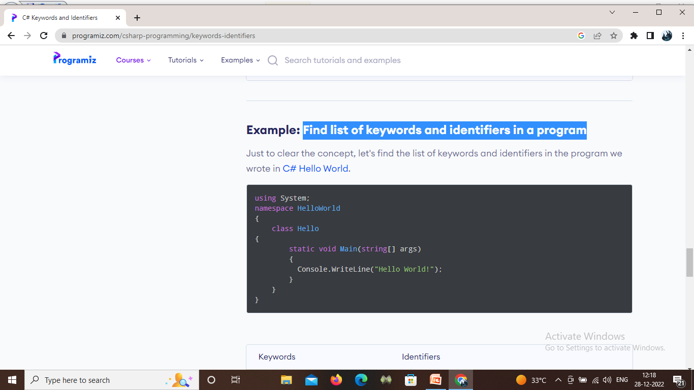
Find list of keywords and identifiers in a program

Slide 36
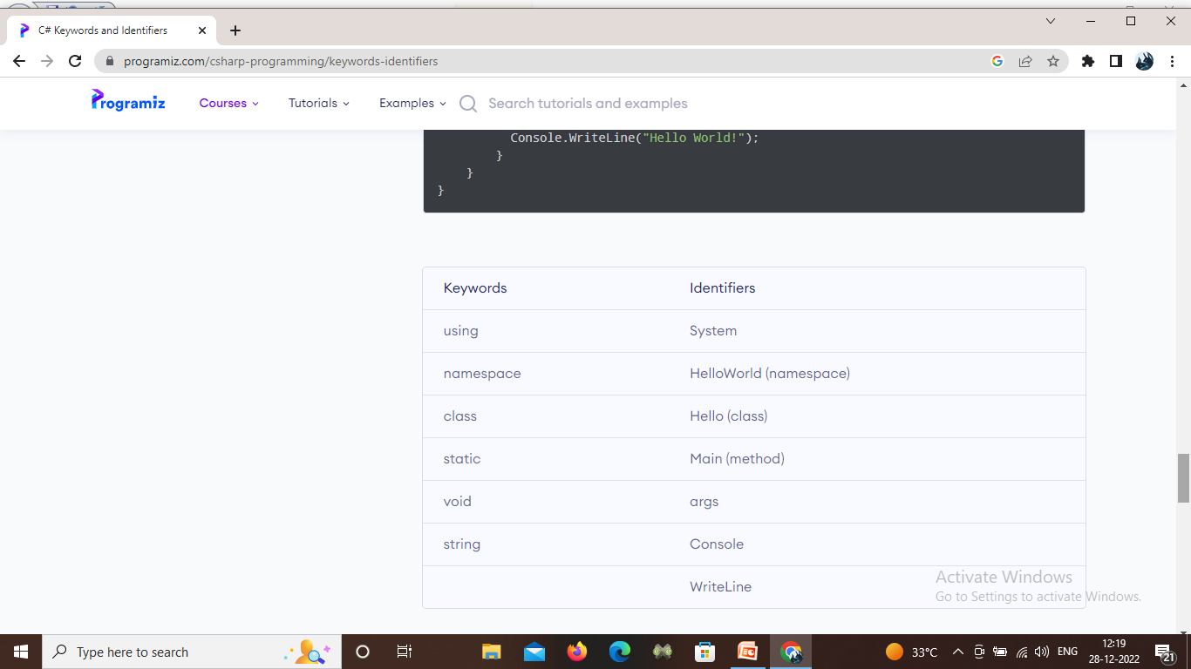

Slide 37
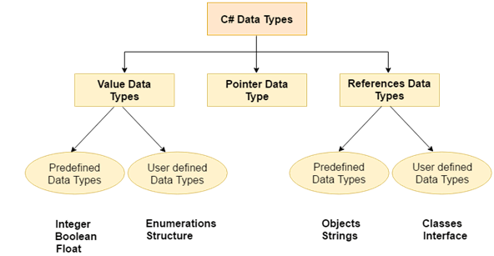
Data type
There are 3 types of data types in C# language.

Slide 38
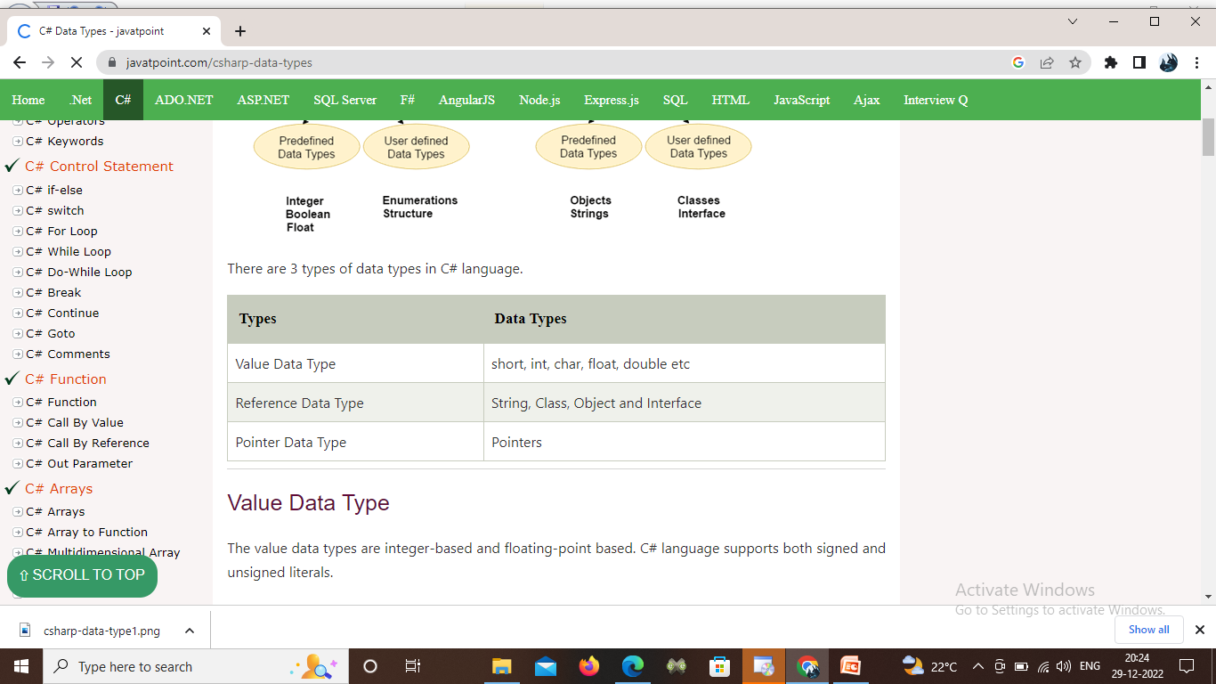
Datatype

Slide 39
Variables
A variable is a name of memory location. It is used to store data. Its value can be changed and it can be reused many times.
It is a way to represent memory location through symbol so that it can be easily identified.
Syntax to declare a variable:
type variable_list;

Slide 40
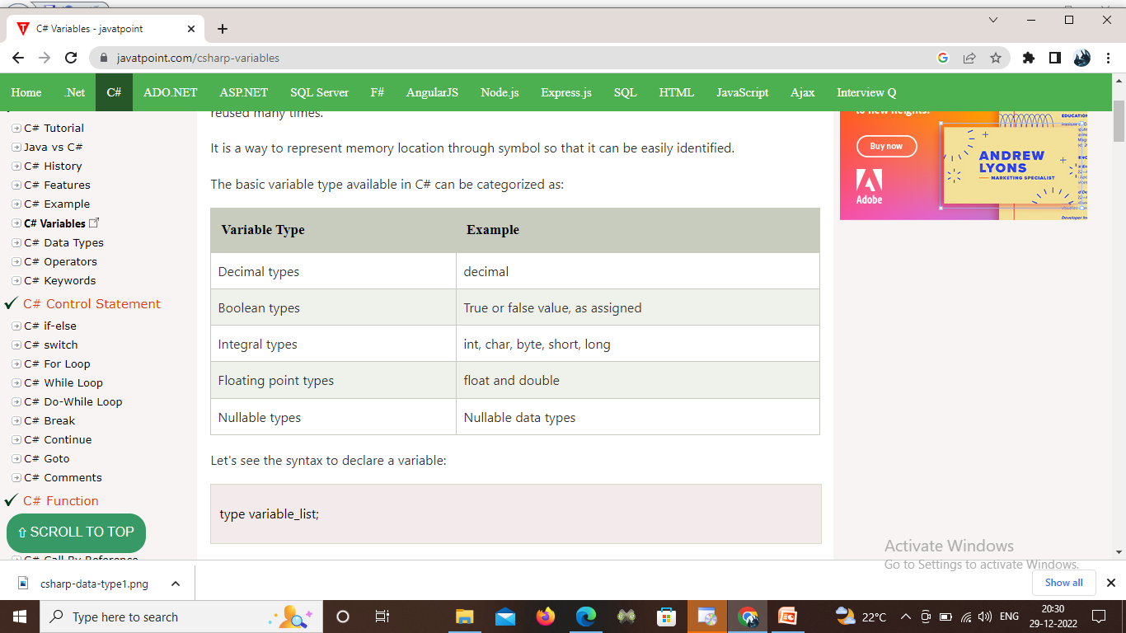
The basic variable type available in C# can be categorized as:

Slide 41
Rules for defining variables
A variable can have alphabets, digits and underscore.
A variable name can start with alphabet and underscore only. It can't start with digit.
No white space is allowed within variable name.
A variable name must not be any reserved word or keyword e.g. char, float etc.

Slide 42
Constants
Constants are immutable values which are known at compile time and do not change for the life of the program. Constants are declared with the const modifier.
C# does not support const methods, properties, or events.
class Calendar2
{ public const int Months = 12, Weeks = 52, Days = 365;
}

Slide 43
Type Conversion
Type conversion is converting one type of data to another type. It is also known as Type Casting.
Implicit type conversion − These conversions are performed by C# in a type-safe manner. For example, are conversions from smaller to larger integral types and conversions from derived classes to base classes.

Slide 44
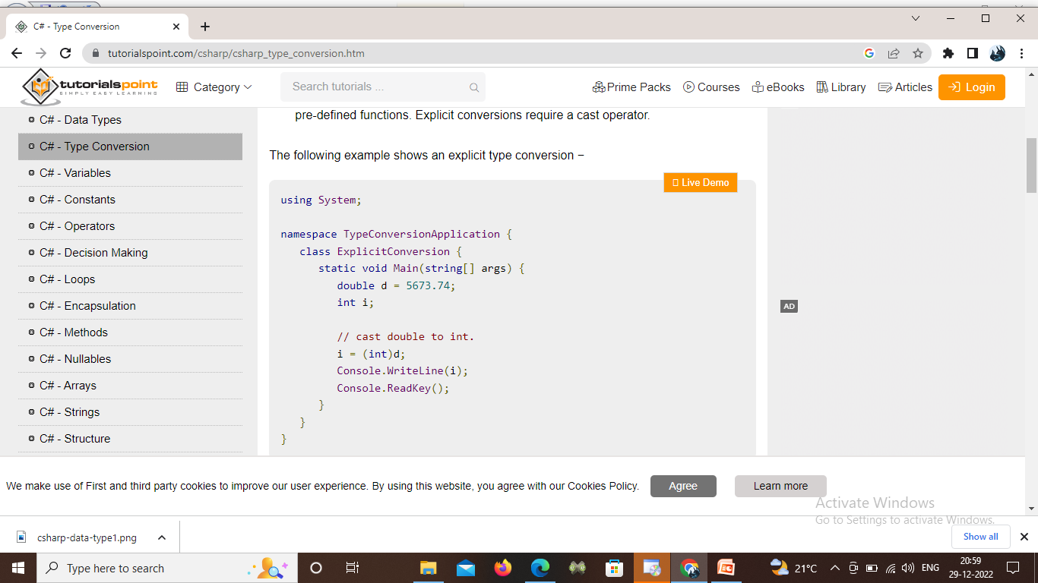
Explicit type conversion − These conversions are done explicitly by users using the pre-defined functions. Explicit conversions require a cast operator.

Slide 45
Boxing and unboxing
The conversion of a value type to a reference type is known as boxing.
Unboxing is just the opposite - it is defined as the process of conversion of a reference type to a value type.
The following code snippet illustrates boxing and unboxing in C#.
int i = 100;
Object obj = i; //Boxing
i = (int)obj; //Unboxing

Slide 46
C# Operator Precedence
Operator precedence is a set of rules which defines how an expression is evaluated.
In C#, each C# operator has an assigned priority and based on these priorities, the expression is evaluated.

Slide 47
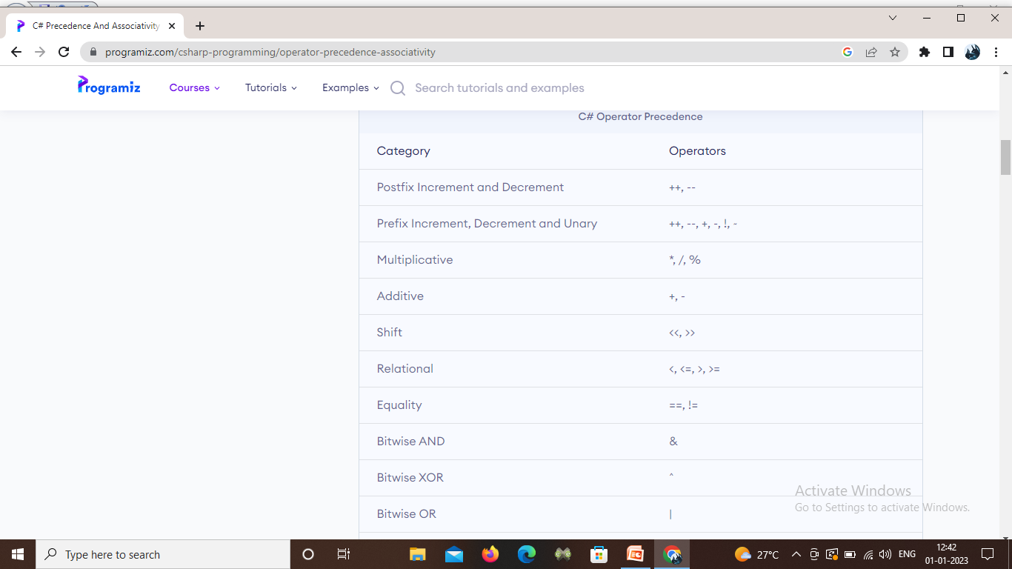
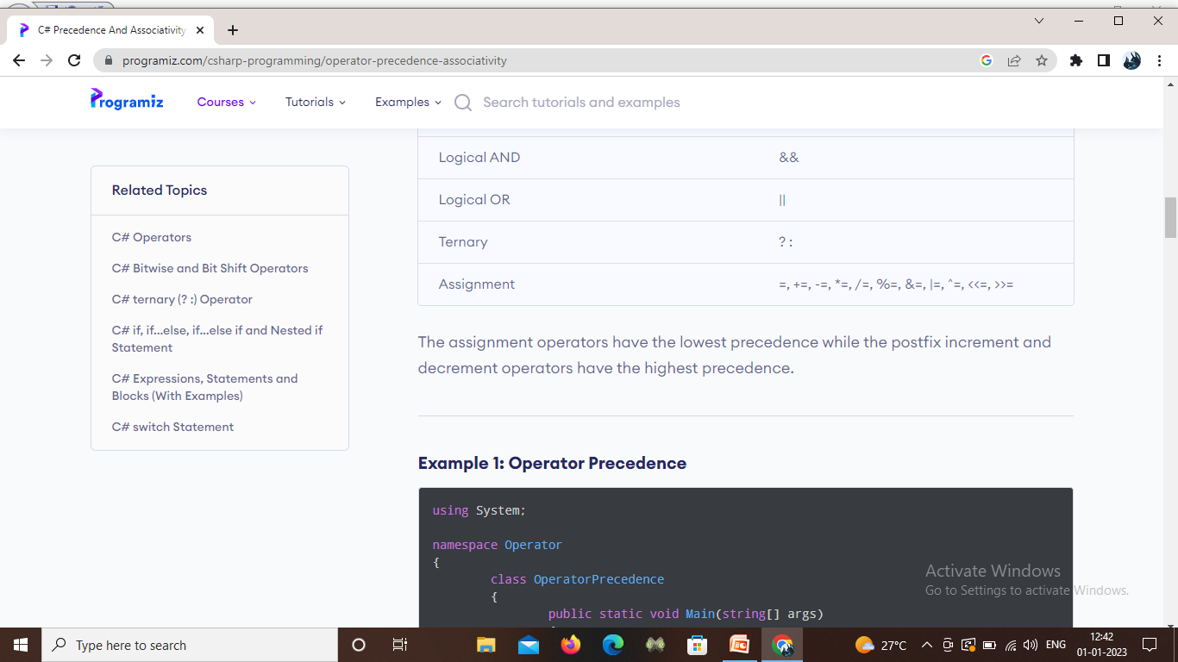

Slide 48
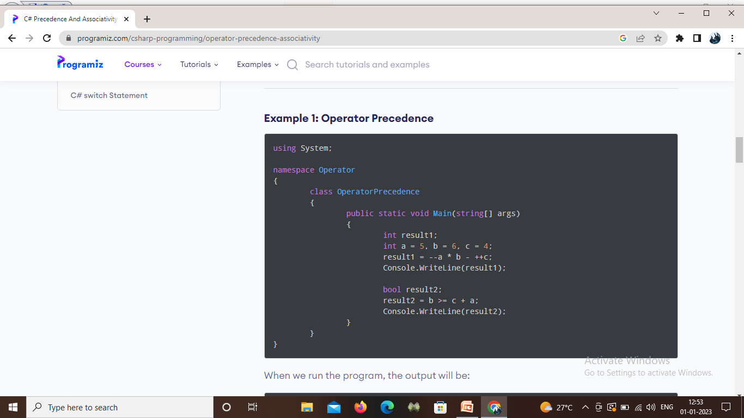

Slide 49
The null-coalescing operators
The null-coalescing operator ?? returns the value of its left-hand operand if it isn't null. otherwise, it evaluates the right-hand operand and returns its result.
The ?? operator doesn't evaluate its right-hand operand if the left-hand operand evaluates to non-null.
The null-coalescing assignment operator ??= assigns the value of its right-hand operand to its left-hand operand only if the left-hand operand evaluates to null.
The ??= operator doesn't evaluate its right-hand operand if the left-hand operand evaluates to non-null.

Slide 50
Scope Resolution Operator
The scope resolution operator in C# has a different meaning as compared with C++. In C++ the :: is used for global variables, whereas in C# it is related to namespaces.
If you have a type that share an identifier in different namespace, then to identify them use the scope resolution operator.
For example, to reference System.Console class, use the global namespace alias with the scope resolution operator.
Eg: global::System.Console

Slide 51
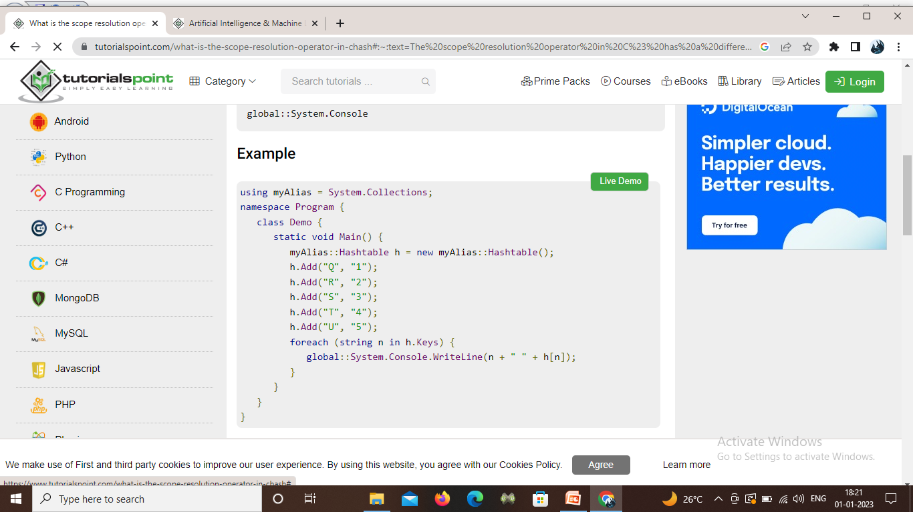

Slide 52
is Operator
The is operator will check if the result of the expression is compatible with a given type by simply testing an expression against a pattern.
It is sometimes called the operator of type testing, and it will check whether the runtime type of an expression's result is compatible with a given type.

Slide 53
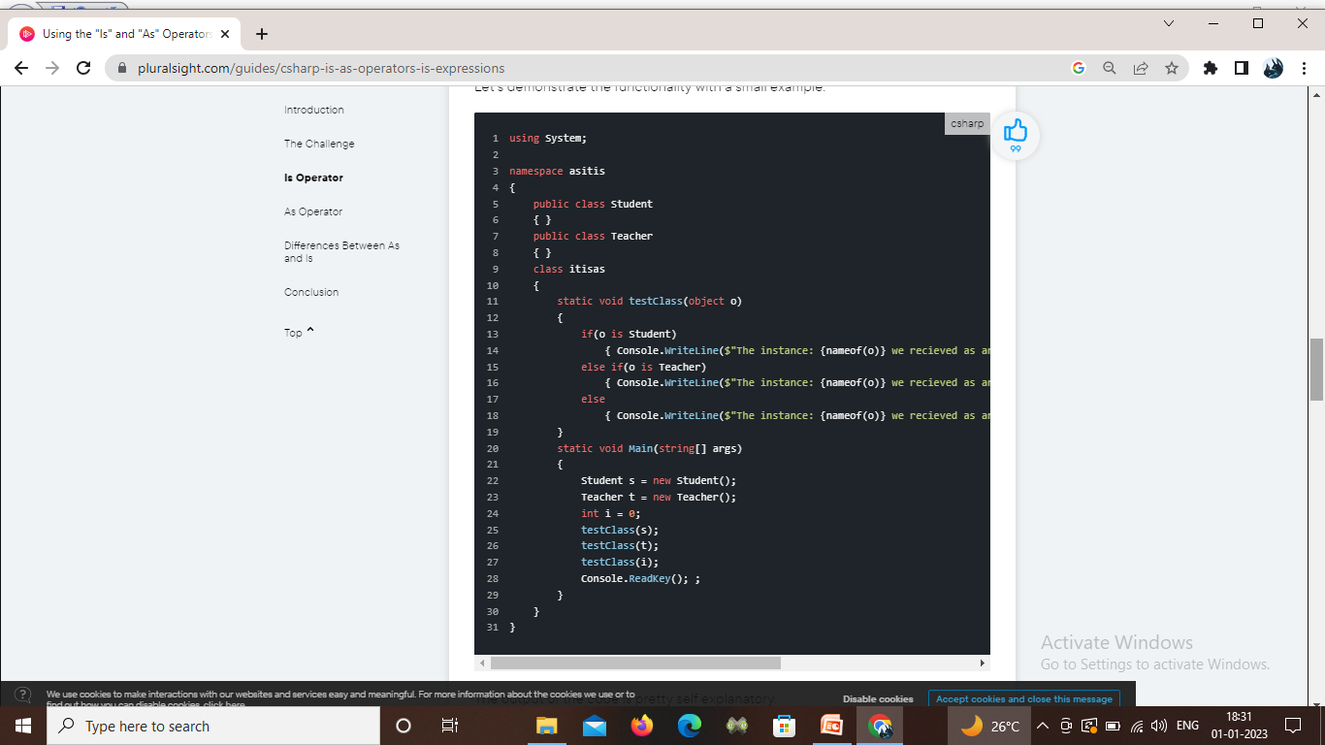

Slide 54
As Operator
The as operator is used to perform conversions between compatible types.
It has a very similar role to the is operator, however, it works differently under the hood.

Slide 55
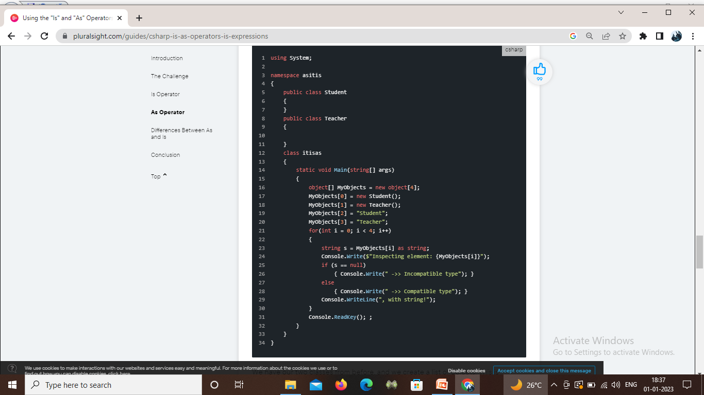

Slide 56
Selection Statements
The if statement determines which statement to execute based on a specified condition.
Syntax: if (statement)
{
statement;
}
eg:
if (BAC >= 0.08) { Console.WriteLine(“Intoxicated.”); }

Slide 57
Else statement
The else statement provides a variation of the if statement which executes a default statement when the condition of the if statement is not true.
Syntax : if (statement)
{ statement; }
else { statement; }

Slide 58
switch statement
The switch statement selects from a list of possible statements based on a set of results.
Syntax: datatype AVariable;
switch (AVariable)
{
case s: statement;
break;
case t: statement;
break;
default: statement;
break;
}

Slide 59
ITERATION
The do statement repeats the execution of a statement(s) until a specified condition is false. It always executes once before evaluating the condition.
Syntax:
do
{
statement;
}
While
(statement);

Slide 60
for statement
The for statement repeats the execution of a statement until a specified condition is false. It proves most useful when the developer knows the exact number of necessary iterations. Its statements initialize the iteration variable, state the related condition, and state the iteration operation. Note that all statements within a for statement are optional, and omissions can create infinite loops.
Syntax: for (initializer; condition; iterator)
{ statement; }

Slide 61
while statement
The while statement executes a statement(s) while a condition evaluates to true.
Syntax:
while (statement)
{ statement; }

Slide 62
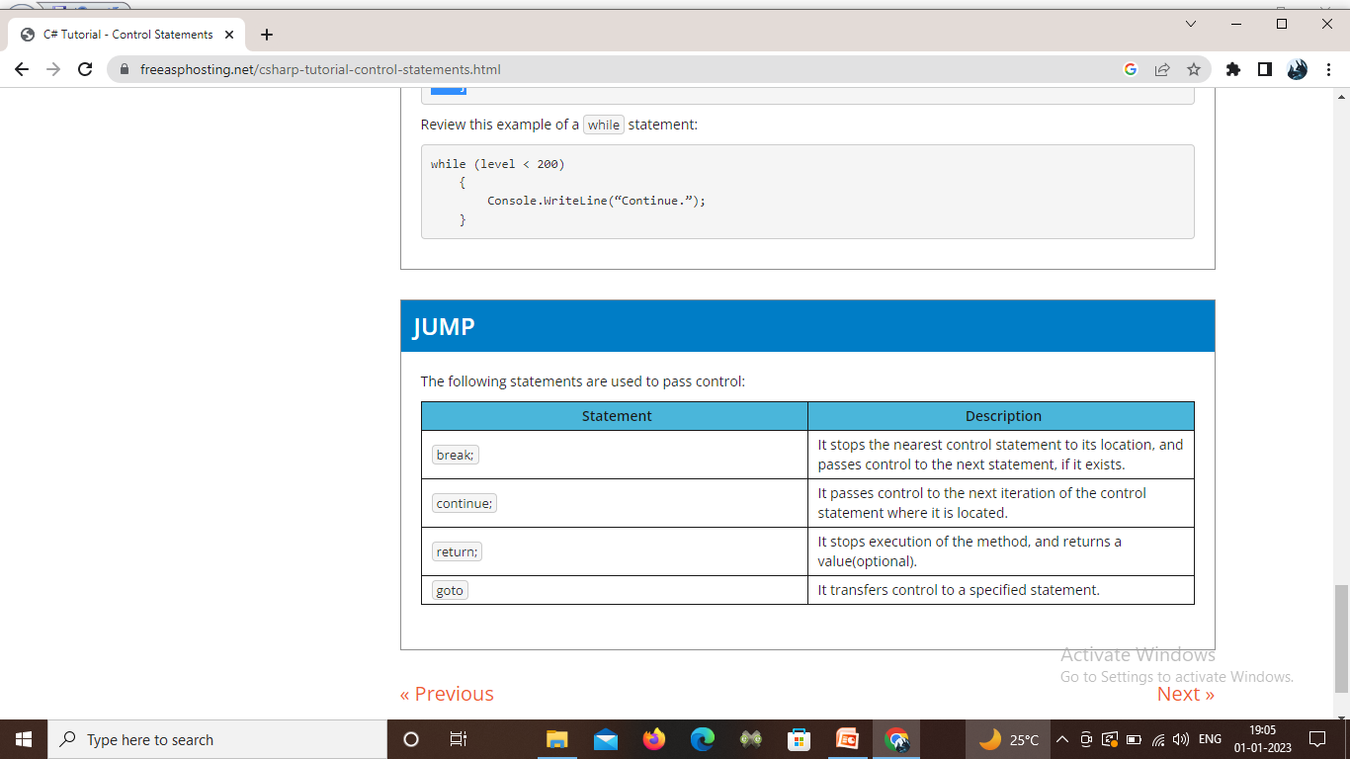
Jump Statements

