Slide 1


Slide 2


Pearls
Second Year Project Synopsis
Submitted by
ROLL | NAME
2301010396 | Srijan Kumar
2301010366 | Sachin Kumar
Industry Mentor: Miss Pallavi Dhingra
Faculty Mentor: Dr. Preeti Rathi
Notes:
New Courses replaced with New Programmes

Slide 3

Project Overview
Pearls is a custom-built e-commerce jewelry store developed to meet the specific requirements of the client. The platform offers a complete online shopping experience, showcasing a wide range of elegant jewelry pieces and enabling seamless browsing, purchasing, and checkout.
Notes:
New Courses replaced with New Programmes

Slide 4
About the Problem
Traditional canteen systems rely heavily on manual ordering and delivery, often resulting in long queues, delays, food wastage, and operational inefficiencies. There is no real-time status update, and the system lacks data-driven insights for better inventory and staff planning.
Our project addresses these issues by digitizing the process, incorporating a backend-driven architecture, predictive analytics via ML, and an automated token system to ensure a smooth experience.
Notes:
New Courses replaced with New Programmes

Slide 5
Problem Statement
-> In an increasingly digital world, the client recognized the need to establish a strong online presence to remain competitive in the jewelry market.
-> Despite offering high-quality products, the lack of an online platform limited their reach and sales potential.
-> The client needed a dedicated e-commerce solution that would not only showcase their jewelry collection but also provide a seamless shopping experience for customers.
Notes:
New Courses replaced with New Programmes

Slide 6
Objective
The goal was to design and develop a fully functional online jewelry store that effectively represents the client's brand identity while enhancing their digital footprint. The platform was built to expand market reach and facilitate direct online sales. Key features include an interactive product catalog, secure payment gateway integration, and user authentication through login and registration functionalities.
Notes:
New Courses replaced with New Programmes

Slide 7
Methodology
We followed the Software Development Life Cycle (SDLC), progressing through planning, analysis, design, implementation, and testing. This included gathering client requirements, designing intuitive interfaces, developing full-stack functionality and testing.
Tools & Technologies Used:
Frontend: React , Axios
Backend: Express
Database: MySQL
Environment: Node.js
Payment Gateway: Razorpay API
Notes:
New Courses replaced with New Programmes

Slide 8
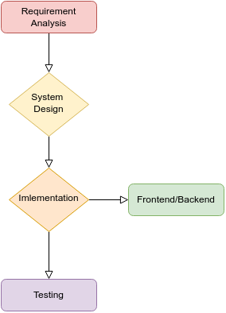
Methodology Flowchart
Notes:
New Courses replaced with New Programmes

Slide 9
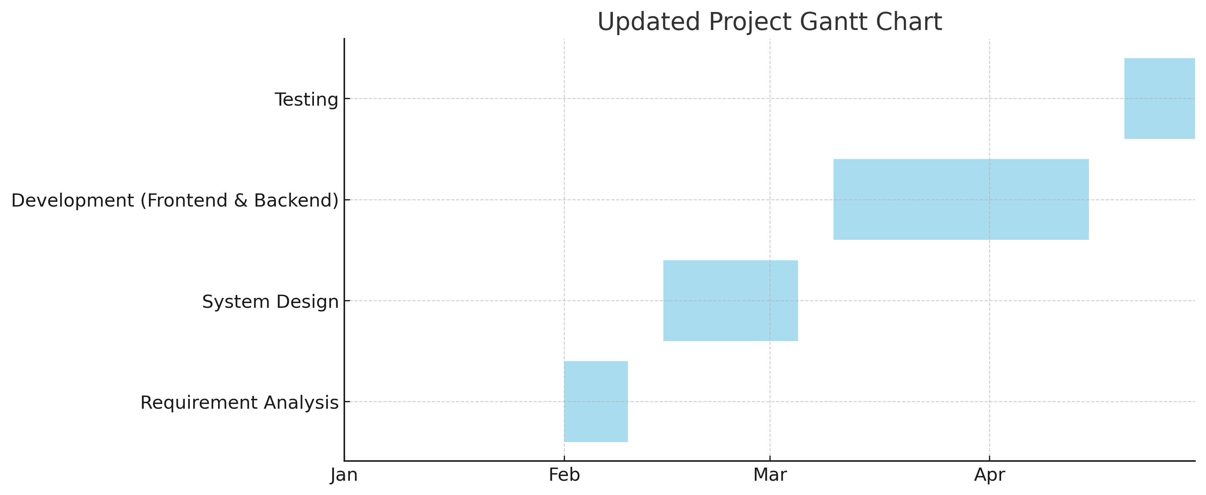
Project Timeline
Notes:
New Courses replaced with New Programmes

Slide 10
Features
Features:
Add product to the cart.
View a list of all available jewellery products.
Update jewellery products in the cart.
Delete products from cart.
Login and Registration
User can make payment using Razorpay API
Notes:
New Courses replaced with New Programmes

Slide 11
Future Scope
Features to be added on futures:
Admin panel for easier controls.
Introducing festive offers and discounts automatically.
Admin can add, update, delete category and jewelleries.
Deployment of the store at a custom domain

Slide 12
References
Node.js Official Documentation
Express.js Guide
MySQL Documentation
React.js Official Site
Stack Overflow Developer Community
Chai aur code Youtube channel
Notes:
New Courses replaced with New Programmes

Slide 13
THANK YOU

