Slide 1
HR Analysis Report

Slide 2
This project has been completed in the group, And All Group member details are given below
Project Name - HR Analysis
Project ID - PRDA -03
Group ID - PTID-CDA-OCT-23-046
SHASHI RANJAN KUMAR SINGH – thesrprofile@gmail.com
JAYESH GUPTA - jayeshgupta4527@gmail.com
MEGHA SANADI - megha.m.sanadi@gmail.com
BHAVNESHWARI DEORE - deorebhumi9@gmail.com
POOJA S DHARNAIK - poojadharnaik74@gmail.com

Slide 3
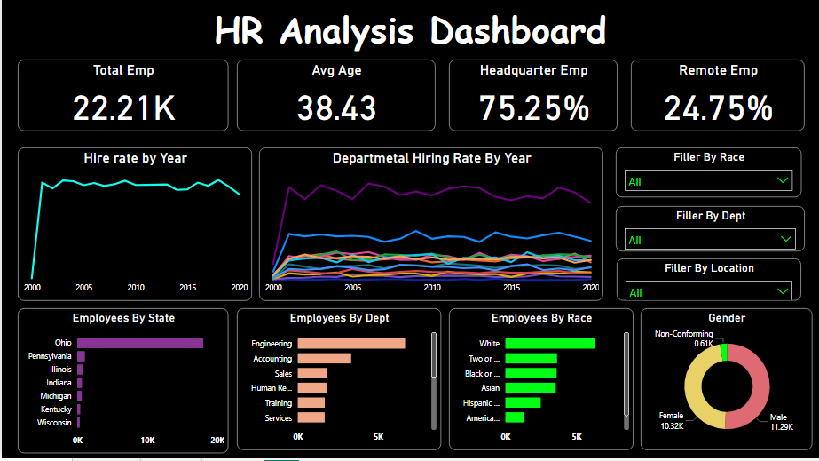
HR Analysis Dashboard

Slide 4
This HR Analytics dashboard can provide valuable insights and benefits to organizations in many different areas, from talent acquisition and retention to workforce planning and diversity and inclusion. In this project We have measured every-thing as per HR analysis.
In this HR Analysis Dashboard we are using multiple types of graphs and filters for better analysis.

Slide 5
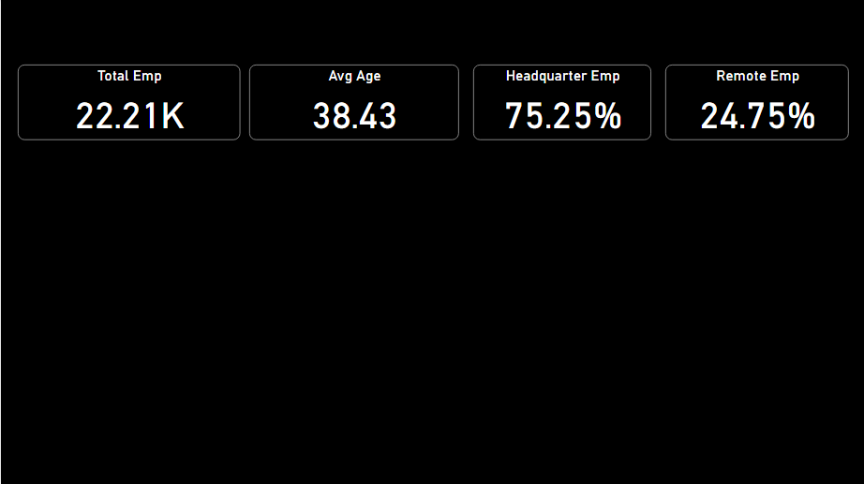
Key Indicator Point (KPIs)

Slide 6
KPIs show how many total employees there are in the company, what is the average age of the employees, how many employees in the company work from home and how many employees work from the office.

Slide 7
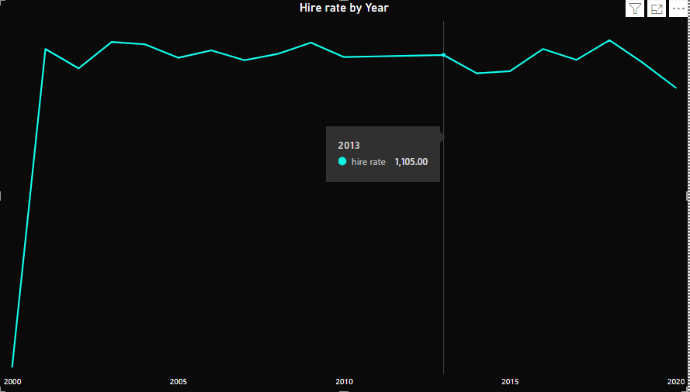
Line Chart Showing The Hiring Rate By Years.

Slide 8
The line chart shows how many employees are hired by the company each year.

Slide 9
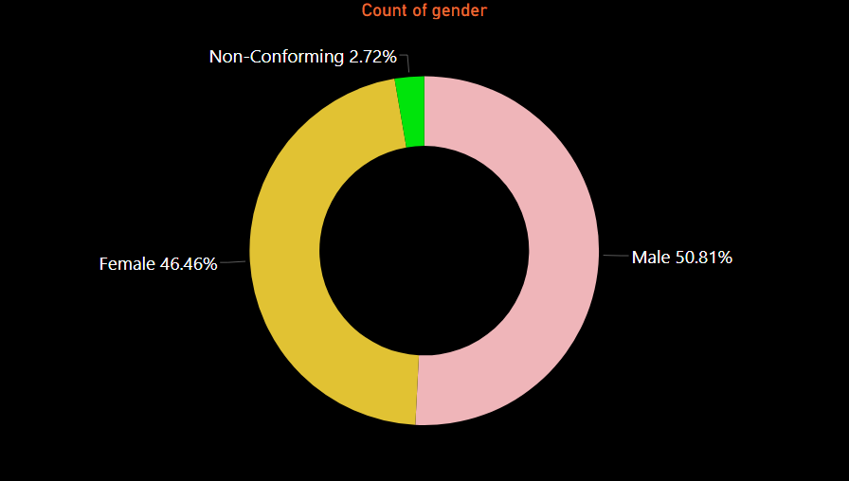
Donut Chart Representing The Gender of Employees

Slide 10
Donut chart shows how many male and female employees work in the company.

Slide 11
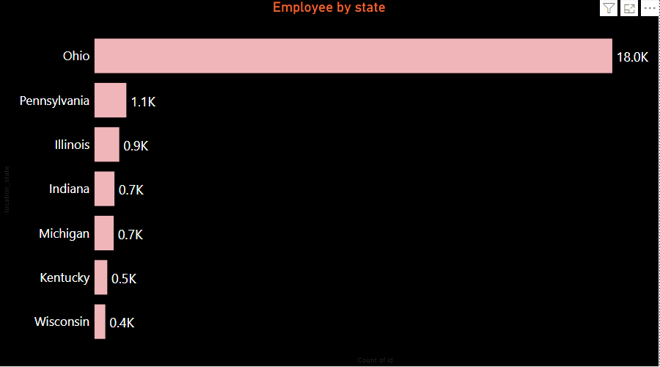
(A) Bar Charts Showing Employees By State

Slide 12
This chart shows how many employees are from which state and from which state the maximum and minimum number of employees are employed in the company.

Slide 13
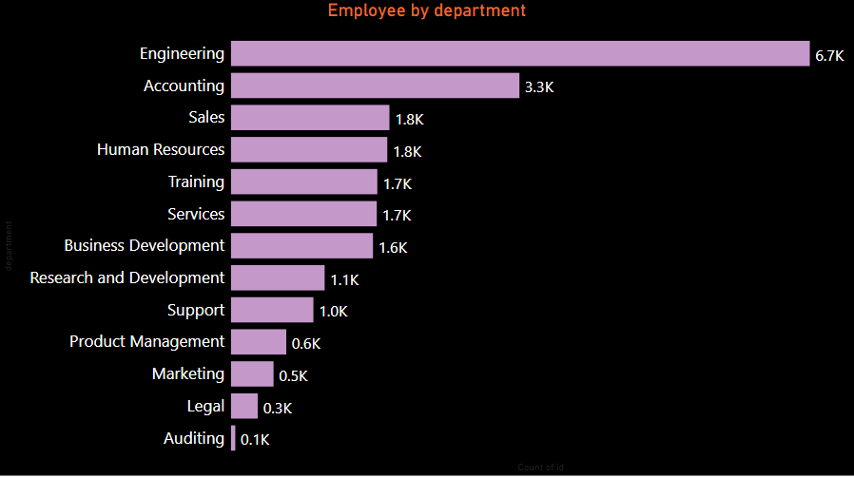
(C) Bar Charts Showing Employees By Department

Slide 14
This bar chart shows how many employees work in which department of the company and which department has the most and least employees.

Slide 15
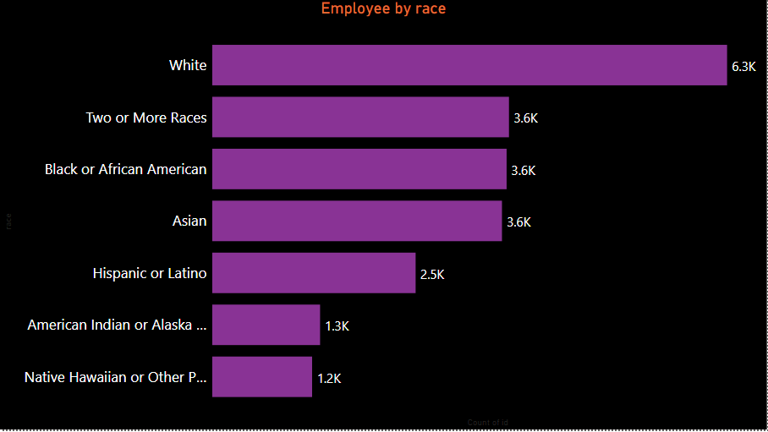
(B) Bar Charts Showing Employees By Race

Slide 16
This bar chart shows which race of employees are working in our company.

Slide 17
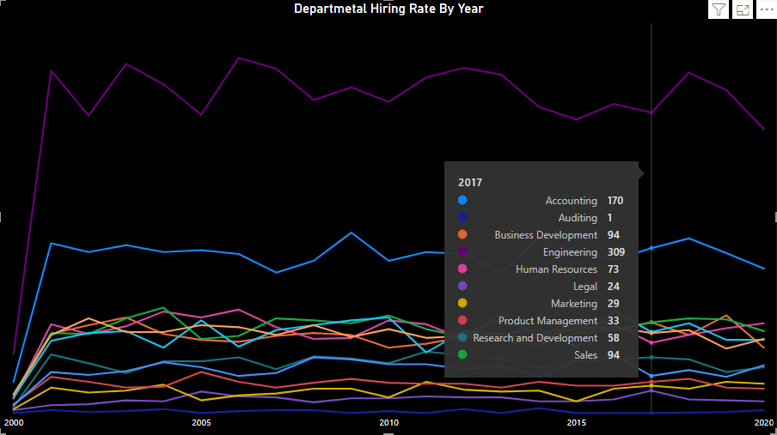
Line Chart Showing The Hiring Rate By Dept.

Slide 18
Departmental hiring chart shows how many employees were hired in which year and in which department.

Slide 19
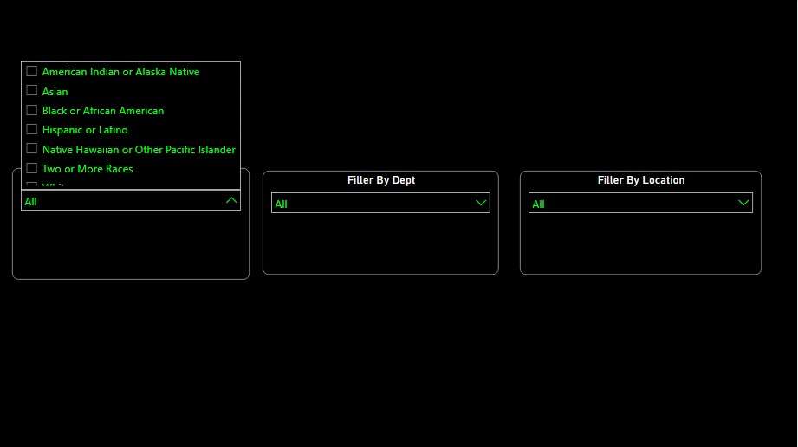
Dashboard Filters

Slide 20
In this Dashboard I am using 3 Filters like
Filter By Department
Filter By Race
Filter By Locations
This Filter Will help to Deep analysis and strong decision making

Slide 21
INSIGHTS & INPUTS/SUGGESTION TO THE COMPANY

Slide 22
Insights
1) HQ Workers are more than remote workers
2) Engineering department has more employees as compared to other departments
3) 2001 has highest higher rate
4) Male employees are more in number whose age is greater then -50

Slide 23
Inputs /Suggestions to the Company
1) Hire even more other departments to the company
2) Even other states should get opportunity to work in this company.

Slide 24
THANK YOU

