Slide 1

Code Bot IQ
Group No. 5
SHRI RAM MURTI SMARAK COLLEGE OF ENGINEERING TECHNOLOGY & RESEARCH BAREILLY
Presented by:
Archana Mishra (2004500100015)
Naincy Maheshwari (2004500100039)
Samiksha Gupta (20045000100046)

Slide 2

Outlines
Introduction
Motivation
Problem Statement
Objectives
Tools and Technology
Literature review
Methodology
Result and Discussion
ChatGPT vs Gemini
Conclusion
Future scope
References

Slide 3
Introduction
Code Bot IQ is an AI-powered language model for developers. It assists in code generation, debugging, and optimization and also acts as a code review assistant for maintaining code quality.
Helps with relevant documentation and resources.
Enforces coding standards and best practices.
Provides code completion suggestions.
Aids in bug detection and debugging.
Supports AI-powered pair programming.

Slide 4
Motivation
Code Bot IQ addresses key challenges in software development, the motivation arises from various sources:
Code Quality and consistency: Maintaining code quality and consistency across projects and teams is a challenges.
Time and productivity: Code Bot IQ can automate these tasks, allowing developers to focus on more creative and critical of their work.
Learning and skill Enhancement: Code Bot IQ can serve as learning tools for both novice and experienced developers.
Code Review and Collaboration: Code Bot IQ can assist in code reviews by identifying issues, suggesting improvements.

Slide 5
Problem Statement
The advanced Code Bot IQ addresses many limitations of early AI models. It stands out with its cutting-edge conversational interface, which fosters more natural and interactive interactions.
Maintaining code quality and ensuring consistency in code practices across development teams could be challenging.
Debugging complex code and identifying errors or issue could be time-consuming and frustrating.
Developers often struggle to find relevant and up-to-date information on programming language, libraries and frameworks.

Slide 6
Objectives
Code Bot IQ aims to assist developers, programmers and students to ease out coding experience.
To design user interface prioritizes usability, and responsiveness.
To verify user identities, manage access permissions, and safeguard the integrity of the overall system.
To enhance learning experience for developers of all skill levels.

Slide 7
Tools and Technology
Development Environment:
Integrated Development Environment (IDE): We have used Pycharm.
Version Control: Git is widely used for version control. GitHub can be used as hosting services.
Build Tools: pip for managing dependencies and building the project.
Programming Language:
We have used HTML, CSS, JavaScript, Python.
Database: We have used MySQL for database.
Backend Framework:
We are using Django for Python in backend framework.

Slide 8
Tools and Technology (contd..)
Frontend Framework/Libraries:
For frontend technologies such as HTML, CSS, JavaScript for web development.
Dependency Management:
Dependencies in Python are managed with pip and expressed in a metadata file called requirements.txt .
API Documentation:
Gemini-pro model for documenting APIs.

Slide 9
Literature Review
Raisa Islam & ImtiazAhmed . (2024). “Gemini-the most powerful LLM: Myth or Truth” in Proceedings of the DOI:10.36227/techrxiv.171177477.70151414/v1, April 2024, the authors observed that the Vertex AI Gemini API and Google AI Gemini API both enable developers to integrate Gemini model functionalities into their applications. This paper offers a concise summary of the Gemini Frameworks In their research, they explored the details of its architecture, pointing out the innovative strategies employed to improve generative AI capabilities. Furthermore, we conducted a comparative study, assessing Gemini's performance against other top generative AI models.

Slide 10
Literature Review (contd...)
Nitin Rane, Saurabh Purushottam Choudhary & Jayesh Rane "Gemini Versus ChatGPT: Applications, Performance, Architecture, Capabilities, and Implementation" in Proceedings of the Journal of Applied Artificial Intelligence, March 2024 suggested that this research paper compares Gemini and ChatGPT, exploring their applications, performance metrics, architectural variances, and capabilities in handling complex language. It examines response coherence, accuracy, latency, scalability, training methodologies, technologies, user intent understanding, dialogue engagement, and ethical considerations. The paper provides insights into their strengths and limitations, aiding stakeholders in informed decision-making for various applications.

Slide 11
Literature Review (contd...)
Norbert Annus "Gemini x ChatGPT: A discussion of two Chatbots about Artificial Intelligence in the Education" in Proceedings of the International Journal of Advanced Natural Sciences and Engineering Researches, March 2024 the authors observed that the impact of chatbots on education, highlighting their potential and limitations. ChatGPT and Gemini engaged in a discussion on AI in education, revealing some insights but also some repetition. While chatbots offer valuable perspectives, further research with more chatbots may be needed for a comprehensive understanding.

Slide 12
Literature Review (contd...)
Hamid Reza Saeidnia "Welcome to the Gemini era: Google DeepMind and the Information Industry" in Proceedings of the Library Hi Tech News, December 2023 this paper explores Google's development of Gemini, an AI-powered chatbot, and its impact on the information industry. Gemini aims to personalize user experiences, streamline information retrieval, and improve customer service. The competition in AI chatbots is fostering innovation. This analysis sheds light on Gemini's potential to transform information access and interaction, contributing to literature on AI tools' competition and implications for the industry's future.

Slide 13

Methodology
A structured AI-powered code review methodology integrates advanced technique into development tools.
Aims to bridge the gap between human creativity and AI capabilities.
Phases include gathering requirements, Model Development, Validation, Integration into Development Workflow, Code Review Process, and Results Monitoring.
This structured approach ensures successful AI integration in software development.

Slide 14
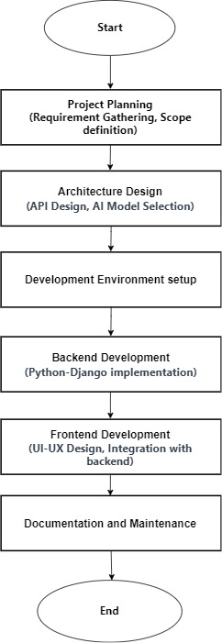
Methodology (contd..)
Fig: Workflow of the Code Bot IQ

Slide 15
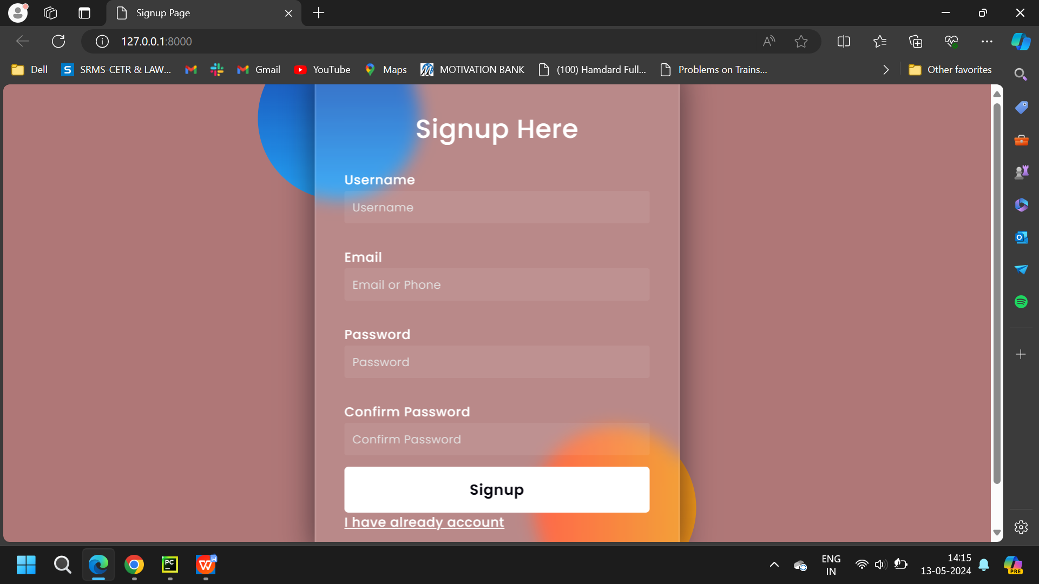
Result and Discussion
Fig: Signup Page

Slide 16
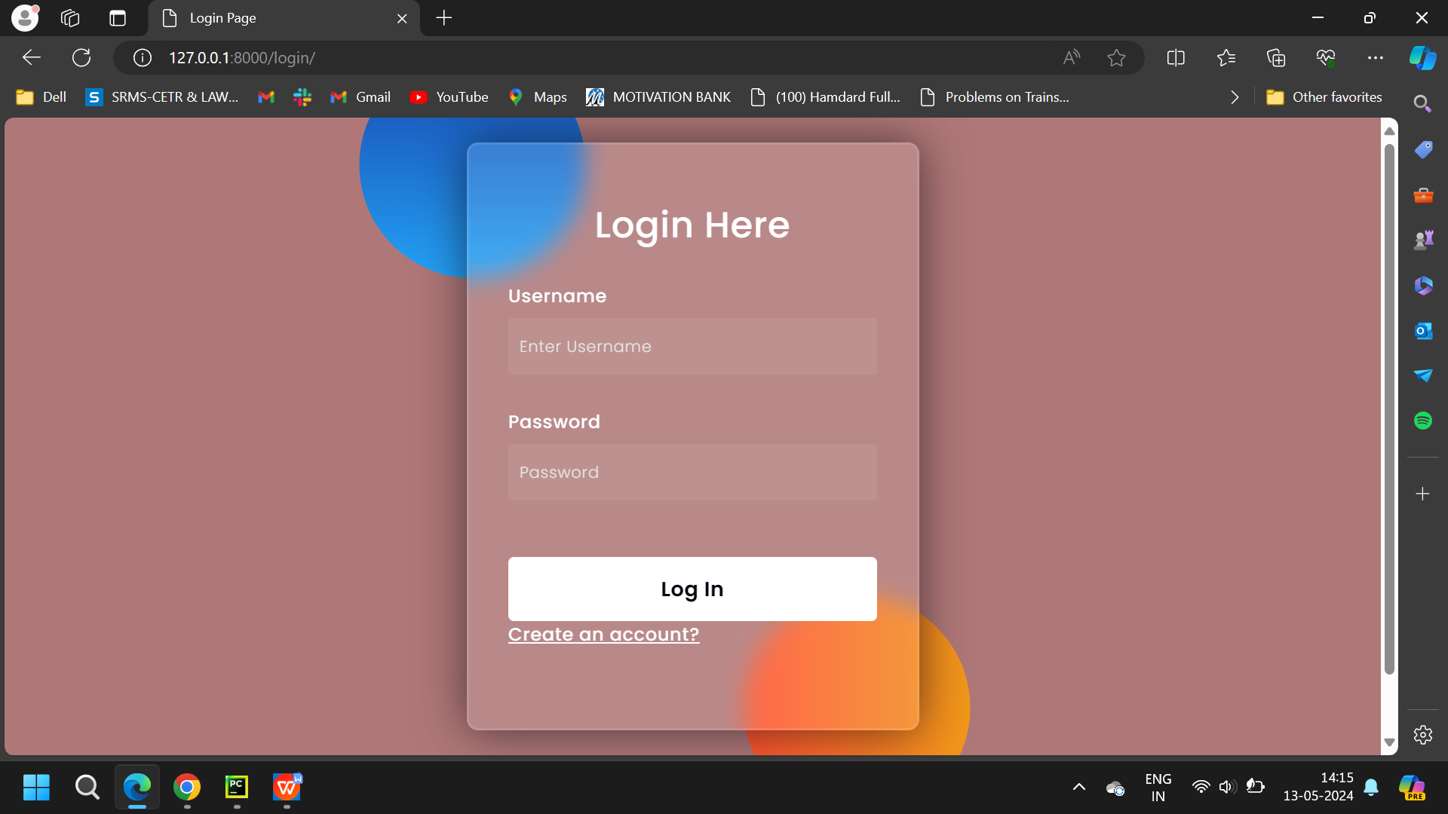
Result and Discussion
Fig: Login Page

Slide 17
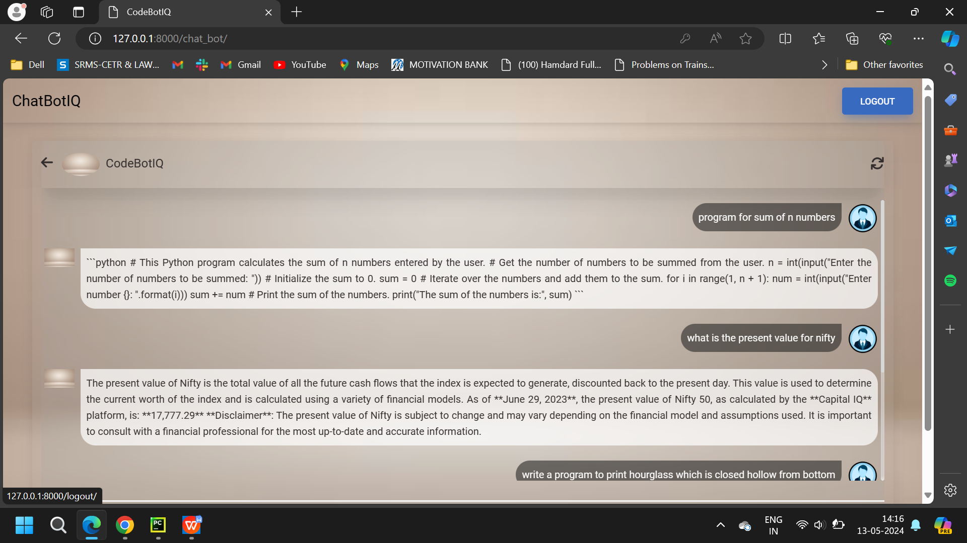
Result and Discussion
Fig: Message Window Page

Slide 18
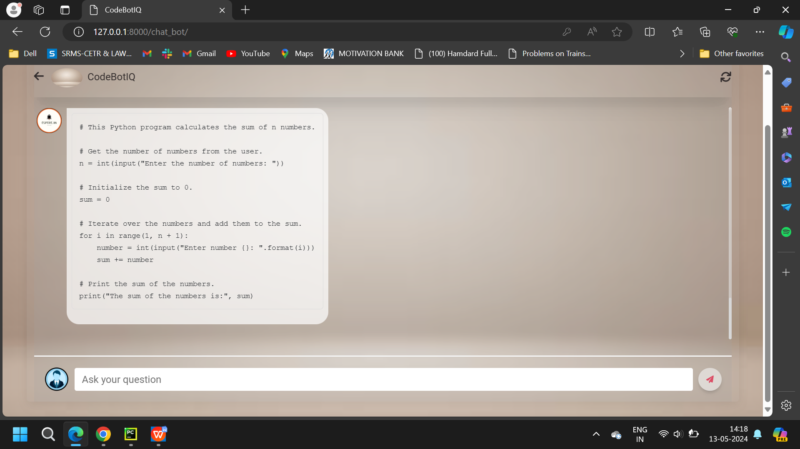
Result and Discussion
Fig: Message Window Page

Slide 19
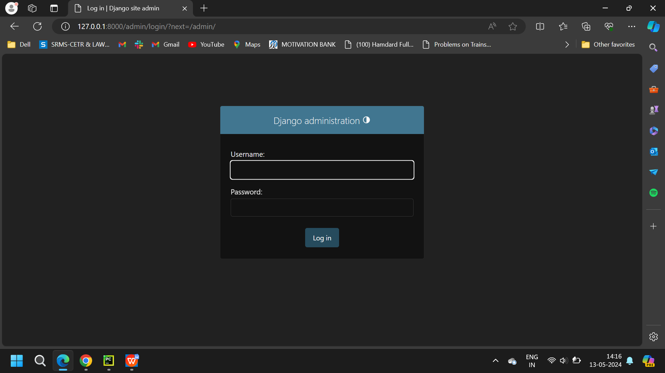
Result and Discussion
Fig: Admin Page

Slide 20
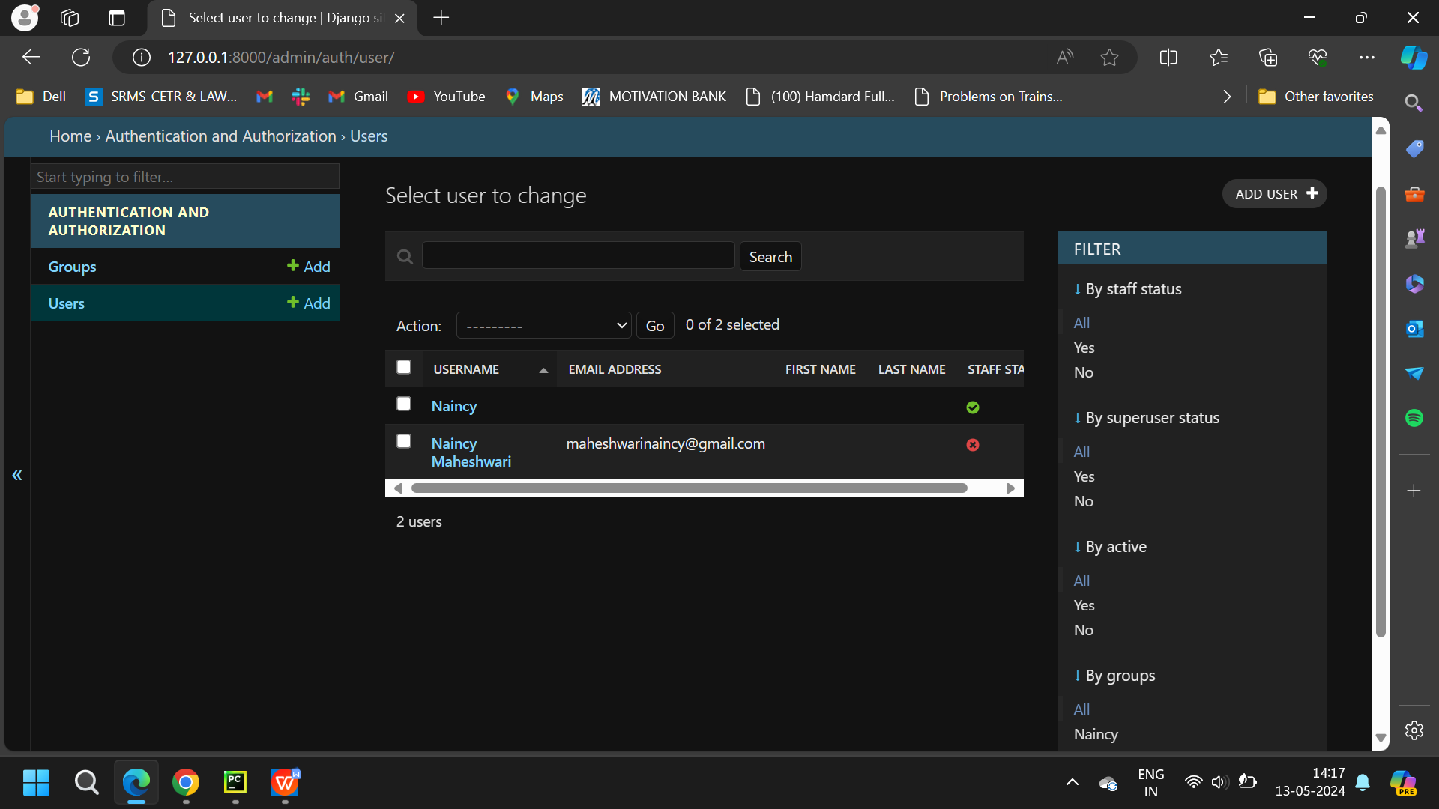
Result and Discussion
Fig: Admin Page

Slide 21
ChatGPT vs Gemini
Feature | ChatGPT | Gemini
Training Models | GPT-3.5 (Free), GPT-4 (Plus) | Gemini Pro, Gemini Ultra, Gemini Nano
Data Sources | Predefined (up to April 2023 for GPT-4) | Real-time internet data
Parameter Count | GPT-4: ~1.5 trillion parameters | Gemini Ultra: 1.6 trillion parameters
Training Data Set | GPT-4: 13 trillion tokens | Gemini Ultra: 1.56 trillion words
User Interface | Simple, no Save button, Archives previous responses | Like/dislike, modify response, review drafts, image upload
Integrations | Windows apps (Word, Excel, etc.), Microsoft Copilot | Google apps (Docs, Gmail, Meet, Slides)

Slide 22
ChatGPT vs Gemini
Feature | ChatGPT | Gemini
Account Requirements | Any email | Google account required
Privacy & Data Storage | Stores all prompts, retains some deleted data | Stores conversations in Google account (configurable retention)
Data Collection | Collects personal info, geolocation, network activity | Collects conversations, location, feedback, usage info
Data Use & Sharing | Uses data to improve services, may share with vendors | Uses data to improve services, personalize ads, shares with consent
User Data Ownership | Users own input/output but OpenAI uses for training | Users can manage data via Google My Activity
Note: Gemini Ultra performs better than ChatGPT on 30 of the 32 academic benchmarks in reasoning and understanding it tested on.

Slide 23
Conclusion
The Code Bot IQ is a groundbreaking coding assistant, transcending previous AI models with its advanced features and conversational interface.
It enhances code quality through automated refactoring suggestions and continually adapts via user feedback. The tool simplifies code documentation with integrated comments and supports seamless multilingual code translation. It also empowers low-code development and transforms natural language into functional code, catering to developers and non-developers alike.
This innovation greatly enhances efficiency and accessibility in the software development realm, marking a significant leap in coding assistance and software development compared to earlier AI models.

Slide 24

Future Scope
The future scope of a code bot IQ project is promising, as it aligns with ongoing trends and challenges in the field of software development and artificial intelligence.
Integration
Advanced AI Capabilities
Enhanced Code Analysis
Customization and Personalization
.

Slide 25
References
Gemini, Google AI for developers, “Gemini API overview”, May 2024, https://docs.gemini.com/rest-api/
Raisa Islam & ImtiazAhmed . (2024). “Gemini-the most powerful LLM: Myth or Truth” in Proceedings of the, April 2024.
Nitin Rane, Saurabh Purushottam Choudhary & Jayesh Rane "Gemini Versus ChatGPT: Applications, Performance, Architecture, Capabilities, and Implementation" in Proceedings of the Journal of Applied Artificial Intelligence, March 2024.
Norbert Annus "Gemini x ChatGPT: A discussion of two Chatbots about Artificial Intelligence in the Education" in Proceedings of the International Journal of Advanced Natural Sciences and Engineering Researches, March 2024.
Hamid Reza Saeidnia "Welcome to the Gemini era: Google DeepMind and the Information Industry" in Proceedings of the Library Hi Tech News, December 2023.

Slide 26
THANK YOU!

