Slide 1
Codigia
a dispersed team example
about.me/hypest
Notes:
Είμαι ο Στέφανος Τογκουλίδης, είμαι software developer.
διατηρώ τη ομάδα Codigia με φίλο developer
Απλά ένα πράδειγμα, δεν αποτελεί πρότυπο
Στοιχεία για μένα μπορείτε να δείτε στο about.me/hypest

Slide 2



3 more partners just around the corner!
Our model WILL adapt!
Notes:
Είμαστε δυο αλλά άλλοι 3 είναι σε standby

Slide 3
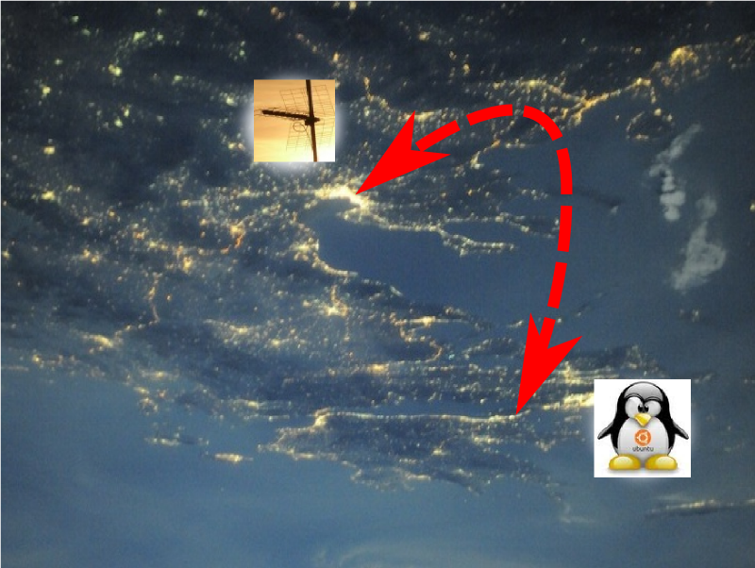

298.623km apart shouldn't matter!
Photo credit: NASA, Astronaut Wheelock
Notes:
As seen from a space visitor :)

Slide 4

  dev
  decisions
  customer contact
  earnings
http://hollywood465599663.
deviantart.com/
Notes:
Equal roles
- dev
- decisions
- customer contact
- equal earnings

Slide 5
own BZR branch
no cross commits
cross merge only
each can publish
no issue tracker YET
Notes:
technically enforce equality

Slide 6






We rely on...
Bazaar

Slide 7
Using it for...
  code and content servers
  multiple EC2 instances, one for each project
  dedicated EC2 for hypest's workstation (ssh)
  dedicated EC2 for gpalouk's testing ground
  we manage everything ourselves

Slide 8
Using it for...
  gtalk: constant chat/brainstorming/deciding
  design layouts (editable by the customer)
  customer paperwork, email drafts
  ANX based todo list/spreadsheet
  "wiki" style, long term brainstorming
  finance
  gcalendar: Events, Customer meetings

Slide 9
Bazaar
Using it for...
  Version control for source code, shell scripts, conf files
  DB backups
  source code sharing among devs
  more usage in the future!

Slide 10
Using it for...
  gmail
  gtalk
  gdocs
  gcalendar

Slide 11
Using it for...
  AWS servers OS
  home servers
  workstation OS in our PCs
  enforcing the separate branches scheme (UNIX groups)

Slide 12
Using it for...
  voice calls for brainstorming and decision making
  talk to customers

Slide 13
Distributed Version Control
in our case...
  no dependency on any central server
  implicit backups. At least in 4 places:
    own repo
    own working copy
    partner's repo
    partner's working copy
  mobile workstations keep history

Slide 14


a typical day...
Notes:
gtalk for decisions

Slide 15
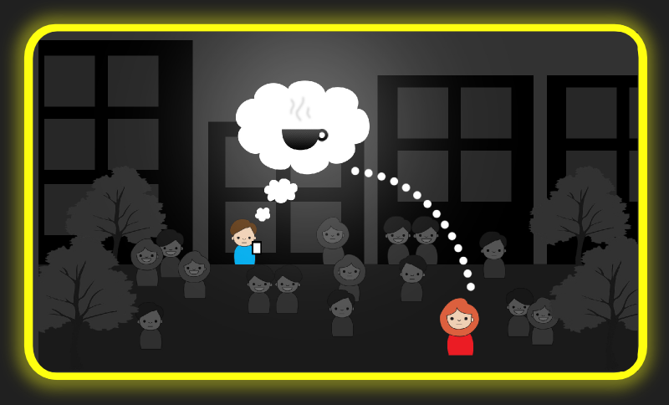
SocialSparks
meet interesting new people!
our current (in alpha) product...

Slide 16
useful links
  BZR: http://bazaar.canonical.com
  AWS: http://aws.amazon.com
  Codigia: http://codigia.com
  SocialSparks: http://sparks.codigia.com

Slide 17
thank you for your attention ;)
about.me/hypest

