Slide 1
Pirate Funnel, 3A3R Metrics & Machine Learning Application
MUSTAFA Berk bacaksız

Slide 2
What is AAARRR Pirate Metrics Framework?
• Awareness: How many people have heard of our brand?
• Acquisition : How many people have found our company and what we offer?
• Activation: How many people take their first important step in their relationship
with our brand?
• Retention: How many people engage with our company’s solution?
• Referral: How many people talk about their experience with our company?
• Revenue: How many people become customers?

Slide 3
Acquisition
• Visitors per channel
• Customer acquisition cost
• Click-through rate
• Cost per click
• Conversion rate

Slide 4
Activation
• New subscribers
• New user accounts
• Average time on page
• Pages/ session
• Visitors per signup rate
• Conversion rate

Slide 5
Revenue
• Revenue by channel
• Revenue by customer type
• Conversion rate by channel
• Revenue per customer
• Average order value
• Revenue by new vs. repeat customers

Slide 6
Retention
• Retention rate
• Churn rate
• Customer Lifetime Value
• Net Promoter Score
• Conversion rate
• Loyalty program conversion rate
• Average days between transactions
• Recency, Frequency, Monetary Value

Slide 7
Referral

Slide 9
Determining the Bottleneck

Slide 10
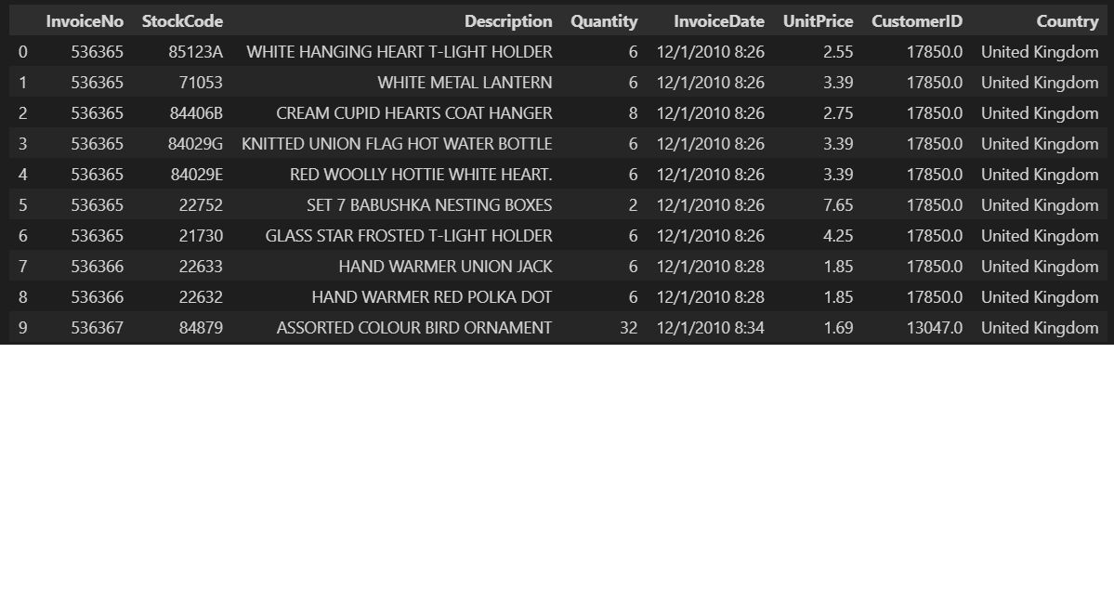
Machine Learning Applications

Slide 11
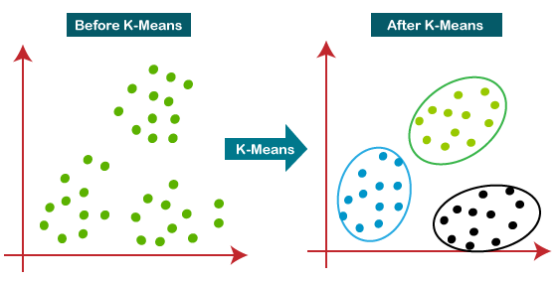
K Means Algorithm

Slide 12
Step-1: Select the number K to decide the number of clusters.
Step-2: Select random K points or centroids. (It can be other from the input dataset).
Step-3: Assign each data point to their closest centroid, which will form the predefined K clusters.
Step-4: Calculate the variance and place a new centroid of each cluster.
Step-5: Repeat the third steps, which means reassign each datapoint to the new closest centroid of each cluster.
Step-6: If any reassignment occurs, then go to step-4 else go to FINISH.
Step-7: The model is ready.

Slide 13
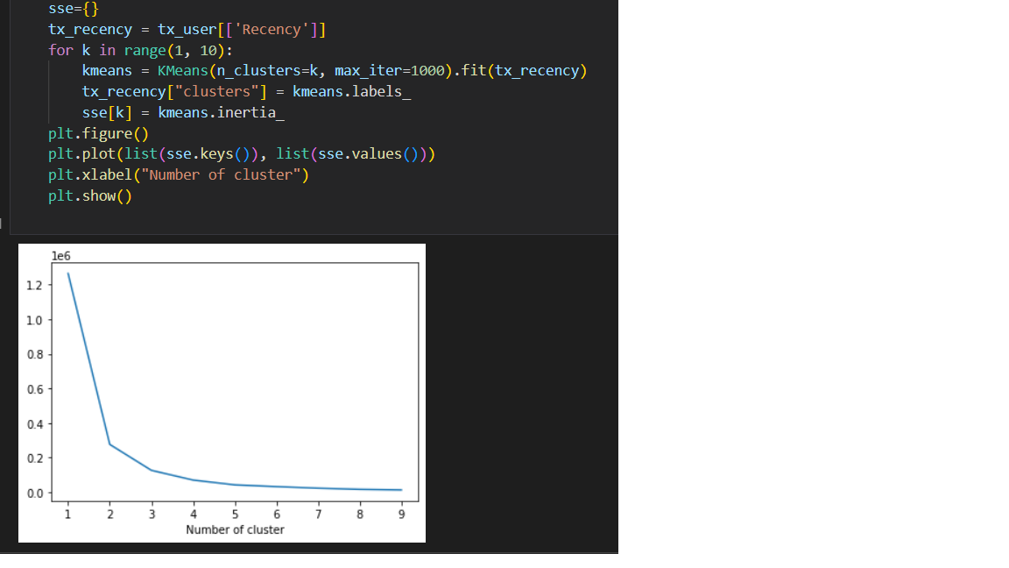
K-Means Algorithm –Determining Cluster Count

Slide 14
K-Means Algorithm –Determining Centroids

Slide 15
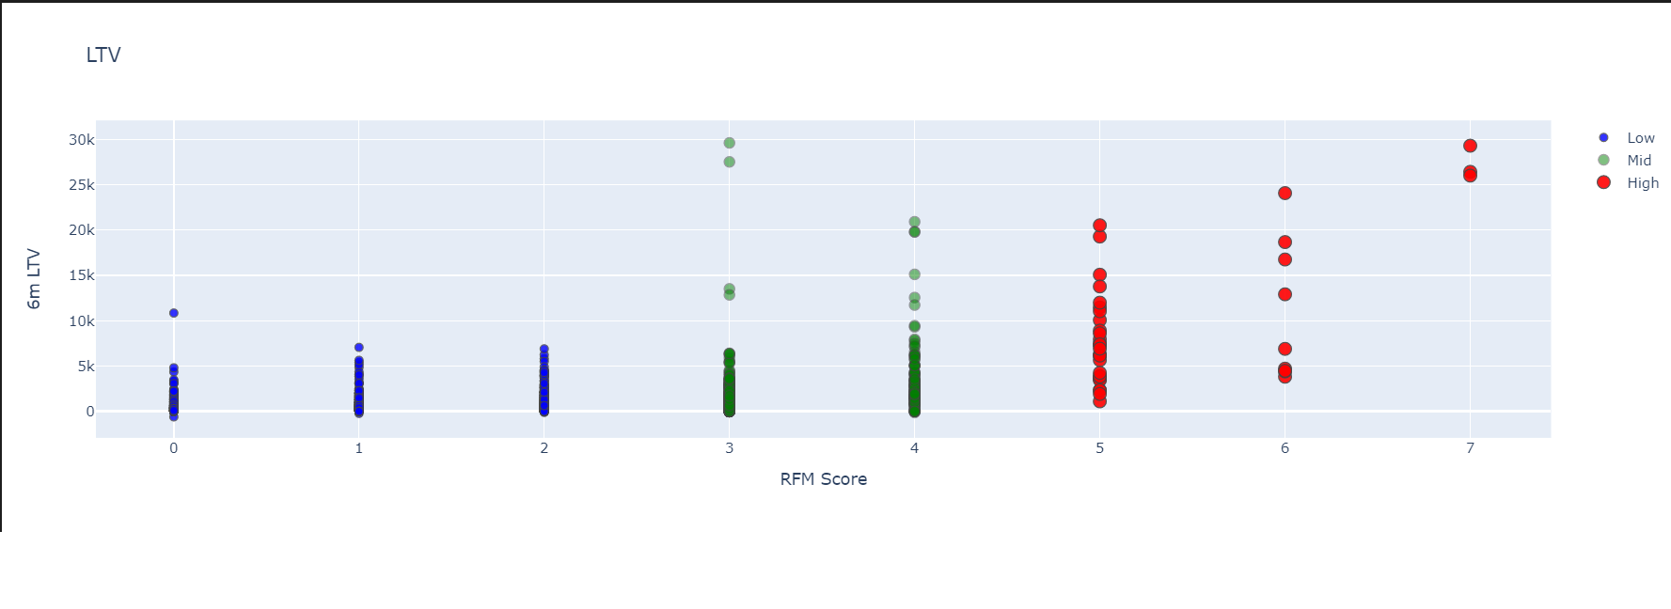
Life Time Value Prediction

Slide 16
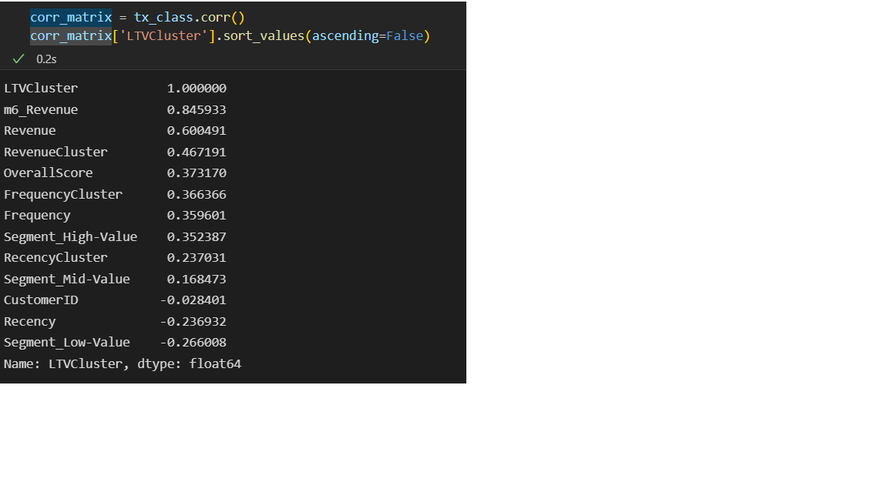

Slide 17
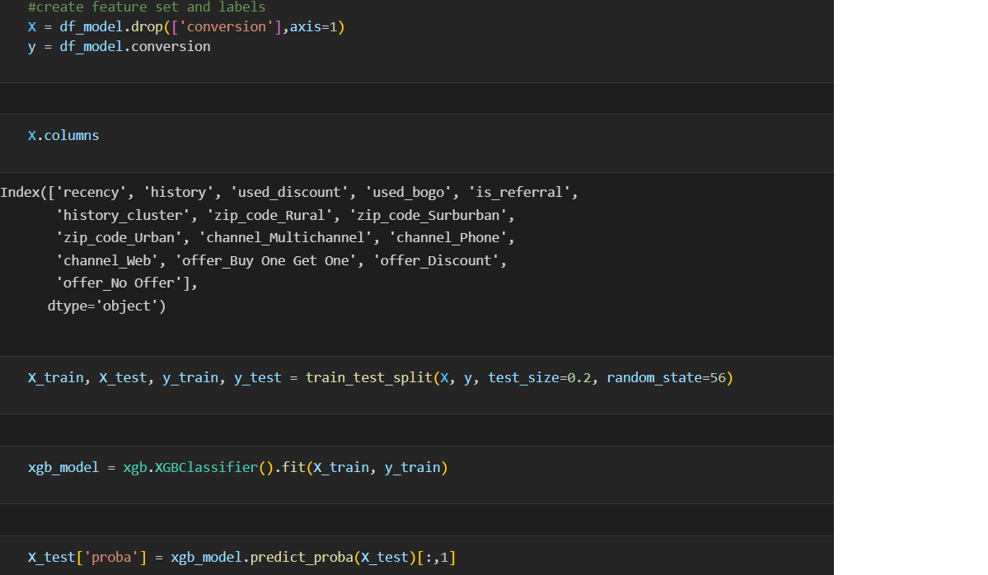
Market Response Model

Slide 18
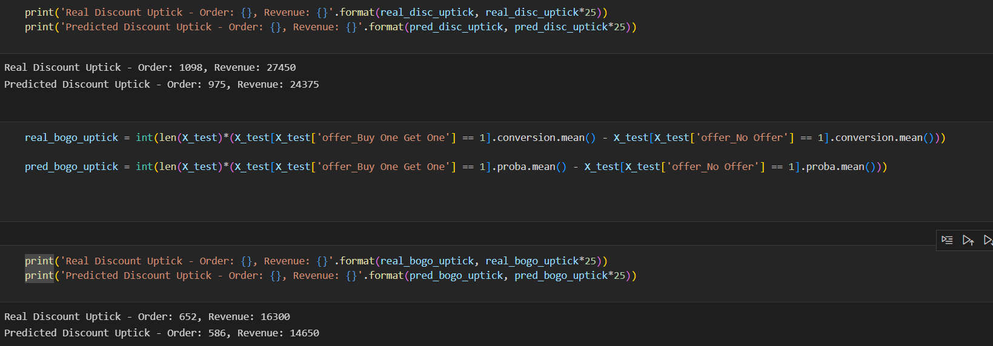

Slide 19
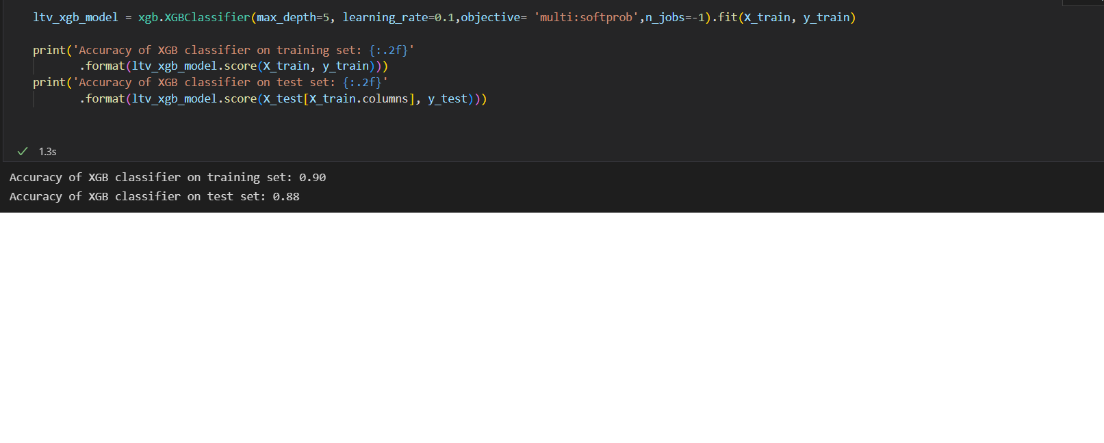
XGBoost (Extreme Gradient Boosting)

Slide 20
Parallel Computing: It is enabled with parallel processing (using OpenMP); i.e., when you run xgboost, by default, it would use all the cores of your laptop/machine.
Regularization: I believe this is the biggest advantage of xgboost. GBM has no provision for regularization. Regularization is a technique used to avoid overfitting in linear and tree-based models.
Enabled Cross Validation: In R, we usually use external packages such as caret and mlr to obtain CV results. But, xgboost is enabled with internal CV function (we’ll see below).
Missing Values: XGBoost is designed to handle missing values internally. The missing values are treated in such a manner that if there exists any trend in missing values, it is captured by the model.
Flexibility: In addition to regression, classification, and ranking problems, it supports user-defined objective functions also. An objective function is used to measure the performance of the model given a certain set of parameters. Furthermore, it supports user defined evaluation metrics as well.
Availability:Currently, it is available for programming languages such as R, Python, Java, Julia, and Scala.
Save andReload: XGBoost gives us a feature to save our data matrix andmodel and reload it later. Suppose, we have a large data set, we can simply save the model and use it in future instead of wasting time redoing the computation.
Tree Pruning: Unlike GBM, where tree pruning stops once a negative loss is encountered, XGBoost grows the tree upto max_depth and then prune backward until the improvement in loss function is below a threshold.

Slide 21
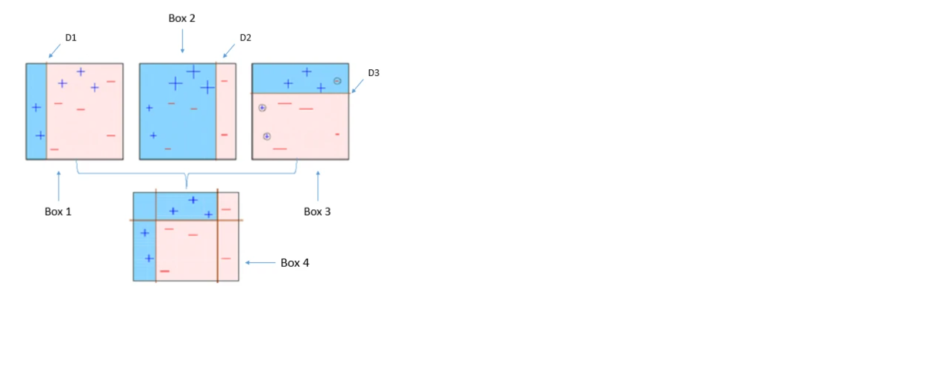

Slide 22
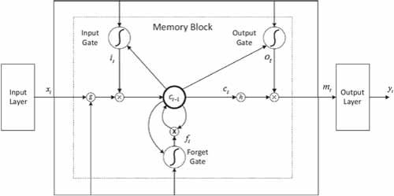
LSTM Model (Long Short Term Memory)

Slide 23
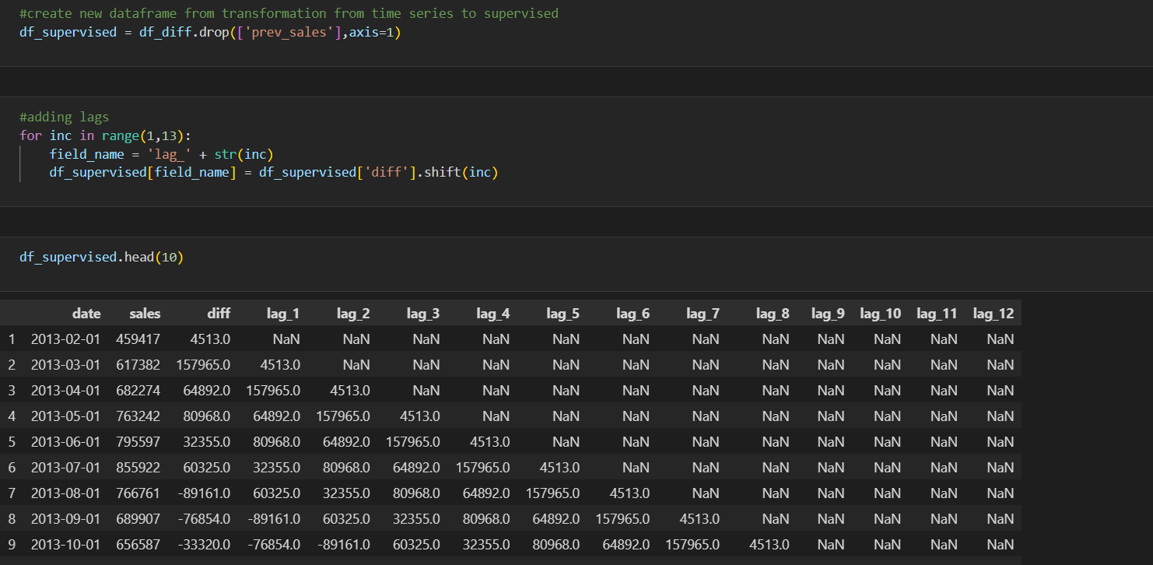
Sales Prediction – LTSM Model

Slide 24
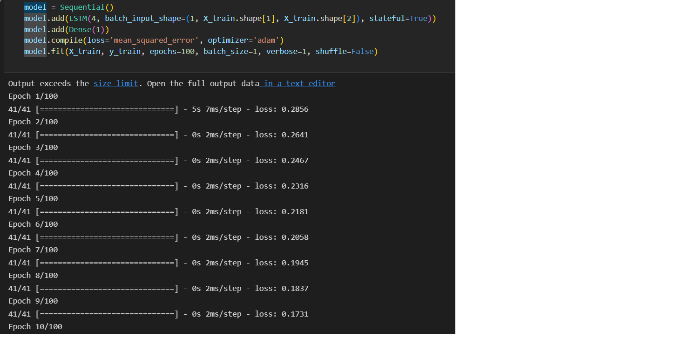

Slide 25
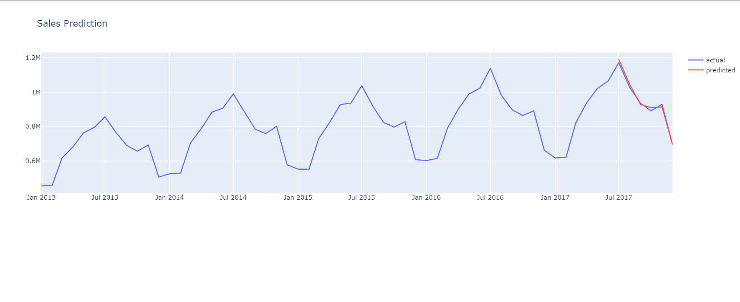

Slide 26
Thank you for listening ☺

