Slide 1

INTRODUCTION
ReactJS · Day Four
Effects and data loading
Subha Prasad
15 October 2026 · 10:00–11:00 AM IST
01
Notes:
Time: 1 minute.
Introduce yourself as TCS Assets Consultant (C3A) and SME trainer. Continue the same small Product Catalog used on Days 2 and 3. Delivery is via Microsoft Teams. This session supports beginner learning; official E1 assessment rules determine certification.
Code blocks are excerpts unless they show a complete component. Product prices are fictional INR values. The cart has one entry per product.

Slide 2
INTRODUCTION
Today’s learning goals
Load products from a JSON resource.
Explain when an Effect is useful.
Show loading, error and empty states.
Retry a failed request and clean up old work.
02
Notes:
Time: 1 minute.
Ask learners whether a page always receives its data immediately. Explain that they will keep all Day 3 interactions while changing the source of product data.
Code blocks are excerpts unless they show a complete component. Product prices are fictional INR values. The cart has one entry per product.

Slide 3
INDEX
Day 4 topic index
01 Day 3 recap and JSON
02 Promises, async/await and fetch
03 useEffect and dependencies
04 Request states, retry and cleanup
05 Hands-on, exercise and quiz
03
Notes:
Time: 1 minute.
Orient learners to the five parts. Keep the browser and App.jsx ready to share; source code and detailed notes remain available after the session.
Code blocks are excerpts unless they show a complete component. Product prices are fictional INR values. The cart has one entry per product.

Slide 4
RECALL
Day 3 state and derived values
Search and cart still use state.
Filters run during rendering.
Today, products arrive after an HTTP request.
const [products, setProducts] =
useState([]);
const visibleProducts =
products.filter(matchesFilter);
The loaded array becomes the source of the catalog
04
Notes:
Time: 1 minute.
Recall: props carry values, callbacks request changes, and state triggers rendering. matchesFilter is an illustrative predicate; the complete project combines name, category and stock checks inline. Initial products is an empty array while status is loading.
Code blocks are excerpts unless they show a complete component. Product prices are fictional INR values. The cart has one entry per product.

Slide 5
DATA
JSON product data
JSON is a text format for data.
Keys and strings use double quotes.
Booleans and numbers stay unquoted.
Comments and trailing commas are invalid.
{
"id": "P-101",
"name": "Notebook",
"price": 80,
"category": "Stationery",
"inStock": true
}
Our resource contains an array of four objects
05
Notes:
Time: 1 minute.
Open public/products.json. Contrast JSON with the earlier JavaScript module: no export statement, single quotes or comments. The example on screen is one object inside the full array. Prices are fictional INR. JSON comments are explained in README and loadProducts.js.
Source: https://developer.mozilla.org/en-US/docs/Web/API/Fetch_API/Using_Fetch
Code blocks are excerpts unless they show a complete component. Product prices are fictional INR values. The cart has one entry per product.

Slide 6
DATA
The local resource URL
Vite serves public files from the site root.
The browser requests /products.json.
The file is local to this project, but loading uses HTTP.
// File in the project:
public/products.json
// URL requested by the browser:
fetch("/products.json");
No external API key or backend is needed
06
Notes:
Time: 1 minute.
Open http://127.0.0.1:5184/products.json during your prepared demo; learners use their own Vite URL. Do not fetch /public/products.json. Use the dev server rather than double-clicking index.html. Root-relative URLs assume this training app is hosted at the root; adjust for a deployment subpath.
Source: https://vite.dev/guide/assets.html#the-public-directory
Code blocks are excerpts unless they show a complete component. Product prices are fictional INR values. The cart has one entry per product.

Slide 7
JAVASCRIPT
A Promise represents a future result
A request takes time.
Its Promise may fulfil or reject.
The browser can keep responding while the request is pending.
const request = fetch("/products.json");
console.log("Request started");
// The response is not ready here.
The Promise is not the product array
07
Notes:
Time: 1 minute.
Explain with ordering: start a request, keep running, then receive a response later. Avoid calling a Promise a thread. A fulfilled fetch Promise supplies a Response; the body still needs to be read.
Source: https://developer.mozilla.org/en-US/docs/Web/API/Fetch_API/Using_Fetch
Code blocks are excerpts unless they show a complete component. Product prices are fictional INR values. The cart has one entry per product.

Slide 8
JAVASCRIPT
async and await
async makes a function return a Promise.
await waits inside that function.
It does not block the whole page.
async function readCatalog() {
const response =
await fetch("/products.json");
const data = await response.json();
return data;
}
Request first, parse the body second
08
Notes:
Time: 2 minutes.
Read each await aloud. This introductory function omits HTTP checks, validation and cancellation; the complete loadProducts helper adds those. Do not describe await as making the request synchronous globally.
Source: https://developer.mozilla.org/en-US/docs/Web/API/Fetch_API/Using_Fetch
Code blocks are excerpts unless they show a complete component. Product prices are fictional INR values. The cart has one entry per product.

Slide 9
JAVASCRIPT
try and catch
Put awaited work inside try.
If it fails, catch receives the error.
Show a helpful message instead of silently hiding the problem.
try {
const data = await readCatalog();
console.log(data.length);
} catch (error) {
console.log(error.message);
}
A failed request follows the error path
09
Notes:
Time: 2 minutes.
This excerpt belongs inside an async function. Demonstrate that catch handles rejected fetch or rejected body parsing. A server HTTP error needs an explicit check before it becomes a thrown error.
Source: https://developer.mozilla.org/en-US/docs/Web/API/Fetch_API/Using_Fetch
Code blocks are excerpts unless they show a complete component. Product prices are fictional INR values. The cart has one entry per product.

Slide 10
FETCH
HTTP status and response.ok
fetch can fulfil for HTTP 404 or 500.
response.ok is true for status 200–299.
Throw an error for other HTTP statuses.
const response = await fetch(url);
if (!response.ok) {
throw new Error(
`Request failed: ${response.status}`
);
}
const data = await response.json();
An HTTP error and a network failure differ
10
Notes:
Time: 2 minutes.
Explain 404 as missing resource and 500 as server failure. Network failure rejects fetch; HTTP 404 usually resolves with a Response. Code is an excerpt of loadProducts, with shorter teaching error text.
Source: https://developer.mozilla.org/en-US/docs/Web/API/Fetch_API/Using_Fetch
Code blocks are excerpts unless they show a complete component. Product prices are fictional INR values. The cart has one entry per product.

Slide 11
FETCH
Checking the loaded data
Valid JSON can still contain the wrong shape.
The catalog expects an array of products.
Check fields before rendering cards.
if (!Array.isArray(data)) {
throw new Error(
"Product data must be an array."
);
}
return validateProducts(data);
Bad data goes to the error screen
11
Notes:
Time: 1 minute.
Open validateProducts in src/data/loadProducts.js. It checks nonblank unique IDs, nonblank names, finite nonnegative numeric prices, allowed categories and boolean stock. An empty array is valid. Do not spend the whole session on every condition; learners first understand the boundary between parsing and validation.
Code blocks are excerpts unless they show a complete component. Product prices are fictional INR values. The cart has one entry per product.

Slide 12
EFFECTS
Render, event and Effect
Render calculates what to show.
An event handler responds to a user action.
An Effect synchronizes with a system outside React.
// Render: compute visible products.
// Event: add a clicked product.
// Effect: load the JSON resource.
Keep fetching out of the component’s render body
12
Notes:
Time: 2 minutes.
Ask learners to classify search filtering, Add to cart, and fetching. Rendering should stay pure. This is a small teaching app; larger apps often use framework loaders or a data library instead of hand-writing every request Effect.
Source: https://react.dev/reference/react/useEffect
Code blocks are excerpts unless they show a complete component. Product prices are fictional INR values. The cart has one entry per product.

Slide 13
EFFECTS
useEffect structure
Call useEffect at the top level.
React runs setup after the component commits.
The setup may return cleanup.
import { useEffect } from "react";
useEffect(() => {
// Set up external work.
return () => {
// Stop or undo that work.
};
}, []);
Hooks stay outside conditions and loops
13
Notes:
Time: 2 minutes.
Explain setup, cleanup and dependency list separately. Effects are tied to committed renders, not a guarantee that they always run after browser paint. The empty example illustrates syntax rather than fetching.
Source: https://react.dev/reference/react/useEffect
Code blocks are excerpts unless they show a complete component. Product prices are fictional INR values. The cart has one entry per product.

Slide 14
EFFECTS
Dependency lists
[]: setup on mount, with cleanup.
[retryCount]: rerun when it changes.
No list: rerun after every commit.
Include the reactive values used by setup.
useEffect(setup, []);
useEffect(setup, [retryCount]);
useEffect(setup);
Dependencies describe what setup reads
14
Notes:
Time: 2 minutes.
Mention the development StrictMode extra setup/cleanup cycle even for []. React compares dependency values using Object.is. In this project the URL is fixed, the loader is imported, setters are stable, and retryCount is deliberately the request trigger. Do not present dependencies as an arbitrary scheduling trick.
Source: https://react.dev/reference/react/useEffect
Code blocks are excerpts unless they show a complete component. Product prices are fictional INR values. The cart has one entry per product.

Slide 15
EFFECTS
Avoid accidental request loops
Setting products requests a render.
If the same Effect depends on products, it can fetch repeatedly.
Typing in search should not refetch this fixed catalog.
// Avoid in this example:
useEffect(() => {
fetchCatalog();
}, [products]);
// Project trigger: [retryCount]
Keep derived filters in rendering, not an Effect
15
Notes:
Time: 2 minutes.
fetchCatalog is defined inside the real Effect. This is a conceptual incorrect example, not code to paste. The fetched array changes identity and triggers another run if used as the dependency. Explain that a dynamic resource URL must itself be included when used.
Source: https://react.dev/reference/react/useEffect
Code blocks are excerpts unless they show a complete component. Product prices are fictional INR values. The cart has one entry per product.

Slide 16
REQUEST STATES
Loading, error and success
status describes the request state.
products holds successful data.
error holds a useful failure message.
retryCount lets Retry request another attempt.
const [products, setProducts] =
useState([]);
const [status, setStatus] =
useState("loading");
const [error, setError] = useState("");
const [retryCount, setRetryCount] =
useState(0);
An empty array alone does not mean loading
16
Notes:
Time: 2 minutes.
Explain why products=[] cannot distinguish waiting from a successful empty catalog. The project uses one status string to avoid contradictory isLoading and hasError booleans. The cart and filters retain their separate Day 3 state.
Code blocks are excerpts unless they show a complete component. Product prices are fictional INR values. The cart has one entry per product.

Slide 17
REQUEST STATES
Starting the request
Start each attempt with loading status.
Clear the previous error.
Create a controller for this attempt.
useEffect(() => {
const controller =
new AbortController();
setStatus("loading");
setError("");
// Fetch and cleanup follow.
}, [retryCount]);
The user sees progress while the resource loads
17
Notes:
Time: 2 minutes.
Open App.jsx and trace the first three lines of setup. This partial excerpt omits request and cleanup shown next. There is no artificial delay in app code; use browser Network throttling for a visible loading demonstration.
Source: https://react.dev/reference/react/useEffect
Code blocks are excerpts unless they show a complete component. Product prices are fictional INR values. The cart has one entry per product.

Slide 18
REQUEST STATES
Receiving successful data
Await the shared loader.
Ignore work cancelled by cleanup.
Save products, then show success.
const nextProducts = await
loadProducts("/products.json",
controller.signal);
if (controller.signal.aborted) return;
setProducts(nextProducts);
setStatus("success");
Four loaded products feed the existing components
18
Notes:
Time: 2 minutes.
This is the try branch inside async fetchCatalog, not a standalone Effect. The loaded array flows through ProductSummary and ProductList; derived filters recompute using state. The guard prevents an old continuation from writing results after cleanup.
Source: https://react.dev/reference/react/useEffect
Code blocks are excerpts unless they show a complete component. Product prices are fictional INR values. The cart has one entry per product.

Slide 19
REQUEST STATES
Displaying request states
Show progress during loading.
Show the error and Retry on failure.
Show the catalog after success.
{status === "loading" && (
<p role="status">Loading products…</p>
)}
{status === "error" && (
<p role="alert">{error}</p>
)}
Request messages use accessible status and alert roles
19
Notes:
Time: 2 minutes.
The slide shows JSX excerpts; the actual error section also includes a heading and Retry button. Show that summary/cards are hidden during loading and error. Success with zero products receives its own message; success with products shows the full Day 3 interface.
Code blocks are excerpts unless they show a complete component. Product prices are fictional INR values. The cart has one entry per product.

Slide 20
REQUEST STATES
Empty data and no filter matches
Empty resource: no products available yet.
Nonempty resource, zero matches: change the filters.
Both are valid outcomes, separate from failure.
status === "success" &&
products.length === 0
// Later, ProductList handles:
visibleProducts.length === 0
Do not turn an empty array into a request error
20
Notes:
Time: 2 minutes.
Temporarily put [] in public/products.json and reload, then restore it. Afterwards search for Laptop in the normal dataset to show the different no-filter-matches message. A successful JSON request can contain no items.
Code blocks are excerpts unless they show a complete component. Product prices are fictional INR values. The cart has one entry per product.

Slide 21
RETRY
Retry after a failed request
Retry changes the request trigger.
React runs cleanup, then new setup.
The loading message replaces the old error.
<button onClick={() =>
setRetryCount(count => count + 1)
}>
Retry
</button>
Restore the resource, then click Retry without reloading
21
Notes:
Time: 2 minutes.
For live practice rename products.json to products-backup.json, reload to cause failure, restore the filename, then click Retry. Vite may return HTML fallback for a missing JSON path; this becomes a parsing error rather than necessarily a 404. The project shows the actual error message. Retry is manual, not an endless automatic loop.
Source: https://react.dev/reference/react/useEffect
Code blocks are excerpts unless they show a complete component. Product prices are fictional INR values. The cart has one entry per product.

Slide 22
CLEANUP
AbortController and cleanup
Give fetch the controller’s signal.
Cleanup aborts the old request.
Ignore a cancelled attempt in catch.
return () => controller.abort();
// Inside the async catch block:
if (controller.signal.aborted) return;
setError(requestError.message);
setStatus("error");
Cancelled work should not show a failure message
22
Notes:
Time: 2 minutes.
Setup creates a new controller for each request. Cleanup runs before setup repeats and when App unmounts. The signal check also guards continuations after response parsing. Explain cancellation as stopping obsolete work; do not call it a guaranteed rollback of server actions.
Source: https://developer.mozilla.org/en-US/docs/Web/API/Fetch_API/Using_Fetch
Code blocks are excerpts unless they show a complete component. Product prices are fictional INR values. The cart has one entry per product.

Slide 23
CLEANUP
async work inside an Effect
The Effect callback returns cleanup.
An async function returns a Promise.
Define the async function inside setup, then call it.
useEffect(() => {
async function fetchCatalog() {
// Await work inside try/catch.
}
fetchCatalog();
return () => controller.abort();
}, [retryCount]);
Do not write useEffect(async () => …)
23
Notes:
Time: 2 minutes.
The excerpt omits controller construction shown on slide 17. Open the full Effect in App.jsx so every fragment connects. StrictMode runs an extra setup/cleanup cycle during development; one cancelled request can appear in Network. Keep StrictMode enabled and write correct cleanup.
Source: https://react.dev/reference/react/useEffect
Code blocks are excerpts unless they show a complete component. Product prices are fictional INR values. The cart has one entry per product.

Slide 24
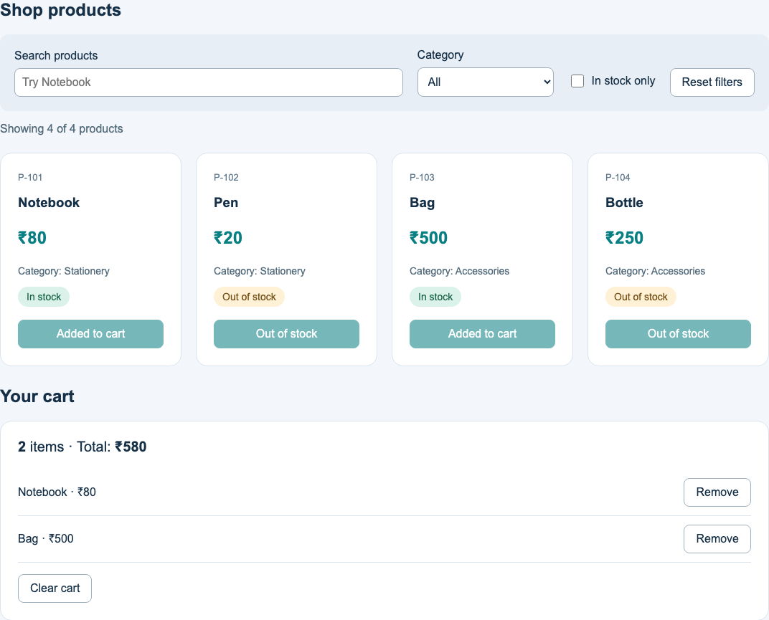
HANDS-ON · WALKTHROUGH
Our loaded Product Catalog
The JSON request supplies four products.
Search and stock filters still work.
Notebook and Bag make a ₹580 cart.
Reload starts a new request and resets local state.
24
Notes:
Time: 4 minutes.
Show the actual screenshot, then share the live browser. Network → products.json demonstrates the HTTP response. Compare App products state with public/products.json. Add Notebook and Bag to reach ₹580. Point out that state remains in memory: there is no checkout or payment.
Code blocks are excerpts unless they show a complete component. Product prices are fictional INR values. The cart has one entry per product.

Slide 25
HANDS-ON
Trace the request in the project
public/products.json → resource data
src/data/loadProducts.js → HTTP and validation
src/App.jsx → Effect and request state
Existing components → catalog and cart
25
Notes:
Time: 3 minutes.
Open these three files in order. Run npm run check:day-four to show async file loading in Node; explain that it does not execute React Hooks. Run the Vite app. Ask one learner to narrate request → body → validation → setProducts → render. Leave earlier Day 1–3 lesson files for revision.
Code blocks are excerpts unless they show a complete component. Product prices are fictional INR values. The cart has one entry per product.

Slide 26
HANDS-ON
Loading and error experiments
Throttle the network and reload.
Watch Loading products, then four cards.
Make the resource unavailable and reload.
Restore it and click Retry.
26
Notes:
Time: 3 minutes.
Use browser Network Slow 3G or equivalent, with cache disabled. In development StrictMode can show a cancelled request plus the active request. For error rename the JSON file, reload, then restore and Retry; missing-path HTML can trigger JSON parsing failure. Close throttling after the demo. Show that filters do not request products again.
Code blocks are excerpts unless they show a complete component. Product prices are fictional INR values. The cart has one entry per product.

Slide 27
YOUR TURN
Change the JSON and empty state
Change Notebook’s price from 80 to 100.
Reload, add Notebook and Bag: expect ₹600.
Try [] and identify the empty message.
Restore the original data.
27
Notes:
Time: 5 minutes.
Give learners 5 minutes. Keep JSON valid: double quotes, no comments, no trailing commas. Expected totals: Notebook100+Bag500=600. Empty JSON array displays No products are available yet. Restore80 and all4products before continuing. Optional exercise: add a success message showing the loaded count, without adding an Effect.
Code blocks are excerpts unless they show a complete component. Product prices are fictional INR values. The cart has one entry per product.

Slide 28
DEBUGGING
Common mistakes
Fetching in render → repeated work.
Skipping response.ok → missed HTTP errors.
An async Effect callback → no proper cleanup.
Using [] for a changing URL → stale resource.
Mutating JSON into invalid syntax → parsing error.
28
Notes:
Time: 2 minutes.
Ask learners to point to the matching correct code. Dependency arrays include reactive resource URLs when present. This project intentionally uses a fixed root-relative URL. Mention that derived search/cart totals need no Effect. Production data-loading tools can add caching and request deduplication.
Source: https://react.dev/reference/react/useEffect
Code blocks are excerpts unless they show a complete component. Product prices are fictional INR values. The cart has one entry per product.

Slide 29
CHECK YOUR UNDERSTANDING
Quick quiz
1 Is the fetch result the product array?
2 Does HTTP 404 always reject fetch?
3 What makes Retry rerun our Effect?
4 Why should cleanup abort old work?
5 Does an empty array mean failure?
29
Notes:
Time: 3 minutes.
Answers: 1 No, it is a Response reached through a Promise; read response.json. 2 No, check response.ok. 3 retryCount changes. 4 It cancels obsolete requests and prevents old continuations from updating this component. 5 No, successful empty data is valid. Have learners answer aloud before revealing the explanations.
Source: https://developer.mozilla.org/en-US/docs/Web/API/Fetch_API/Using_Fetch
Code blocks are excerpts unless they show a complete component. Product prices are fictional INR values. The cart has one entry per product.

Slide 30
RECAP · TRY AT HOME
Day 4 recap and next practice
Effect: connect to the resource.
fetch + await: request and parse JSON.
State: loading, error and success.
Cleanup: stop obsolete requests.
Try at home: add a valid fifth product.
30
Notes:
Time: 2 minutes.
Homework: add P-105 Pencil price10 Stationery inStocktrue to public/products.json. Reload and expect5total,3in stock,2out of stock; addingNotebook+Bag+Pencil gives590. Keep unique IDs and known categories. Day5 can consolidate components, forms and the final mini-project. Reference React useEffect, MDN Using Fetch, Vite public directory; W3Schools React useEffect can be supplementary reading, not the technical authority.
Source: https://react.dev/reference/react/useEffect
Code blocks are excerpts unless they show a complete component. Product prices are fictional INR values. The cart has one entry per product.

