Slide 1

INTRODUCTION
ReactJS · Day Three
Events and state in our Product Catalog
Subha Prasad
14 October 2026 · 10:00–11:00 AM IST
01
Notes:
Time: 1 minute.
Welcome learners. Ask who changed a prop in Day 2. Today users change the screen through browser controls.
Code blocks are excerpts unless they show a complete component. Product prices are fictional INR values. The cart has one entry per product.

Slide 2
INTRODUCTION
Today’s learning outcomes
TCS · Assets Consultant (C3A) · SME trainer
Connect user actions to event handlers.
Keep changing values in React state.
Build search, filters and a simple cart.
Read and submit controlled form inputs.
02
Notes:
Time: 1 minute.
Use the same fictional shop: Notebook ₹80, Pen ₹20, Bag ₹500 and Bottle ₹250. Notebook and Bag are in stock. One entry per product keeps the cart example small.
Code blocks are excerpts unless they show a complete component. Product prices are fictional INR values. The cart has one entry per product.

Slide 3
TOPIC INDEX
Today’s topic index
01 Day 2 recall and event handlers
02 useState and state updates
03 Controlled search and filters
04 Shared state and callback props
05 Cart arrays and derived totals
06 Forms and Product Catalog hands-on
07 Quiz and try at home
03
Notes:
Time: 1 minute.
Keep extra discussion of state snapshots for revision if learners need more input practice. There is no separate schedule slide.
Code blocks are excerpts unless they show a complete component. Product prices are fictional INR values. The cart has one entry per product.

Slide 4
RECALL
Day 2 inputs become interactive
Day 2 supplied values through props.
The parent chose which products appeared.
Today a browser action changes those inputs.
// Day 2: a fixed source value
const selectedStock = 'All';
// Day 3: a changing UI value
const [onlyInStock, setOnlyInStock] =
useState(false);
A checkbox can now change the stock filter
04
Notes:
Time: 1 minute.
Recall ProductList and StockBadge. Preview the checkbox, without explaining all its code yet.
Source: https://react.dev/learn/state-a-components-memory
Code blocks are excerpts unless they show a complete component. Product prices are fictional INR values. The cart has one entry per product.

Slide 5
EVENTS
Event handlers
An event handler runs after a user action.
React calls the function attached to onClick.
Use a button for a button action.
function handleResetFilters() {
setSearch('');
}
<button type="button"
onClick={handleResetFilters}>
Reset filters
</button>
A click requests an empty search value
05
Notes:
Time: 2 minutes.
This is an excerpt from a component. setSearch comes from useState, introduced next. Ask learners to identify the function definition and its JSX reference.
Source: https://react.dev/learn/responding-to-events
Code blocks are excerpts unless they show a complete component. Product prices are fictional INR values. The cart has one entry per product.

Slide 6
EVENTS
A function reference in JSX
Pass the handler function to onClick.
Calling it with () executes it during rendering.
React should receive the function to call later.
// Runs when clicked
onClick={handleResetFilters}
// Calls it while rendering
onClick={handleResetFilters()}
Parentheses change when the function runs
06
Notes:
Time: 1 minute.
Discuss why the second form can cause repeated renders when the function sets state. Keep the teaching example as an excerpt rather than applying the broken version to the project.
Source: https://react.dev/learn/responding-to-events
Code blocks are excerpts unless they show a complete component. Product prices are fictional INR values. The cart has one entry per product.

Slide 7
EVENTS
A handler with an argument
An arrow function delays the call until a click.
The callback can read the current product prop.
The parent decides how to update the cart.
<button type="button"
onClick={() => onAddToCart(product)}>
Add to cart
</button>
The callback receives the clicked product
07
Notes:
Time: 1 minute.
Point to ProductCard.jsx. The outer callback has no arguments. It calls the parent handler with this product.
Source: https://react.dev/learn/responding-to-events
Code blocks are excerpts unless they show a complete component. Product prices are fictional INR values. The cart has one entry per product.

Slide 8
STATE
A changing value needs state
A local variable does not request a new render.
A state setter tells React to render again.
React keeps the state between renders.
// Local variable example
let count = 0;
function handleClick() {
count = count + 1;
}
// The displayed JSX will not update
// just because count changed.
useState connects changing data to the screen
08
Notes:
Time: 1 minute.
Explain the difference between a changing JavaScript variable and the component remembering data. Do not turn this broken excerpt into a learner copy-and-paste task.
Source: https://react.dev/learn/state-a-components-memory
Code blocks are excerpts unless they show a complete component. Product prices are fictional INR values. The cart has one entry per product.

Slide 9
STATE
useState returns a value and setter
Import useState from React.
The first item is the current value.
The second item requests an update.
The initial value applies on the first render.
import { useState } from 'react';
function SearchExample() {
const [search, setSearch] = useState('');
return <button type="button"
onClick={() => setSearch('Notebook')}>
Search for Notebook
</button>;
}
The next render receives search = Notebook
09
Notes:
Time: 2 minutes.
Array destructuring gives the two returned values names. The example only introduces state syntax. The full app also reads search while filtering its products.
Source: https://react.dev/learn/state-a-components-memory
Code blocks are excerpts unless they show a complete component. Product prices are fictional INR values. The cart has one entry per product.

Slide 10
STATE
Rules of Hooks
Call Hooks at the top level of a component.
Keep their order the same on each render.
Place handlers after the Hook declarations.
function App() {
const [search, setSearch] = useState('');
const [cart, setCart] = useState([]);
function handleReset() {
setSearch('');
}
// JSX follows here
}
Conditions and handlers can use the existing setters
10
Notes:
Time: 1 minute.
Do not call useState inside an if, a loop or an event handler. Hooks can also run inside custom Hooks, which are outside today’s core lesson.
Source: https://react.dev/reference/rules/rules-of-hooks
Code blocks are excerpts unless they show a complete component. Product prices are fictional INR values. The cart has one entry per product.

Slide 11
STATE
State belongs to a render snapshot
A setter schedules the next state value.
The current handler still reads its old value.
The next render uses the updated value.
// This render started with count = 0
setCount(count + 1);
console.log(count); // 0 in this handler
// The next render receives count = 1
A setter does not replace the current local value
11
Notes:
Time: 1 minute.
This is an excerpt from a counter click handler. Ask learners to predict the console output. Avoid the vague claim that state is always immediately available after the setter.
Source: https://react.dev/learn/state-as-a-snapshot
Code blocks are excerpts unless they show a complete component. Product prices are fictional INR values. The cart has one entry per product.

Slide 12
STATE
An update from the previous value
Use an updater when the next value depends on the pending value.
React passes it in.
Keep the updater function pure.
setCount(currentCount => currentCount + 1);
// Our cart follows the same pattern
setCart(currentCart => [
...currentCart, product
]);
The update reads the cart React passes to it
12
Notes:
Time: 2 minutes.
React can queue updates and may call updaters twice in development StrictMode to check purity. Return data from the updater. Avoid side effects such as sending requests or showing alerts inside it.
Source: https://react.dev/learn/queueing-a-series-of-state-updates
Code blocks are excerpts unless they show a complete component. Product prices are fictional INR values. The cart has one entry per product.

Slide 13
CONTROLLED INPUTS
Controlled search input
State supplies the input’s value.
onChange reads the new text and updates state.
The filter uses that state on the next render.
const [search, setSearch] = useState('');
<input id="product-search"
value={search}
onChange={event =>
setSearch(event.target.value)}
/>
Typing NOTE updates search to NOTE
13
Notes:
Time: 2 minutes.
The actual input has a visible label and type=search. event.target.value is a string. Keep the initial value an empty string rather than undefined.
Source: https://react.dev/reference/react-dom/components/input
Code blocks are excerpts unless they show a complete component. Product prices are fictional INR values. The cart has one entry per product.

Slide 14
CONTROLLED INPUTS
Category selection
The select value comes from category state.
Each option provides a matching value.
A change supplies the selected string.
<select value={category}
onChange={event =>
setCategory(event.target.value)}>
<option value="All">All</option>
<option value="Stationery">Stationery</option>
<option value="Accessories">Accessories</option>
</select>
Accessories selects Bag and Bottle
14
Notes:
Time: 1 minute.
Show FilterBar.jsx. category starts as All. React controls the select using value on the select element.
Source: https://react.dev/reference/react-dom/components/select
Code blocks are excerpts unless they show a complete component. Product prices are fictional INR values. The cart has one entry per product.

Slide 15
CONTROLLED INPUTS
A checkbox stores a boolean
checked supplies the current yes/no value.
Read event.target.checked after a change.
A boolean keeps the stock condition simple.
const [onlyInStock, setOnlyInStock] =
useState(false);
<input type="checkbox"
checked={onlyInStock}
onChange={event =>
setOnlyInStock(event.target.checked)}
/>
Checking the box keeps Notebook and Bag
15
Notes:
Time: 1 minute.
A checkbox needs checked rather than a text value for its state. The actual input has the visible label In stock only.
Source: https://react.dev/reference/react-dom/components/input
Code blocks are excerpts unless they show a complete component. Product prices are fictional INR values. The cart has one entry per product.

Slide 16
FILTERING
Visible products are derived data
Trim the search and ignore letter case.
Combine name, category and stock conditions.
Calculate matches during each render.
const text = search.trim().toLowerCase();
const visibleProducts = products.filter(p =>
p.name.toLowerCase().includes(text) &&
(category === 'All' ||
p.category === category) &&
(!onlyInStock || p.inStock)
);
Accessories + In stock only gives Bag
16
Notes:
Time: 2 minutes.
The deck uses p and text as short names. App.jsx expands the same conditions into named booleans for beginners. An empty search matches every product name. Explain each condition independently before combining them.
Source: https://react.dev/learn/choosing-the-state-structure
Code blocks are excerpts unless they show a complete component. Product prices are fictional INR values. The cart has one entry per product.

Slide 17
SHARED STATE
State shared by several children
App owns the search, filters and cart.
FilterBar reads values and requests changes.
ProductList and CartPanel share cart data.
The note form owns its separate local state.
App
FilterBar
ProductList
ProductCard
CartPanel
PracticeNote
The closest shared parent coordinates the cart
17
Notes:
Time: 2 minutes.
The outline is a component hierarchy, not JavaScript. Shared state lives in App. PracticeNote owns draft and saved values because no sibling needs them.
Source: https://react.dev/learn/sharing-state-between-components
Code blocks are excerpts unless they show a complete component. Product prices are fictional INR values. The cart has one entry per product.

Slide 18
SHARED STATE
Callback props request an update
Values travel from the parent to the child.
The child calls the supplied callback.
The parent setter changes the state it owns.
// App supplies both inputs
<FilterBar search={search}
onSearchChange={setSearch} />
// FilterBar reads its callback prop
onChange={event =>
onSearchChange(event.target.value)}
One input change reaches App’s setter
18
Notes:
Time: 1 minute.
Trace the callback through FilterBar. onSearchChange is our custom prop name. onChange is the browser input’s React event prop.
Source: https://react.dev/learn/sharing-state-between-components
Code blocks are excerpts unless they show a complete component. Product prices are fictional INR values. The cart has one entry per product.

Slide 19
CART
Adding a product to the cart
Treat an array in state as read-only.
Spread creates a new array with the new item.
Our cart allows one entry per product.
Out-of-stock items keep their button disabled.
setCart(currentCart => {
const exists = currentCart.some(
item => item.id === product.id
);
return exists ? currentCart
: [...currentCart, product];
});
Notebook creates one cart entry at ₹80
19
Notes:
Time: 2 minutes.
App also rejects out-of-stock products before the updater. some returns a boolean. The duplicate guard retains the same array when the product already exists. The disabled button makes the rule visible to the user.
Source: https://react.dev/learn/updating-arrays-in-state
Code blocks are excerpts unless they show a complete component. Product prices are fictional INR values. The cart has one entry per product.

Slide 20
CART
Removing a product from the cart
The child sends the product’s stable ID.
filter keeps all items with a different ID.
The new array becomes the next cart.
function handleRemoveFromCart(productId) {
setCart(currentCart =>
currentCart.filter(
item => item.id !== productId
)
);
}
Removing P-101 leaves Bag in the cart
20
Notes:
Time: 1 minute.
Notebook plus Bag costs ₹580. Removing Notebook leaves one item costing ₹500. The original array is never changed with splice.
Source: https://react.dev/learn/updating-arrays-in-state
Code blocks are excerpts unless they show a complete component. Product prices are fictional INR values. The cart has one entry per product.

Slide 21
CART
The total comes from the cart
reduce combines values into one result.
Start the sum at zero for an empty cart.
The total follows add, remove and clear actions.
const cartTotal = cart.reduce(
(sum, product) => sum + product.price,
0
);
// Notebook + Bag = 80 + 500
// cartTotal = 580
Two items cost ₹580 in this practice cart
21
Notes:
Time: 1 minute.
Introduce reduce as a running sum. Ask learners to calculate 0, then 80, then 580. Keep cartTotal as a derived value rather than another state variable.
Source: https://react.dev/learn/choosing-the-state-structure
Code blocks are excerpts unless they show a complete component. Product prices are fictional INR values. The cart has one entry per product.

Slide 22
FORMS
Form submission
onSubmit handles the form submission.
preventDefault keeps the browser on this page.
A submit button and Enter both use the handler.
function handleSubmit(event) {
event.preventDefault();
setSavedNote(note.trim());
}
<form onSubmit={handleSubmit}>
{/* controlled note input */}
<button type="submit">Save note</button>
</form>
Gift wrap please appears as the saved note
22
Notes:
Time: 2 minutes.
This optional form uses PracticeNote local state. The input value is the draft. savedNote stores the last submitted value. No network request or real order is created. Keep this as a quick demo if search needs more practice.
Source: https://react.dev/learn/responding-to-events
Code blocks are excerpts unless they show a complete component. Product prices are fictional INR values. The cart has one entry per product.

Slide 23
RESET
Resetting selected state
Reset filters sets their initial values again.
Clearing the cart uses a new empty array.
Each action changes only the state it targets.
function handleResetFilters() {
setSearch('');
setCategory('All');
setOnlyInStock(false);
}
// Clear cart button callback
onClick={() => setCart([])}
Reset filters preserves the selected cart items
23
Notes:
Time: 1 minute.
Ask whether cart should disappear when resetting search. This app keeps the cart. Reloading the page resets all local state because this lesson has no persistence.
Source: https://react.dev/learn/state-a-components-memory
Code blocks are excerpts unless they show a complete component. Product prices are fictional INR values. The cart has one entry per product.

Slide 24
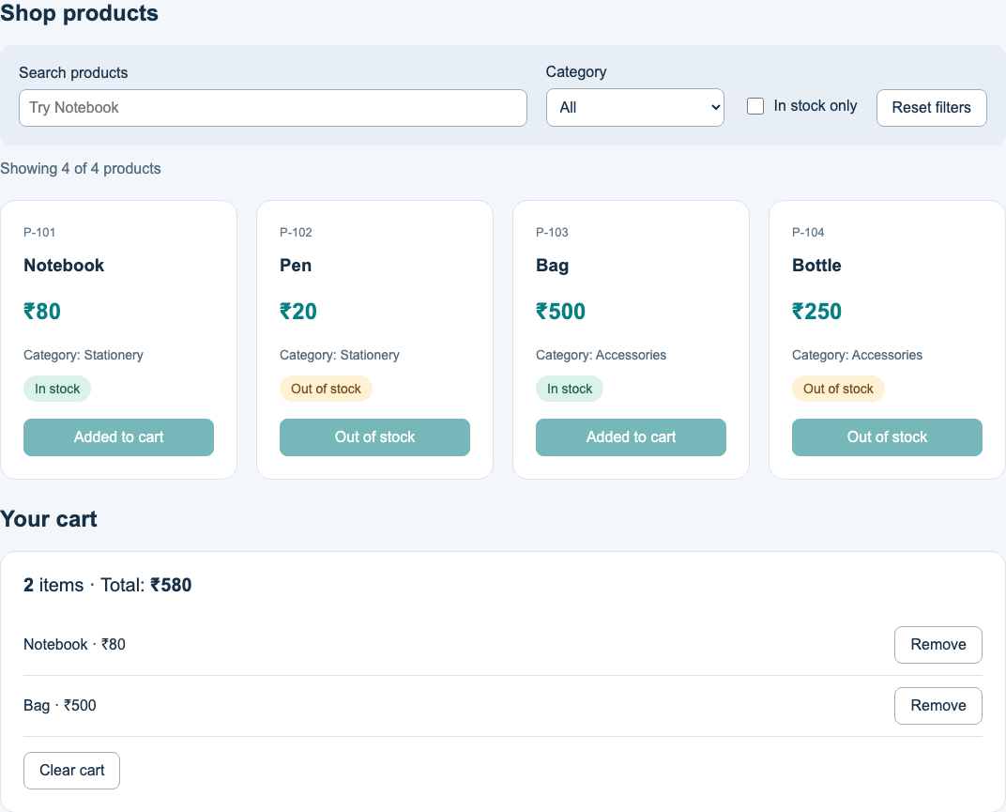
HANDS-ON · WALKTHROUGH
Our interactive Product Catalog
The catalog starts with four products.
Search and filters change the visible cards.
The cart displays selected items and a total.
The note form demonstrates submit handling.
24
Notes:
Time: 2 minutes.
Show the actual app. The screenshot contains Notebook and Bag in the cart, 2 items and ₹580. The full catalog summary remains 4 total, 2 in stock, 2 out of stock.
Code blocks are excerpts unless they show a complete component. Product prices are fictional INR values. The cart has one entry per product.

Slide 25
HANDS-ON · DATA FLOW
The files behind one click
App declares state and cart handlers.
FilterBar supplies controlled inputs.
ProductCard calls onAddToCart(product).
CartPanel calls onRemove(product.id).
src/
App.jsx
components/FilterBar.jsx
components/ProductCard.jsx
components/CartPanel.jsx
components/PracticeNote.jsx
lessons/day-three-state.js
A user action reaches the parent through a callback
25
Notes:
Time: 5 minutes.
5-minute guided reading. Start the app and run check:day-three. Open App, FilterBar, ProductCard and CartPanel in that order. Ask learners to locate both the sender and receiver of each callback.
Code blocks are excerpts unless they show a complete component. Product prices are fictional INR values. The cart has one entry per product.

Slide 26
HANDS-ON · DEMO
Search, filter and cart experiments
Type NOTE and observe Notebook.
Choose Accessories and check In stock only.
Reset filters, then add Notebook and Bag.
Remove Notebook, then clear the cart.
// Expected observations
' NOTE ' matches Notebook
Accessories + stock matches Bag
Notebook + Bag costs ₹580
Remove Notebook: ₹500
Clear cart: 0 items and ₹0
Browser controls now update the screen directly
26
Notes:
Time: 7 minutes.
7-minute demo: search 1 min, combined filters and no matches 2 min, add/remove/clear 3 min, note submit 1 min. Filters preserve the cart. Pen and Bottle are disabled. Submit the note with Enter and confirm the page does not reload.
Code blocks are excerpts unless they show a complete component. Product prices are fictional INR values. The cart has one entry per product.

Slide 27
HANDS-ON · YOUR TURN
A category visibility checkbox
Create showCategory state in App.
Add a Show categories checkbox.
Pass the value into ProductList.
Check that prices stay visible in both cases.
const [showCategory, setShowCategory] =
useState(true);
<ProductList
products={visibleProducts}
cart={cart}
onAddToCart={handleAddToCart}
showCategory={showCategory}
/>
Unchecking hides category paragraphs on every card
27
Notes:
Time: 8 minutes.
8-minute exercise: explain 1 min, learner work 5 min, check 2 min. ProductList already forwards showCategory. Add the checkbox in App for the shortest solution, or extend FilterBar with showCategory/onShowCategoryChange. Use checked and event.target.checked. A worked checklist is in the README, without adding the completed exercise to the starter.
Code blocks are excerpts unless they show a complete component. Product prices are fictional INR values. The cart has one entry per product.

Slide 28
TROUBLESHOOTING
Common Day 3 mistakes
Calling a handler while rendering.
Changing an array with push or splice.
Reading value for a checkbox’s boolean.
Supplying value without an onChange setter.
Calling a Hook inside a condition.
// New array for React state
setCart(items => [...items, product]);
// Boolean for a checkbox
onChange={event =>
setOnlyInStock(event.target.checked)}
A console warning often points to the input or handler
28
Notes:
Time: 2 minutes.
2-minute repair discussion. A controlled field can appear frozen if value never changes. Keep state setters in events and Hook declarations at the top level. Use browser errors to locate the component.
Source: https://react.dev/reference/react-dom/components/input
Code blocks are excerpts unless they show a complete component. Product prices are fictional INR values. The cart has one entry per product.

Slide 29
QUIZ
Day 3 knowledge check
1. When should a click handler execute?
2. What does useState return?
3. Which checkbox property gives a boolean?
4. Why return a new cart array?
5. Where should shared cart state live?
6. What does preventDefault do here?
29
Notes:
Time: 4 minutes.
4-minute Teams chat quiz. Answers: after a click, current value and setter, event.target.checked, to update without mutating state, closest shared parent App, prevents the browser’s default form navigation. Ask one learner to trace Notebook from a button click to cartTotal.
Code blocks are excerpts unless they show a complete component. Product prices are fictional INR values. The cart has one entry per product.

Slide 30
TRY AT HOME
Recap and learning references
Events call handlers that request state updates.
Controlled inputs display the current state.
The cart total derives from selected products.
Try at home: add a price limit filter.
React learning guides: react.dev/learn
Next: useEffect and loading JSON products.
30
Notes:
Time: 1 minute.
1-minute close. For the price exercise store the input text, validate it before converting with Number, and treat an empty value as no price limit. Core references are in the README. Day 4 adds effects and loading states. Certification follows the official TCS E1 syllabus and assessment rules.
Source: https://react.dev/learn/choosing-the-state-structure
Code blocks are excerpts unless they show a complete component. Product prices are fictional INR values. The cart has one entry per product.

