Slide 1

INTRODUCTION
ReactJS · Day Two
Reusable components, props and lists
Subha Prasad
13 October 2026 · 10:00–11:00 AM IST
01
Notes:
## Slide 1: ReactJS · Day Two
Time: 1 minute.
Welcome learners. This session builds on Day 1. The project uses fictional product data.
Project example: Product Catalog. Products have a numeric INR price and a boolean inStock field.

Slide 2
INTRODUCTION
Today’s learning outcomes
TCS · Assets Consultant (C3A) · SME trainer
Explain parent and child components.
Pass data through props and compose children.
Choose conditional UI and render keyed lists.
02
Notes:
## Slide 2: Today’s learning outcomes
Time: 1 minute.
Ask learners to recall the ProductCard from Day 1. The goal is to explain the data flow and change source configuration.
Project example: Product Catalog. Products have a numeric INR price and a boolean inStock field.

Slide 3
TOPIC INDEX
Today’s topic index
01 Day 1 recall and component extraction
02 Imports, props and default values
03 Composition with children
04 Conditional rendering
05 Lists, keys and CSS
06 Product Catalog hands-on
07 Quiz and try at home
03
Notes:
## Slide 3: Today’s topic index
Time: 1 minute.
Use the topic index. Delivery timing lives in trainer notes and README, without a separate schedule slide.
Project example: Product Catalog. Products have a numeric INR price and a boolean inStock field.

Slide 4
RECALL
Day 1 in one example
An object groups facts about a product.
A function component returns JSX.
Braces display JavaScript values.
const product = { name: 'Notebook' };
function ProductCard({ product }) {
return <h3>{product.name}</h3>;
}
<ProductCard product={product} />
The component displays Notebook
04
Notes:
## Slide 4: Day 1 in one example
Time: 2 minutes.
Ask what the function receives and returns. Today explains the props argument in detail. Source: https://react.dev/learn/passing-props-to-a-component
Project example: Product Catalog. Products have a numeric INR price and a boolean inStock field.

Slide 5
COMPONENTS
A component has a clear job
Split the page when a part has a clear purpose.
A list manages several products.
A card shows a product name, price and category.
A badge shows whether it is in stock.
App
PageHeader
ProductSummary
Section
ProductList
ProductCard
StockBadge
A component hierarchy for our project
05
Notes:
## Slide 5: A component has a clear job
Time: 2 minutes.
Read this as a text outline, not executable code. Avoid creating a component for every line of markup. Source: https://react.dev/learn/thinking-in-react
Project example: Product Catalog. Products have a numeric INR price and a boolean inStock field.

Slide 6
COMPONENTS
Component extraction
Move repeated markup into a named component.
Keep component definitions at the top level.
Use capital letters for component names.
function ProductTitle() {
return <h3>Notebook</h3>;
}
export default function App() {
return <ProductTitle />;
}
The parent uses the extracted component
06
Notes:
## Slide 6: Component extraction
Time: 2 minutes.
Demonstrate the fixed title before introducing a prop. Explain that definitions should not be nested inside App. Source: https://react.dev/learn/your-first-component
Project example: Product Catalog. Products have a numeric INR price and a boolean inStock field.

Slide 7
MODULES
Default and named imports
A file can have one default export.
Named exports keep their exported names.
Import paths point to the correct file.
// ProductCard.jsx
export default function ProductCard() { /* ... */ }
// products.js
export const products = [];
// App.jsx
import ProductCard from './components/ProductCard.jsx';
import { products } from './data/products.js';
Default imports and named imports use different syntax
07
Notes:
## Slide 7: Default and named imports
Time: 1 minute.
Code is a module syntax excerpt. Explain braces around a named import. Source: https://react.dev/learn/importing-and-exporting-components
Project example: Product Catalog. Products have a numeric INR price and a boolean inStock field.

Slide 8
PROPS
Props are component inputs
The parent supplies a named value.
The child receives it in a props object.
One component can display different values.
function ProductTitle(props) {
return <h3>{props.name}</h3>;
}
<ProductTitle name="Notebook" />
<ProductTitle name="Pen" />
Two uses display different names
08
Notes:
## Slide 8: Props are component inputs
Time: 2 minutes.
Relate a prop to a function parameter. Props can change when the parent renders with new values. Source: https://react.dev/learn/passing-props-to-a-component
Project example: Product Catalog. Products have a numeric INR price and a boolean inStock field.

Slide 9
PROPS
Destructuring the props object
Destructuring reads selected property names.
It keeps component code easier to read.
The braces belong inside the parameter parentheses.
function ProductTitle({ name }) {
return <h3>{name}</h3>;
}
// Same input as props.name in the previous example
name comes from the parent’s props object
09
Notes:
## Slide 9: Destructuring the props object
Time: 1 minute.
Explain ({ name }) slowly. Do not confuse it with an ordinary positional parameter. Source: https://react.dev/learn/passing-props-to-a-component
Project example: Product Catalog. Products have a numeric INR price and a boolean inStock field.

Slide 10
PROPS
Passing different value types
Quoted values pass strings.
Braces pass JavaScript expressions.
Props can contain objects, arrays and booleans.
<PageHeader title="Shop products" />
<ProductSummary products={products} />
<ProductCard product={products[0]} showCategory={false} />
false is a boolean, while "false" is a string
10
Notes:
## Slide 10: Passing different value types
Time: 1 minute.
Ask learners why showCategory="false" would still be truthy. Source: https://react.dev/learn/passing-props-to-a-component
Project example: Product Catalog. Products have a numeric INR price and a boolean inStock field.

Slide 11
PROPS
Default values
A default applies to missing or undefined props.
An explicit null, false or zero keeps its value.
Defaults express useful optional inputs.
function StockBadge({ inStock = true }) {
return <span>{inStock
? 'In stock' : 'Out of stock'}</span>;
}
<StockBadge />
<StockBadge inStock={false} />
The badges display In stock and Out of stock
11
Notes:
## Slide 11: Default values
Time: 1 minute.
Run check:day-two to compare undefined and null. Keep the null explanation for revision if the group needs more time. Source: https://react.dev/learn/passing-props-to-a-component
Project example: Product Catalog. Products have a numeric INR price and a boolean inStock field.

Slide 12
PROPS
Props are read-only inputs
The child reads the supplied data.
Keep transformations separate from the input.
The parent supplies new values when data changes.
const inStockProducts = products.filter(
product => product.inStock
);
// products still holds the original collection
filter creates a new array of matching items
12
Notes:
## Slide 12: Props are read-only inputs
Time: 2 minutes.
Avoid modifying incoming product.inStock. State updates arrive on Day 3. Source: https://react.dev/learn/passing-props-to-a-component
Project example: Product Catalog. Products have a numeric INR price and a boolean inStock field.

Slide 13
COMPOSITION
Nested content becomes children
A wrapper can accept different nested content.
React supplies that content through children.
The wrapper decides where it appears.
function Section({ title, children }) {
return (
<section>
<h2>{title}</h2>
{children}
</section>
);
}
The title is a prop. Nested JSX fills children.
13
Notes:
## Slide 13: Nested content becomes children
Time: 2 minutes.
Show Section.jsx and point to {children}. Source: https://react.dev/learn/passing-props-to-a-component
Project example: Product Catalog. Products have a numeric INR price and a boolean inStock field.

Slide 14
COMPOSITION
The same wrapper, different content
Reuse Section for the inventory and the empty demo.
Each use supplies its own heading and nested JSX.
<Section title="Shop products">
<ProductList products={products} />
</Section>
<Section title="Empty-list example">
<ProductList products={[]} />
</Section>
Section does not need to know the child’s data
14
Notes:
## Slide 14: The same wrapper, different content
Time: 1 minute.
Excerpt omits headingId for brevity. The full project supplies unique heading IDs for accessibility. Source: https://react.dev/learn/passing-props-to-a-component
Project example: Product Catalog. Products have a numeric INR price and a boolean inStock field.

Slide 15
CONDITIONS
An early return chooses another UI
A component can return early for an empty list.
The usual list rendering follows the other branch.
function ProductList({ products = [] }) {
if (products.length === 0) {
return <p>No products to display.</p>;
}
return <div>{/* product cards */}</div>;
}
An empty array shows a helpful message
15
Notes:
## Slide 15: An early return chooses another UI
Time: 2 minutes.
This excerpt focuses on control flow. The actual component maps cards in the second branch. Source: https://react.dev/learn/conditional-rendering
Project example: Product Catalog. Products have a numeric INR price and a boolean inStock field.

Slide 16
CONDITIONS
A ternary selects between two values
A ternary has a condition and two expressions.
Use it for short choices in JSX.
Keep complex branches readable.
<p>
{product.inStock
? 'Ready to order'
: 'Currently unavailable'}
</p>
Out of stock products show Currently unavailable
16
Notes:
## Slide 16: A ternary selects between two values
Time: 1 minute.
Ask learners which branch In stock selects. Source: https://react.dev/learn/conditional-rendering
Project example: Product Catalog. Products have a numeric INR price and a boolean inStock field.

Slide 17
CONDITIONS
&& includes optional content
A true condition includes the expression after &&.
A false boolean leaves that content out.
Use a boolean for visibility props.
{showCategory && (
<p>Category: {product.category}</p>
)}
showCategory={false} hides the paragraph
17
Notes:
## Slide 17: && includes optional content
Time: 1 minute.
Show the actual ProductCard and change showCategory in App later. Source: https://react.dev/learn/conditional-rendering
Project example: Product Catalog. Products have a numeric INR price and a boolean inStock field.

Slide 18
CONDITIONS
The zero rendering pitfall
A numeric zero remains a value in JSX.
Use an explicit comparison for a yes/no condition.
// count is 0: this can display 0
{count && <p>Products found</p>}
// count > 0 is false: renders no paragraph
{count > 0 && <p>Products found</p>}
A comparison produces the boolean you intended
18
Notes:
## Slide 18: The zero rendering pitfall
Time: 1 minute.
Ask learners to predict both outputs when count is zero. Source: https://react.dev/learn/conditional-rendering
Project example: Product Catalog. Products have a numeric INR price and a boolean inStock field.

Slide 19
LISTS
map returns one element per product
Each callback receives one product object.
The returned JSX becomes a sibling in the list.
The key belongs on that returned component.
{products.map(product => (
<ProductCard
key={product.id}
product={product}
/>
))}
Four objects create four cards
19
Notes:
## Slide 19: map returns one element per product
Time: 1 minute.
Revisit map from Day 1 and show its JSX return value. Source: https://react.dev/learn/rendering-lists
Project example: Product Catalog. Products have a numeric INR price and a boolean inStock field.

Slide 20
LISTS
Keys follow the item’s identity
Use stable IDs from the data.
Keys need to be unique among siblings.
Avoid random keys created during rendering.
Indices become unreliable when items move.
// Before reordering
['P-101', 'P-102', 'P-103']
// After reordering
['P-103', 'P-101', 'P-102']
Positions changed. Each product’s ID stayed the same.
20
Notes:
## Slide 20: Keys follow the item’s identity
Time: 1 minute.
Use npm run check:day-two to show ID order. React uses keys to match items across updates. Source: https://react.dev/learn/rendering-lists
Project example: Product Catalog. Products have a numeric INR price and a boolean inStock field.

Slide 21
LISTS
key and regular props
React uses key to track a sibling’s identity.
A child receives its explicit data props.
Send an ID separately when the child needs it.
<ProductCard key={product.id} product={product} />
// Inside ProductCard:
<span>{product.id}</span>
ProductCard reads product.id rather than props.key
21
Notes:
## Slide 21: key and regular props
Time: 1 minute.
Explain that key is special and not forwarded as a regular prop. Source: https://react.dev/learn/rendering-lists
Project example: Product Catalog. Products have a numeric INR price and a boolean inStock field.

Slide 22
LISTS
Filtering before rendering
The parent selects the visible collection.
The list component renders whichever array it receives.
Summary counts can still describe the full dataset.
const visibleProducts = products.filter(
product => product.inStock
);
<ProductSummary products={products} />
<ProductList products={visibleProducts} />
Two cards appear. The summary still shows four total.
22
Notes:
## Slide 22: Filtering before rendering
Time: 1 minute.
Source configuration is intentional for Day 2. State and inputs arrive on Day 3. Source: https://react.dev/learn/rendering-lists
Project example: Product Catalog. Products have a numeric INR price and a boolean inStock field.

Slide 23
CSS
Styling reusable components
className connects JSX to CSS rules.
A stock boolean chooses a class.
The component still uses semantic HTML.
const stockClass = inStock
? 'in-stock' : 'out-of-stock';
<span className={
`status ${stockClass}`
}>{inStock ? 'In stock' : 'Out of stock'}</span>
In stock and Out of stock have different visual styles
23
Notes:
## Slide 23: Styling reusable components
Time: 1 minute.
This snippet belongs inside StockBadge. Text also conveys status, so meaning does not rely on colour alone. Source: https://react.dev/learn
Project example: Product Catalog. Products have a numeric INR price and a boolean inStock field.

Slide 24
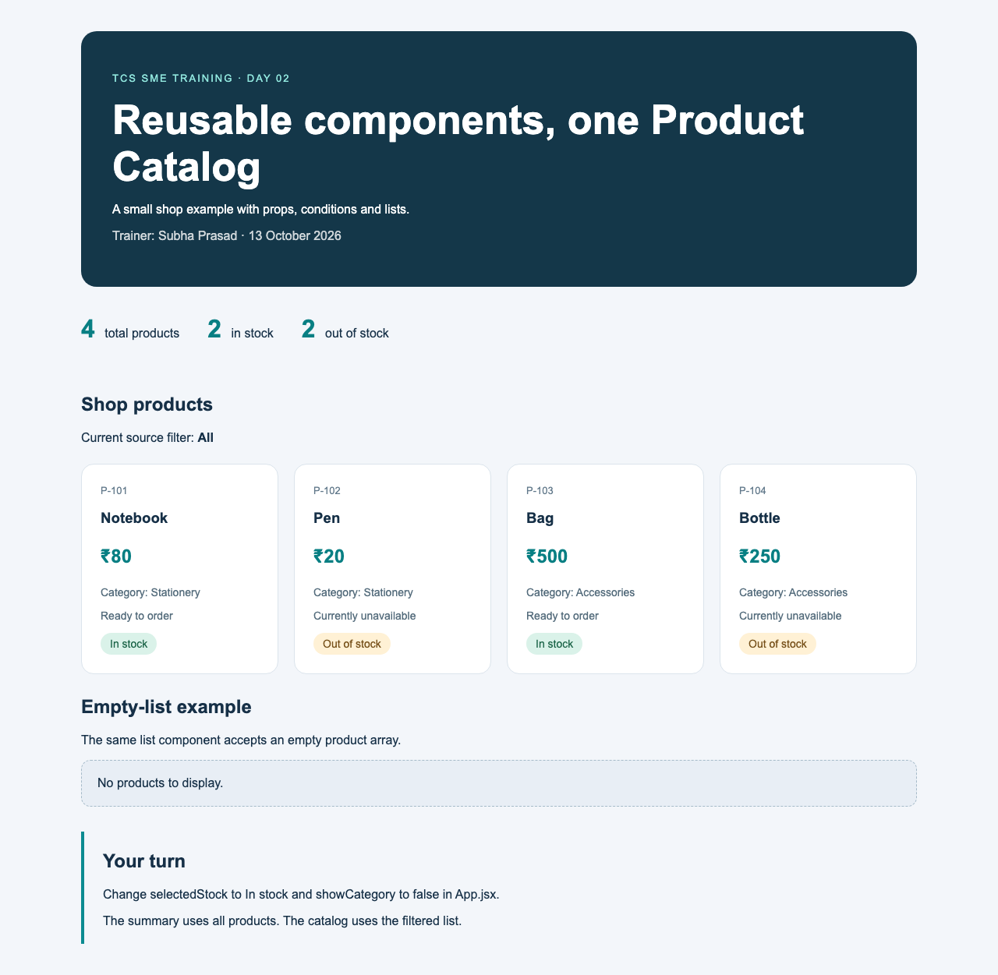
HANDS-ON · WALKTHROUGH
Our composed Product Catalog
Four fictional products use the same card component.
The summary derives totals from all products.
Section accepts different nested content.
The empty example uses the same ProductList.
24
Notes:
## Slide 24: Our composed Product Catalog
Time: 2 minutes.
Walk through the actual UI for 2 minutes. Original counts: 4 total, 2 in stock, 2 out of stock.
Project example: Product Catalog. Products have a numeric INR price and a boolean inStock field.

Slide 25
HANDS-ON · DATA FLOW
Tracing parent and child props
App supplies products to ProductList.
ProductList maps one ProductCard per item.
ProductCard passes inStock to StockBadge.
Section receives the list through children.
App: <ProductList products={visibleProducts} />
ProductList: <ProductCard product={product} />
ProductCard: <StockBadge inStock={product.inStock} />
Follow one product from source data to the badge
25
Notes:
## Slide 25: Tracing parent and child props
Time: 6 minutes.
6-minute demo. Open each file and ask learners to identify the receiving parameter. Point out showCategory forwarding and headingId in Section.
Project example: Product Catalog. Products have a numeric INR price and a boolean inStock field.

Slide 26
HANDS-ON · DEMO
Changing the component inputs
Change selectedStock to In stock in App.
Change showCategory to false and save.
Pass an empty array to the inventory ProductList.
Restore the original configuration afterward.
const selectedStock = 'In stock';
const showCategory = false;
// Empty-list experiment:
<ProductList products={[]} />
In stock: two cards. Empty array: fallback message.
26
Notes:
## Slide 26: Changing the component inputs
Time: 7 minutes.
7-minute demo: filtering 2 min, category 2 min, empty list 2 min, restore 1 min. Changes happen in source files, not UI controls.
Project example: Product Catalog. Products have a numeric INR price and a boolean inStock field.

Slide 27
HANDS-ON · YOUR TURN
A brand on every card
Add brand to each product object.
Display it in ProductCard.
Pass showBrand through the parent and list.
Verify the true and false cases.
// ProductCard JSX excerpt:
{showBrand && (
<p>Brand: {product.brand}</p>
)}
A boolean prop controls the brand paragraph
27
Notes:
## Slide 27: A brand on every card
Time: 10 minutes.
10-minute learner exercise. First 2 min explain, next 6 min work, last 2 min inspect results. ProductCard accepts showBrand=true as a default. ProductList forwards it. App supplies it.
Project example: Product Catalog. Products have a numeric INR price and a boolean inStock field.

Slide 28
QUIZ
Day 2 knowledge check
1. How does a parent pass data to a child?
2. Does a default apply to null?
3. Which prop receives nested JSX?
4. What should a list key identify?
5. Why use count > 0 with &&?
6. Should a child mutate its props?
28
Notes:
## Slide 28: Day 2 knowledge check
Time: 3 minutes.
3-minute Teams chat quiz. Answers: props, no, children, stable sibling item identity, to avoid rendering numeric zero, no. Discuss the answer learners most often miss.
Project example: Product Catalog. Products have a numeric INR price and a boolean inStock field.

Slide 29
RECAP
Components describe UI from inputs
Props supply the data a component reads.
children supplies nested content.
Conditions choose the displayed UI.
Lists need stable keys attached to their items.
29
Notes:
## Slide 29: Components describe UI from inputs
Time: 1 minute.
1-minute recap. Ask a learner to explain the path from App to StockBadge. Next session adds events, state and controlled forms.
Project example: Product Catalog. Products have a numeric INR price and a boolean inStock field.

Slide 30
TRY AT HOME
Practice and learning references
Extract a ProductDetails component.
Compare missing, undefined and null props.
Repeat the brand exercise.
React: react.dev/learn
Props, conditions and lists: React learning guides
30
Notes:
## Slide 30: Practice and learning references
Time: 1 minute.
1-minute close. Sources: https://react.dev/learn/passing-props-to-a-component https://react.dev/learn/conditional-rendering https://react.dev/learn/rendering-lists. Keep the project running before Day 3. Certification coverage follows the official TCS E1 syllabus.
Project example: Product Catalog. Products have a numeric INR price and a boolean inStock field.

