Slide 1

INTRODUCTION
ReactJS · Day One
JavaScript foundations and your first React screen
Subha Prasad
12 October 2026 · 10:00–11:00 AM IST
01
Notes:
Teaching approach: explain the value, predict the output, then run the example. Code blocks are excerpts unless shown as complete components.

Slide 2
INTRODUCTION
Meet your trainer
Subha Prasad
TCS · Assets Consultant (C3A)
SME trainer for this ReactJS learning programme
Today we learn through fictional asset data.
02
Notes:
Introduce yourself without inventing credentials. Ask learners to type their name and JavaScript experience in Teams chat.
Teaching approach: explain the value, predict the output, then run the example. Code blocks are excerpts unless shown as complete components.

Slide 3
TOPIC INDEX
Today’s topic index
01 The web and React
02 JavaScript values and variables
03 Objects, arrays and functions
04 map, filter and modules
05 React setup, components and JSX
06 Asset Dashboard hands-on
07 Quiz and next steps
03
Notes:
Use this index to establish the learning path. Advanced syntax slides can be revisited after the session.
Teaching approach: explain the value, predict the output, then run the example. Code blocks are excerpts unless shown as complete components.

Slide 4
SESSION PLAN
One hour of guided learning
10:00–10:05 Introduction and outcomes
10:05–10:25 JavaScript with examples
10:25–10:45 React concepts and demo
10:45–10:55 Hands-on practice
10:55–11:00 Quiz and recap
04
Notes:
Keep the first section to 5 minutes total. Avoid reading every line aloud. Short syntax examples receive 1–3 minutes each.
Teaching approach: explain the value, predict the output, then run the example. Code blocks are excerpts unless shown as complete components.

Slide 5
WEB FOUNDATIONS
HTML, CSS and JavaScript
HTML describes the content and structure.
CSS controls appearance and layout.
JavaScript works with data and behaviour.
<h1>Asset Dashboard</h1>
h1 { color: teal; }
const assetCount = 3;
One heading, one style rule, one value
05
Notes:
Use a building analogy briefly: structure, appearance, behaviour. Explain that JSX looks like HTML but is JavaScript syntax.
Teaching approach: explain the value, predict the output, then run the example. Code blocks are excerpts unless shown as complete components.

Slide 6
REACT INTRODUCTION
What React does
React is a library for building user interfaces.
A component describes a reusable part of a screen.
Components use data to produce JSX.
React commits necessary changes to the browser DOM.
function Heading() {
return <h1>Asset Dashboard</h1>;
}
<Heading /> displays the heading
06
Notes:
Source: https://react.dev/learn/your-first-component and https://react.dev/learn/render-and-commit
Teaching approach: explain the value, predict the output, then run the example. Code blocks are excerpts unless shown as complete components.

Slide 7
JAVASCRIPT · VALUES
Values and data types
A string stores text. A number stores numeric data.
A boolean represents true or false.
The value determines what operations make sense.
const name = 'Laptop';
const cost = 50000;
const available = true;
console.log(typeof cost);
Console output: number
07
Notes:
Open src/lessons/javascript-basics.js. Ask which value describes a yes/no condition.
Teaching approach: explain the value, predict the output, then run the example. Code blocks are excerpts unless shown as complete components.

Slide 8
JAVASCRIPT · VARIABLES
const and let
A variable gives a value a name.
const prevents reassignment of the binding.
let allows reassignment when the value changes.
const trainer = 'Subha Prasad';
let topic = 'JavaScript';
topic = 'ReactJS';
console.log(topic);
Console output: ReactJS
08
Notes:
Explain that const does not freeze object properties. Use const by default and let when reassignment is required.
Teaching approach: explain the value, predict the output, then run the example. Code blocks are excerpts unless shown as complete components.

Slide 9
JAVASCRIPT · OBJECTS
An object describes one asset
Properties group related facts.
Each property has a name and a value.
Dot notation reads a property.
const asset = {
id: 'A-101',
name: 'Laptop',
status: 'Available'
};
console.log(asset.name);
Console output: Laptop
09
Notes:
Ask learners to add location: Kolkata. Objects can contain many types of values.
Teaching approach: explain the value, predict the output, then run the example. Code blocks are excerpts unless shown as complete components.

Slide 10
JAVASCRIPT · ARRAYS
An array stores a collection
An array holds an ordered list of values.
Indexes begin at zero.
length gives the number of items.
const names = ['Laptop', 'Monitor'];
console.log(names[0]);
console.log(names.length);
Console output: Laptop, then 2
10
Notes:
Relate this to the assets array in src/data/assets.js.
Teaching approach: explain the value, predict the output, then run the example. Code blocks are excerpts unless shown as complete components.

Slide 11
JAVASCRIPT · FUNCTIONS
Functions turn inputs into results
A parameter names an input.
The function body performs the work.
return sends the result back to the caller.
function getName(asset) {
return asset.name;
}
const name = getName({ name: 'Laptop' });
console.log(name);
Console output: Laptop
11
Notes:
Identify definition and call separately. Without return this function would return undefined.
Teaching approach: explain the value, predict the output, then run the example. Code blocks are excerpts unless shown as complete components.

Slide 12
JAVASCRIPT · CONDITIONS
Conditions choose an outcome
if runs a branch when its condition is true.
=== compares without type conversion.
The ternary is an expression with two outcomes.
const status = 'Available';
if (status === 'Available') {
console.log('Ready to allocate');
}
const label = status === 'Available'
? 'Ready' : 'In use';
label contains Ready
12
Notes:
Use true/false examples. Explain ? and : slowly.
Teaching approach: explain the value, predict the output, then run the example. Code blocks are excerpts unless shown as complete components.

Slide 13
JAVASCRIPT · ARROW FUNCTIONS
Arrow function syntax
Arrow functions offer compact function syntax.
One expression can return without return.
This form appears often in array callbacks.
const getName = asset => asset.name;
// Equivalent for this example:
function getNameLong(asset) {
return asset.name;
}
Both return the asset’s name
13
Notes:
Explain arrow as function syntax before using map. Differences in this binding are outside today’s core scope.
Teaching approach: explain the value, predict the output, then run the example. Code blocks are excerpts unless shown as complete components.

Slide 14
JAVASCRIPT · MAP
map transforms every item
map calls a function for each array item.
It collects the returned values into a new array.
React often uses it to create a list of elements.
const assets = [
{ name: 'Laptop' },
{ name: 'Monitor' }
];
const names = assets.map(a => a.name);
names: ["Laptop", "Monitor"]
14
Notes:
Show the input items and the returned names one at a time. Source: https://developer.mozilla.org/en-US/docs/Web/JavaScript/Reference/Global_Objects/Array/map
Teaching approach: explain the value, predict the output, then run the example. Code blocks are excerpts unless shown as complete components.

Slide 15
JAVASCRIPT · FILTER
filter selects matching items
The callback returns true to keep an item.
filter creates a new array of matches.
The original array remains available.
const assets = [
{ name: 'Laptop', status: 'Available' },
{ name: 'Monitor', status: 'Assigned' }
];
const ready = assets.filter(
a => a.status === 'Available'
);
ready contains only the Laptop object
15
Notes:
Use ready.length to connect the example to the dashboard count.
Teaching approach: explain the value, predict the output, then run the example. Code blocks are excerpts unless shown as complete components.

Slide 16
JAVASCRIPT · MODERN SYNTAX
Destructuring and spread
Destructuring reads named properties.
Spread copies properties into another object.
Later properties override earlier values.
The copy is shallow.
const asset = { id: 'A-101', status: 'Available' };
const { id } = asset;
const copy = { ...asset, status: 'Assigned' };
id: A-101 · original status: Available
16
Notes:
Optional deeper explanation after class if learners need more time on functions. Nested objects still share references in a shallow copy.
Teaching approach: explain the value, predict the output, then run the example. Code blocks are excerpts unless shown as complete components.

Slide 17
JAVASCRIPT · MODULES
import and export
A module is a file with its own declarations.
export makes a value available to another file.
import reads that exported value.
// src/data/assets.js
export const assets = [{ id: 'A-101' }];
// src/App.jsx
import { assets } from './data/assets.js';
App can now read assets
17
Notes:
Explain named exports and matching braces. App uses a default export for its main component.
Teaching approach: explain the value, predict the output, then run the example. Code blocks are excerpts unless shown as complete components.

Slide 18
REACT · SETUP
The prepared training project
Node.js runs development tools.
Vite serves and builds this React project.
The lockfile keeps installations reproducible.
// In the cloned project folder:
npm ci
npm run check:lessons
npm run dev
Open the local URL printed by Vite
18
Notes:
Clone the codex/day-one branch using the README command, then run these commands. Use an organisation-approved compatible Node version. Source: https://vite.dev/guide/
Teaching approach: explain the value, predict the output, then run the example. Code blocks are excerpts unless shown as complete components.

Slide 19
REACT · PROJECT STRUCTURE
Where each piece belongs
main.jsx mounts React in the root element.
App.jsx composes the page.
AssetCard.jsx displays a single asset.
assets.js supplies fictional data.
src/
main.jsx
App.jsx
styles.css
components/AssetCard.jsx
data/assets.js
lessons/javascript-basics.js
Data, component and presentation have clear homes
19
Notes:
Open the files in this order during the demo. Explain the root div in index.html.
Teaching approach: explain the value, predict the output, then run the example. Code blocks are excerpts unless shown as complete components.

Slide 20
REACT · COMPONENTS
Your first function component
Component names begin with a capital letter.
The function returns the UI it describes.
export default makes this the file’s main export.
export default function App() {
return (
<main>
<h1>Asset Dashboard</h1>
</main>
);
}
App displays the page heading
20
Notes:
Source: https://react.dev/learn/your-first-component
Teaching approach: explain the value, predict the output, then run the example. Code blocks are excerpts unless shown as complete components.

Slide 21
REACT · JSX
JSX rules with an example
Return one root element or a fragment.
Close every tag.
Use className for a CSS class.
Use parentheses for multiline returned JSX.
return (
<>
<h1 className="title">Assets</h1>
<input aria-label="Asset name" />
</>
);
The fragment groups elements without an extra div
21
Notes:
Source: https://react.dev/learn/writing-markup-with-jsx
Teaching approach: explain the value, predict the output, then run the example. Code blocks are excerpts unless shown as complete components.

Slide 22
REACT · EXPRESSIONS
JavaScript values inside JSX
Braces insert a JavaScript expression.
Use a value, a property or a calculation.
Statements such as if belong outside these braces.
const trainer = 'Subha Prasad';
const assets = ['Laptop', 'Monitor'];
return (
<p>{trainer}: {assets.length} assets</p>
);
Subha Prasad: 2 assets
22
Notes:
Source: https://react.dev/learn/javascript-in-jsx-with-curly-braces
Teaching approach: explain the value, predict the output, then run the example. Code blocks are excerpts unless shown as complete components.

Slide 23
REACT · COMPOSITION
One component, different data
The parent supplies an asset through a prop.
The child reads its name and status.
Reuse the same component for each asset.
function AssetCard({ asset }) {
return <h3>{asset.name}</h3>;
}
<AssetCard asset={{ name: 'Laptop' }} />
<AssetCard asset={{ name: 'Monitor' }} />
Two headings: Laptop and Monitor
23
Notes:
Introduce props only enough to understand the guided project. Day 2 covers props in depth. Source: https://react.dev/learn/passing-props-to-a-component
Teaching approach: explain the value, predict the output, then run the example. Code blocks are excerpts unless shown as complete components.

Slide 24
REACT · LISTS
Asset data becomes a list
map returns one component for each asset.
key identifies each sibling using its stable ID.
The asset prop carries the object into the child.
{assets.map(asset => (
<AssetCard
key={asset.id}
asset={asset}
/>
))}
Three objects produce three asset cards
24
Notes:
key is a special React attribute, not a normal prop. Source: https://react.dev/learn/rendering-lists
Teaching approach: explain the value, predict the output, then run the example. Code blocks are excerpts unless shown as complete components.

Slide 25
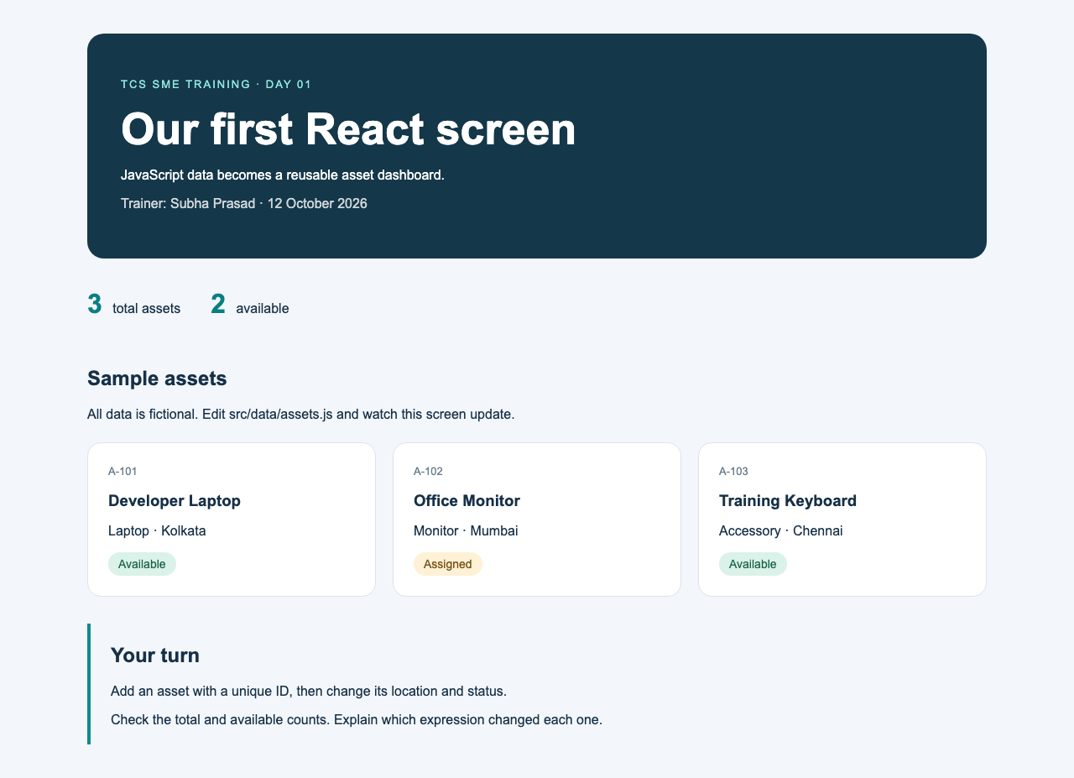
HANDS-ON · WALKTHROUGH
The Asset Dashboard demo
Run the JavaScript lesson and predict its output.
Inspect the three fictional asset objects.
Open App and find map plus filter.
Follow the asset prop into AssetCard.
25
Notes:
Use npm run check:lessons. Show how count, name, location and status come from data. Keep this walkthrough inside the 20-minute React/demo block.
Teaching approach: explain the value, predict the output, then run the example. Code blocks are excerpts unless shown as complete components.

Slide 26
HANDS-ON · YOUR TURN
A fourth asset on the screen
Add this object to src/data/assets.js.
Save the file and observe the browser.
Explain why both counts changed.
{
id: 'A-104',
name: 'Training Mouse',
category: 'Accessory',
status: 'Available',
location: 'Delhi'
}
Expected counts: 4 total, 3 available
26
Notes:
10 minutes. First 2 min demonstrate the file, next 6 min learner work, final 2 min verify. Keep IDs unique.
Teaching approach: explain the value, predict the output, then run the example. Code blocks are excerpts unless shown as complete components.

Slide 27
HANDS-ON · TROUBLESHOOTING
Common Day 1 mistakes
A missing comma can break an object or array.
A lowercase component name behaves like an HTML tag.
An import path must match the file location.
A missing list key causes a React warning.
27
Notes:
Show one console error and its file location. If setup fails, learners can edit the JavaScript lesson and predict the expected output.
Teaching approach: explain the value, predict the output, then run the example. Code blocks are excerpts unless shown as complete components.

Slide 28
QUIZ
Five questions before we finish
1. Which keyword allows reassignment?
2. Which method transforms every array item?
3. Which method selects matching items?
4. What belongs inside JSX braces?
5. How should a component name begin?
28
Notes:
Ask learners to respond in Teams chat before revealing answers. Answers: let, map, filter, a JavaScript expression, a capital letter.
Teaching approach: explain the value, predict the output, then run the example. Code blocks are excerpts unless shown as complete components.

Slide 29
RECAP
What you can now explain
JavaScript describes our asset data.
Functions and array methods work with that data.
Components return JSX to describe the screen.
The same AssetCard displays different assets.
29
Notes:
Ask a learner to explain the route from assets.js to the browser. Homework: serialNumber and Assigned count. Day 2: deeper props, conditions and component reuse.
Teaching approach: explain the value, predict the output, then run the example. Code blocks are excerpts unless shown as complete components.

Slide 30
AFTER CLASS
Practice and learning references
Homework: add serialNumber to each card.
Compute an Assigned count using filter.
Repeat the JavaScript lesson without copying.
React: react.dev/learn
JavaScript: MDN JavaScript Guide
Vite: vite.dev/guide
30
Notes:
20–30 minutes homework. Official TCS E1 syllabus and assessment rules govern certification coverage. Sources: https://react.dev/learn https://developer.mozilla.org/en-US/docs/Web/JavaScript/Guide https://vite.dev/guide/
Teaching approach: explain the value, predict the output, then run the example. Code blocks are excerpts unless shown as complete components.

