Slide 1
Ubiquitous Systems Lab
*
Kristof Van Laerhoven
Part 3
u•biq•ui•tous (yoo-bik’wi-t∂s) adj. Being or seeming to be everywhere at the same time; omnipresent.

Slide 2
Homework 2 Grading Rubric
Criterion | Excellent (full points) | Good (partial points) | Needs Improvement (low points) | Points
Task Completion (5 pts) | All required features fully implemented and working correctly (Time/date display, button interaction, swipe interaction, intervals, sensor reading). (5 pts) | Most required features implemented correctly, minor issues. (3-4 pts) | Many required features incomplete or significant errors. (0-2 pts) | __ / 5
Code Quality and Readability (2 pts) | Clean, organized, readable code structure; includes helpful comments. (2 pts) | Code generally clear but somewhat disorganized or minimally commented. (1 pt) | Poorly structured or difficult-to-read code; lacks comments or readability. (0 pts) | __ / 2
Visual Presentation (2 pts) | Simulator app visually appealing, clearly organized, and easy to understand. (2 pts) | App understandable but visual clarity or aesthetics could improve. (1 pt) | Visually unclear, difficult to understand or interact with. (0 pts) | __ / 2
Creativity (1 pt) | Demonstrates originality, creativity, or unique ideas beyond basic task requirements. (1 pt) | Shows some creativity or original thinking, but limited. (0.5 pts) | Minimal or no creativity evident; straightforward implementation only. (0 pts) | __ / 1

Slide 3
Creating Ubiquitous Systems That Think
Ubiquitous Computing: Technology embedded everywhere in everyday life.
Next Step: Ubiquitous systems that reason, adapt, and respond intelligently.

Slide 4
Real-World Examples of "Thinking" Ubiquitous Systems
Smart Home Assistants (Amazon Alexa, Google Home) ➔ Interpret voice, reason about context, suggest actions.
Wearable Health Trackers (Apple Watch, Fitbit) ➔ Monitor vitals and suggest health interventions (e.g., "Take a walk!").
Adaptive Traffic Lights ➔ Optimize traffic flow based on real-time traffic analysis.
Smart Thermostats (Nest, Tado) ➔ Learn user preferences and weather data to adjust temperatures intelligently.
Context-Aware Notifications (Smartphones) ➔ Silent mode at work, driving mode detection, adaptive alerts.

Slide 5
Why Use Local AI for Ubiquitous Systems?
Privacy and Data Protection ➔ User data stays on the device — no cloud dependency.
Offline Availability ➔ System continues working without internet access.
Customization and Control ➔ Tailor models specifically for your system’s needs.
Speed and Latency ➔ Instant responses without server round-trips.
Cost Efficiency ➔ No need to pay for cloud API access (e.g., OpenAI tokens).

Slide 6
Local LLMs: Brains for Ubiquitous Systems
LLM = Large Language Model ➔ Trained to understand, generate, and reason with human-like text.
Local LLM ➔ Runs directly on your machine (no cloud needed).
Capabilities:
Understand natural language (questions, commands).
Generate smart outputs (advice, summaries, decisions).
Reason step-by-step when prompted correctly.

Slide 7
How Ubiquitous Systems Think: Basic Architecture
1. Sensors or Inputs ➔ Collect information from the environment (e.g., temperature, motion, user commands).
2. Local LLM (Reasoning Core) ➔ Processes the input, reasons about it, generates meaningful responses.
3. Actuators or Outputs ➔ System acts based on the LLM's reasoning (e.g., notifications, physical actions).
Flow: ➔ Sense → Think → Act

Slide 8
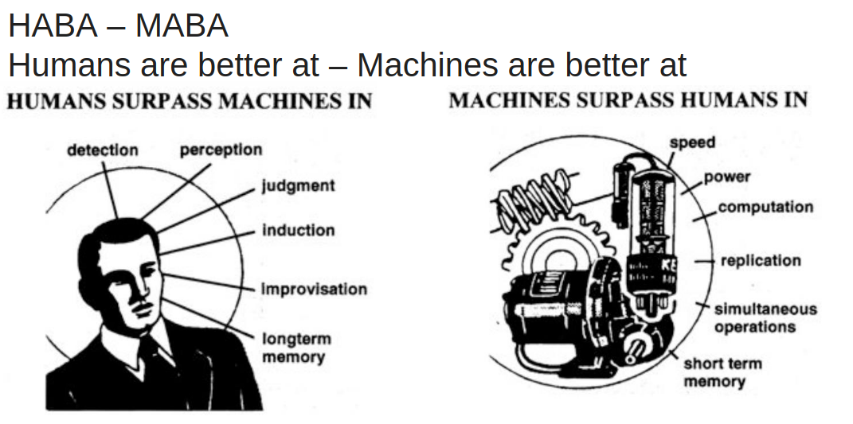
Human-Machine Strengths (HABA–MABA)

Slide 9
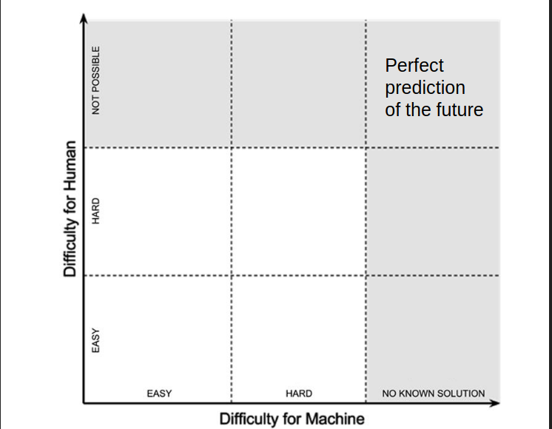
Human-Machine Strengths (HABA–MABA)

Slide 10
Talking to Machines: Prompt Engineering
Prompts = Instructions for the LLM ➔ Tell the model what you want and how you want it.
Good prompts:
Clear
Specific
Context-rich
Prompting = Programming with Language ➔ You design the system behavior by crafting the right prompt!
Key Idea: ➔ Better prompts → Smarter, more useful systems.

Slide 11
Zero-Shot Prompting: Just Ask!
Zero-shot = No examples given ➔ You simply ask the LLM directly.
When to use:
Simple, well-known tasks
When expecting a general, reasonable response
Example Prompt:
"List three benefits of smart home systems."
Advantages:
Fast and simple
Good for general knowledge or reasoning

Slide 12
One-Shot Prompting: Show and Tell
One-shot = Give one example ➔ Model learns the pattern you expect.
When to use:
Task is specific or has a special format.
You want to steer the LLM to match a style or pattern.
Example Prompt: "Example: Germany → Berlin. Now, France →"
Advantages:
Adds clarity.
Reduces misunderstandings.

Slide 13
Few-Shot Prompting: Teach with Several Examples
Few-shot = Provide multiple examples ➔ Model learns the task better by seeing a pattern.
When to use:
Complex tasks.
Tasks requiring specific style, format, or reasoning steps.
Example Prompt: "Example 1: Germany → Berlin Example 2: France → Paris Example 3: Italy → Rome Now, Spain → ?"
Advantages:
Improves reliability.
Reduces randomness in output.

Slide 14
Self-Refine: Iterative Improvement with AI
Self-Refine = AI improves its own outputs ➔ Generates an answer, critiques it, and revises.
Process:
Initial attempt (first output)
Self-feedback (identify issues)
Revision (improve the answer)
Why it matters:
Better quality over time.
Reduces human correction needed.
Applies to:
Writing, coding, reasoning, task planning.

Slide 15
How Self-Refine Works in Practice
Step 1: Task Definition ➔ Give the model a clear task. Example: "Suggest improvements to this Python code."
Step 2: Model Critiques Its Own Output ➔ Lists problems, inefficiencies, or risks.
Step 3: Model Revises Based on Its Own Feedback ➔ Produces an improved version.
Result:
Higher-quality solutions
Less manual correction

Slide 16
Solving Big Problems Step-by-Step
Divide and Conquer = Break big tasks into smaller subtasks ➔ LLM plans out the pieces before solving.
Process:
Ask model to list subproblems.
Solve each subproblem individually.
Combine the solutions into a final answer.
Why it matters:
Tackles complex tasks systematically.
Reduces mistakes by focusing on smaller goals.

Slide 17
Step-by-Step Reasoning with LLMs
Chain-of-Thought = Prompt the model to show its reasoning steps ➔ Not just the answer — the thinking process.
How it works:
Ask the model to explain how it reaches a conclusion.
Model reasons out loud before giving a final answer.
Why it matters:
More transparent decision-making.
Easier to spot and fix mistakes.
Useful for:
Complex logic, calculations, problem-solving.

Slide 18
Feeding the Model Useful Background Information
Prompting with Knowledge = Give extra context before asking ➔ Embed facts, documents, or examples inside the prompt.
Why do it?
Guides the model toward better, more informed answers.
Reduces errors from missing information.
Examples of sources:
Wikipedia summaries
Previous reports
Technical manuals
User manuals or FAQs
Key Idea: ➔ The model answers based only on what you feed it!

Slide 19
When the AI Creates Knowledge on Demand
Knowledge Generation Prompting = Ask AI to invent useful background ➔ Fill in missing facts, steps, or examples creatively.
Why use it?
Solve gaps when real data is unavailable.
Brainstorm new ideas, scenarios, or designs.
Examples:
"Imagine features for a future smart city."
"Suggest possible problems with a wearable device."
Key Caution: ➔ Validate critical information — AI can hallucinate!

Slide 20
Let the AI Help You Write Better Prompts
Meta-Prompting = Prompting the AI to create prompts ➔ Use AI to design detailed instructions for specific tasks.
Why use it?
Saves time crafting complex prompts.
Generates professional-quality task descriptions.
Example:
"Create a detailed prompt to design a wearable that tracks mood."
Key Benefit: ➔ AI helps structure your ideas better before you even start!

Slide 21
Bringing It All Together: A Smart Thermostat Advisor
Sensors/Input:
Room temperature
Humidity level
Time of day
Local LLM Reasoning:
Analyze comfort vs. energy efficiency.
Suggest actions ("lower heating", "open window").
Output/Action:
Notify user with recommendation.
Or adjust thermostat settings automatically.
Prompt Example: "Given 20°C room temperature and 65% humidity at 11 PM, suggest if user should open window, adjust heating, or do nothing."

Slide 22
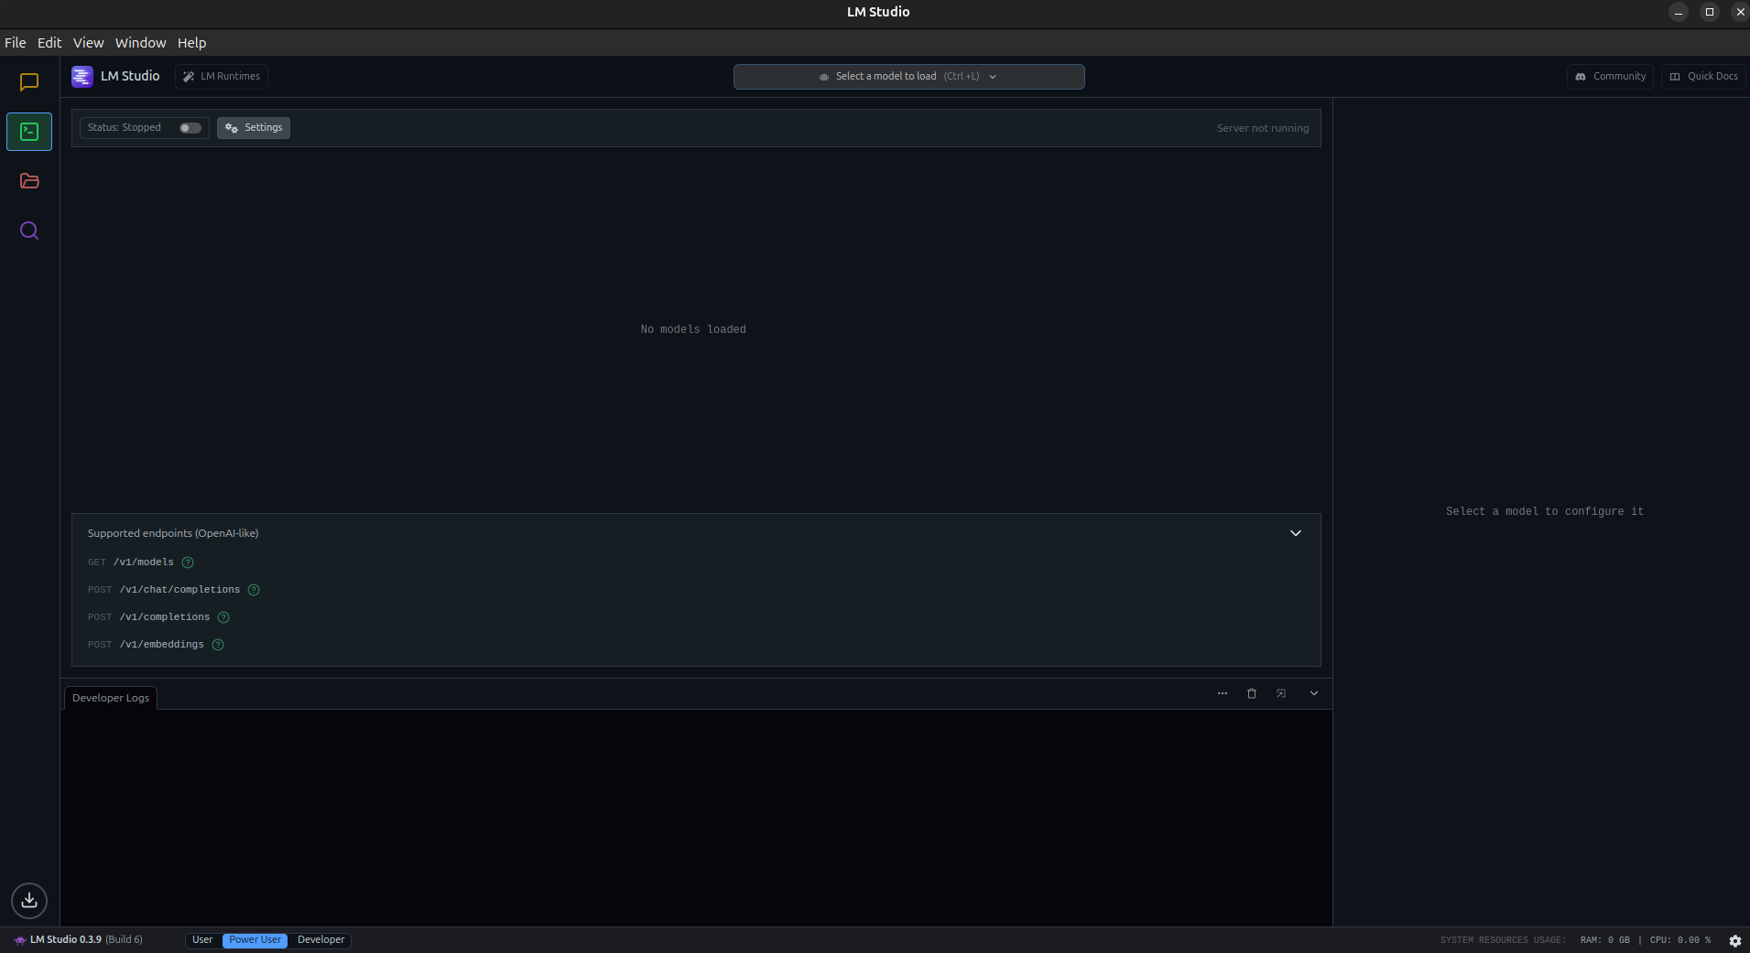

Slide 23
Linking Sensors, LLMs, and Interfaces
Basic Flow:
Sensor/Input → Collect data
Frontend → Send input to Local LLM server
Local LLM → Reason and respond
Frontend → Show output to user or trigger action
Technical Overview:
Use HTTP POST requests (simple web calls).
Local server address example: http://localhost:1234/v1/chat/completions
Data Format:
JSON (easy to read/write)
Includes prompt, model, and input data
Key: ➔ Treat your local LLM like a smart API!

Slide 24
What to Watch Out For When Building Thinking Systems
Bad or Vague Prompts ➔ Leads to unpredictable, useless, or wrong outputs.
Overtrusting AI Outputs ➔ AI can sound convincing even when it’s wrong — always validate critical results!
Latency and Slow Responses ➔ Local LLMs may be slower on limited hardware — design for short, clear interactions.
Privacy and Data Leaks ➔ Even local systems need to carefully manage sensitive user data.
Lack of User Control ➔ Smart systems should suggest, not force actions.

Slide 25
Homework Build Your Own Thinking Ubiquitous System!
Application Requirements:
Design and prototype a simple "thinking" system using a local LLM.
Simulate at least one sensor input (or user input).
Use prompt engineering to reason about the input.
Show clear output (notification, advice, action suggestion).
Tools
LM Studio or Ollama (local LLMs)
HTML + JavaScript frontend (or Python Flask backend)
You have to submit a presentation showing:
Working prototype demo (screenshots or video).
Short explanation of your prompt logic.

