Slide 1
SoC Estimation using BALARKAN
Team ELEMENTX:
Suryasaradhi
Ananthakrishnan
A Novel SOC Estimation method using LTSpice Simulation coupled with AI and Signal Analysis

Slide 2
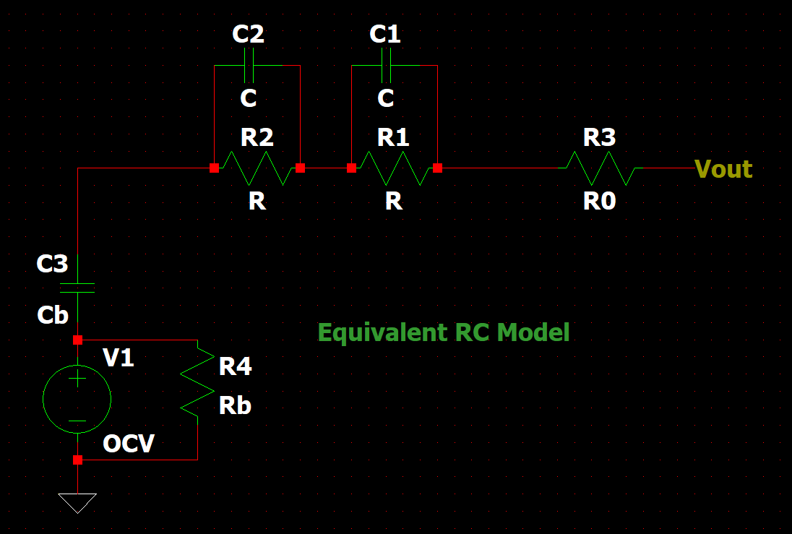
Model Taken
We have taken a two RC model to simulate a battery response under load, We try using curve fitting to match the model response to the real world response
The model has :
R0 (Internal Resistance)
R1 R2 (Dynamic Response Resistance)
C1 C2 (Dynamic Response Capacitance)
Cb ( Polarisation Capacitance)
Rb (Self Discharge Resistance)

Slide 3
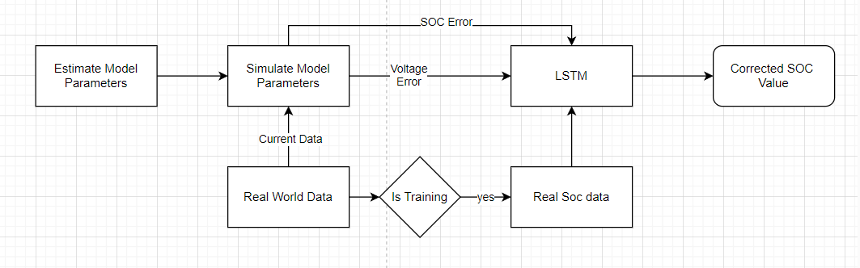
Complete Process Flow
We first Guess the parameters for the 2RC model then Feed it into Spice simulator then use an LSTM to correct for error to get SOC values

Slide 4
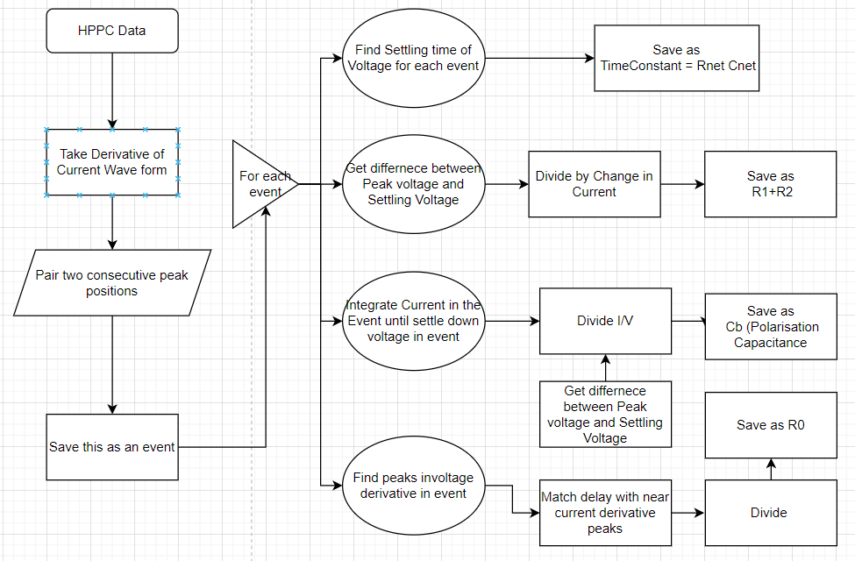
Processflow of Parameter Identification
We first analyse these many parameters to make an initial guess of the 2RC model:
R0
R1 R2
C1 C2
Cb Rb
The Calculation for each value from the HPPC process is as in the flowchart

Slide 5
Processflow for Simulation
So as to simulate the response of the model instead of preparing a mathematicaly complex equation that defines the system we simply create an electrical circuit with the estimated values of the components and use the real world current draw as the output load to calculate the SOC.
This is done using Pyspice
The output of the simulation gives the output voltage and the soc level. The Simulated voltage response is then compared with the real world voltage response to generate an error rate. Same is done with SOC
This error rates are then fed into an LSTM along with the real SOC values which learns how to decrease the constant error function.

Slide 6
Processflow for Simulation
Simplified SOC estimation by simulating a 2RC model as an electrical circuit instead of solving complex equations.
Implementation:
- Circuit created with estimated component values using PySpice.
- Real-world current draw used as load input.
- Outputs: Simulated voltage response and SOC levels.
Error Analysis:
- Compare simulated outputs with real-world data to calculate error rates for voltage and SOC.
Error Correction with LSTM:
- Feed error rates and real SOC values into an LSTM model.
- LSTM learns to minimize the error, improving SOC prediction accuracy.
Result: A practical, AI-enhanced approach to accurately model and predict SOC.

Slide 7
Processflow for Simulation
Simplified SOC estimation by simulating a 2RC model as an electrical circuit instead of solving complex equations.
Implementation:
- Circuit created with estimated component values using PySpice.
- Real-world current draw used as load input.
- Outputs: Simulated voltage response and SOC levels.
Error Analysis:
- Compare simulated outputs with real-world data to calculate error rates for voltage and SOC.
Error Correction with LSTM:
- Feed error rates and real SOC values into an LSTM model.
- LSTM learns to minimize the error, improving SOC prediction accuracy.
Result: A practical, AI-enhanced approach to accurately model and predict SOC.

Slide 8
Thankyou
Refer README for more updates
Kindly refer for updated project: https://github.com/thesunRider/Balarkan

