Slide 1
MVUS – Messaging and Voice for Underwater Systems
Project by: Suryasaradhi

Slide 2
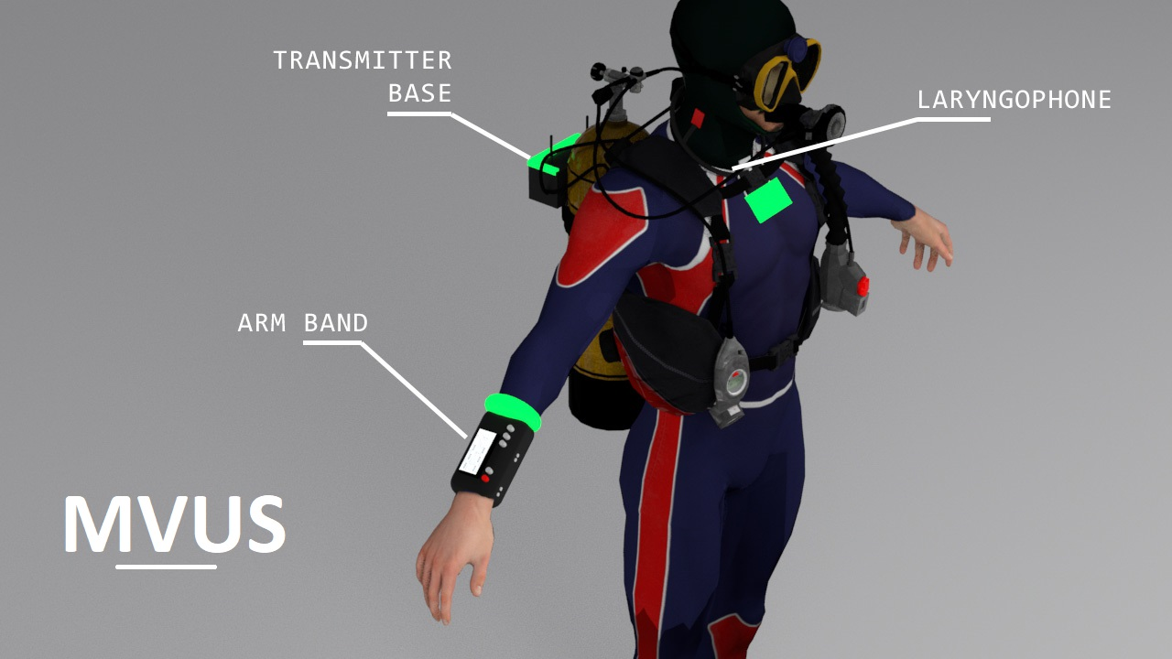
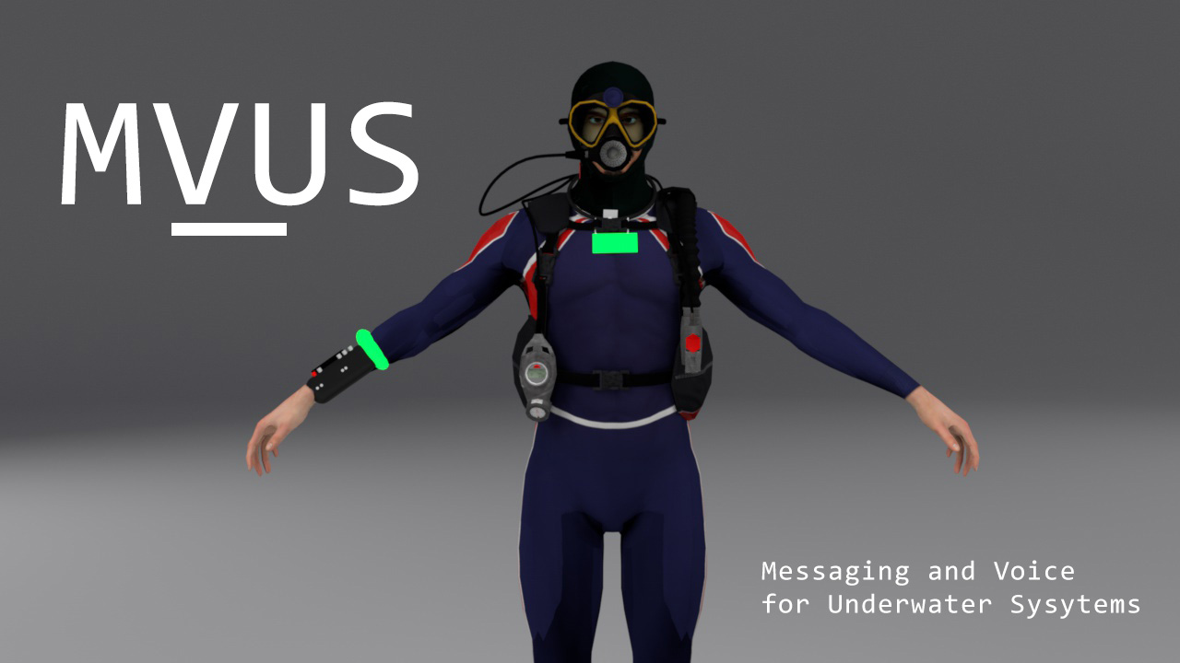
Brief on Prototype
The proposed solution is a hybrid system consisting of RF, Light and Acoustic systems to enable communication underwater. The technology uses RF to communicate when outside water, and uses an acoustic and Light hybrid communication underwater, Since RF can’t be used underwater due to its high attenuation.
Using state of the art ML technologies combined with High Performant communication protocols ,high Fidelity (320kbps) Realtime audio streaming is achieved.
The solution even goes on prescribing extra optional hardware like repeaters and Bridgers to increase the functionality of the current setup,

Slide 3
Features Available
Easily attachable to diver-suits
Is able to fully integrate into an existing diver communication suite
Equipped with an emergency mode of communication to alert other divers and base stations in case of distress
A mechanism to measure and communicate the heartbeat of the diver to base stations as a basic health monitoring system
Use of laryngophone for better Fidelity in communication
AI controlled feedback system that analyses pitch changes w.r.t to underwater pressure and corrects voice output accordingly.
Transceiver switching capability to extend range ,where each node retransmits data from a different user.
Automatic Analog Compensation for doppler shifts in signals.
Incorporated Radio for Out of water communication.
Realtime High Fidelity Audio Streaming
Hybrid Communication Technology , with Automatic Channel Switching for high fidelity communication

Slide 4
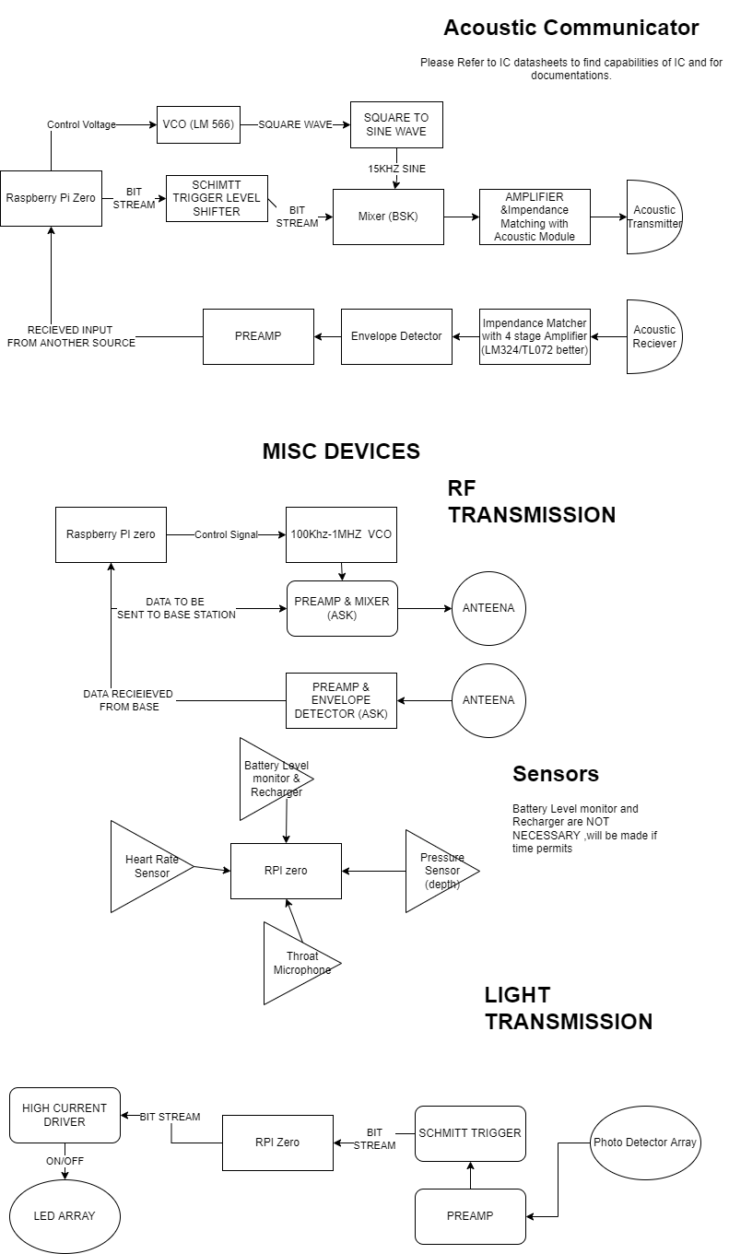
Technologies Used (Hard & Soft -ware)
Human audio can span up to 5khz ,Analogue signals are inherently weak and are prone to distortion. Since we are capable of only sending 3Kbps, We use LYRA a revolutionary AI based audio codec open-sourced by “Google” capable of sending 360kbps audio via a 3Kbps stream without any considerable distortion.
C++ written direct hardware addressing Protocol’s used for high speed communications.
Automatic Audio Pitch and gain control
Simulations based on Fischer-Simmon Model where made to realize distance of data transmission.
PCB simulation (ASK) were realized in proteus.
SPI used for RF and Light based communication, providing high speed communication operating at 10Mhz
Instead of direct ASK ,BSK (Binary Shift Keying) was used which provided more immunity to noise as data is sent digitally and packets can be retransmitted if received signal was distorted.
DSB suppression controlled with adjustable signal power
Product detector used instead of envelope detector provides better SNR.

Slide 5
Prototyping & Status Quo
MVUS Transceiver
This wearable device is attached to the divers suit for communication ,the device is further segmented to three functioning groups:
Arm Band
Neck Band
Transmitter Base
RF Buoy [optional]
Used to Provide a Communication link between underwater and surface (i.e , a boat to a diver)
Acoustic Repeater [optional]
Used to increase the range of transmission
PROTOTYPE | STATUS
Acoustic Range Simulation | DEPLOYED
Electronics Simulation | DEPLOYED
Digital Communication Audio Encoding (LYRA) | DEPLOYED
Communication Protocols | PROGRESS
Light Transmitter | DEPLOYED
Light Receiver | PARTIAL
RF Transmitter | DEPLOYED
RF Receiver | DEPLOYED
Acoustic Transmitter | DEPLOYED
Acoustic Receiver | DEPLOYED
Housings | PARTIAL

