Slide 1
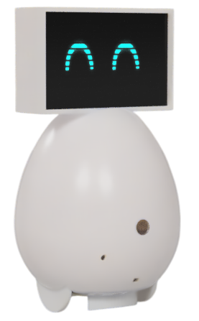
CUBO – Implementation Updates
Ubiquitous Lab Systems – MID TERM PRESENTATION

Slide 2
Implementation Overview
Implemented the CAD model
Code testing
Connection Modelling
Simulation

Slide 3
Hardware Procurement
Hardware Used:
Raspberry Pi Zero W - 1x
ULN8BYJ - Stepper motor - 2x
5MP Camera Module for Raspberry Pi Zero
TOF Sensor (VL53L0x) - 1x or equivalent
4inch LCD Module with touch screen SPI preferred - 1x
Capacitive touch sensor - 2x
Electret Mic module - 2x
Battery Overvoltage Protector - 1x
Battery Charger Module - 1x
Stepper Driver for ULN8BYJ - 1x
Wireless charging module - 1x
GPS module - 1x
IMU Module - 1x
IR obstacle sensor - 2x

Slide 4
Implemented Code
Implemented Test code in python for :
Stepper movement with encoding
Camera realtime streaming
LCD Display with robotic eyes
Capacitive touch sensor
Sound Recording and Streaming
Ollama based model for AI end
Whisper AI backend for speech recognition

Slide 5
Setbacks
No components available
Deadlines shifted
Code compilation time > 1 minute

Slide 6
Expected Outcome
AI integrated bot
Speech recognition
Movement control by AI
Basic App Integration

Slide 7
THANK YOU

