Slide 1
934_6672 : DECOLI (DEvice of COgnitive Listening)
Full Name
Suryasaradhi Balarkan
PAN Card No.
KWKPS1935N
Are you currently or previously employed in central govt / state govt / PSU? If yes, please give details
No
Are you currently or previously employed in DRDO? If yes, please give details
No
Have you submitted your entry/entries earlier in Dare to Dream or Similar contest? If yes, please give details
Yes,Dare to Dream 3.0 , 2nd prize winner in Underwater submissions category (Individual), Kavach – Cybersecurity Hackathon ( LoRA Wideband RF Decoder which scans for all sub Ghz frequencies for lora and demods them)
Have you won any award for same or similar entry earlier in Dare to Dream or similar contest? If yes, please give details
(2nd Prize) Sainya Ranakshetram ( Indian Army Hackathon), For Creating AI classifier for RF Finger Printing , (Finalist) HacKP – Kerala Police Hackathon for Creating AI crime profiling tool.
Is the work of the application sponsored by any agency or been given any grant or funding from any agency? If yes, please give details
No
Are you a resident Indian?
Yes

Slide 2
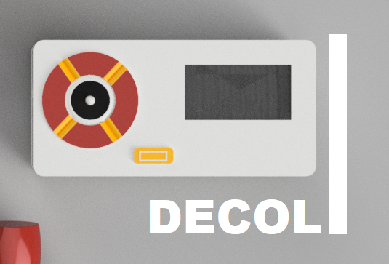
934_6672 : DECOLI (DEvice of COgnitive Listening)
Decoli is a pocket carry, compact RX only SDR capable of reception from 20Khz – 10Ghz.Having Internet connectivity It can be used to implement a variety of decoders and even Translators for the received signal.
Cognitive Listening Device
We have developed a compact SDR capable of receiving from 20khz to 10Ghz spectrum
Our SDR is compact with the size of a mobile phone (15xm * 7cm * 4cm)
For Wideband frequency receptions we have used multiple chip anteenas which is able to provide with a well maintained VSWR less than 4 upto until 10Ghz, For low frequency we have chosen an alternate route of using a ferrite rod anteena which is used to concentrate the magnetic field and use it to receive small signals like in old AM radios.
Our downconversion Mixer consists of separate LO and mixer stages unlike traditional approaches. We use Gilbert Cell Mixers to achieve maximum bandwidth.
The SDR is self contained having a display and control, The compact size means it can be used readily on site with minimal power usage.
Our SDR features Internet through Wifi allowing transalations and cloud based ML models.
As for our current stage ,we have a 1.5Ghz portable prototype and a design for 10Ghz SDR downcoverter.
We have created a concept (schematic and layout created) raspberry pi zero hat rf downconverter which can be used with an RTL-SDR dongle to upconvert the low frequency 20 – 500Khz and downconvert the higher frequencies 2 – 10Ghz. This method can be used to test the prepared design.
Our design primarily focuses on from scratch no copyright open source implementation of a compact RX only SDR, The standalone SDR features NUC980DK arm processor for running a linux tinycore OS.

Slide 3
934_6672 : DECOLI (DEvice of COgnitive Listening)
SDRs available in the industry are not self contained nor portable with poor power efficiencies, If so they do not cover a huge spectrum.
Stage of innovation
Prototype
Competitors with similar solutions
RTLSDR ( Compact Non self contained 25Mhz – 1.2Ghz SDR)
HackRF ( Non Self Contained 1Mhz – 6Ghz SDR)
XIEGU SDR (Compact Self Contained 1Mhz – 50Mhz)
Our product is a RX only portable self contained SDR.
Coverage of 20khz – 10 Ghz
Leveraging Wideband Antennas and Gilbert style mixers
Self contained with Wifi connectivity offers implementation of Cloud based ML decoders and Language transalators.
The product is first of its kind compact portable self contained large bandwidth SDR with inbuilt anteenas for full frequency coverage.
Targeted sectors for impact
Radar
Automobile
Robotics
Electronic Warfare.
Proof for highlighting USP
None -
Patent Status
None -

Slide 4
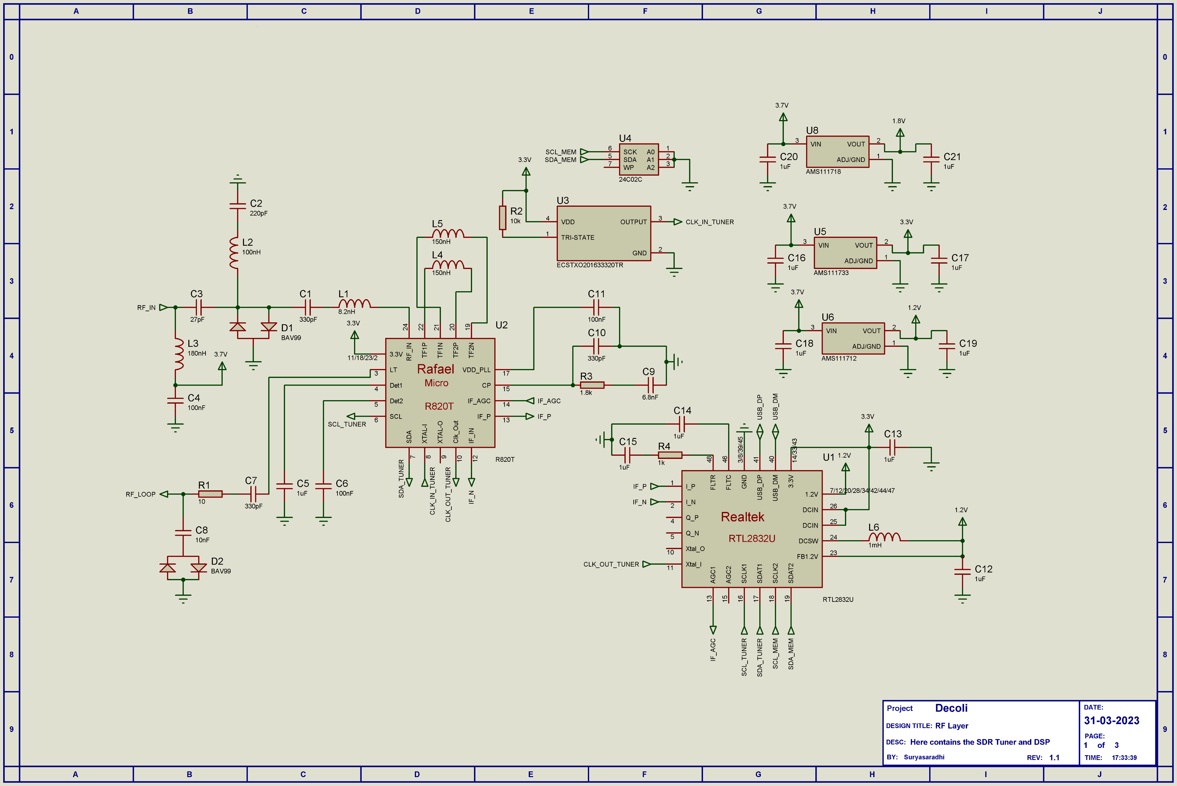
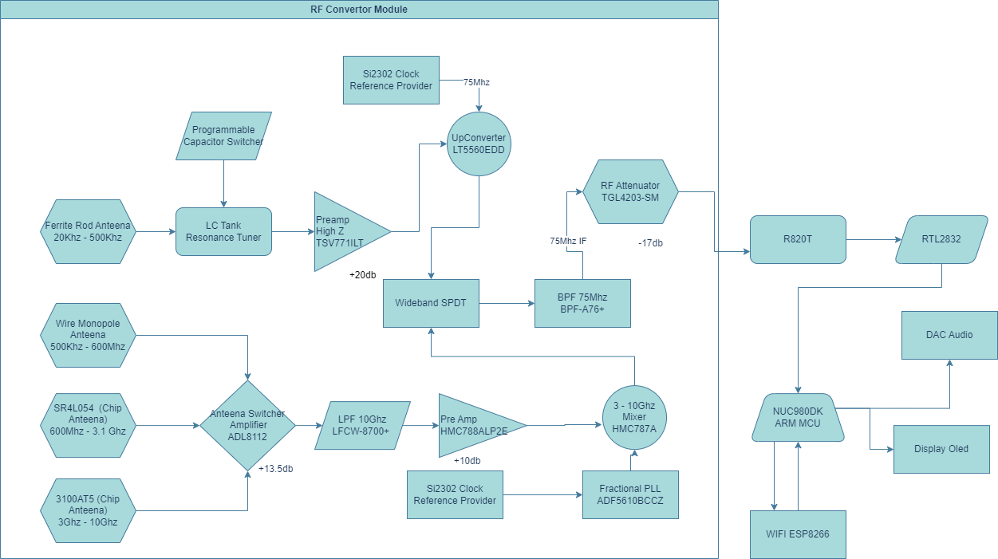
934_6672 : DECOLI (DEvice of COgnitive Listening)
We have completed the design of our Upconverter module with the below Architecture, All IC’s mentioned below were handpicked and used in the project.
Entire project with schematics and layout in github: https://github.com/thesunRider/decoli

Slide 5
934_6672 : DECOLI (DEvice of COgnitive Listening)
Question 1
Antennae to cover VLF to Ka band not mentioned.
For LF – Ferrite Rod Antenna
For HF – Dipole Wire Antenna comprising of the earphones that are to be plugged into the device. (VSWR < 8 )
For VHF – Chip Antenna (VSWR < 5 )
For UHF – Chip Antenna (VSWR < 5 )
Question 2
2) S/W modules to be employed not discussed
The Antenna switcher is a wideband Amplifier with a switcher in it, ADL8112, The down-conversion mixer is a HMC787A which handles from 3Ghz to 10Ghz, The rest of the frequency is directly fed to the the tuner R820T
Question 3
.3) Work experience in the area
Completed Eng.Physics , Is a Ham Radio Enthusiast, Electronics Hobbyist, Worked as a hardware Engineer and as a Schematic designer.
Question 4
4) Some details/ workout towards implementation of the design in a product form as defined in the problem statement
We have created the PCB layout with all precacutions taken for RF engineering, All it needs is to order the PCB which would cost Rs. 75,000+ and then test it.

