Slide 1

KAVACH - 2023
PSID: KVH-016
Problem Statement Title: Detecting usage of LoRa - Thambura
Team Name: Moonface
Team Leader Name: Suryasaradhi
No. of Team members: 6
Startup / Organization Name : Medgyor
Organization Logo :

Slide 2
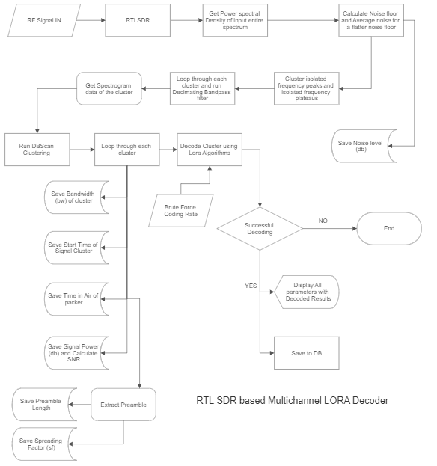
Idea/Approach Details
Developed Prototype – thambura :
We have developed a hybrid, hardware-software solution for Scanning/decoding/replaying unknown Lora packets in the air.
We use an SDR (RTL-SDR/HackRF) to scan through a wide range of frequencies (frequency-hopping) displaying signal SNR and RSSI.
For playing back the signal an SX1276 Lora Transceiver is used.
Approach Taken:
The frequency components in the IQ data signals above the noise floor are separated by filtering,Then all available discrete signals in the spectrum are clustered into groups. Each cluster gives bandwidth(bw) and Time in air (TIA) information of the signal packet.
Each clustered signal has its preamble extracted, The preamble FF is ran through an sFFT followed by Squelching to get Peak frequency which would correspond to symbol rate (Rs),Since we already know bw,spreading factor (sf) is calculated from bw and Rs. Since we have time in air, We can calculate Coding rate (Cr) from bw,sf and TIA.
If the signal gets demodulated using our demodulator algorithms with the calculated parameters we save the results and show it with its RSSI and SNR over a web interface.
Describe your Technology stack here:
Python, Django, RTLSDR
Matlab,Docker
C++ - SX127, Gnuradio

Slide 3
Idea/Approach Details
Describe your Use Cases here
Describe your Dependencies / Show stopper here
Lora Scanners as of now is able to scan for signals given the parameters of the signal they are trying to look for, Our scanner looks for all possible signals and extract the demodulation parameters from the signals itself.
We are able to scan through multiple channels at once unlike the traditional single channel scanners.
Automatic Gain control , RSSi and SNR detection.
Able to replay a captured signal. Ability to monitor a separate parallel single channel with better SNR provided all signal parameters. (Both feature implemented using SX127)
Demodulation and Decoding Unknown signals and displaying all calculated parameters
Live spectrogram view.
Docker setup for fast and easy deployment.
Intuitive Web-UI interface.
Project available at : https://github.com/thesunRider/thambura
Docker is used for quicker deployment of the tool, This minimizes any chance for platform based dependency conflict.
We have used GNU Radio for initial experimentation of segmentation and filtering of signals, We generated Lora signals on PC itself using GNUradio’s Lora modulator which we used for testing our algorithms before linking everything with a physical RTLSDR.
We had developed initial algorithms in matlab,The Lora demodulator we use outperforms previous methods by lowering the SNR floor. We have used the following paper: Zhenqiang Xu, Pengjin Xie, Shuai Tong, Jiliang Wang. From Demodulation to Decoding: Towards Complete LoRa PHY Understanding and Implementation. ACM Transactions on Sensor Networks 2022. [pdf] which had an implementation in matlab, we transalated this library to python.
We used python as it would be easy to manage the web front end , communicate with rtlsdr and SX127 using pythons existing libraries. Furthermore we can leverage GPU features of python to increase the speed of analysis
Django was used to serve the web stack.

Slide 4
Team Member Details
Sr. No. | Name of Team Member | Designation | Education | Stream | Position in team | Year of Experience
1 | Suryasaradhi | Embedded Electronics Intern | B.Tech | Engineering Physics | Team Leader | 2
2 | Dinoj | CEO | M.Des,B.Tech | Product Design | CAD Modeling | 7
3 | Daniya | Product Design Intern | B.Tech | Mechanical Engineering | Algorithm Designer | 1
4 | Jismy | Electronics Intern | B.Tech | Electronics and Communications Engineering | Embedded Developer | 1
5 | Harshith | Product Design Intern | B.Tech | Mechanical Engineering | Front End Developer | 1
6 | Riya | Electronics Intern | B.Tech | Electronics and Communications Engineering | Hardware Developer | 1

