Slide 1
TSL ERP Demo: Premium Garment Management
Integrated Solutions for Modern Manufacturing Corporate Presentation 2026

Slide 2
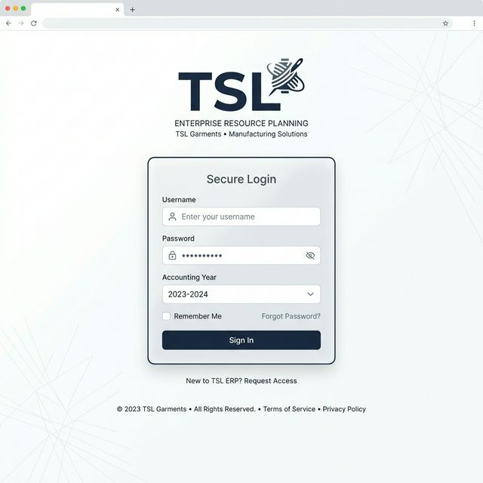
1. Secure Login & Session Access
â€¢ TSL Corporate Branding Integration â€¢ Multi-Year Financial Accounting Support â€¢ Password-Protected Year Switching â€¢ JWT-Secured Authentication Layer

Slide 3
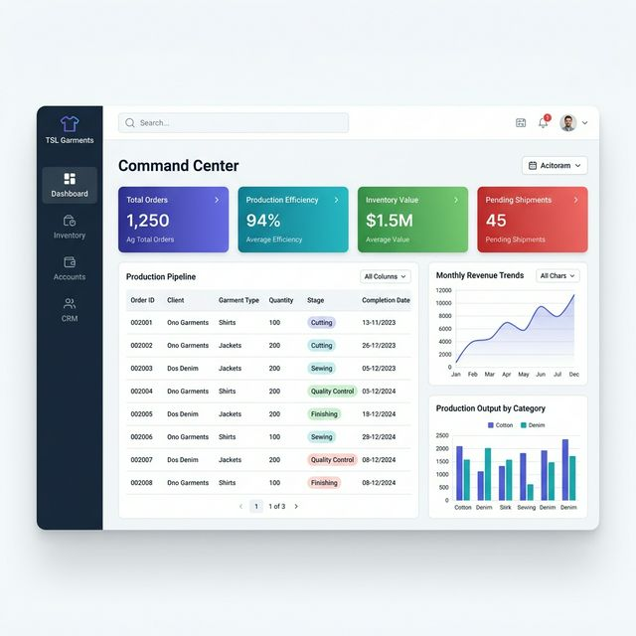
2. Command Center (Live Operations)
â€¢ Real-Time Order & Production Tracking â€¢ Live Capacity & Team Load Distribution â€¢ Priority Delivery Alarms & Critical Alerts â€¢ Dynamic KPI Visualization Cards

Slide 4
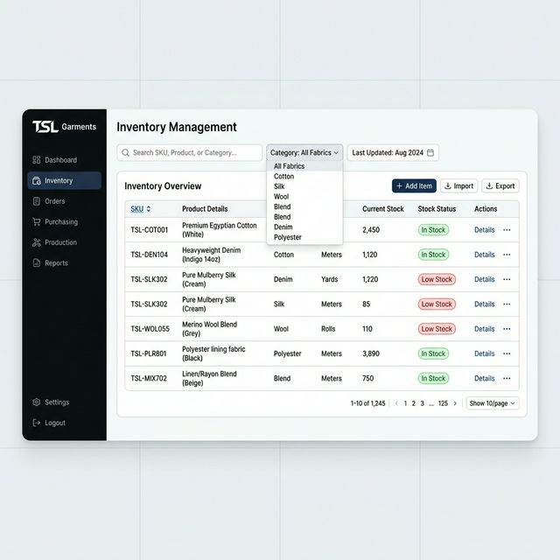
3. Intelligent Inventory Lifecycle
â€¢ SKU-Wise Tracking (Yarn to Finish) â€¢ Smart Low-Stock Warning System â€¢ Categorized Filtering & Warehouse Mapping â€¢ Automated Real-Time Stock Deductions

Slide 5
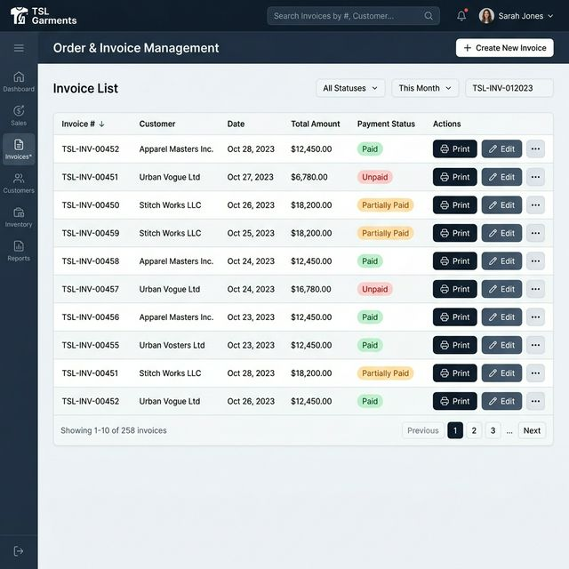
4. Order & Financial Processing
â€¢ Consolidated Billing & Invoice Tracking â€¢ Payment Milestone Monitoring (Paid/Partial) â€¢ Instant PDF/Excel Export Functionality â€¢ Real-Time Ledger Synchronization

Slide 6
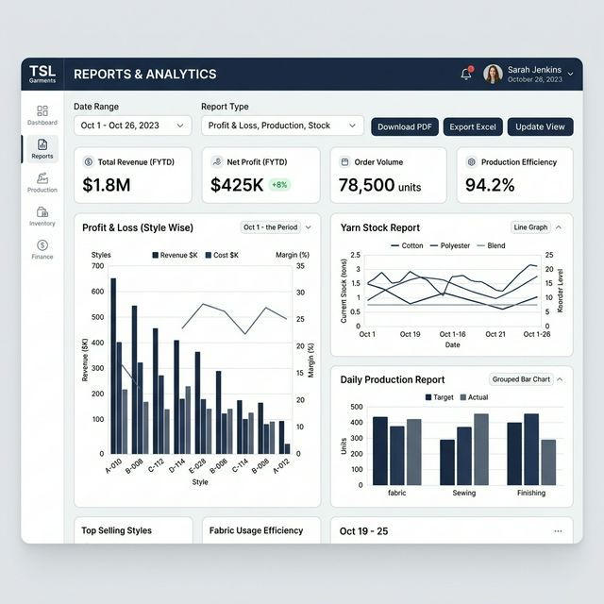
5. Advanced Reporting & BI
â€¢ Style-Wise Profit & Loss Analysis â€¢ Automated GST (GSTR-1) Preparations â€¢ Comprehensive Financial Statements â€¢ Raw Material Resource Audit Reports

Slide 7
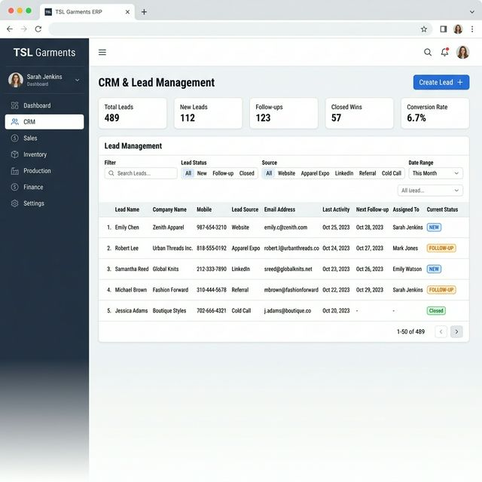
6. CRM & Growth Pipeline
â€¢ Integrated Lead & Sales Funnel â€¢ Source Performance & ROI Tracking â€¢ Status-Driven Customer Engagement â€¢ Centralized Client Communication Hub

Slide 8
TSL ERP: Powering the Future of Garments
Contact us for a detailed walkthrough or configuration queries. Rebranded. Optimized. Prepared for Success.

