Slide 1
TSL
TSL ERP
Integrated Garment Management System
Corporate Presentation • 02 April 2026
📦 Inventory
📊 Reports
💰 Accounts
🤝 CRM
👗 Garments
TSL ERP • Confidential • 02 April 2026

Slide 2
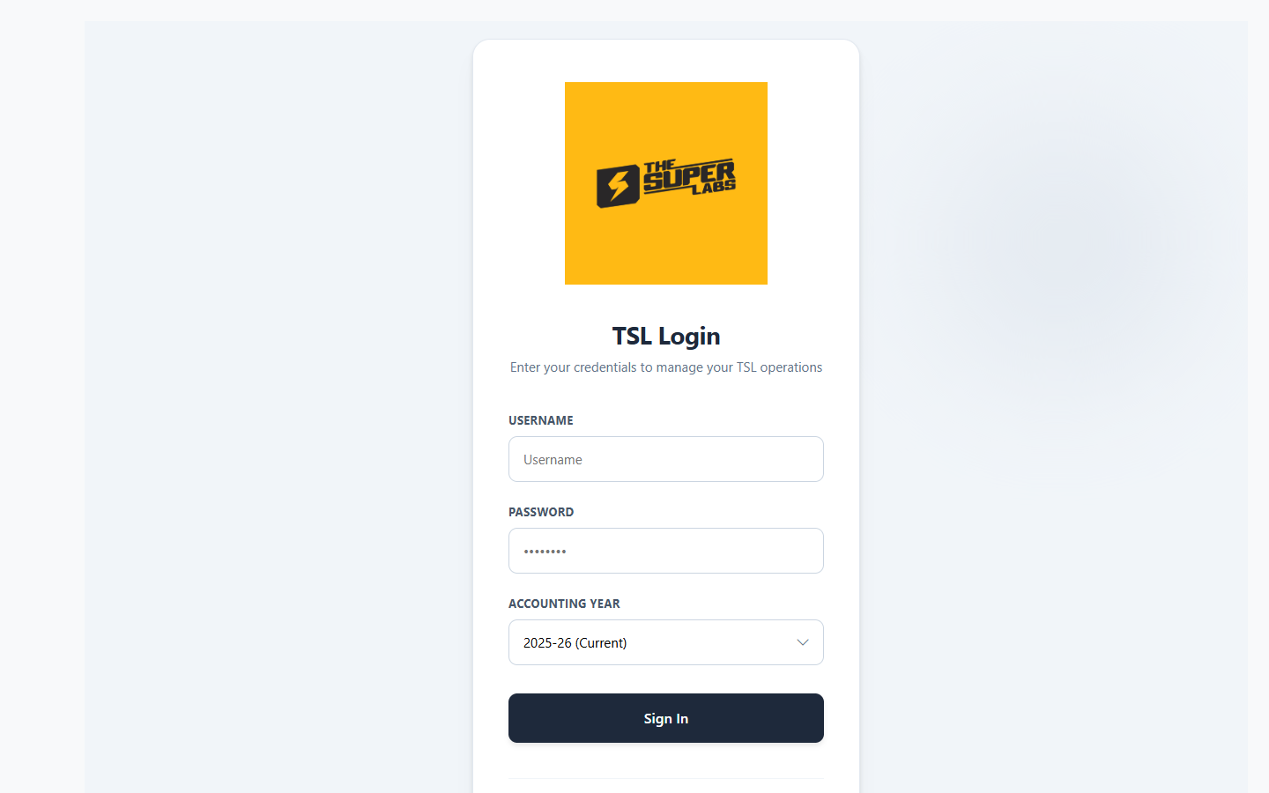
01
Secure Login & Authentication
JWT-Secured Auth
Multi-Year Support
Role-Based Access
Corporate Branding
TSL ERP • Confidential • 02 April 2026

Slide 3

02
2. Command Center (Live Operations)
Real-Time Order & Production Tracking
Live Capacity & Team Load Distribution
Priority Delivery Alarms & Critical Alerts
Dynamic KPI Visualization Cards
TSL ERP • Confidential • 02 April 2026

Slide 4
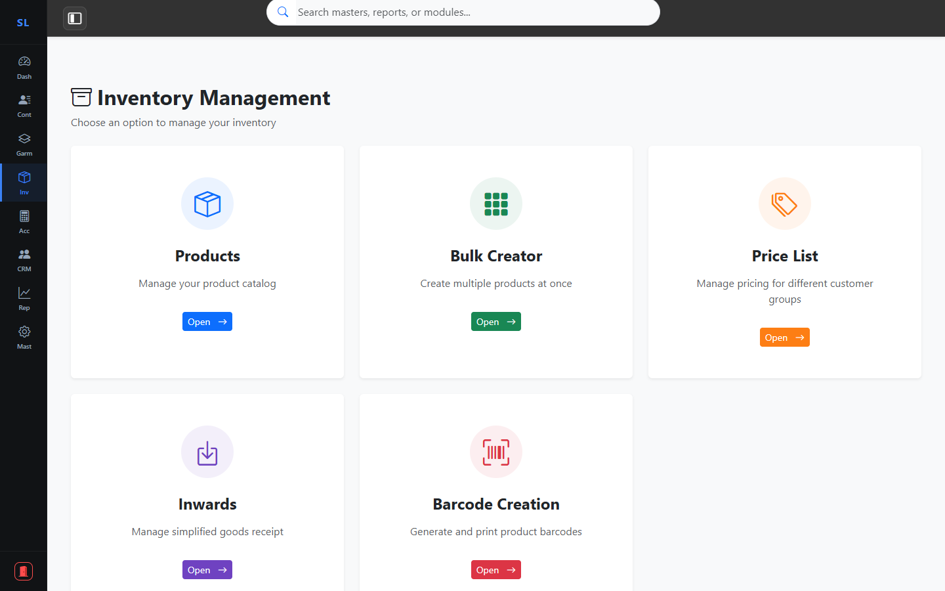
03
3. Intelligent Inventory Lifecycle
SKU-Wise Tracking (Yarn to Finish)
Smart Low-Stock Warning System
Categorized Filtering & Warehouse Mapping
Automated Real-Time Stock Deductions
TSL ERP • Confidential • 02 April 2026

Slide 5

04
4. Order & Financial Processing
Consolidated Billing & Invoice Tracking
Payment Milestone Monitoring (Paid/Partial)
Instant PDF/Excel Export Functionality
Real-Time Ledger Synchronization
TSL ERP • Confidential • 02 April 2026

Slide 6
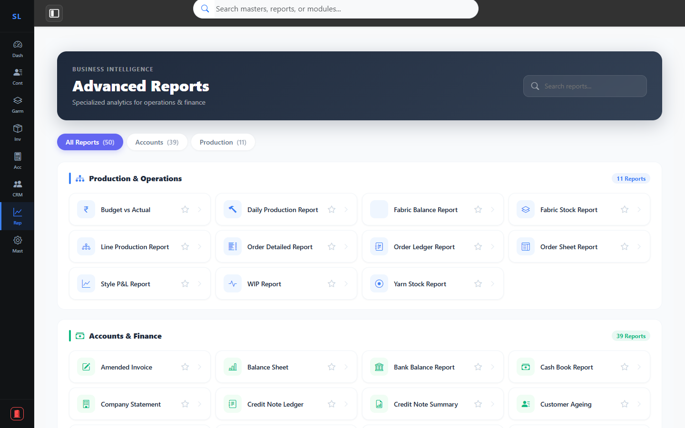
05
5. Advanced Reporting & BI
Style-Wise Profit & Loss Analysis
Automated GST (GSTR-1) Preparations
Comprehensive Financial Statements
Raw Material Resource Audit Reports
TSL ERP • Confidential • 02 April 2026

Slide 7
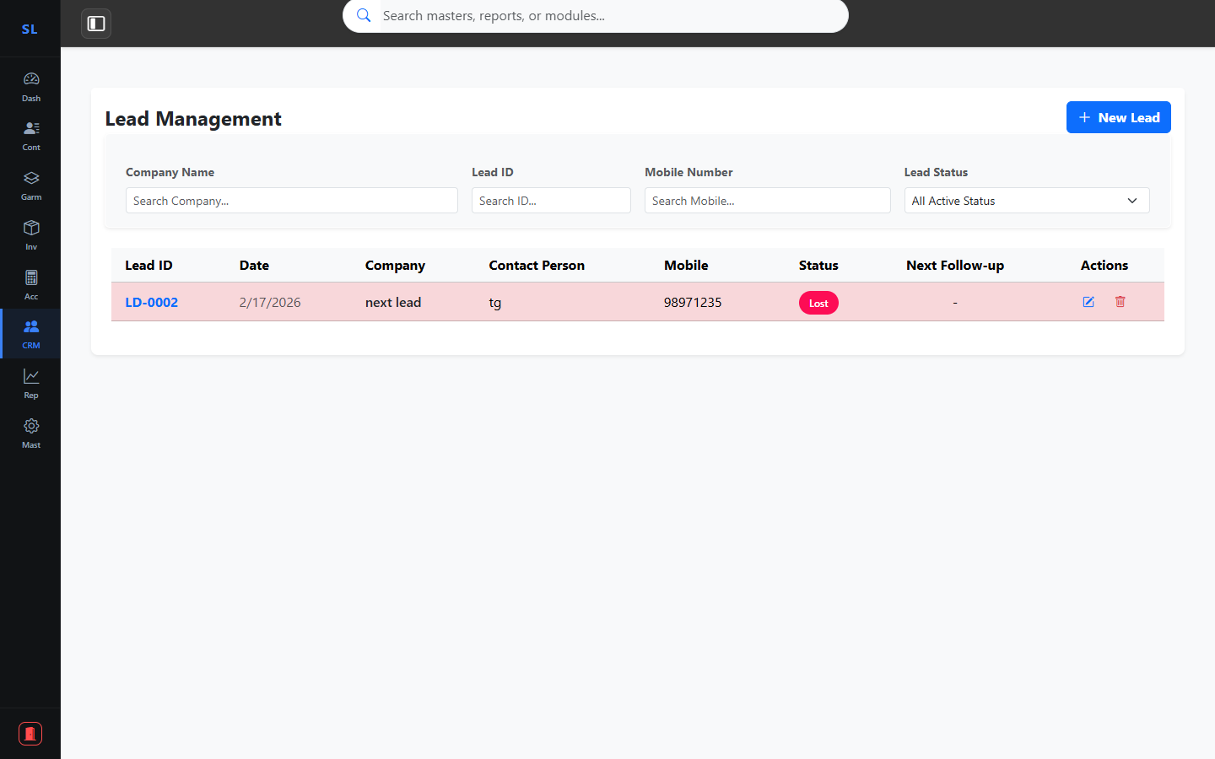
06
6. CRM & Growth Pipeline
Integrated Lead & Sales Funnel
Source Performance & ROI Tracking
Status-Driven Customer Engagement
Centralized Client Communication Hub
TSL ERP • Confidential • 02 April 2026

Slide 8
TSL
TSL ERP
Powering the Future of Garments Industry
Rebranded. Optimized. Prepared for Success.
Contact us for a detailed walkthrough or configuration queries.
Presentation Date: 02 April 2026
TSL ERP • Confidential • 02 April 2026

