Slide 1
TSL
TheSuperlabs ERP
Integrated Garment Management System
📅 02 April 2026
Corporate Presentation
📦 Inventory
📊 Reports
💰 Accounts
🤝 CRM
👗 Garments
🧾 Invoices
Confidential — For Internal Use Only

Slide 2
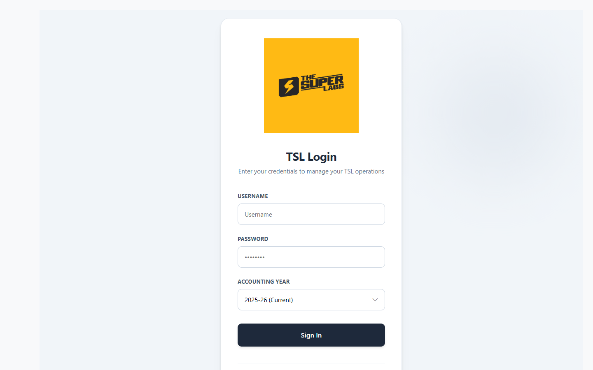
02
Secure Login & Authentication
Module: Login
Multi-Year Accounting Support
Role-Based Access Control
TSL Corporate Branding
TheSuperlabs ERP • Confidential • 02 April 2026

Slide 3
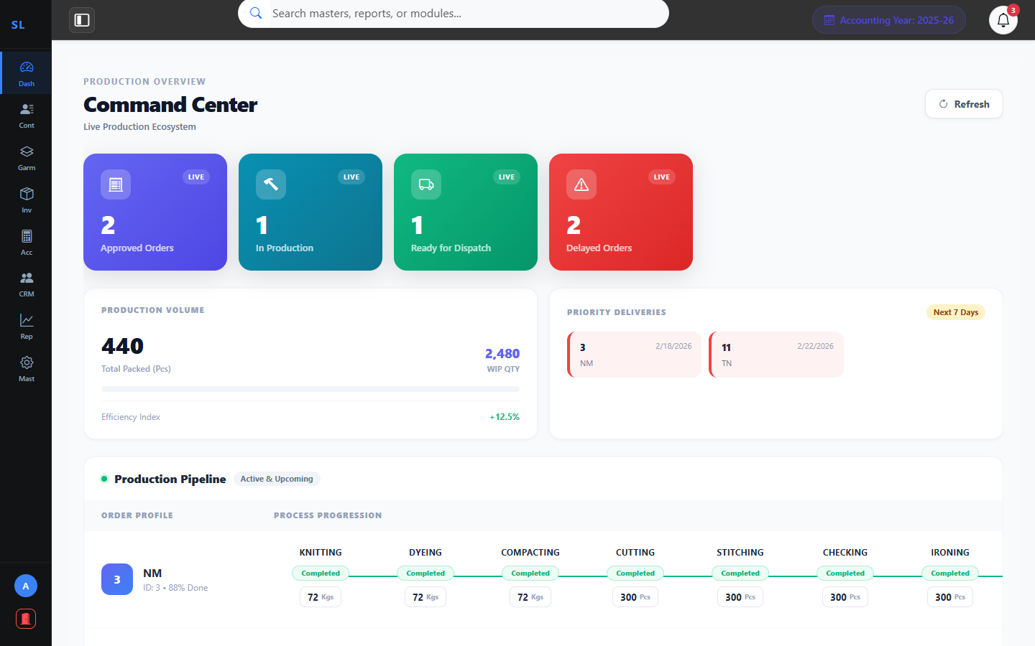
03
Command Center – Live Operations
Module: Dashboard
Real-Time KPI Cards
Order & Production Tracking
Priority Delivery Alerts
Team Load & Capacity View
TheSuperlabs ERP • Confidential • 02 April 2026

Slide 4
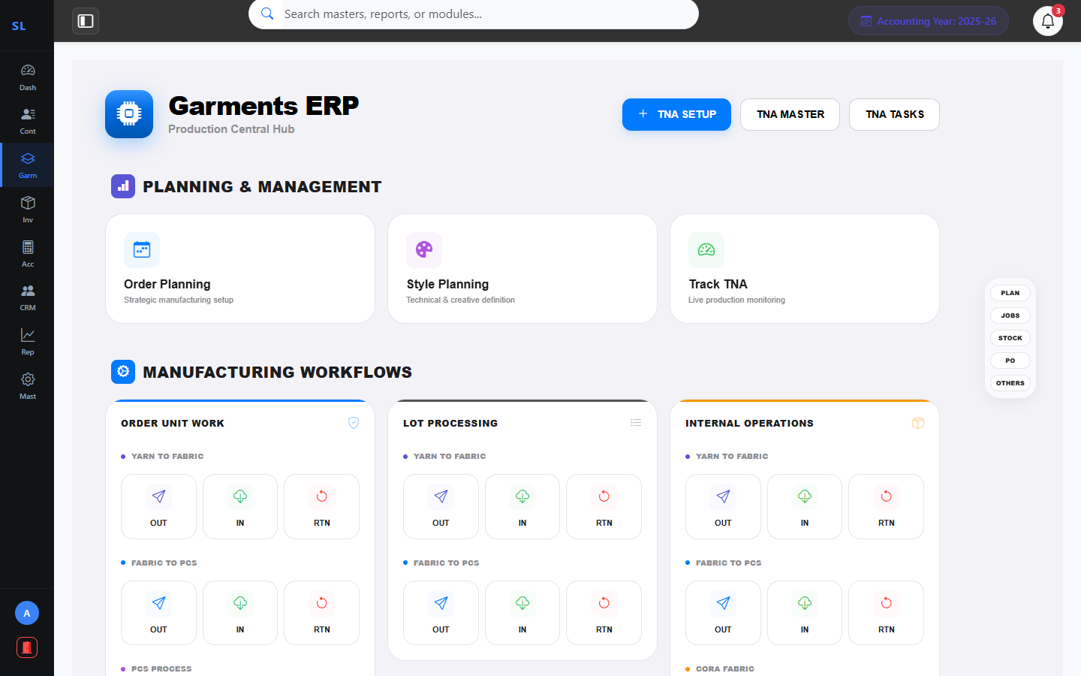
05
Garments Production Hub (1/2) – Planning & Workflows
Module: Garments
Order & Style Planning
Track TNA Progress
Order Unit Workflows
Lot & Internal Processing
TheSuperlabs ERP • Confidential • 02 April 2026

Slide 5
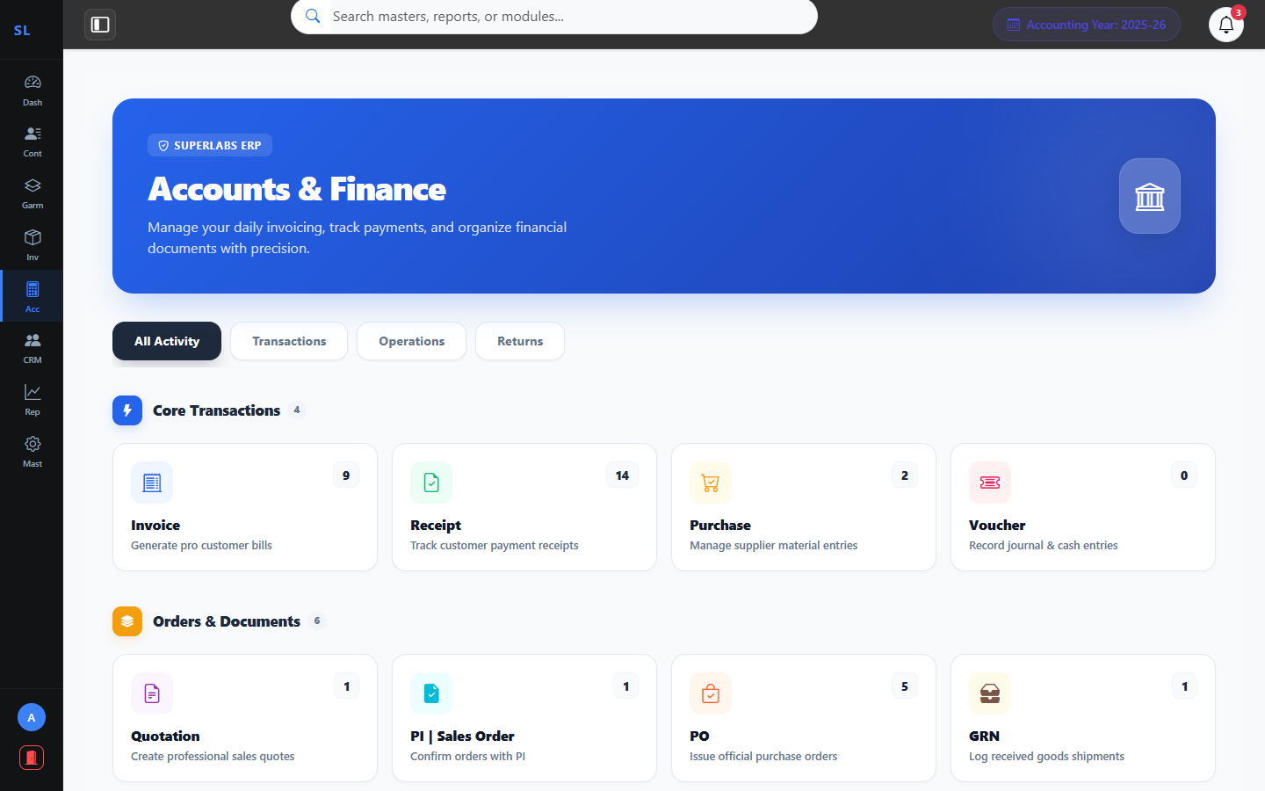
08
Accounts & Finance
Module: Accounts
Invoice & Billing Hub
Purchase & Receipts
Credit / Debit Notes
Voucher & Ledger Management
TheSuperlabs ERP • Confidential • 02 April 2026

Slide 6
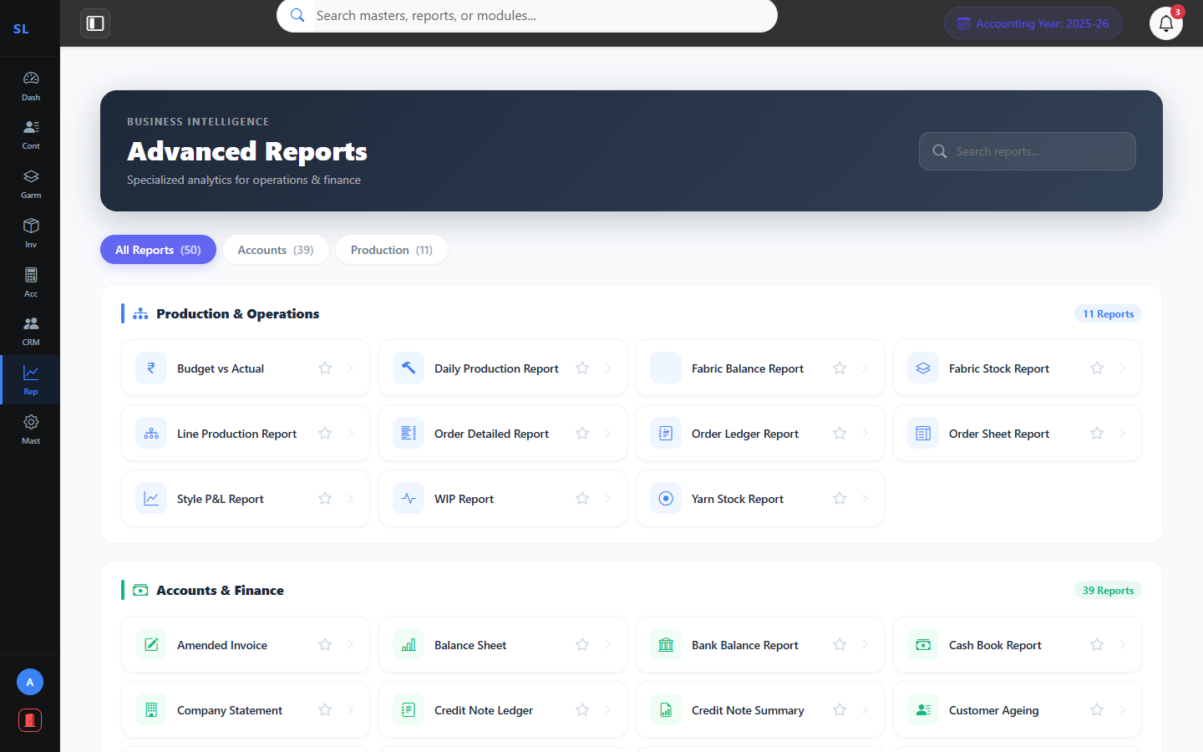
10
Advanced Reporting & Business Intelligence
Module: Reports
Profit & Loss (Style-Wise)
GSTR-1 Preparation
Balance Sheet & Trial Balance
Stock & Ageing Reports
TheSuperlabs ERP • Confidential • 02 April 2026

Slide 7
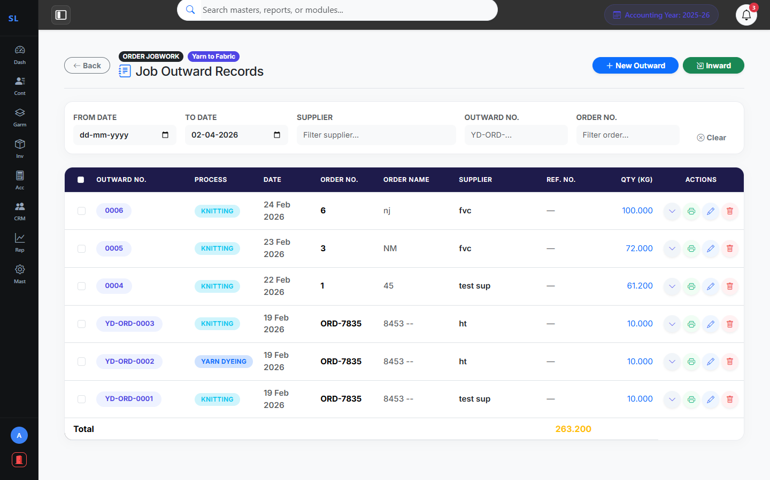
11
Yarn to Fabric Workflow
Garments: Production Workflows
Yarn Dyeing Tracking
Track Outward & Inward
Reference & Ref No Support
Real-time Stock Impact
TheSuperlabs ERP • Confidential • 02 April 2026

Slide 8
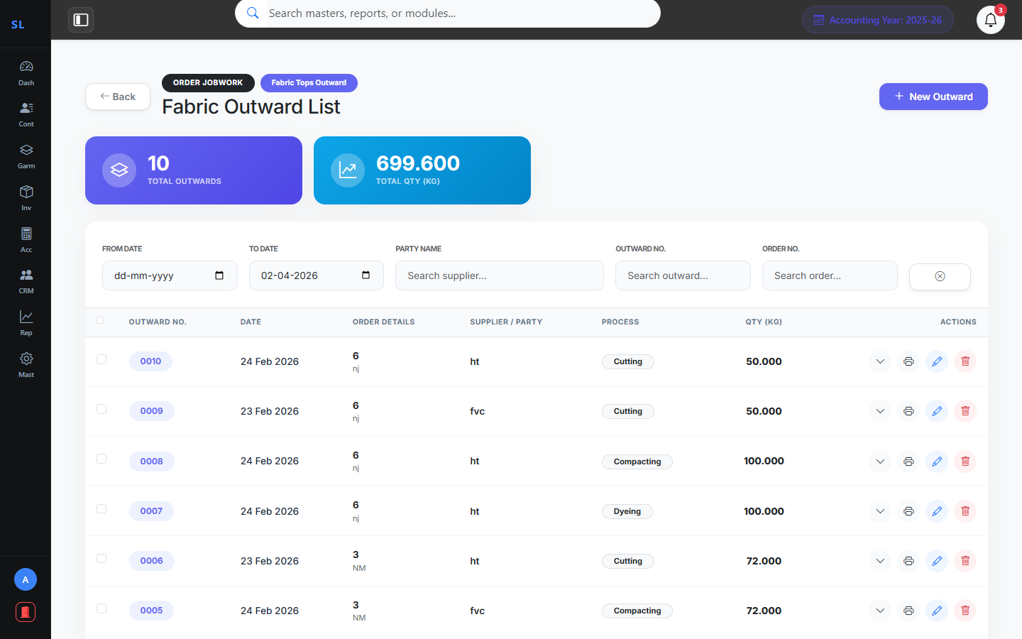
13
Fabric to Pcs Outward Flow
Garments: Production Workflows
Fabric Delivery Tracking
Contractor-wise Management
Style & Color Integrity
Outward for Cutting/Printing
TheSuperlabs ERP • Confidential • 02 April 2026

Slide 9
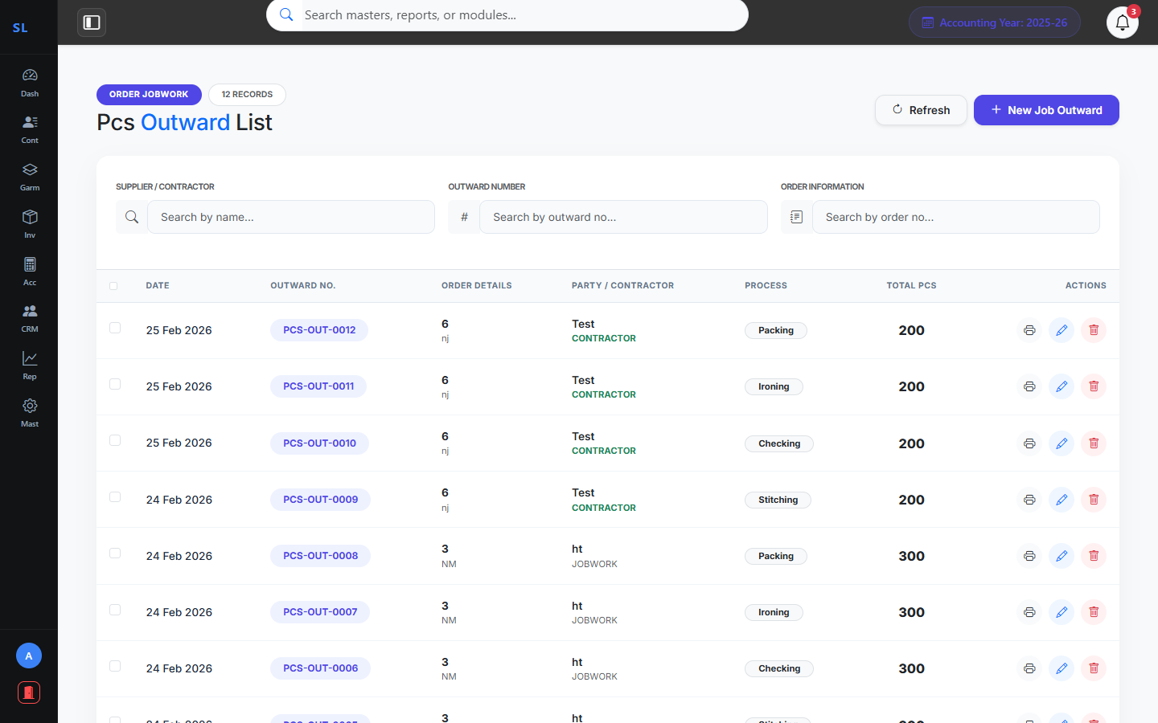
15
PCS Outward Tracking
Garments: Production Workflows
Finished Piece Tracking
Jobwork Production Control
Stage-wise Audit Flow
Approval Lifecycle Status
TheSuperlabs ERP • Confidential • 02 April 2026

Slide 10
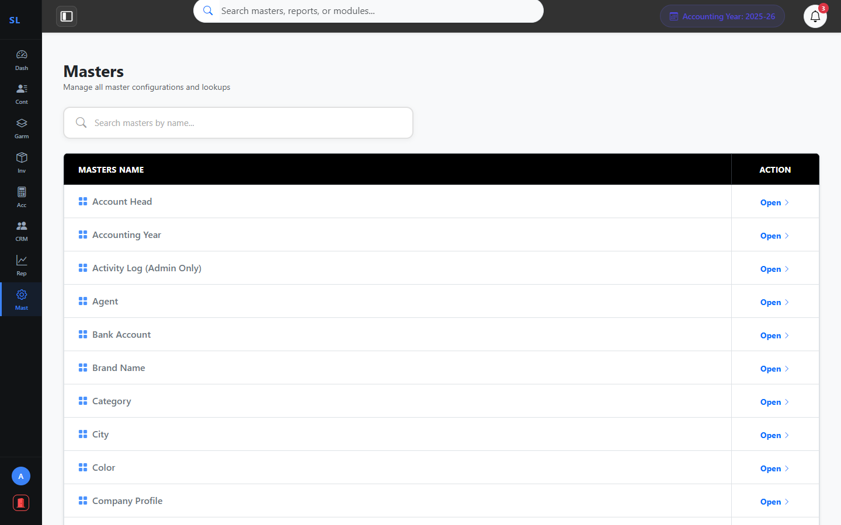
17
System Masters & Configuration
Module: Masters
Company Profile Setup
User & Privilege Management
Accounting Year Configuration
All Reference Master Data
TheSuperlabs ERP • Confidential • 02 April 2026

Slide 11
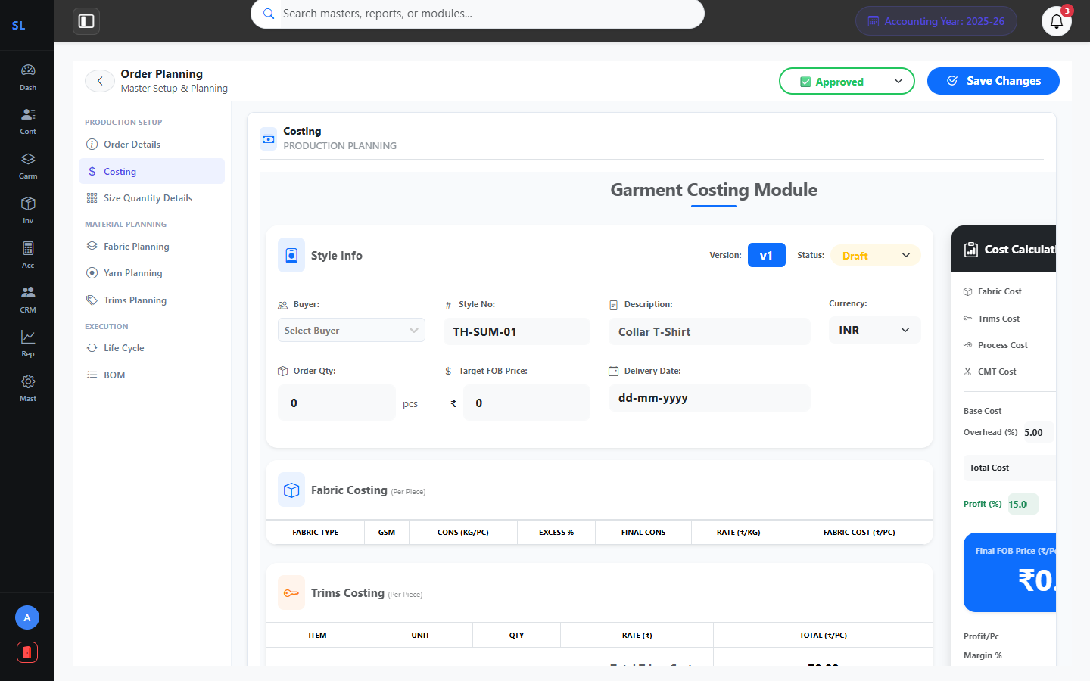
24
Order Planning – Costing
Module: Garments → Order Planning → Costing
Budget Cost Per Piece
CMT & Material Costing
Overhead & Profit Margins
Buyer-Wise Pricing
TheSuperlabs ERP • Confidential • 02 April 2026

Slide 12
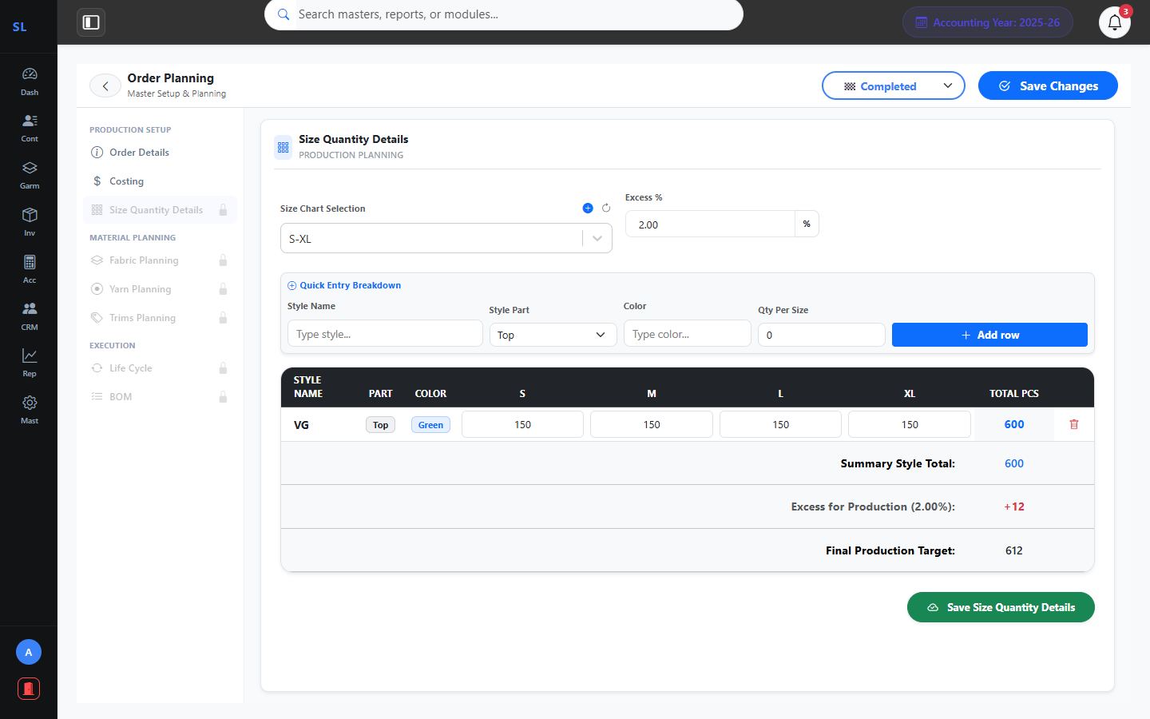
25
Order Planning – Size Quantity
Module: Garments → Order Planning → Size Qty Details
Size Chart Integration
Style-Wise Qty Matrix
Color & Ratio Breakdown
Total Qty Auto-Calc
TheSuperlabs ERP • Confidential • 02 April 2026

Slide 13
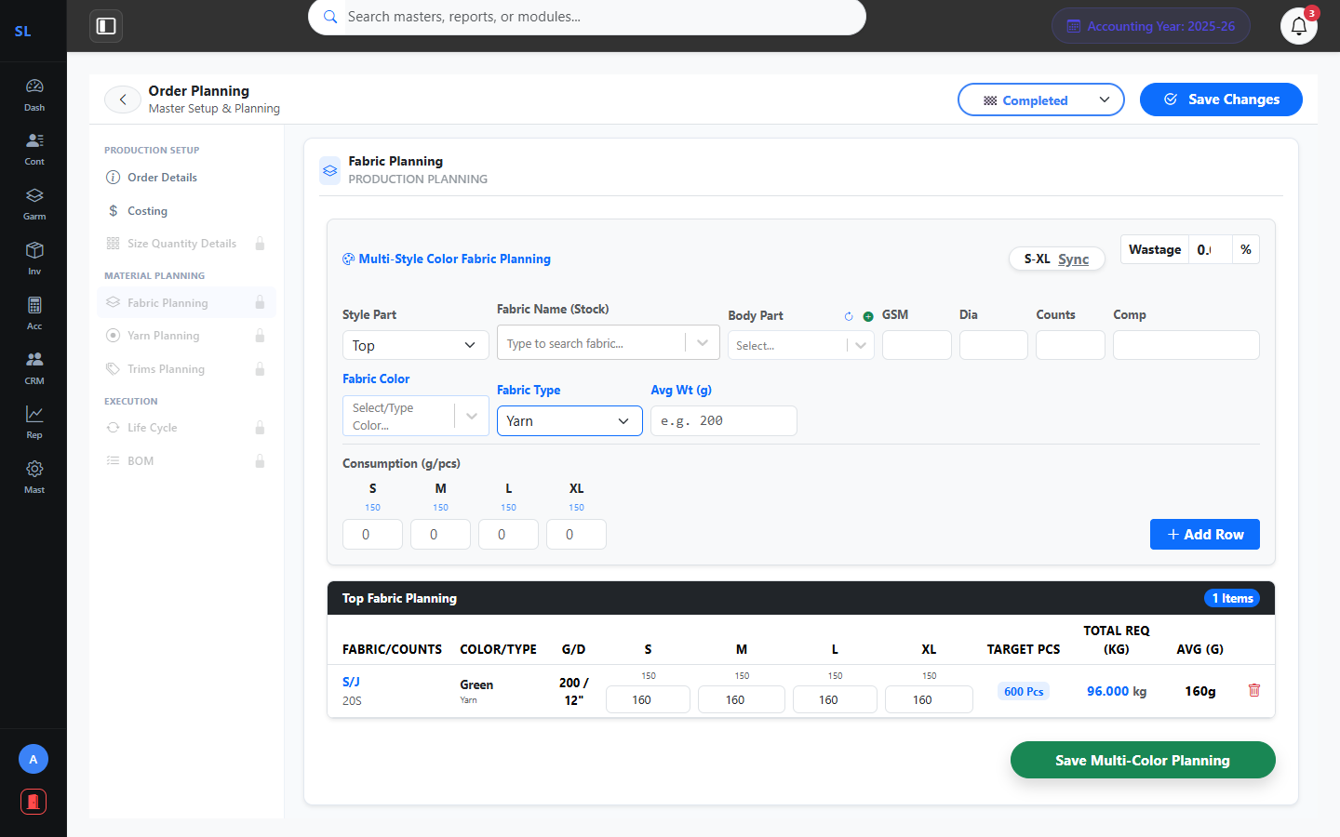
26
Order Planning – Fabric Planning
Module: Garments → Order Planning → Fabric Planning
Fabric Code & Composition
Required Qty per Size
Supplier Mapping
Shrinkage Allowance
TheSuperlabs ERP • Confidential • 02 April 2026

Slide 14
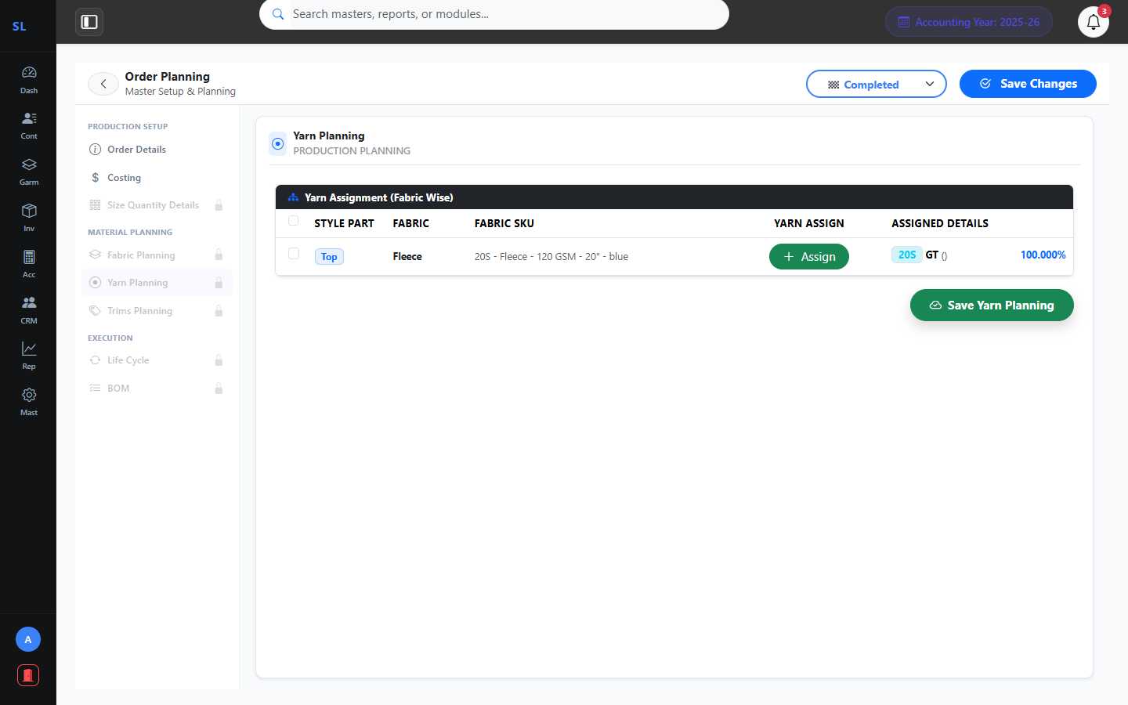
27
Order Planning – Yarn Planning
Module: Garments → Order Planning → Yarn Planning
Yarn Type & Count
Per Kg Requirement
Supplier & Mill Details
Color & Twist Specs
TheSuperlabs ERP • Confidential • 02 April 2026

Slide 15
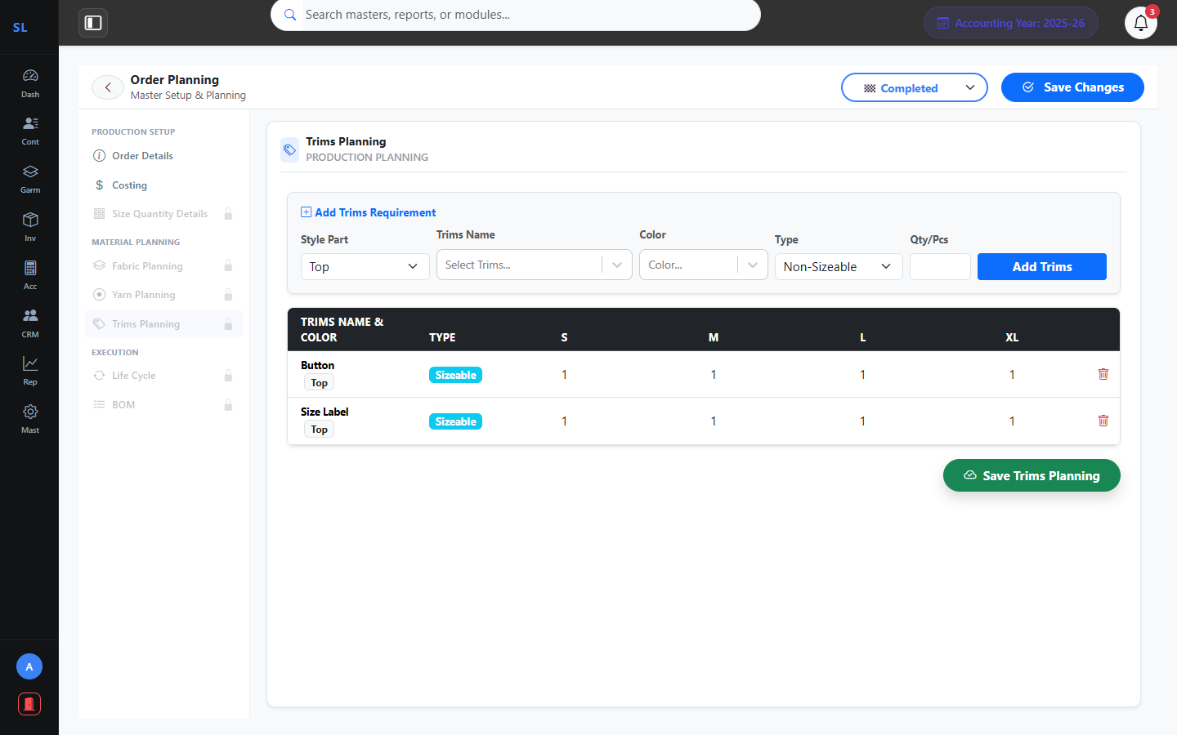
28
Order Planning – Trims Planning
Module: Garments → Order Planning → Trims Planning
Button, Label & Tag Planning
Per Piece Consumption
Supplier & Brand Details
Cost Tracking
TheSuperlabs ERP • Confidential • 02 April 2026

Slide 16
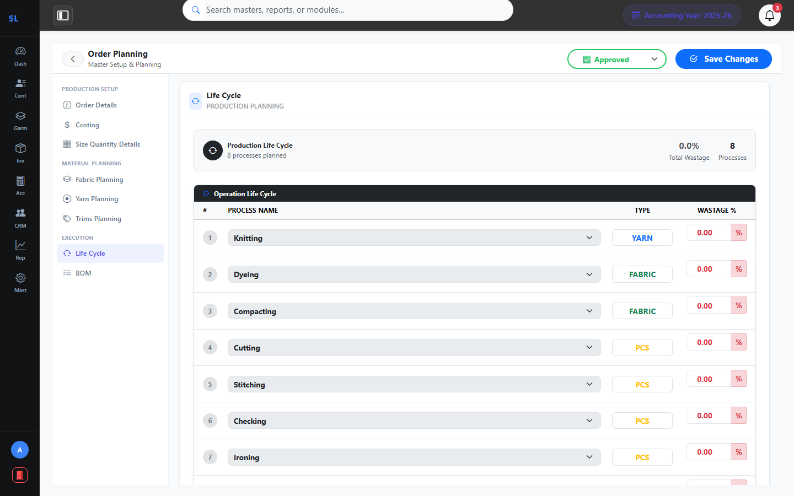
29
Order Planning – Life Cycle
Module: Garments → Order Planning → Life Cycle
Production Stage Mapping
Date & Progress Tracking
Responsibility Assignment
Status Monitoring
TheSuperlabs ERP • Confidential • 02 April 2026

Slide 17
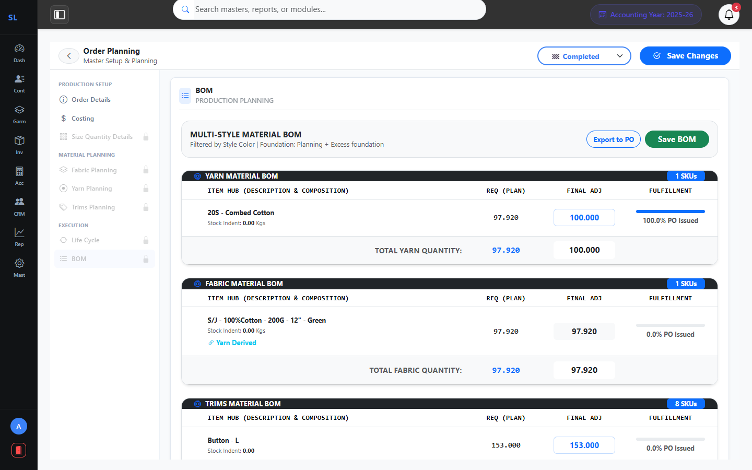
30
Order Planning – Bill of Materials
Module: Garments → Order Planning → BOM
Complete Material List
Estimated vs Actual Cost
Auto-Generated from Plans
Export Ready Summary
TheSuperlabs ERP • Confidential • 02 April 2026

Slide 18
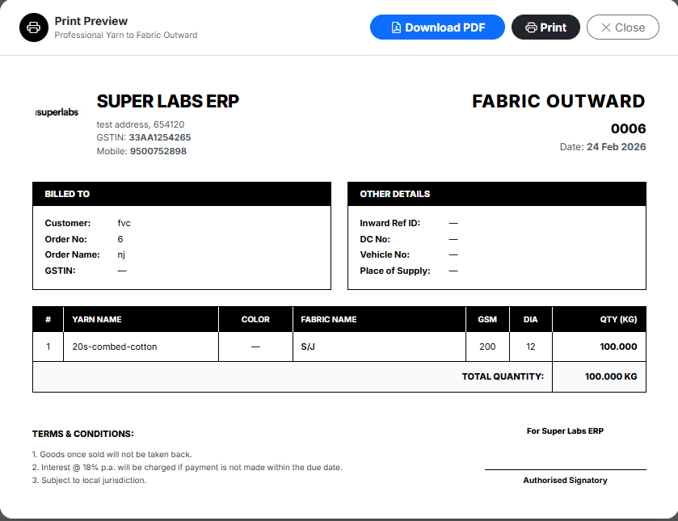
31
Print Preview: Yarn to Fabric Outward
Garments: Print Layouts
Professional Print Layout
Company Branding Header
Order & Party Details
Billed To & Shipping Info
TheSuperlabs ERP • Confidential • 02 April 2026

Slide 19
TSL
TheSuperlabs ERP
Powering the Future of Garments Industry
Thank You!
Rebranded. Optimized. Prepared for Success.
Contact us for a detailed walkthrough or configuration queries.
Presentation Date: 02 April 2026
📦 Inventory
🧾 Invoices
📊 Reports
🤝 CRM
👗 Garments

