Slide 1
TSL
TheSuperlabs ERP
Integrated Garment Management System
📅 02 April 2026
Corporate Presentation
📦 Inventory
📊 Reports
💰 Accounts
🤝 CRM
👗 Garments
🧾 Invoices
Confidential — For Internal Use Only

Slide 2
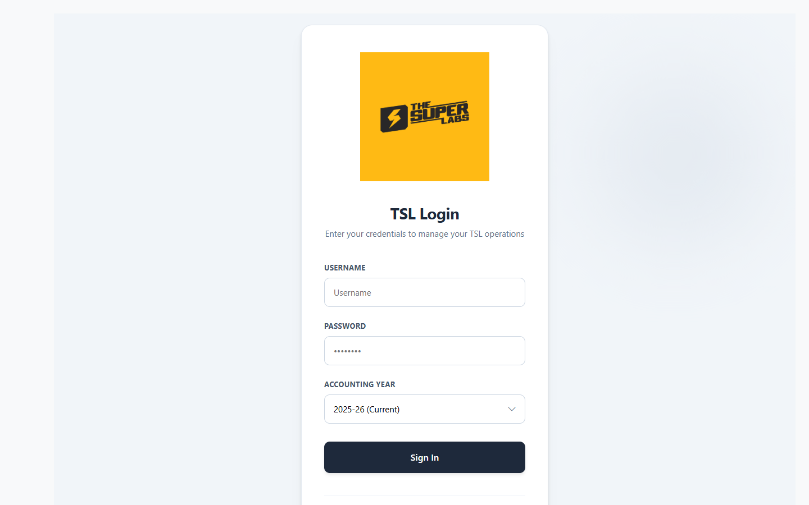
02
Secure Login & Authentication
Module: Login
JWT-Secured Authentication
Multi-Year Accounting Support
Role-Based Access Control
TSL Corporate Branding
TheSuperlabs ERP • Confidential • 02 April 2026

Slide 3
03
Command Center – Live Operations
Module: Dashboard
Real-Time KPI Cards
Order & Production Tracking
Priority Delivery Alerts
Team Load & Capacity View
TheSuperlabs ERP • Confidential • 02 April 2026

Slide 4
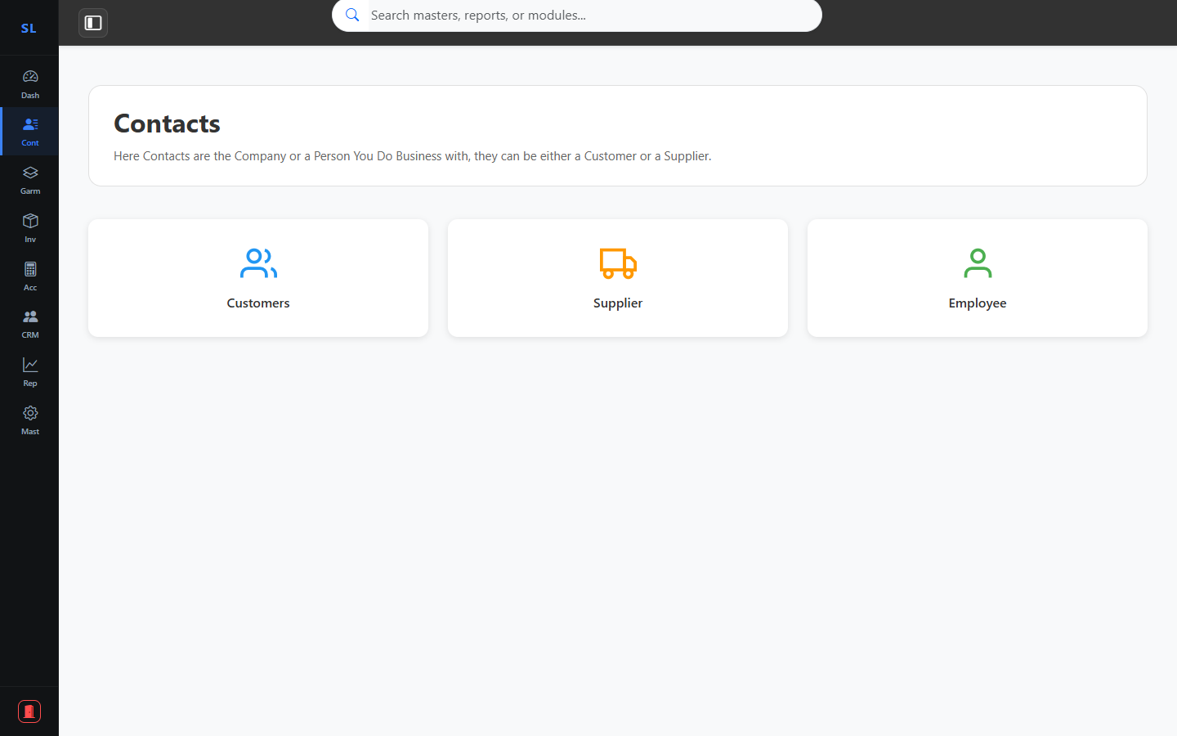
04
Contacts & Directory
Module: Contacts
Customer Directory
Supplier Directory
Agent & Staff Contacts
Search & Quick Lookup
TheSuperlabs ERP • Confidential • 02 April 2026

Slide 5
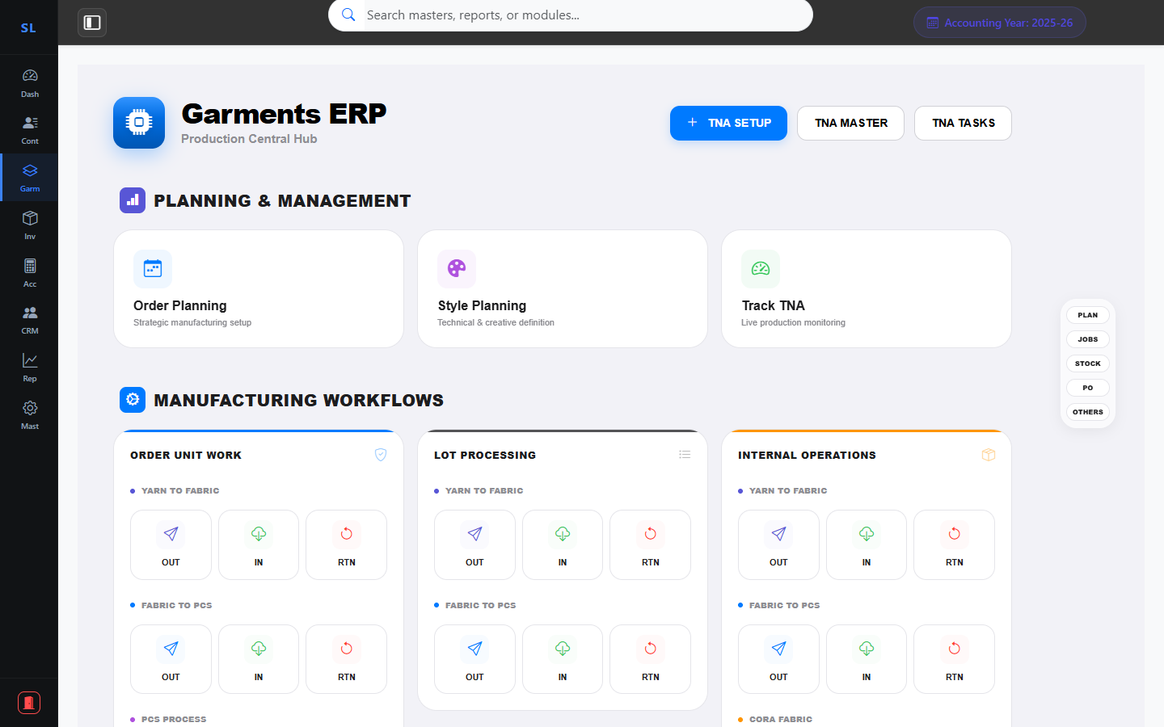
05
Garments Production Hub (1/2) – Planning & Workflows
Module: Garments
Order & Style Planning
Track TNA Progress
Order Unit Workflows
Lot & Internal Processing
TheSuperlabs ERP • Confidential • 02 April 2026

Slide 6
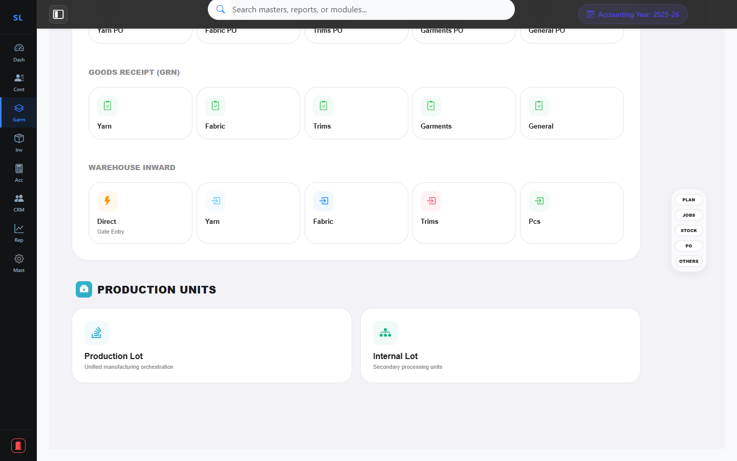
06
Garments Production Hub (2/2) – Materials & Logistics
Module: Garments
Yarn / Fabric / Trims Stock
Purchase Orders (PO)
Goods Receipt (GRN)
Production & Internal Lots
TheSuperlabs ERP • Confidential • 02 April 2026

Slide 7
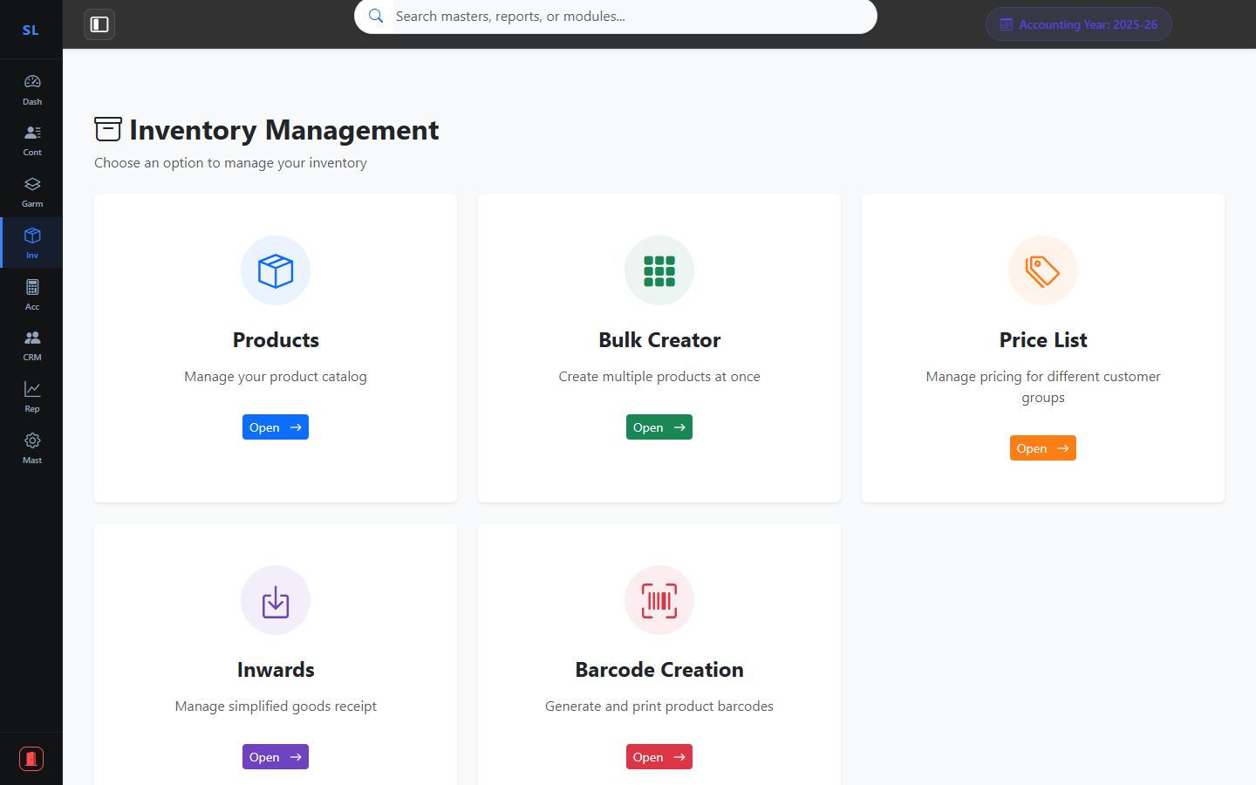
07
Inventory Management
Module: Inventory
Product Catalogue
SKU-Wise Stock Tracking
Price List Management
Barcode Generation
TheSuperlabs ERP • Confidential • 02 April 2026

Slide 8
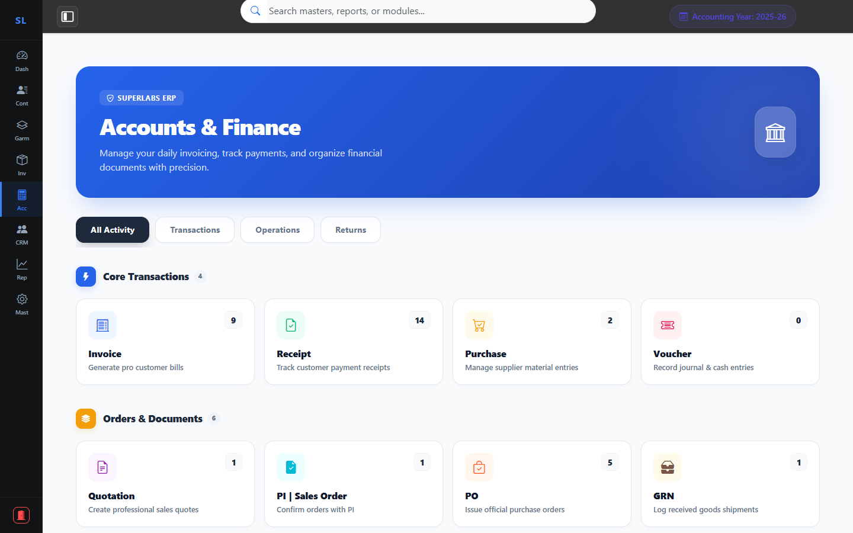
08
Accounts & Finance
Module: Accounts
Invoice & Billing Hub
Purchase & Receipts
Credit / Debit Notes
Voucher & Ledger Management
TheSuperlabs ERP • Confidential • 02 April 2026

Slide 9
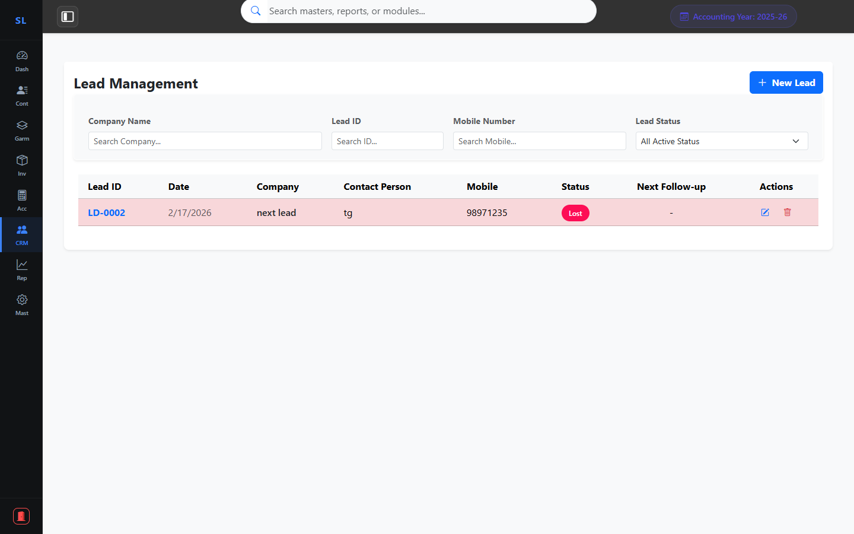
09
CRM – Growth Pipeline
Module: CRM
Lead & Sales Funnel
Source Performance Tracking
Status-Driven Engagement
Client Communication Hub
TheSuperlabs ERP • Confidential • 02 April 2026

Slide 10
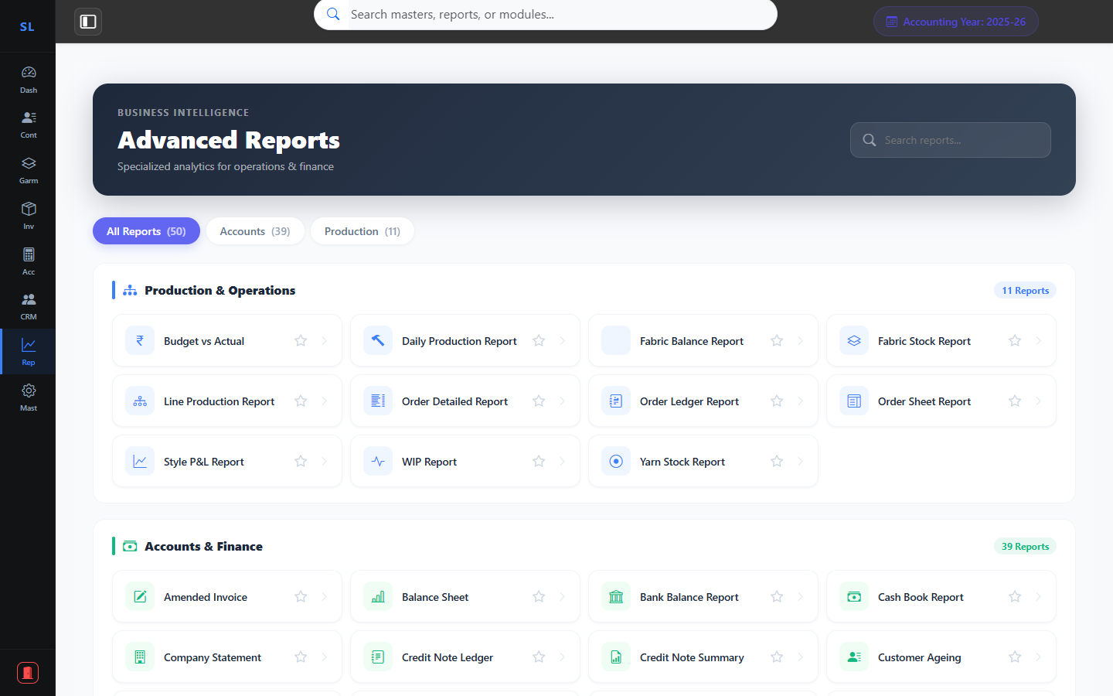
10
Advanced Reporting & Business Intelligence
Module: Reports
Profit & Loss (Style-Wise)
GSTR-1 Preparation
Balance Sheet & Trial Balance
Stock & Ageing Reports
TheSuperlabs ERP • Confidential • 02 April 2026

Slide 11
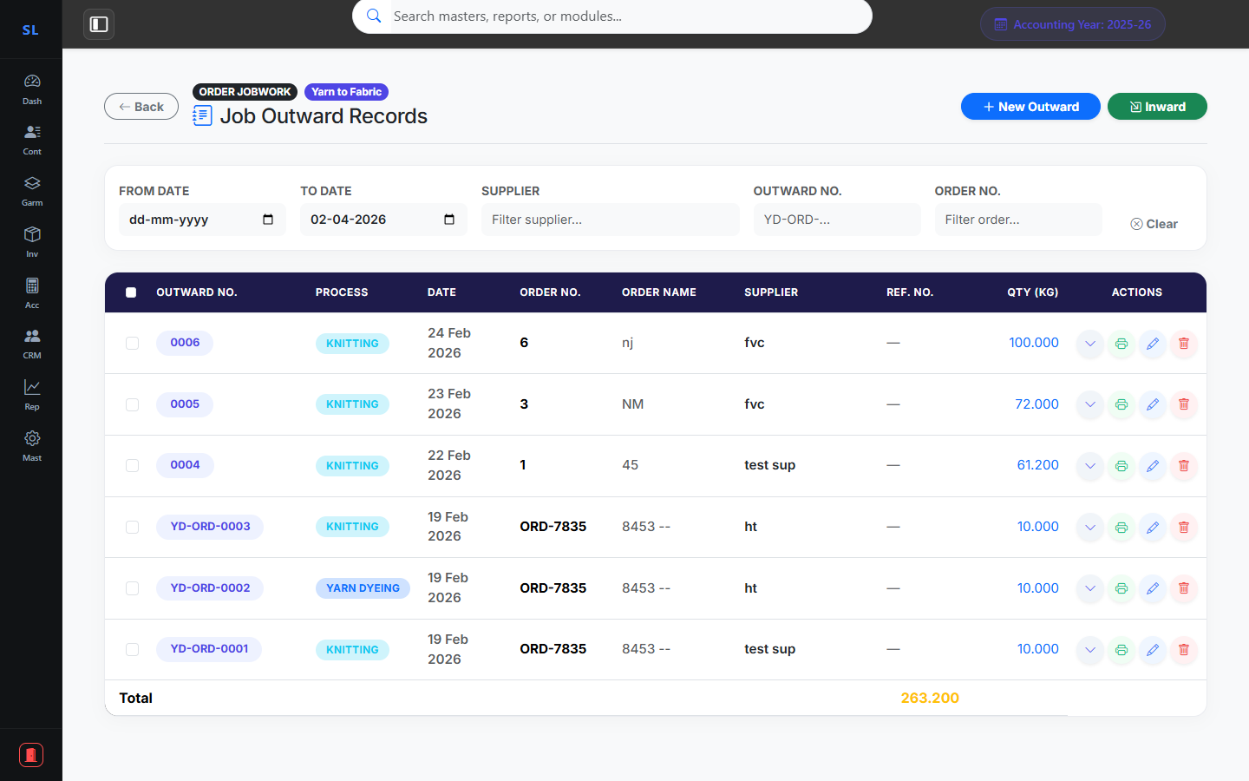
11
Yarn to Fabric Workflow
Garments: Production Workflows
Yarn Dyeing Tracking
Track Outward & Inward
Reference & Ref No Support
Real-time Stock Impact
TheSuperlabs ERP • Confidential • 02 April 2026

Slide 12
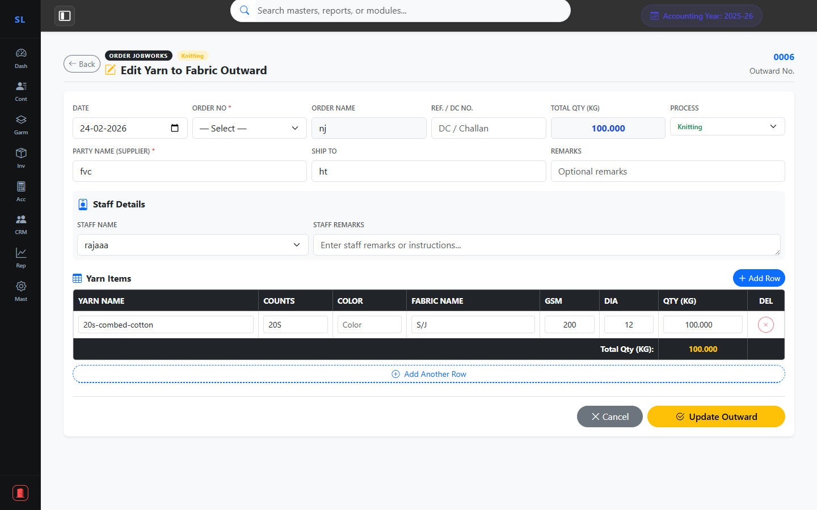
12
Yarn to Fabric Form Details
Garments: Jobwork Forms
Detailed Yardage Tracking
Process Selection & Party Mapping
Audit Log & Remarks Support
Multi-item Outward Flow
TheSuperlabs ERP • Confidential • 02 April 2026

Slide 13
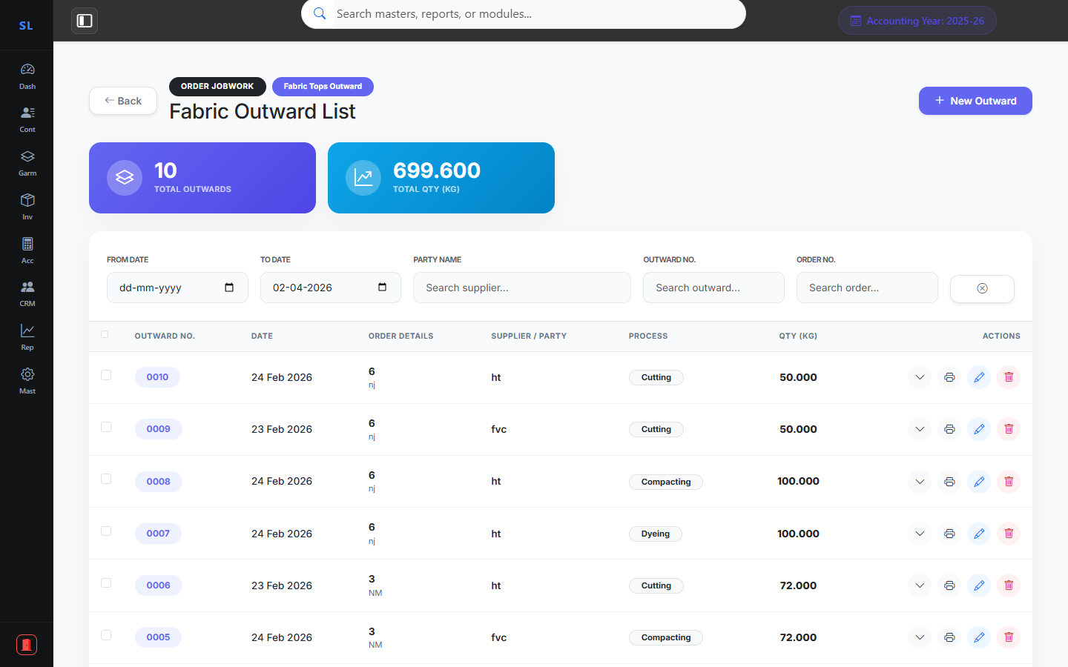
13
Fabric to Pcs Outward Flow
Garments: Production Workflows
Fabric Delivery Tracking
Contractor-wise Management
Style & Color Integrity
Outward for Cutting/Printing
TheSuperlabs ERP • Confidential • 02 April 2026

Slide 14
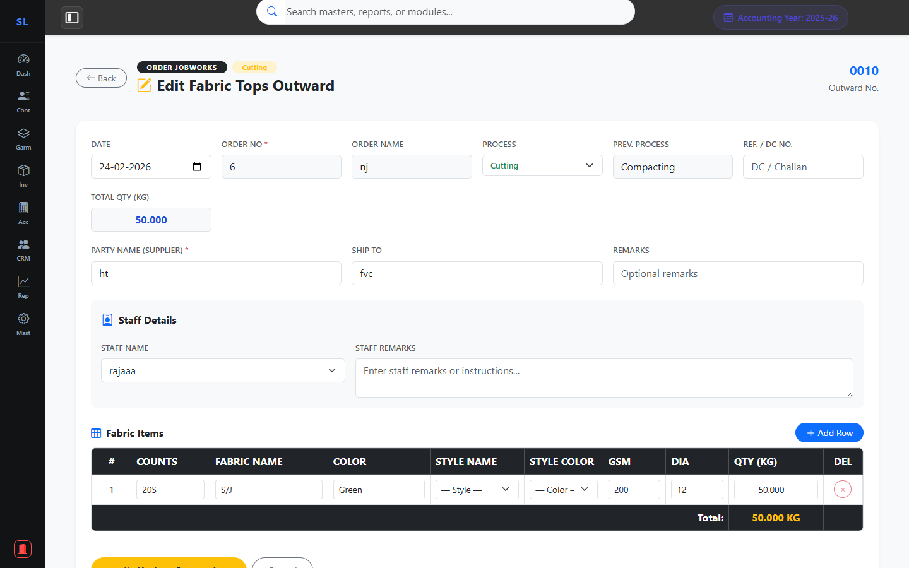
14
Fabric to Pcs Form Details
Garments: Jobwork Forms
GSM & Dia Verification
SKU-level Accuracy
Auto-reduction of Fabric Stock
Contractor Assignment Flow
TheSuperlabs ERP • Confidential • 02 April 2026

Slide 15
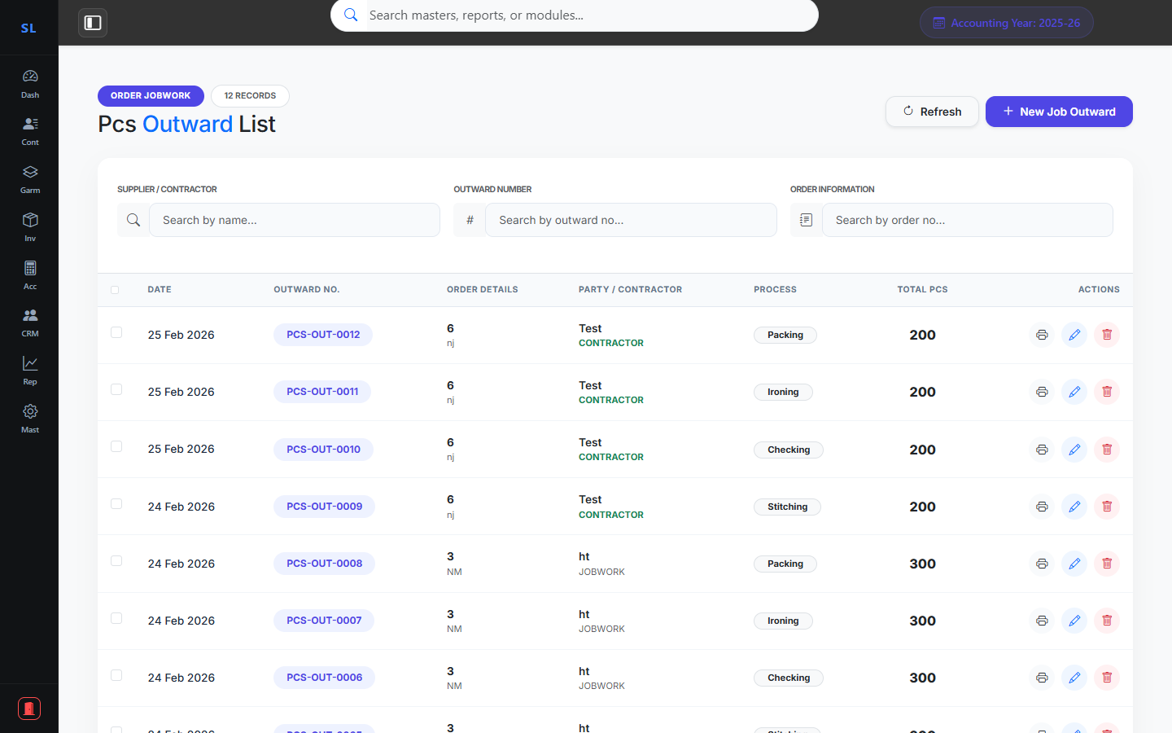
15
PCS Outward Tracking
Garments: Production Workflows
Finished Piece Tracking
Jobwork Production Control
Stage-wise Audit Flow
Approval Lifecycle Status
TheSuperlabs ERP • Confidential • 02 April 2026

Slide 16
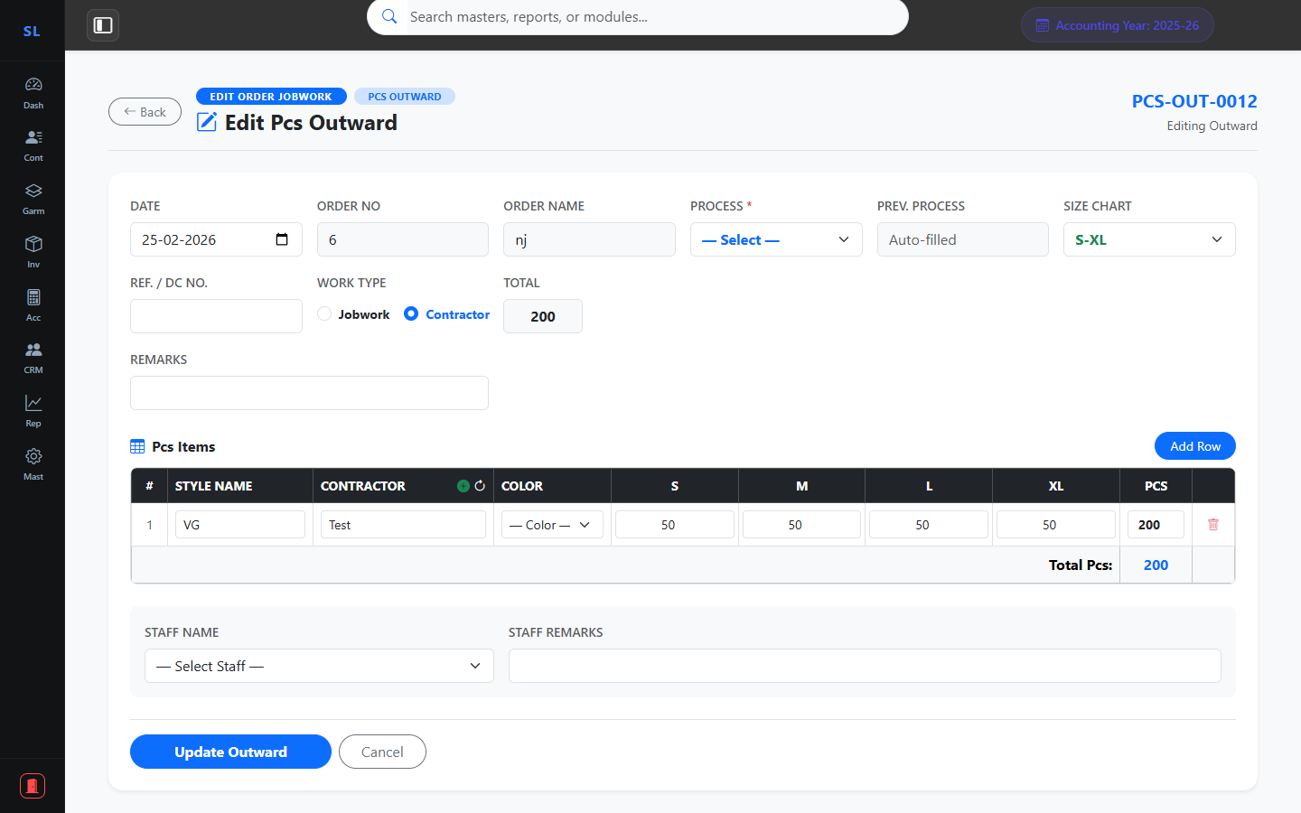
16
PCS Outward Form Details
Garments: Jobwork Forms
Production Qty Validation
Itemized Distribution
Real-time WIP Reports
Seamless Data Entry Experience
TheSuperlabs ERP • Confidential • 02 April 2026

Slide 17
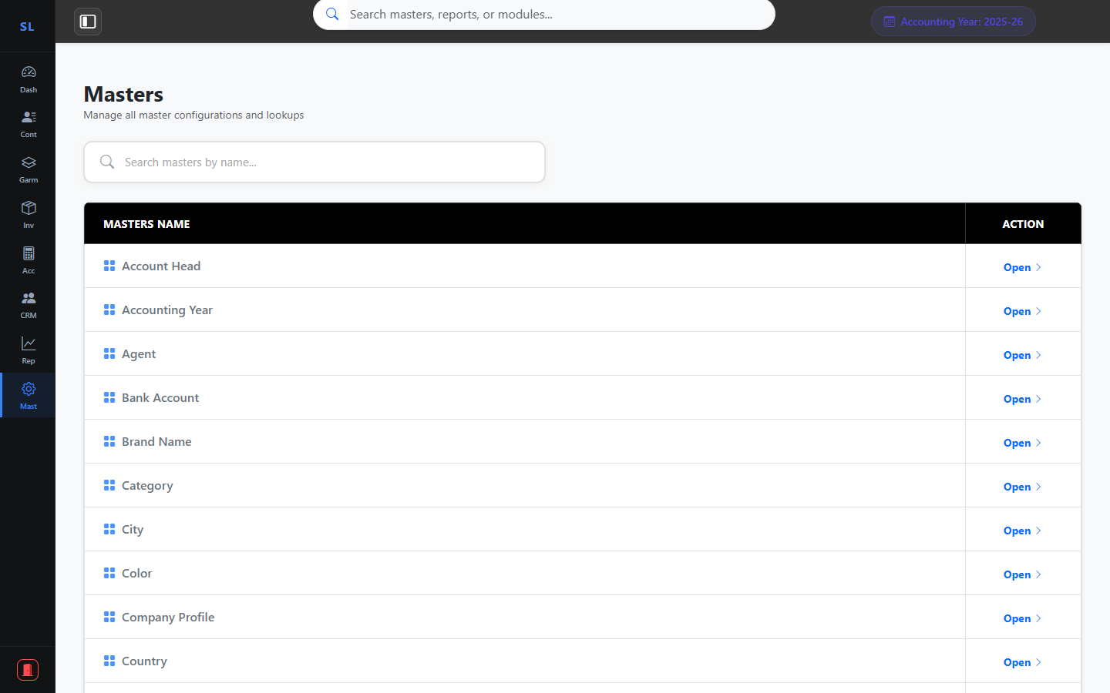
17
System Masters & Configuration
Module: Masters
Company Profile Setup
User & Privilege Management
Accounting Year Configuration
All Reference Master Data
TheSuperlabs ERP • Confidential • 02 April 2026

Slide 18
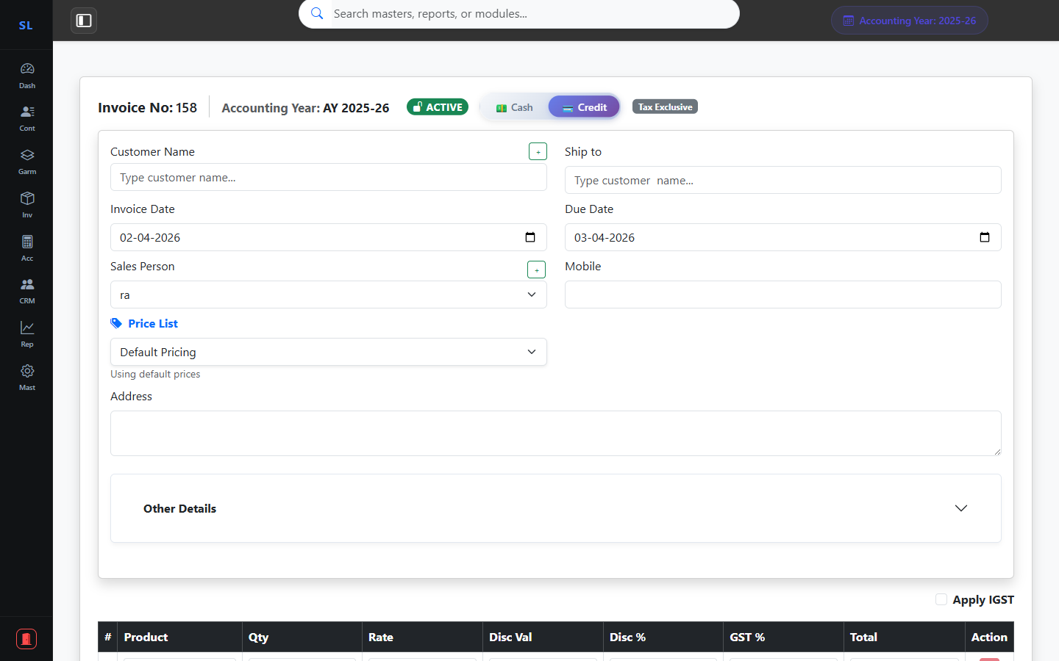
18
Invoice Creation Form
Module: Accounts → New Invoice
Auto Product Search
Multi-Item Line Billing
GST & Tax Calculation
PDF Download Ready
TheSuperlabs ERP • Confidential • 02 April 2026

Slide 19
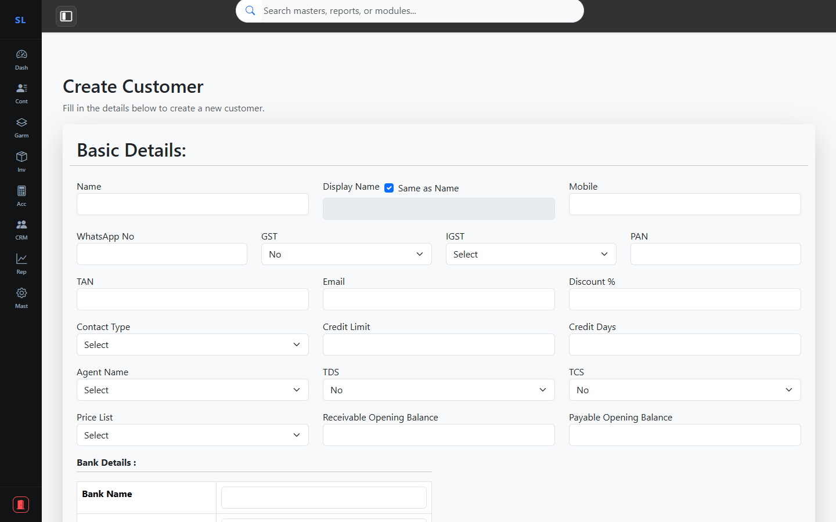
19
Customer Registration Form
Module: Contacts → New Customer
Full Contact Details
GST & PAN Fields
Address & Billing Info
Referral Code Support
TheSuperlabs ERP • Confidential • 02 April 2026

Slide 20
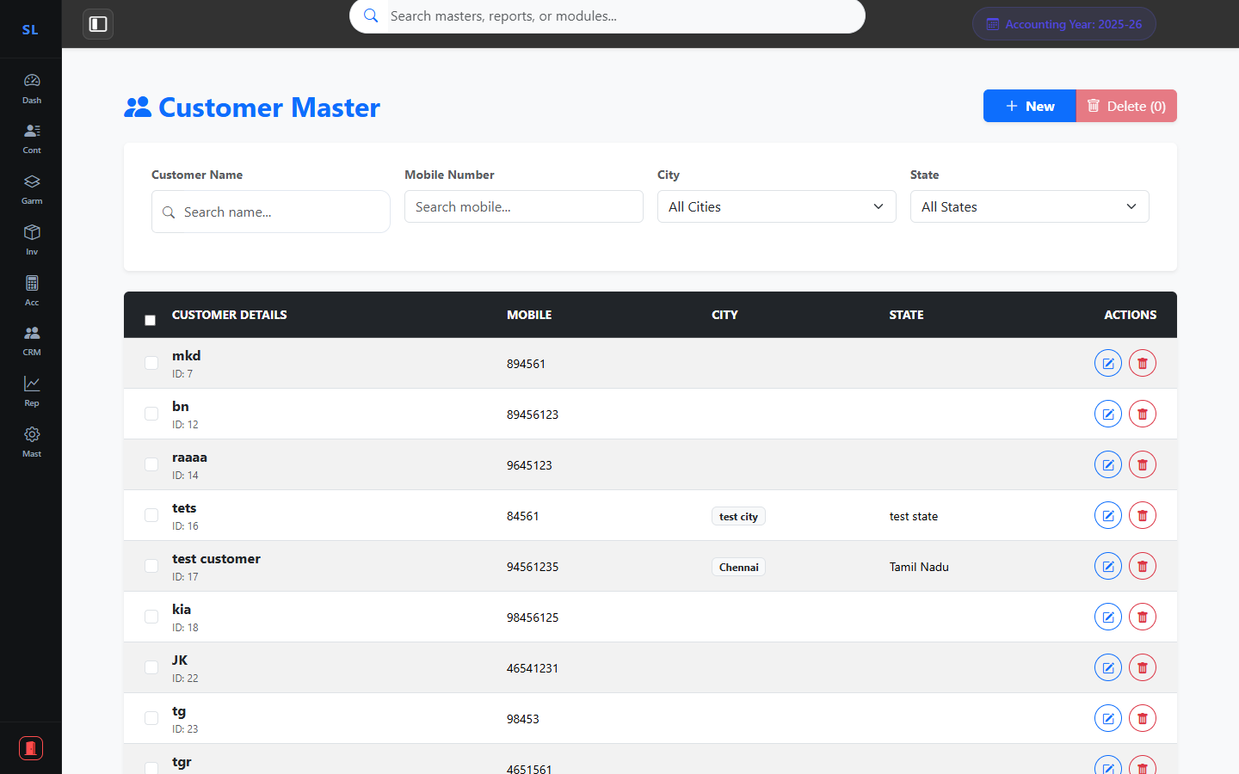
20
Customer Master List
Module: Contacts → Customer List
All Customer Records
Quick Edit & Delete
Bulk Import Support
Smart Search & Filter
TheSuperlabs ERP • Confidential • 02 April 2026

Slide 21

21
Invoice List & Ledger
Module: Accounts → Invoice List
All Invoice Records
Payment Status Filter
Search & Date Range
Export to Excel / PDF
TheSuperlabs ERP • Confidential • 02 April 2026

Slide 22
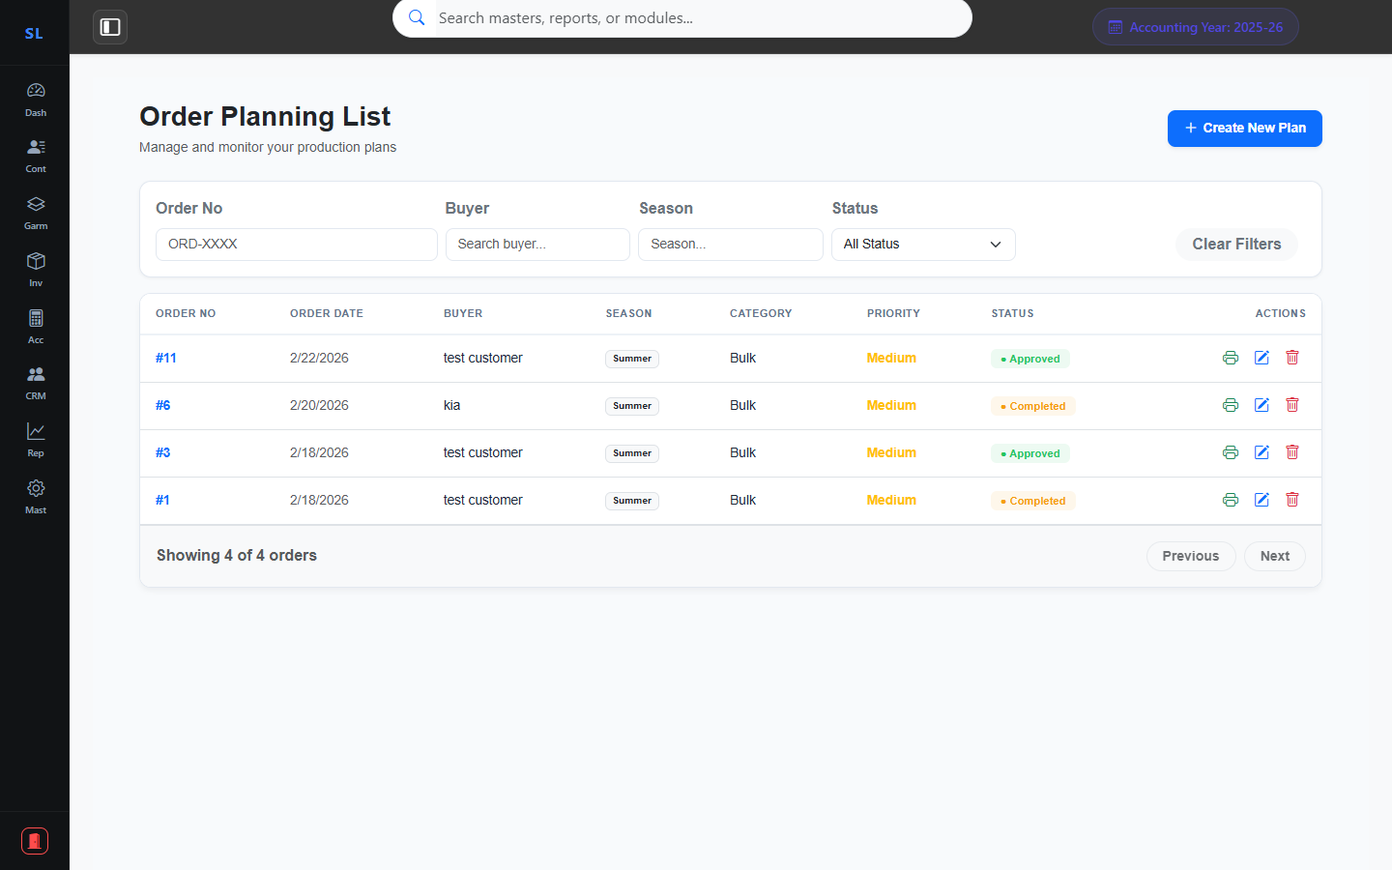
22
Order Planning List
Module: Garments → Order Planning
All Orders At a Glance
Status Tracking (Pending / Approved)
Filter by Buyer & Season
Quick Edit & Print Reports
TheSuperlabs ERP • Confidential • 02 April 2026

Slide 23
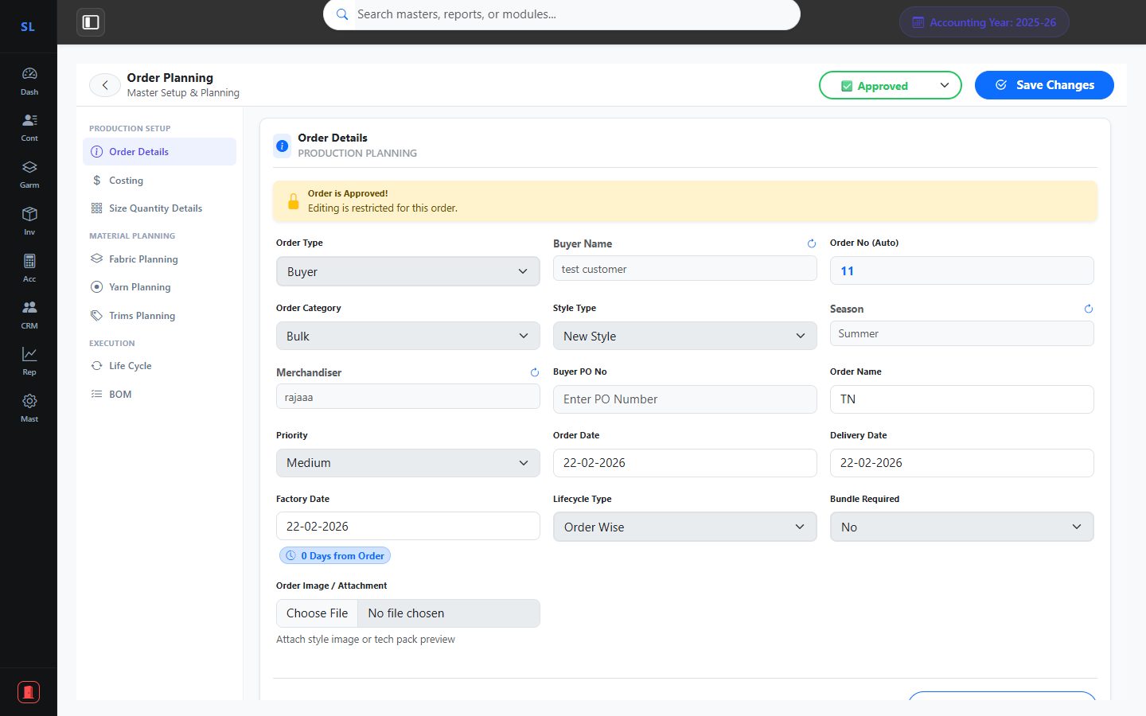
23
Order Planning – Order Details
Module: Garments → Order Planning → Order Details
Buyer / Own Brand Toggle
Auto Order Number
Season & Merchandiser
Delivery & Factory Dates
TheSuperlabs ERP • Confidential • 02 April 2026

Slide 24
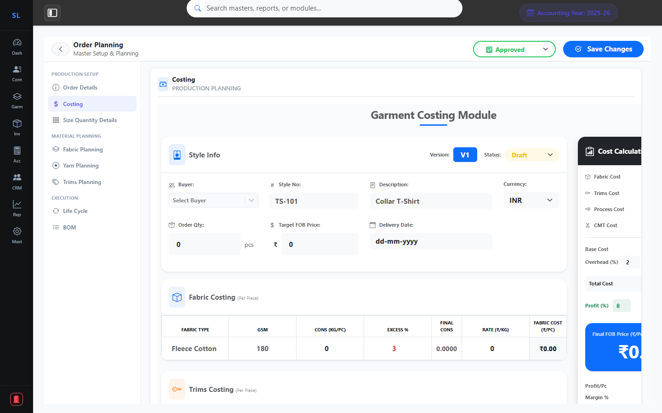
24
Order Planning – Costing
Module: Garments → Order Planning → Costing
Budget Cost Per Piece
CMT & Material Costing
Overhead & Profit Margins
Buyer-Wise Pricing
TheSuperlabs ERP • Confidential • 02 April 2026

Slide 25
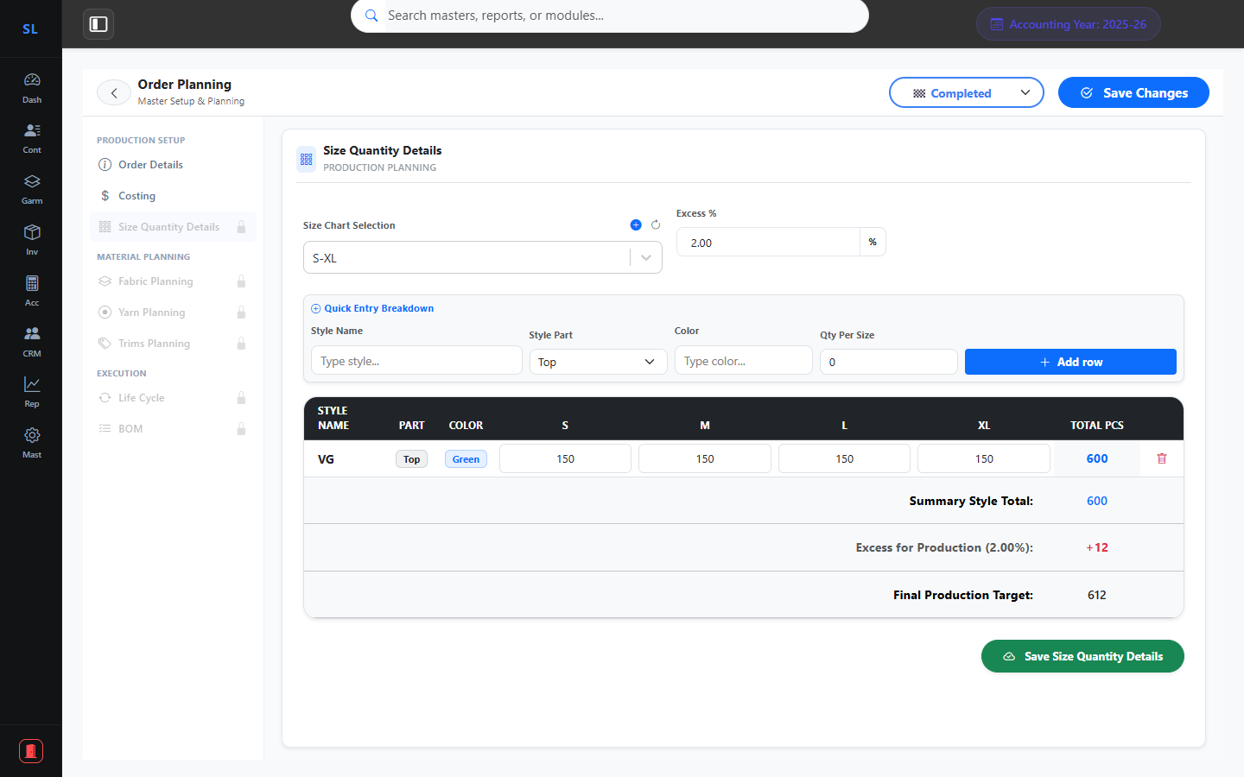
25
Order Planning – Size Quantity
Module: Garments → Order Planning → Size Qty Details
Size Chart Integration
Style-Wise Qty Matrix
Color & Ratio Breakdown
Total Qty Auto-Calc
TheSuperlabs ERP • Confidential • 02 April 2026

Slide 26
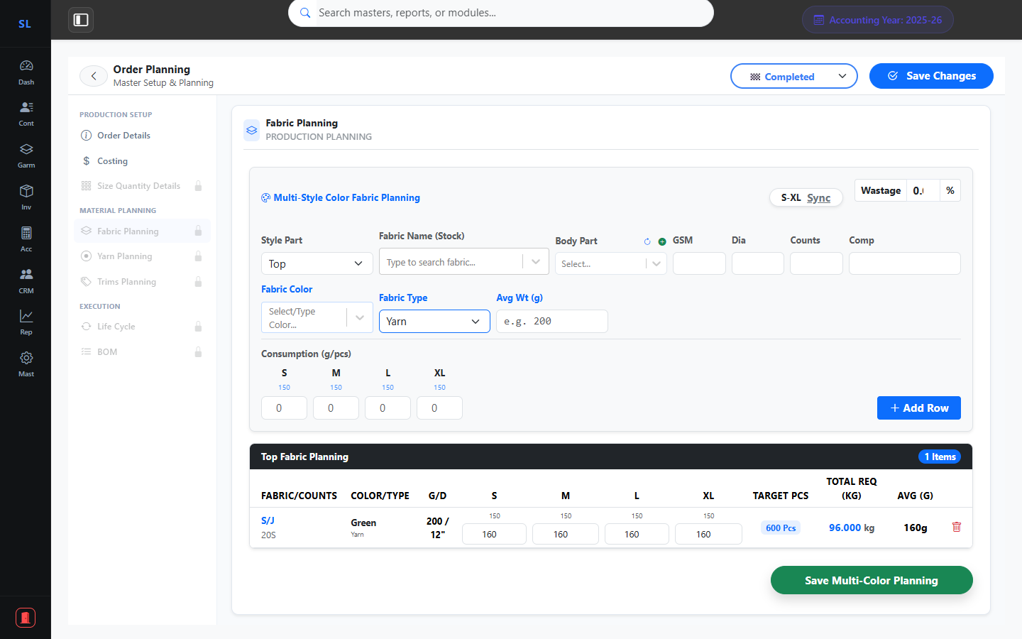
26
Order Planning – Fabric Planning
Module: Garments → Order Planning → Fabric Planning
Fabric Code & Composition
Required Qty per Size
Supplier Mapping
Shrinkage Allowance
TheSuperlabs ERP • Confidential • 02 April 2026

Slide 27
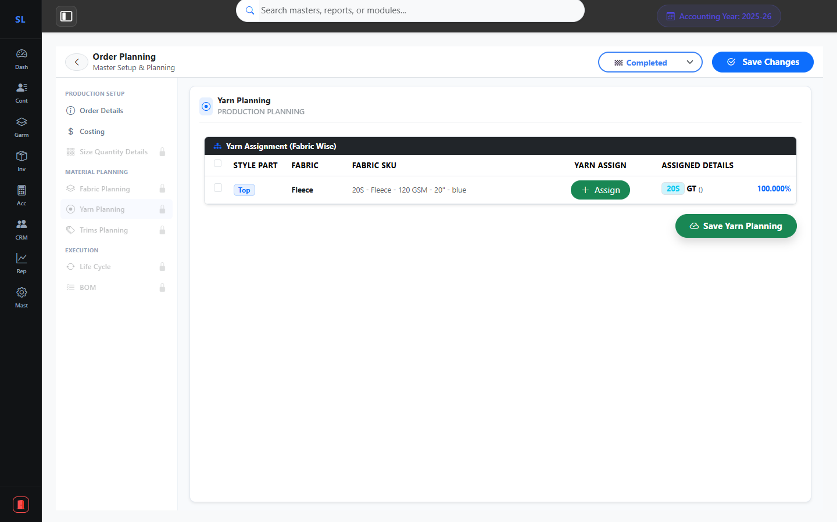
27
Order Planning – Yarn Planning
Module: Garments → Order Planning → Yarn Planning
Yarn Type & Count
Per Kg Requirement
Supplier & Mill Details
Color & Twist Specs
TheSuperlabs ERP • Confidential • 02 April 2026

Slide 28
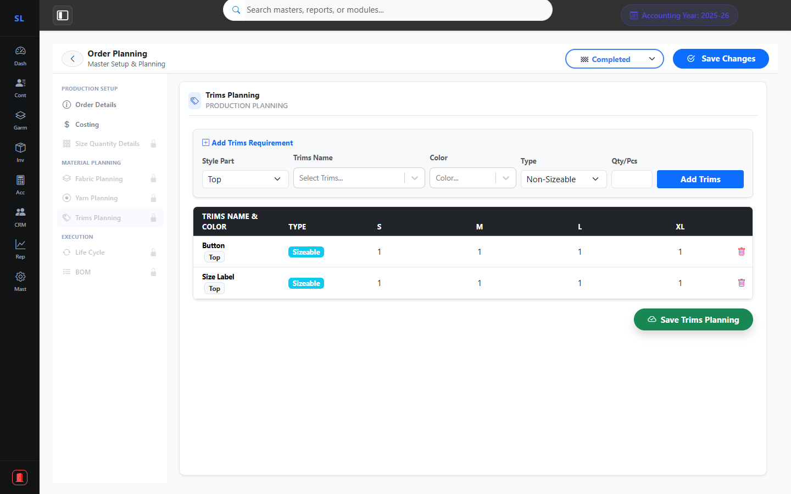
28
Order Planning – Trims Planning
Module: Garments → Order Planning → Trims Planning
Button, Label & Tag Planning
Per Piece Consumption
Supplier & Brand Details
Cost Tracking
TheSuperlabs ERP • Confidential • 02 April 2026

Slide 29
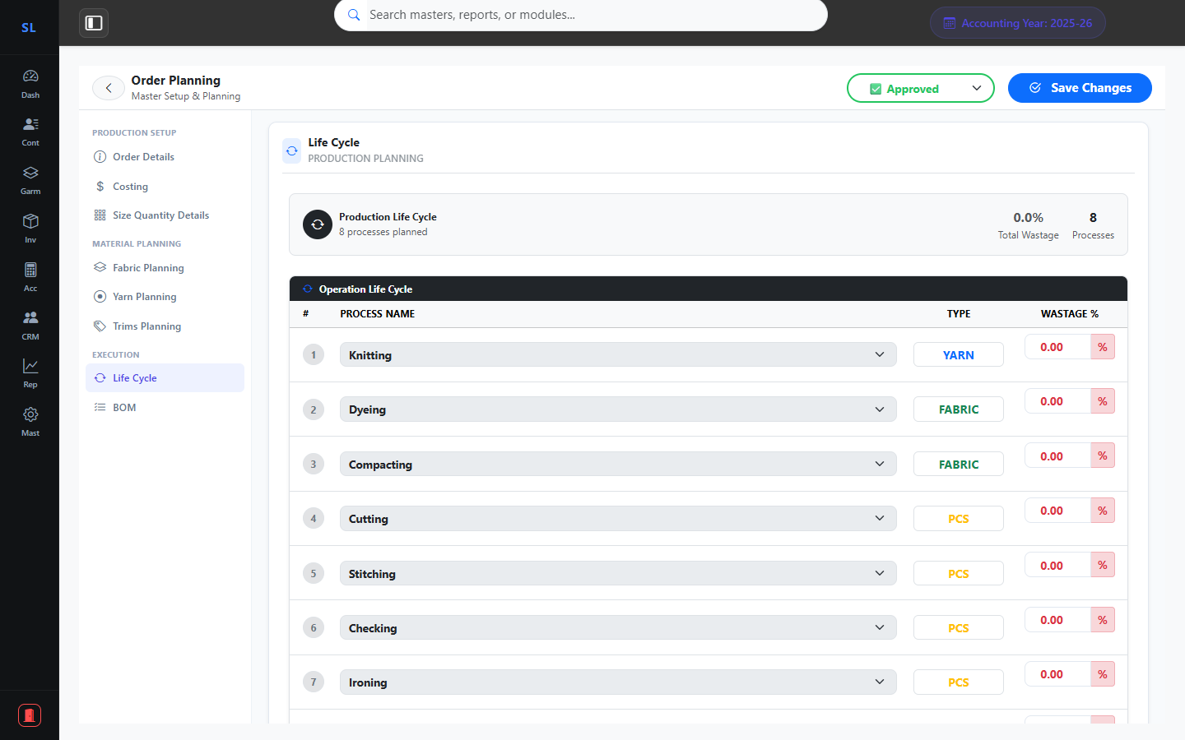
29
Order Planning – Life Cycle
Module: Garments → Order Planning → Life Cycle
Production Stage Mapping
Date & Progress Tracking
Responsibility Assignment
Status Monitoring
TheSuperlabs ERP • Confidential • 02 April 2026

Slide 30
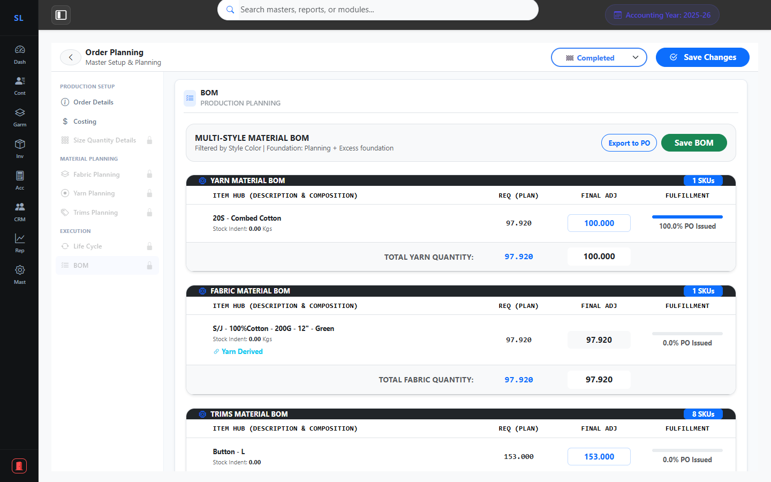
30
Order Planning – Bill of Materials
Module: Garments → Order Planning → BOM
Complete Material List
Estimated vs Actual Cost
Auto-Generated from Plans
Export Ready Summary
TheSuperlabs ERP • Confidential • 02 April 2026

Slide 31
TSL
TheSuperlabs ERP
Powering the Future of Garments Industry
Thank You!
Rebranded. Optimized. Prepared for Success.
Contact us for a detailed walkthrough or configuration queries.
Presentation Date: 02 April 2026
📦 Inventory
🧾 Invoices
📊 Reports
🤝 CRM
👗 Garments

