Slide 1


What is Python?

Slide 2

What is Python?
Python is a popular high-level programming language used in various applications
Python is an easy language to learn because of its simple syntax
Python can be used for simple tasks such as plotting or for more complex tasks like machine learning

Slide 3
Variables, Objects, and Classes
A variable is a reference to a value stored in a computer’s memory.
Variables can be sorted into a variety of categories (or data types) such as numbers (int/float etc), Boolean values (true/false), and sequences (strings, lists etc).
An object is a collection of data from a computer’s memory that can be manipulated.
ALL VARIABLES ARE OBJECTS although some objects can be defined by data referred to by multiple variables.
Methods are the functions used to act on/alter an object’s data. They describe what your object can “do.”

Slide 4
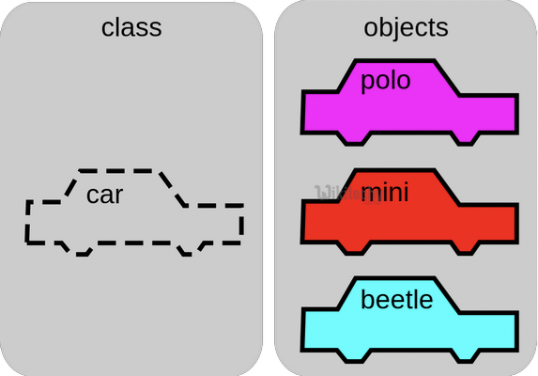
Variables, Objects, and Classes (cont.)
A class is a collection of objects who share the same set of variables/methods.
The definition of the class provides a blueprint for all the objects within it (instances).
Instances may share the same variables (color, size, shape, etc.), but they do NOT share the same values for each variable (blue/red/pink, small/large, square/circular etc.)
Instance #1
Color: Pink
Name: Polo
Instance #2
Color: Red
Name: Mini
Instance #3
Color: Blue
Name: Beetle

Slide 5

Basic Syntax Rules
The name of your variable (myInt etc.) is placed on the left of the “=“ operator.
Most variable names are in camel case where the first word begins with a lowercase letter and any subsequent words are capitalized
Variable names may also appear in snake case where all words are lowercase, with underscores between words
The assignment operator (“=“) sets the variable name equal to the memory location where your value is found.
The value of your variable (“Hello, World”) is placed on the right of the “=“ operator.
The type of this value does NOT need to be stated but its format must abide by a given object type (as shown).
myString = “Hello, World” myInt = 7 myFloat = 7.0 myList = [7, 8, 9] myBoolean = true

Slide 6

Basic Syntax Rules
Function Syntax
def...: indicates that you are defining a new function.
function() refers to the name of your function. By convention, this name is typically lowercase and represents a verb/action.
a,b refers to parameters (values or variables) that can be used within the statements of your function’s definition (......). If your function has no parameters, an empty parenthetical () is used.
The return statement is an optional statement that will return a value for your function to your original call.
def function(a, b):
......
return a + b

Slide 7

Basic Syntax Rules (cont.)
Calling a function
Call the function by referring to its name (function()) and by placing any necessary arguments (1, 2) within the parenthesis separated by commas. myValue = function(1, 2)
If you wish, you can set your function call equal to a variable (myValue). The value returned by the function will be assigned to your variable name.
myValue = function(1, 2)

Slide 8
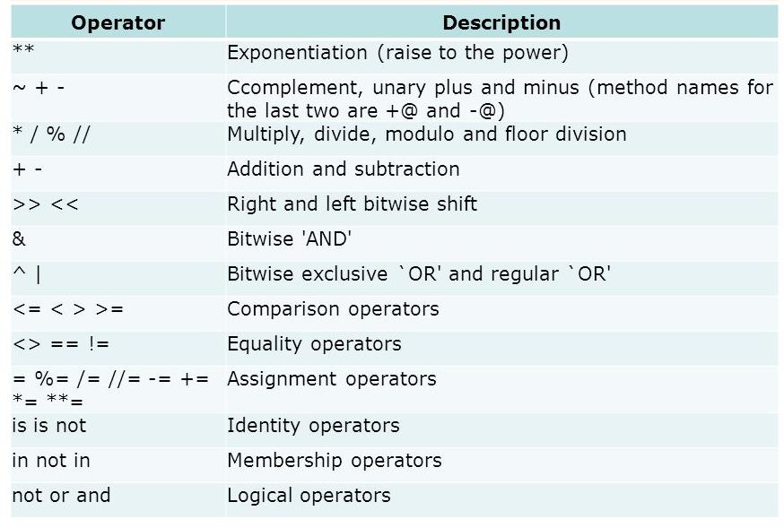
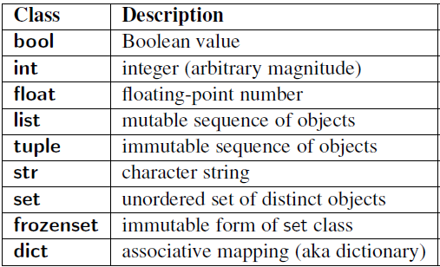
Common Data Types and Operators
A data type is a means of classifying a value and determining what operations can be performed on it. All objects have a data type.
Operators are symbols used carry out specific functions/computations.
https://www.youtube.com/watch?v=v5MR5JnKcZI

Slide 9

Input/Output
Input functions (input()) allow users of a program to place values into programming code.
The parameter for an input function is called a prompt. This is a string (this can be indicated by “” or ‘’) such as “Enter a number: “
The user’s response to the prompt will be returned to the input statement call as a string. To use this value as any other data type, it must be converted with another function (int()).
Print functions (print()) allow programs to output strings to users on a given interface.
The parameter of this function is of any type. All types will automatically be converted to strings.
xString = input(“Enter a number: “)
x = int(xString) y=x+2 print(y)

Slide 10

If-else Statements
If-else statements allow programmers to adapt the function of their code based on a given condition.
If a given condition (i.e. x % 2 == 0) is true, then the statements following the if statement (if) will be executed. If the condition is false, the statements following the else statement (else) will be executed.
The condition is tested using the Boolean operators == (is equal to), != (is not equal to), and (used to test multiple conditions), and or (used to test if AT LEAST ONE condition is true).
Additionally, else-if statements (elif) can be used to provide unique coding statements for multiple conditions.
xString = input(“Enter a number: “)
x = int(xString)
if x % 2 == 0: print(“This is an even number”)
elif x == 0: print(“This number equals 0”)
else:
print(“This is an odd number”)

Slide 11

For Loops
For loops perform the same task (iterate) for the number of times specified by an iterable (something that can be evaluated repeatedly such as a list, string, or range).
for defines the for loop
x is the variable defining the number of times the statements within the loop (print(myInt)) are executed.
The range(start, stop, step) function is often used to define x.
The starting value is defined by start, the final value is defined by stop – 1, and the magnitude at which x changes between loops is defined by step.
in is a Boolean operator that returns true if the given value (x) is found within a given list, string, range etc.
myString = input(“Enter a number: “)
myInt = int(myString)
for x in range(0, 5, 1): print(myInt)

Slide 12

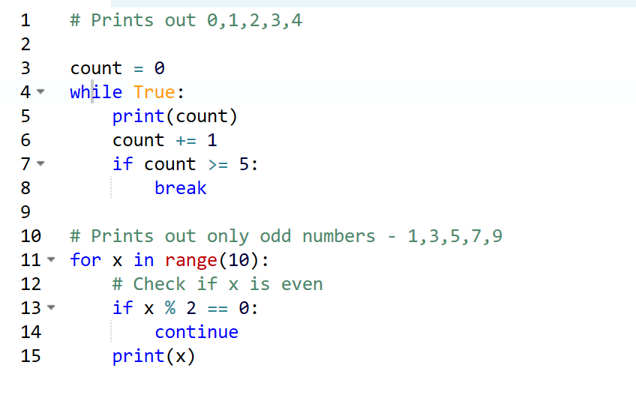
While Loops
myString = input(“Enter a number: “)
myInt = int(myString)
x = 0 while x < 5:
print(myInt)
x= x +1
While loops are statements that iterate so long as a given Boolean condition is met.
x (the variable determining whether or not the condition is met) is defined and manipulated OUTSIDE of the header of the while loop (while)
The condition (x < 5) is a statement containing a Boolean variable.
break is a statement used to exit the current for/while loop.
continue is a statement used to reject all statements in the current for/while loop iteration and return to the beginning of the loop.

