Slide 1
CPI, PCE, PPI, AND GDP DEFLATOR ANALYSIS (PROJECT 1)
PRESENTATION
KEHLEBOE GONGLOE, SARAH WOLBERG, CALEB WILLIAMS, TATIANA FLORES, MATTHEW WYLIE

Slide 2
AGENDA
Explain the CPI, PCE, PPI, GDP
Explain the relationship between CPI and other inflation indices and how does it correlate with other indicators
Is the hypothesis tested and confirmed or refuted?
Decipher if the conclusion is indicative based off data

Slide 3




INDICES
Consumer price index (CPI) is a price index, a consolidation of consumer goods and services purchased by households. created in 1913. Ex household goods and consumables. (CPI_t=\frac{Ct}{C0} * 100)
CPI_t = consumer price index in current period
Ct = cost of market basket in current period
C0 = cost of market basket in base period

Slide 4




INDICES CONT.
Personal Consumption Expenditures (PCE) measures inflation that’s released at the end of each month
Producer Price index (PPI) measures the average change over time in the selling prices received by domestic producers for their output.
Gross domestic product (GDP) is a monetary value of all good and services produced in a country or region within a specific time. This is the most important out of the indices because it usually measures the overall health of a specific country’s economic health
C0 = cost of market basket in base period

Slide 5

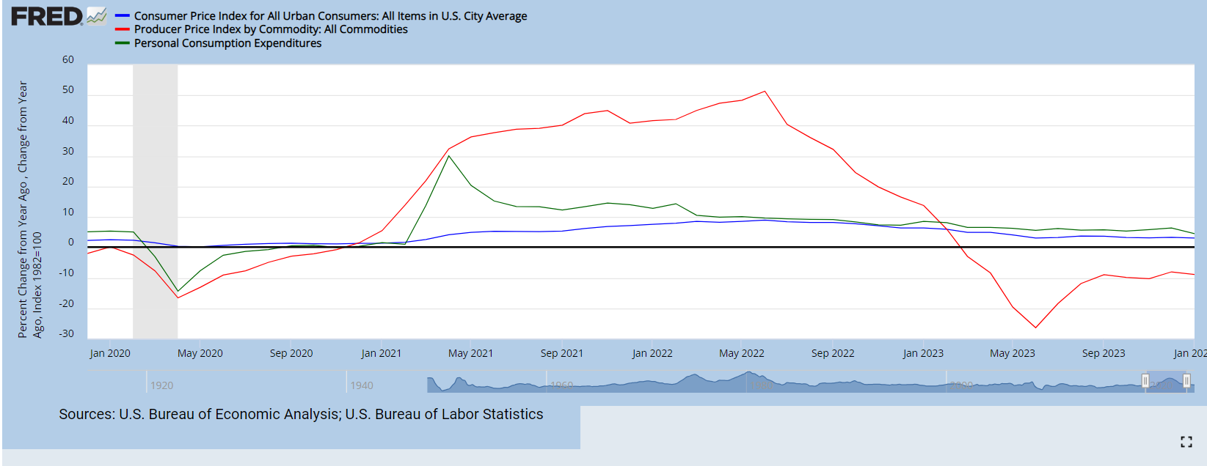
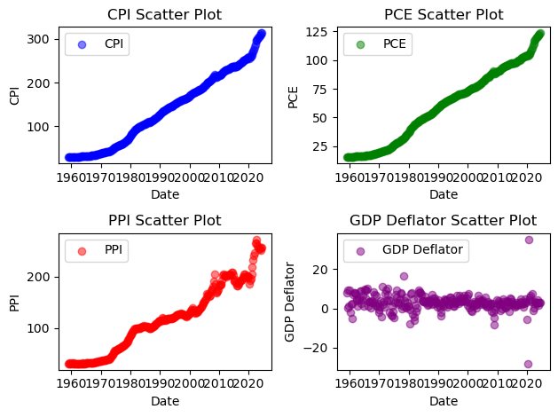
WHAT IS THE CORRELATION OF THE CPI AND OTHER INDICES?
The CPI, according to the first hypothesis, indicates that there’s a clear correlation to the other indices. Although, the CPI usually measures consumer level, and PPI measures at a producer level. The PPI has a major influence and is used as an indicator of inflation.
As shown, the PPI had a major spike of inflation around covid-19 and further which shows that the CPI and PPI are congruent, unless there’s inflation in productivity.

Slide 6
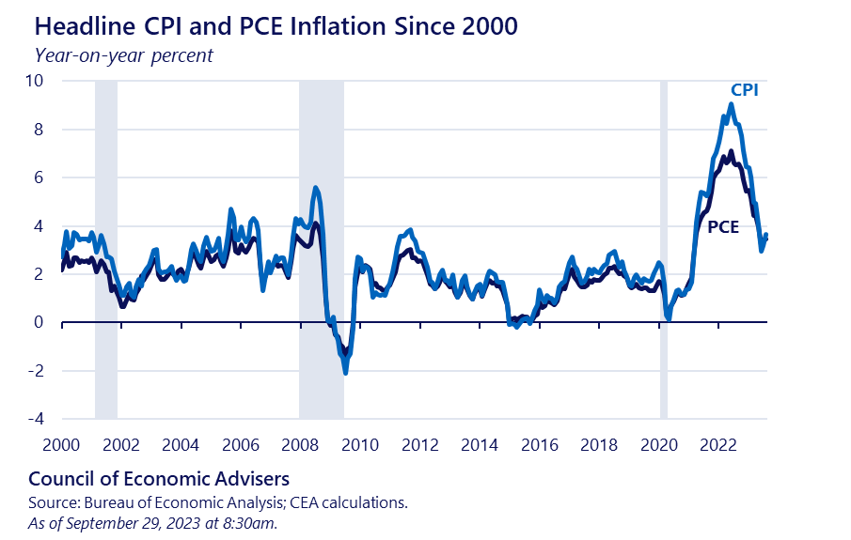
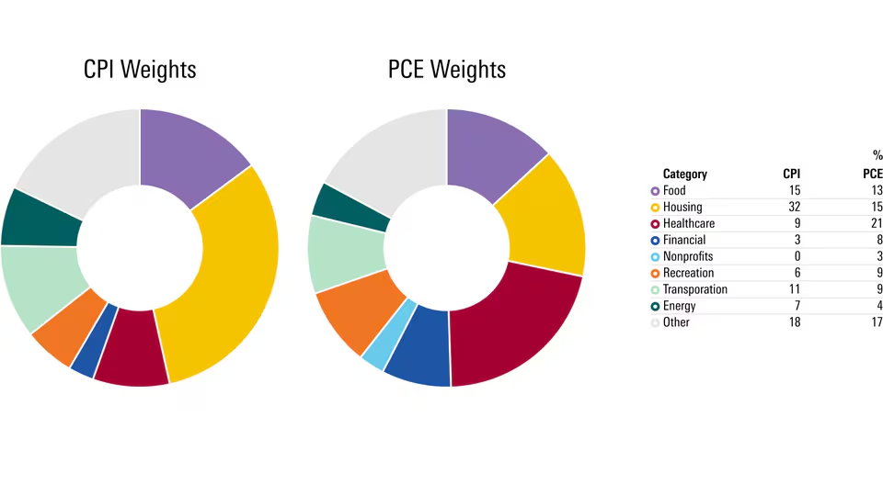
WHAT IS THE CORRELATION OF THE CPI AND OTHER INDICES? CONT.
CPI and the PCE has a correlation when it comes consumers, but the minute difference is, the PCE looks at the magnitude of goods and other consumables by households by gov’t or employers.
The PCE is mainly sourced from businesses.
Ex. CPI only includes a portion of costs like medical and is paid directly by consumers, whereas PCE includes the entirety of medical care costs and contributions made by the employer.

Slide 7
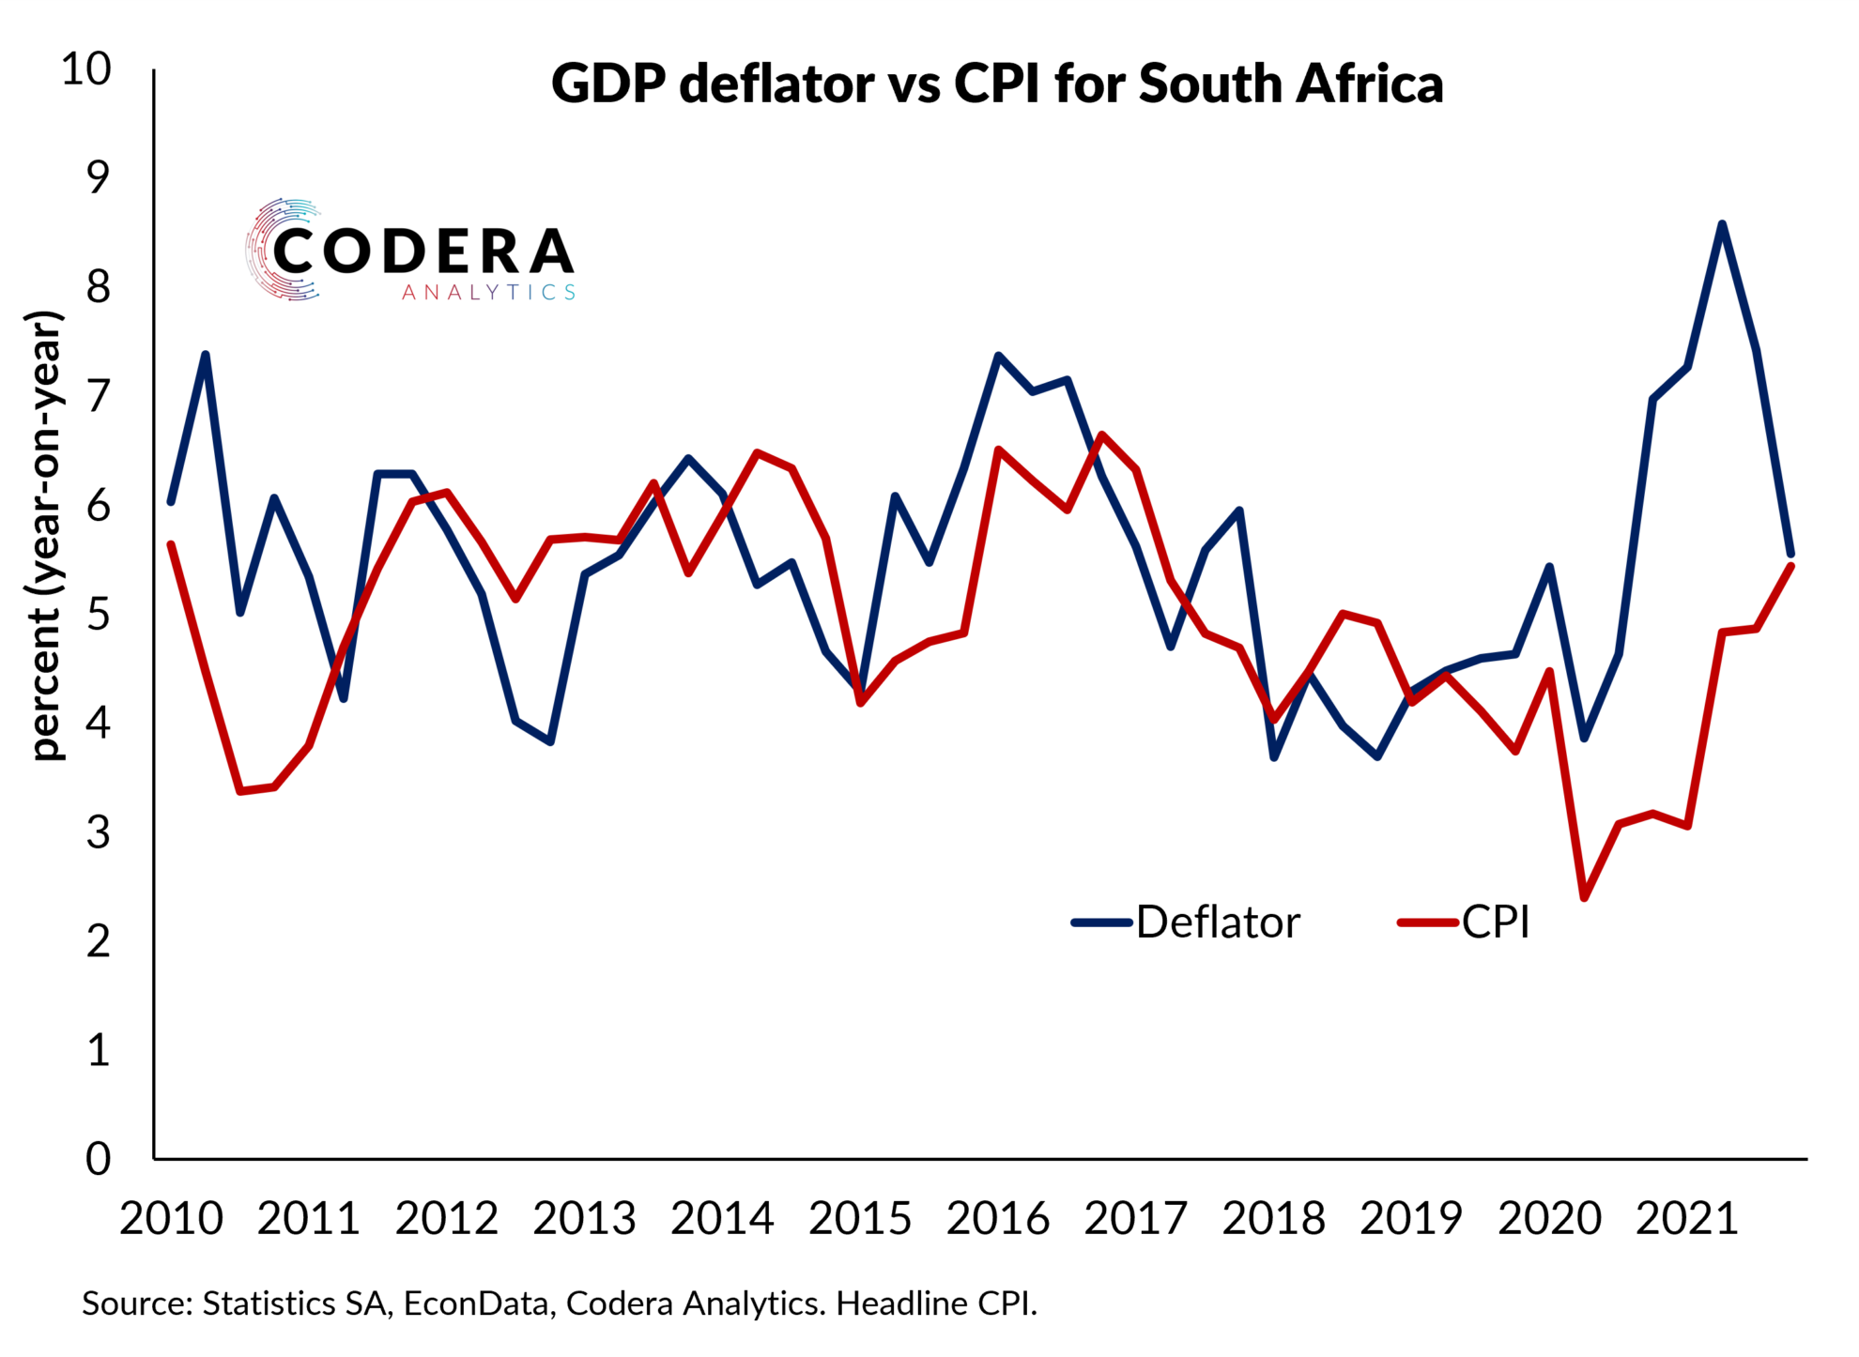
WHAT IS THE CORRELATION OF THE CPI AND OTHER INDICES? CONT.
BOTH THE CPI AND GDP DEFLATOR MEASURES INFLATION, BUT THE GDP DEFLATOR ONLY MEASURES PRICE OF ALL GOODS THAT ARE PRODUCED STRICTLY IN THE UNITED STATES.
THE GDP IS CONSIDERED A BETTER MEASUREMENT AS IT REFLECTS THE COSTS OF GOODS WITHIN THE ECONOMY WHILE THE CPI TRACKS CONSUMABLES WITHIN THE ECONOMY AS WITH IMPORTS WHICH RESULTS IN A CORRELATION

Slide 8
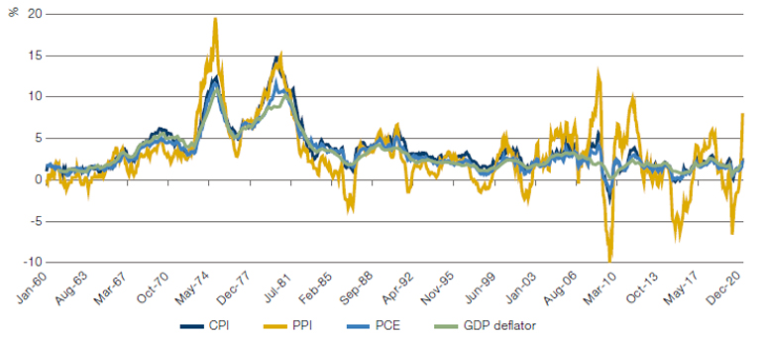
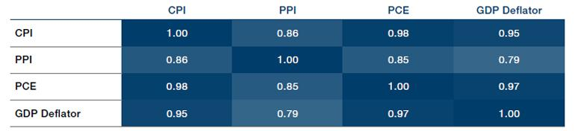
USING A LINEAR REGRESSION MODEL TO PREDICT CPI FROM PCE, PPI, GDP DEFLATOR.
Both graphs presented show that there is a large delineation when using the PCE, PPI, GDP Deflator to predict the CPI.
As presented, at least one coefficient is greater than zero which proves that our hypothesis was proven correct that the CPI can be predicted by the other indices. Only the PPI was affected the most because of Covid.

Slide 9
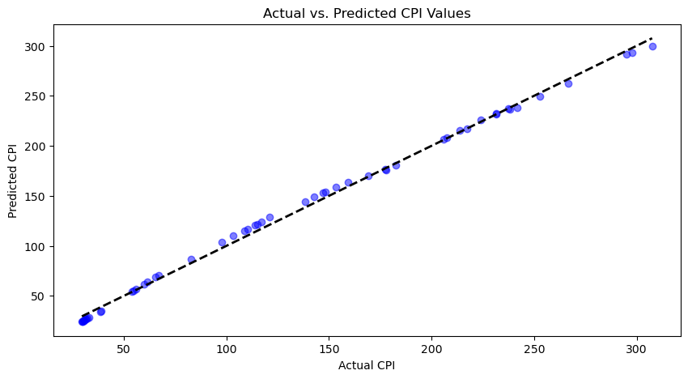
USING LINEAR REGRESSION TO PREDICT CPI VS ACTUAL CPI
As shown, the linear regression is one of the best models to predict CPI as the prediction nearly mirrors the actual data shown.
A few key points when using linear regression is that there are stipulations when considering the data collected for future use when regarding CPI, including but not limited to, volatility (massive inflation, outbreaks, strikes etc.)
Linear regression model uses metrics such as, R², Mean absolute error, and Mean squared error ( MSE)

Slide 10

RELATIONSHIP BETWEEN CPI AND OTHER PREDICTOR VARIABLES.
According to the repeated data, the relationship between the CPI and the other indices are generally positive.
When the CPI increases, most, if not all, predictor variables like wages and interest rates tend to increase as well, signaling inflation.
This is a major correlation to overall price level in the economy

Slide 11
CONCLUSION
Overall, each of our hypothesis was proven correct as proven by the data.
There were strong correlations between the CPI and other indices and the linear regression model was proven to be effective with minimal errors.
The MSE presented was approx. 19.57 which isn’t the greatest but not the standard which should be closer to zero for better accuracy which would lead to finding more accurate models

