Slide 1

Basic Details of the Team and Problem Statement
Ministry - Ministry of Corporate Affairs
PS Code - 25035 Problem Statement Title - Sentiment Analysis of comments received through E-consultation module Team Name - __Coders Team Leader Name – Tarun S Institute Code (AISHE) - C-16604 Institute Name - SSN College of Engineering, Chennai.
Theme Name - Miscellaneous

Slide 2
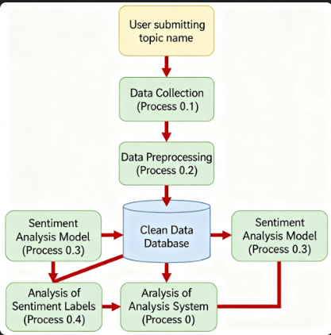
Idea/Approach Details
IDEAS
Integrating sentiment analysis with stakeholder feedback received through the MCA e-Consultation module – covering both structured comments and suggestions.
Legislative Sentiment contrast analytics Compare sentiment of feedback across different draft legislations or provisions to identify supportive, neutral, and opposing views.
Policy Disparity solution finder Detect areas of economic, social, or regulatory discontent and recommend focused improvements in draft legislations.
Time-tuned Sentiment Synopsis Track how sentiments evolve during the open consultation period.
Interactive Data visualizations Provide dashboards with charts and graphs for policymakers to easily interpret stakeholder feedback.
Refined Sentiment Scoring Incorporate stakeholder type (individual, industry body, NGO, etc.) for weighted scoring to ensure balanced analysis.
Multilingual Comment Translation Enable automatic translation of feedback (Hindi ↔ English and other regional languages) to support inclusive consultations.
Word Cloud Generation Highlight frequently used terms in stakeholder feedback to quickly identify focus areas and concerns.
Summary Generation Automatically generate concise summaries of long stakeholder comments for quicker review.
TECH STACK
Data Collection – Structured comments from MCA21 portal (API or CSV download if provided).
Data Pre-processing – NLTK, spaCy, SpeechRecognition libraries (if voice comments added in future).
Data Storage – Relational databases, NoSQL DB, data lakes, and secure government cloud (MeitY empanelled).
ML Models – Transformers (BERT, GPT-3/4), LSTM, and Ensemble models for sentiment & summarization.
Visualization Tools – Plotly/D3.js/PowerBI/Tableau dashboards for policymakers.
Frontend – HTML, CSS, JavaScript, React/Angular, with possible integration into MCA21 portal.

Slide 3
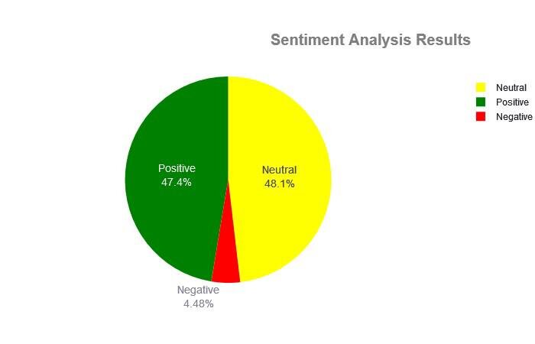
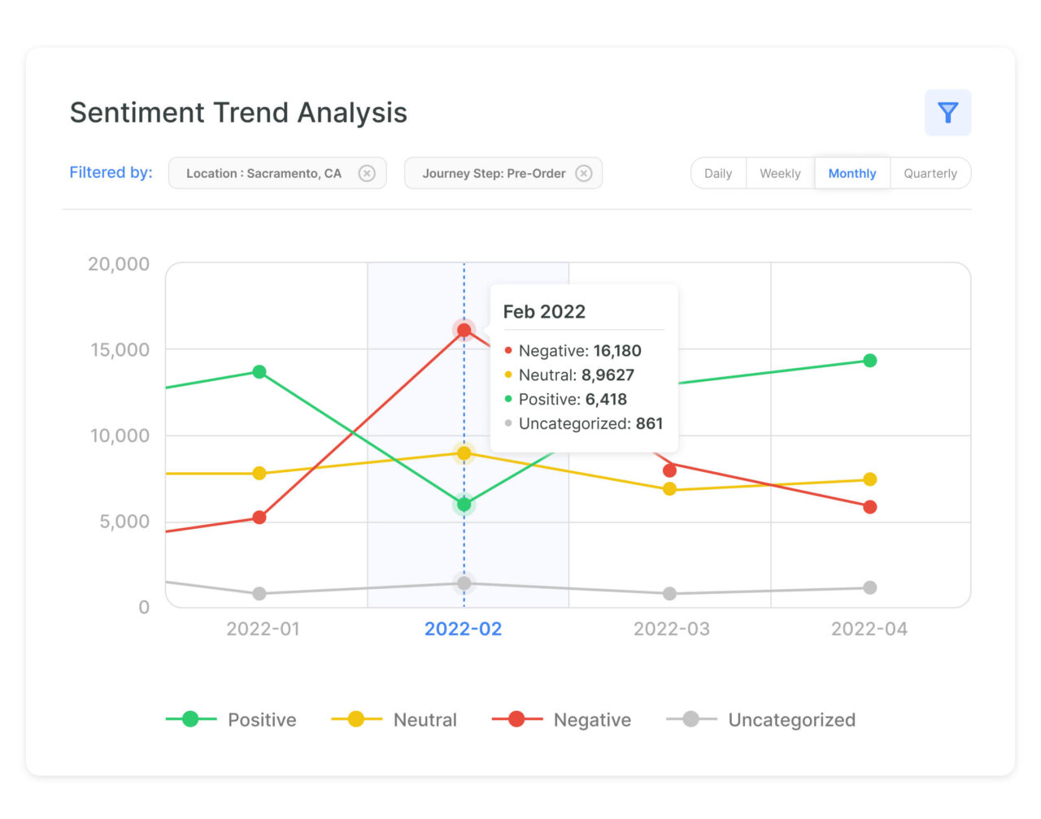
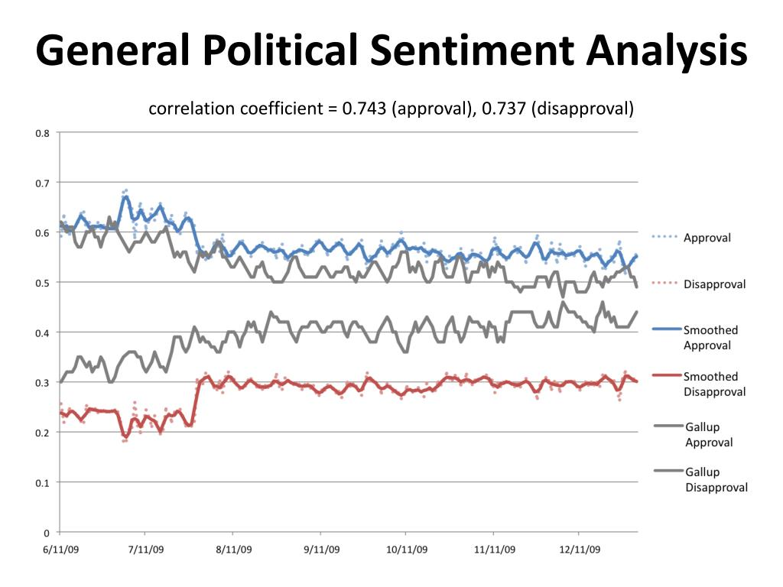
Use Cases and Dependencies
USE CASES
Rapid Policy Assessment
Quickly gauge the overall public and stakeholder reception (positive, negative, neutral) towards a proposed legislation.
Targeted Legislative Refinement
Isolate specific clauses or sections of a draft law that generate the most significant or controversial feedback, allowing for focused revisions.
Stakeholder Concern Mapping
Analyze and categorize feedback to understand the unique perspectives and key concerns of different stakeholder groups, such as industry associations, non-profits, or the general public.
Automated Feedback Triage
Systematically sort high volumes of comments, enabling policy analysts to prioritize the most critical, complex, or frequently mentioned suggestions for manual review.
Enhanced Public Trust and Transparency
Ensure every submitted comment is processed and categorized, demonstrating a commitment to an inclusive and thorough consultation process.
Thematic Trend Identification
Generate summaries and word clouds to instantly identify recurring themes, arguments, and keywords, providing a high-level overview of the entire feedback pool.
DEPENDENCIES / SHOW STOPPERS
Integration APIs for MCA21 Portal
Adequate Computing Resources & GPUs
Anonymized Access to MCA21 Comments
Availability of Legal/Policy Experts (SMEs)

Slide 4
Team Member Details
Team Leader Name – Tarun S
Branch - BE Stream - CSE Year - II
Team Member 1 Name – Sanjana Meena
Branch - BE Stream - CSE Year - II
Team Member 2 Name – Suganth T
Branch - BE Stream - CSE Year - II
Team Member 3 Name – Sujith M
Branch - BE Stream - CSE Year - II
Team Member 4 Name – Sujith T
Branch - BE Stream - CSE Year - II
Team Member 5 Name – Tanish S. K.
Branch - BE Stream - CSE Year - II
Team Mentor 1 Name – Dr. Rajalakshmi S.
Category - Academic Expertise – AI/ML & Natural language processing Domain Experience (In years) - 14

