Slide 1
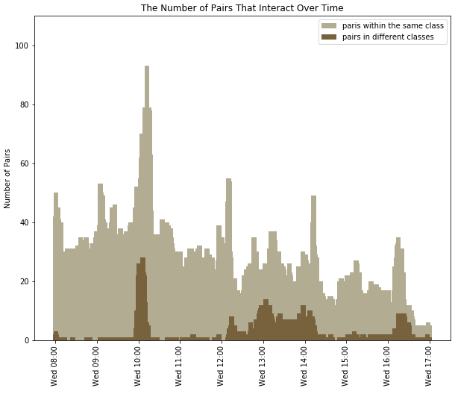
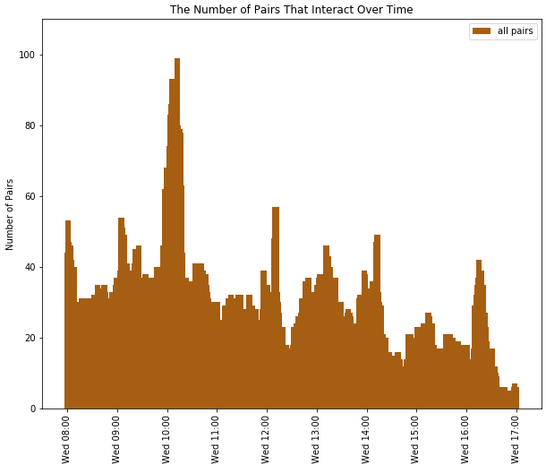
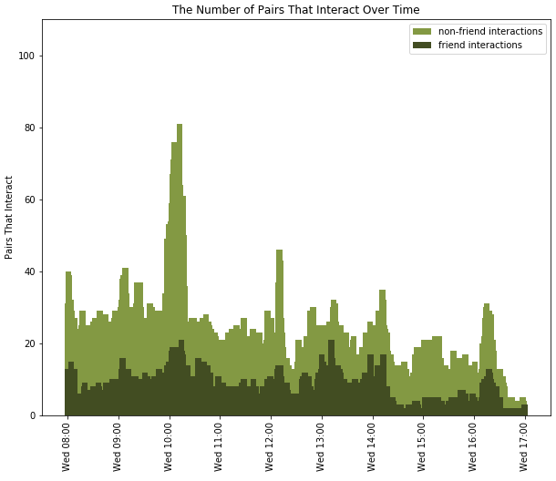
Deducing School Schedules based on Daily Contact Frequency
By Delaynie McMillan
Decline in interactions at the end of the day
Tuesday, 25 August 2020
Introduction
The goal of this investigation was to examine frequency of interaction between students, and how it is affected by friendships and classes.
30-minute long break time at 10AM
Most of the people that students interact with are not listed as friends
Method
This data was collected in 2013 using sensors in badges that the students wore throughout the day.
Mapped interaction frequency throughout the day
Filtered data through other statistics:
Friendship status
Class
Class time in the morning, few outside-class interactions

