Slide 1
ENTERPRISE WEB APPLICATION DEVELOPMENT WITH ASP.NET CORE MVC
EXCLUSIVE RAMADAN CAMP
BY
THETA SOLUTIONS

Slide 2
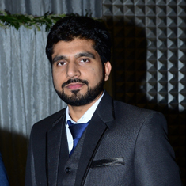
Trainer profile
Usman Nazir
CEO Theta Solutions
Software Engineer, Trainer
MS University of Wales, United Kingdom
Gold Medallist UET LHR Pakistan
With 10+ years of professional development experience in international market, he has worked in various technologies and platforms and has professionally trained 1000’s of students who are serving the IT industry in various sectors across globe.

