Slide 1
Comparison of Interpolative Data Augmentation Techniques
MATH 7203
NUMERICAL ANALYSIS – 1
Mini Project 2
Abhilasha Jain

Slide 2
Data Augmentation
Set of techniques used to increase the amount of data by adding modified copies of already existing data.
Sometimes, it creates newly synthetic data from the existing data.
Acts as a regularizer and assists in managing the overfitting of data.
Disadvantage: It increases the possibility of overfitting the model by generating additional training data and exposing the model to different versions of data.

Slide 3
Project Pipeline
Data Preprocessing
Data Augmentation Using Different Interpolation Methods
Calculation of SSIM, PSNR, MSE
Statistical Analysis on calculated metrics

Slide 4


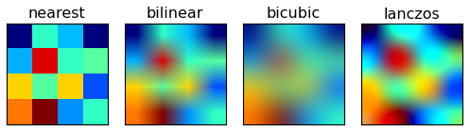

Interpolation Methods
z

Slide 5
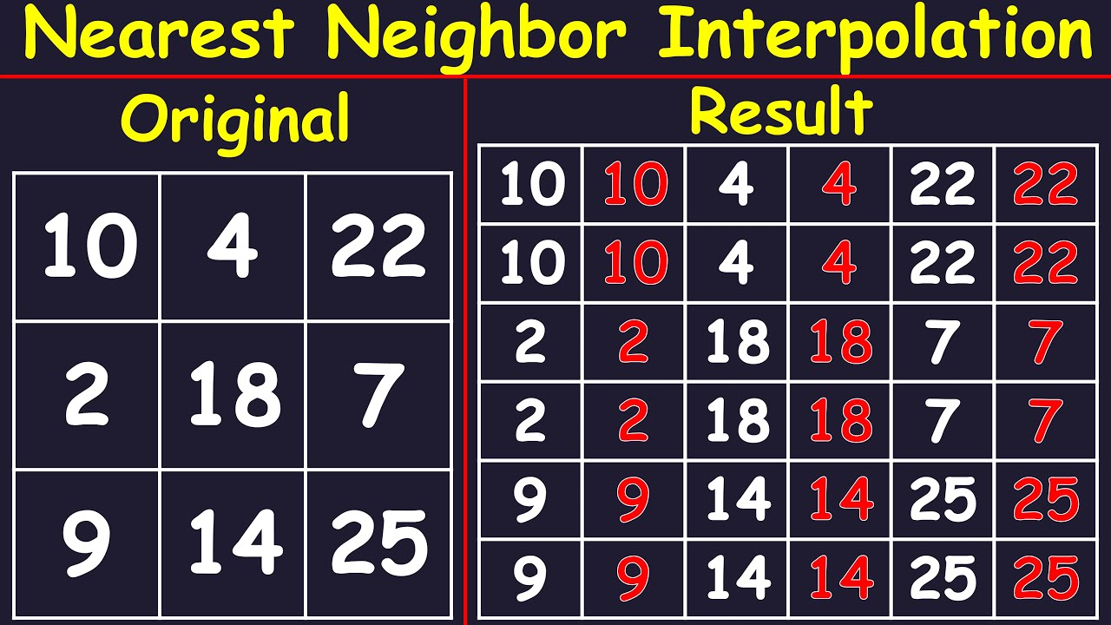
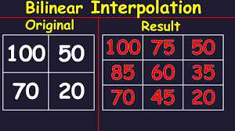
Bilinear Interpolation
Nearest Neighbor Interpolation
z

Slide 6
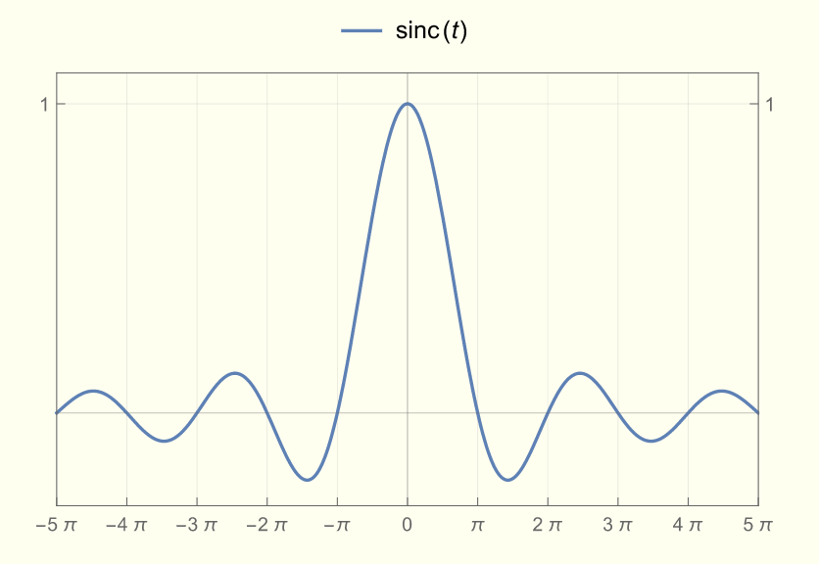
Lanczos Interpolation
z
Lanczos Kernel

Slide 7
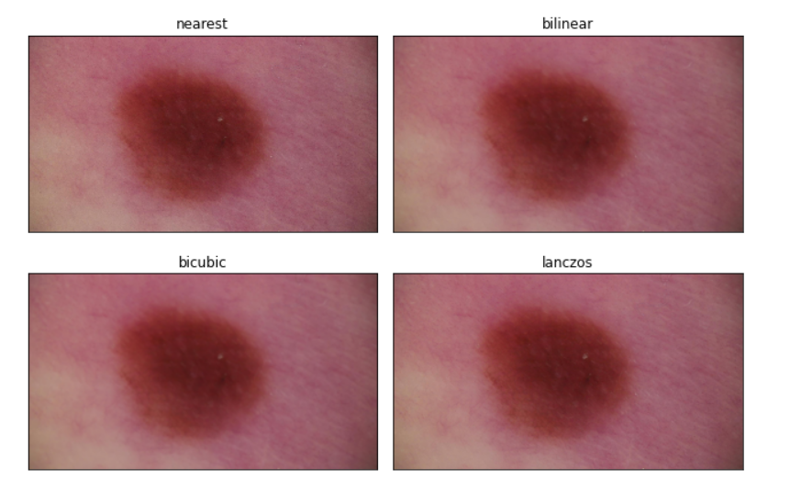
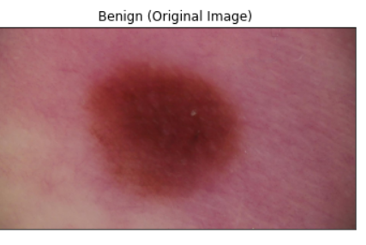
Interpolation on Benign Skin Lesion
z

Slide 8
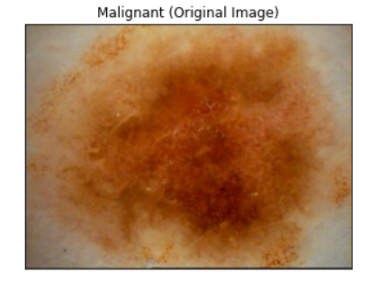
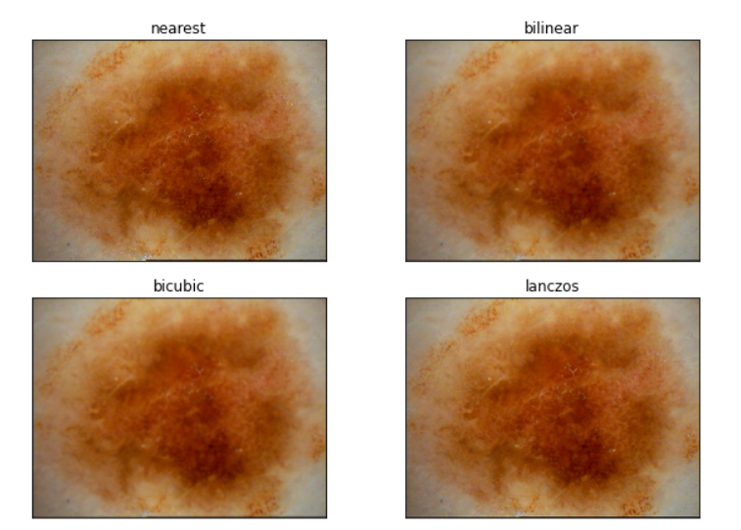
Interpolation on Malignant Skin Lesion
z

Slide 9

Structural Similarity Index (SSIM)
Metric that quantifies image degradation
Compares the same image before and after processing
Value given from –1 to +1
+1 images are the same, -1 images are very different
Luminance $μ_{x}= \frac{1}{N}\sum_{i=1}^{N}{x_{i}}$
Contrast $σ_{x}={\left(\frac{1}{N −1}\sum_{i=1}^{N}{{\left(x_{i} − μ_{x}\right)}^{2}}\right)}^{\frac{1}{2}}$
Structure $(x − μ_{x}$)/ $σ_{x}$
Notes:
Luminance comparison function l(x,y) is then a function of mux and muy Contrast comparison c(x,y) is then the comparison of sigmax and sigma y

Slide 10
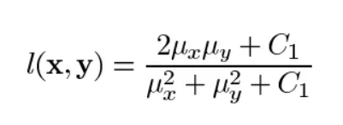

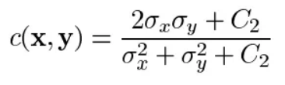

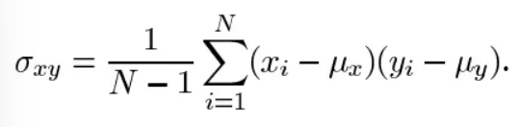
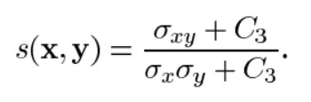
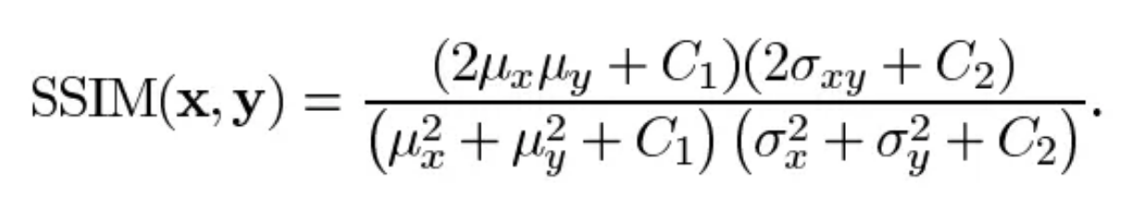
SSIM continued…
Luminance Comparison Function
Contrast Comparison Function
Structure Comparison Function

Slide 11
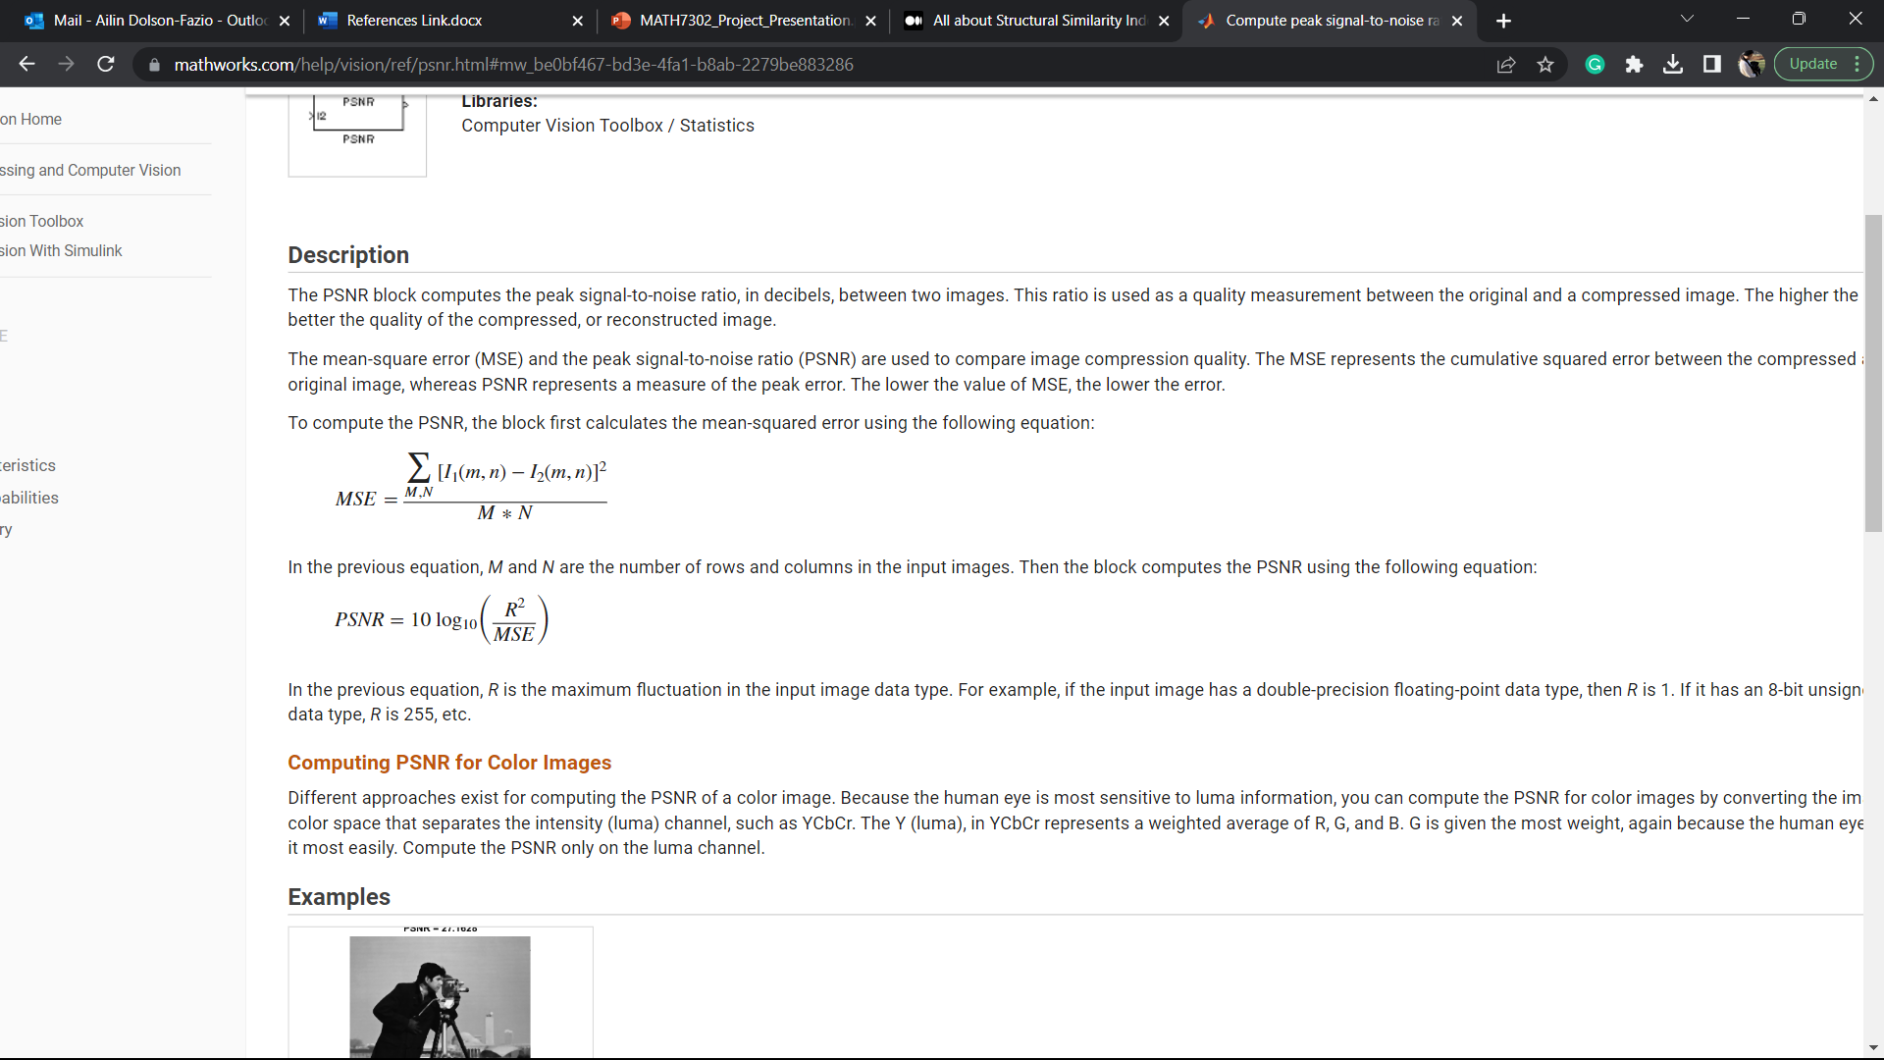
Mean Square Error (MSE)
Cumulative squared error between original and compressed image
Most common editor
Variance of estimator with no bias
Values closer to zero mean higher quality

Slide 12
Peak Signal to Noise Ratio (PSNR)
MSE required first
PSNR measures peak error
Used as a quality measurement between original and compressed images
The higher the PSNR value to better the image quality
Measured in decibels

Slide 13
Methods Used From OpenCV Library
INTER_NEAREST: nearest neighbor interpolation technique
INTER_LINEAR: bilinear interpolation (default)
INTER_AREA: resampling using pixel area relation
INTER_CUBIC: bicubic interpolation over 4 x 4 pixel neighborhood
INTER_LANCZOS4: Lanczos interpolation over 8 x 8 pixel neighborhood

Slide 14
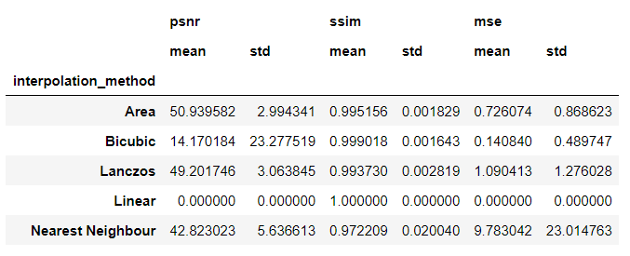
Results
z

Slide 15
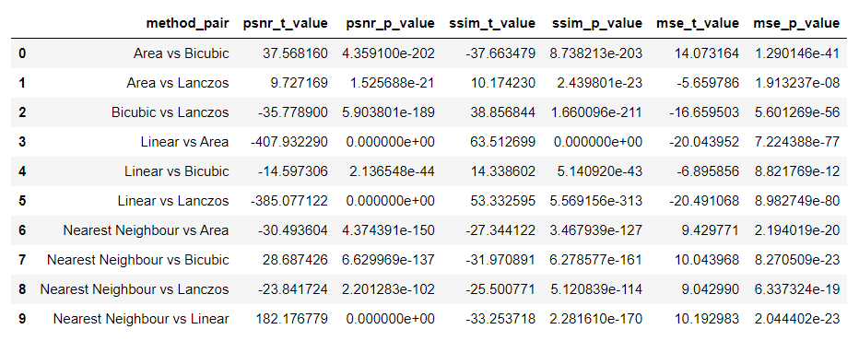
Statistical Analysis
z

Slide 16

Conclusion
Based on the t-test results, it can be concluded that there are significant differences between the different interpolation methods.
For PSNR, it is seen that all method pairs have very small p-values, indicating that the differences in PSNR values between the methods are statistically significant. The t-values are also quite high for most pairs, indicating a large difference in PSNR values.
For SSIM, it shows the same pattern as PSNR, with all pairs having small p-values and high t-values, indicating significant differences.
For MSE, a similar pattern can be seen, with all pairs having small p-values and some pairs having high t-values.
Based on these results, it can be concluded that different interpolation methods do have a significant effect on the quality of the image, as measured by PSNR, SSIM, and MSE. Therefore, the choice of interpolation method should be carefully considered based on the specific needs of the task.

Slide 17
Summary
Interpolation Methods
Nearest Neighbor
Bilinear
Bicubic
Lanczos
Different Metrics to compare results
Mean Squared Error (MSE)
Peak Signal to Noise Ratio (PSNR)
Structural Similarity Index (SSIM)
Statistical Analysis
Conclusion

Slide 18
References
Datta, P. (n.d.). All about structural similarity index ssim theory code in pytorch. Retrieved from Medium: https://medium.com/srm-mic/all-about-structural-similarity-index-ssim-theory-code-in-pytorch-6551b455541e
Jeugt, J. V. (2022, 10 07). Lanczos. Retrieved from mazzo: https://mazzo.li/posts/lanczos.html
PSNR. (n.d.). Retrieved from Mathworks: https://www.mathworks.com/help/vision/ref/psnr.html#mw_be0bf467-bd3e-4fa1-b8ab-2279be883286
SSIM: Structural Similarity Index. (2023, April 6). Retrieved from Imatest: https://www.imatest.com/docs/ssim/
Zhaotao Wu, J. W. (2020, Jan 31). Inter-slice image augmentation based on frame interpolation for boosting medical image segmentation accuracy. Retrieved from arXiv:2001.11698v1: https://arxiv.org/pdf/2001.11698.pdf

Slide 19

Thank You
z

