Slide 1
Comparative Analysis of ECG Denoising
Abhilasha Jain

Slide 2
Background
Fundamental for diagnosing and monitoring cardiovascular diseases (contaminated by various types of noise)
Denoising ECG signals is crucial for accurate diagnosis and monitoring of heart conditions
Several methods for denoising ECG signals
Fourier transform-based methods
Wavelet transform-based methods
Singular value decomposition-based methods
The choice of denoising method depends on several factors, including the characteristics of the noise present in the signal, the desired level of denoising, and the specific application.

Slide 3
Approach
Data Selection – ECG Apnea Dataset from Physionet
Add White Noise to get a noisy signal
Perform Denoising (Hankel and FFT)
Plot Denoised Signal
Calculate Performance Matrix (SNR, RMSE, Correlation Coefficient)

Slide 4
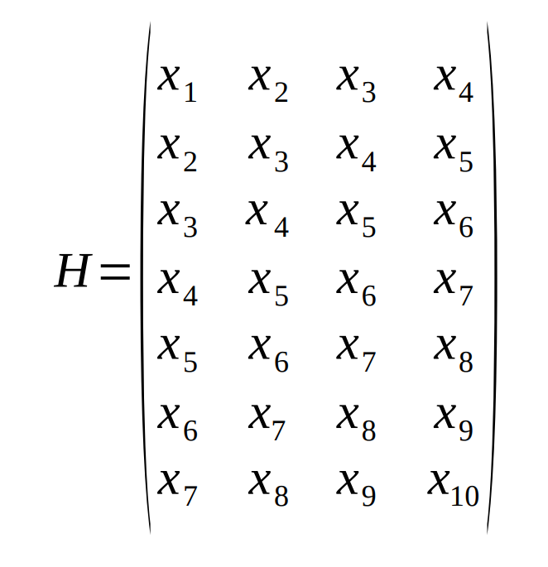

First Approach – Hankel Denoising
Convert Signal into Hankel Matrix
Time Series Vector -> Hankel Matrix
Time series data form a Hankel matrix by “striping” the data into columns, with the elements in each successive column shifted by one.
SVD on Hankel Matrix
Zero out higher order singular values
Reform Hankel Matrix using new S
Reconstruction of Time Series
New Hankel Matrix -> Denoised Time Series
Extract first row and concatenate with last column to obtain the signal.
If x is original time series is
$$x = [x_{1},x_{2}, x_{3},x_{4},x_{5},x_{6},x_{7},x_{8},x_{9},x_{10}]$$
Then, a Hankel matrix would be

Slide 5
Second Approach – FFT Denoising
Convert Signal to Frequency Domain Signal
Time Domain -> Frequency Domain
Perform FFT and FFT Shift
Apply Bandpass Filter
Bandpass filter of 1 – 30 Hz
Filtered Frequency -> Denoised Time Series
Perform Inverse FFT Shift and Inverse FFT
Allows signal lying within a certain band of frequencies to pass and blocks all others.
Reconstruction of Time Series

Slide 6
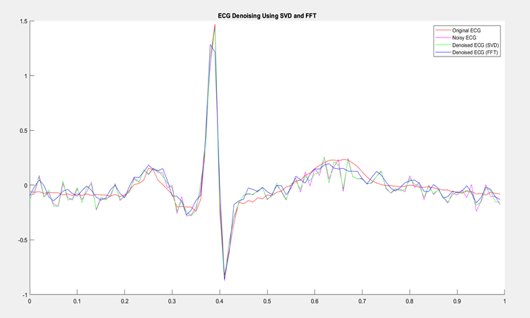
Results

Slide 7
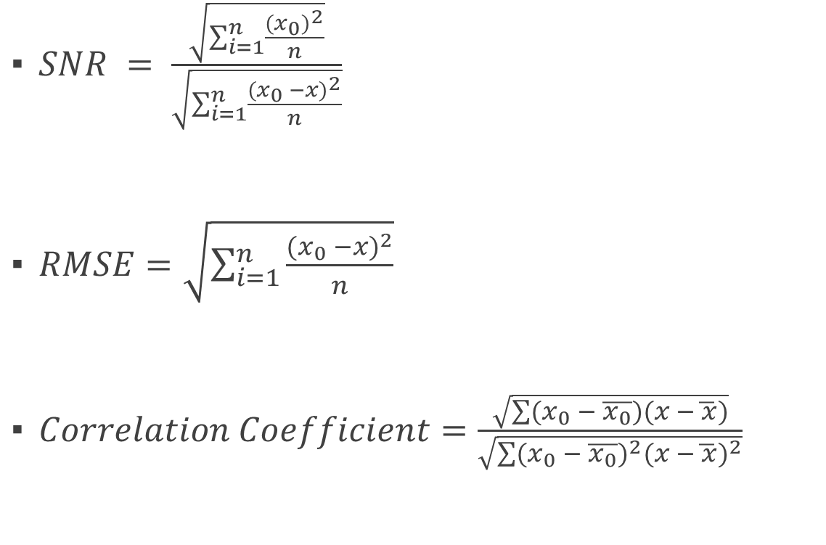
Performance Metrics
$SNR = \frac{\sqrt{\sum_{i=1}^{n}{\frac{{(x_{0})}^{2}}{n}}}}{\sqrt{\sum_{i=1}^{n}{\frac{{(x_{0} −x)}^{2}}{n}}}}$
$RMSE=\sqrt{\sum_{i=1}^{n}{\frac{{(x_{0} −x)}^{2}}{n}}}$
$Correlation Coefficient=\frac{\sqrt{\sum{(x_{0} − \overline{x_{0}})}(x −\overline{ x})}}{\sqrt{\sum{{(x_{0} − \overline{x_{0}})}^{2}{(x −\overline{ x})}^{2}}}}$
Parameters | Noisy Signal | Denoised SVD | Denoised FFT
Signal to Noise Ratio | 0.161528 | 0.168933 | 0.183280
Root Mean Squared Error | 0.076457 | 0.073106 | 0.067383
Correlation Coefficient | 0.951342 | 0.955292 | 0.962054

Slide 8
Future Scope
Research and development to improve the accuracy and robustness of ECG signal denoising methods.
Deep learning techniques such as convolutional neural networks and recurrent neural networks have shown great potential in various signal processing tasks including ECG signal denoising.
Development of real-time denoising algorithms that can be implemented on portable and wearable ECG monitoring devices.
Real-time denoising algorithms would enable continuous monitoring and early detection of heart conditions in ambulatory settings.
Continued advances in ECG signal denoising are likely to have significant impact on diagnosis and treatment of heart conditions.

Slide 9
Thank You!!!

