Slide 1
PULSE DIAGNOSIS MATHEMATICAL MODEL USING MACHINE LEARNING
Abhilasha Jain (BBE – 15005)
Natalie Birwadkar (BBE – 16015)

Slide 2






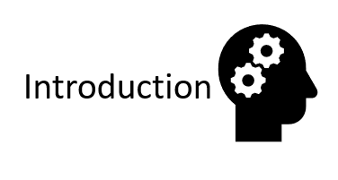
Results
Conclusion
Materials
&
Methods
Literature
Review
Aim
Future Scope

Slide 3
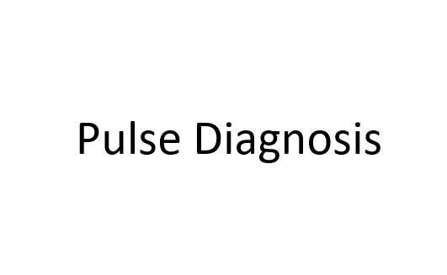
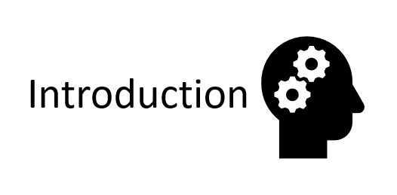
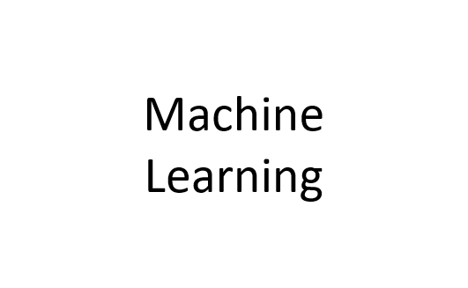
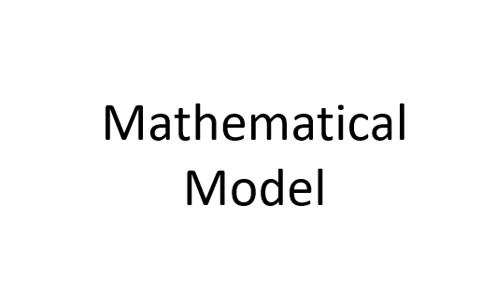

Slide 4
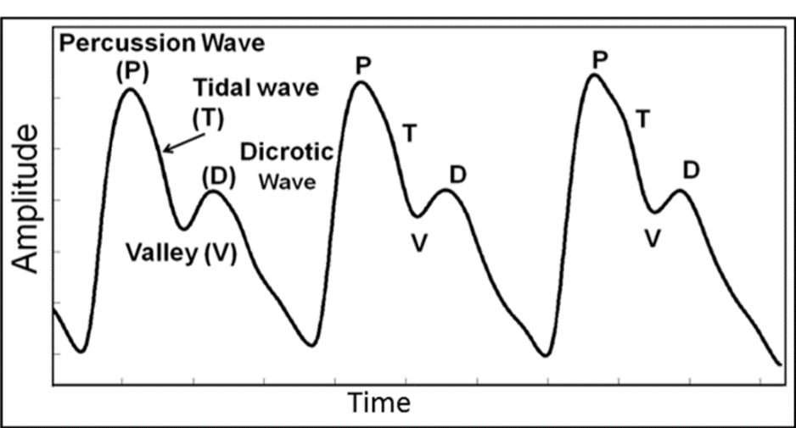
Pulse Diagnosis

Slide 5
Model is a description of a system, theory or phenomenon that accounts for its known or inferred properties and maybe used for further study of its characteristics.
A mathematical model is a mathematical structure that can be used to describe and method of simulating real life situations with mathematical equations to forecast their future behaviour.
Models have limitations but are useful and can be changed based on new evidence.
Mathematical Model

Slide 6
Machine Learning is a discipline of AI, specifying the ability of systems to automatically learn from experience without the need of being explicitly programmed. A key, building block of Artificial Intelligence, Machine Learning mimics human learning to allow systems automatically process data, infer results and adapt its behaviour.
Machine Learning

Slide 7
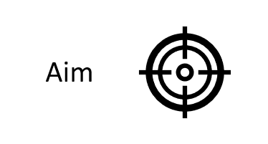
Results
Conclusion
Materials
&
Methods
Literature
Review
Future Scope

Slide 8
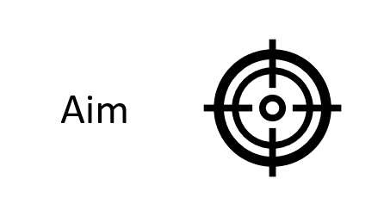
To quantify an Ayurvedic practice of diagnosing medical conditions from pulse readout of the human body.
To develop a mathematical model that can classify if a subject is suffering from some ailment or not based on their features of pulse.
To develop an accompanying low cost and portable hardware for collecting the data.

Slide 9
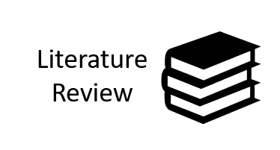
Results
Conclusion
Materials
&
Methods
Future Scope

Slide 10
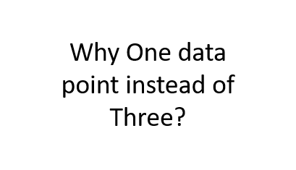

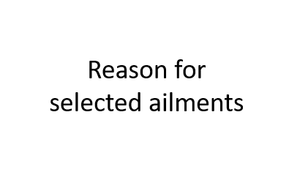
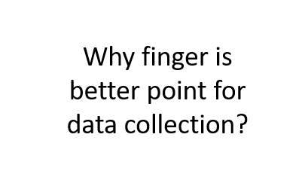
Correlation between Pulse & Disease
Previous model drawbacks

Slide 11
Mean Values | A_{p}E_{n}
 | Vata | Pitha | Kapha
Normal Patients | 0.2651 | 0.2517 | 0.2849
Diabetic Patients | 0.1771 | 0.1731 | 0.1751
Why One data point instead of Three?

Slide 12
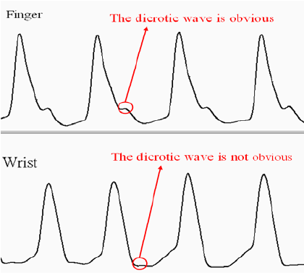
Why finger is better point for data collection?

Slide 13
Normal Pulse
Reason for selected ailments
Diabetic Pulse
Hypertensive Pulse

Slide 14
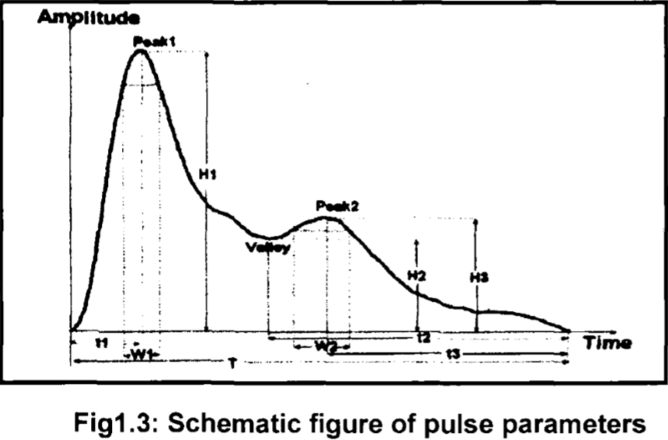
Normal Pulse

Slide 15
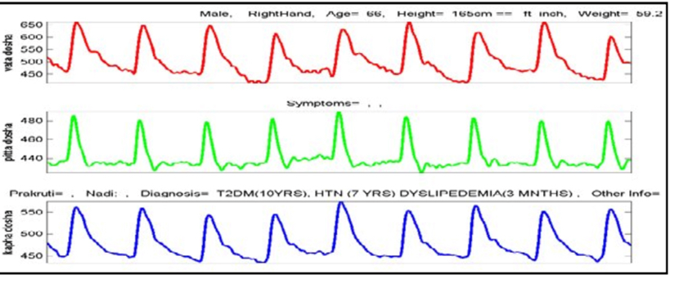
Diabetic Pulse

Slide 16
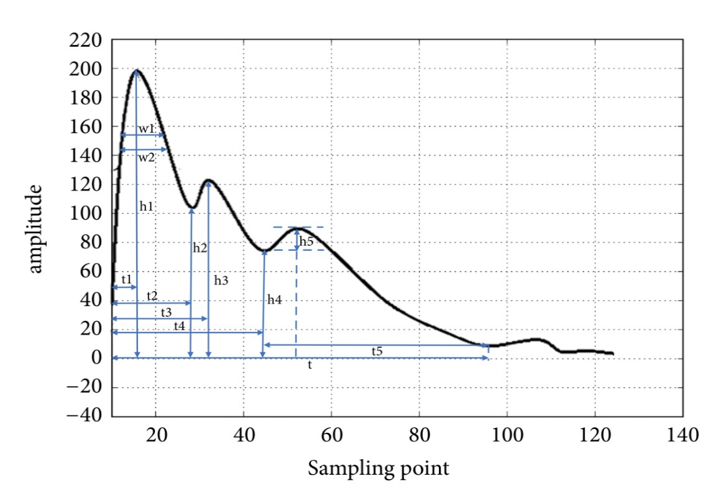


Slide 17
Correlation between Pulse & Disease
Previous model drawbacks

Slide 18
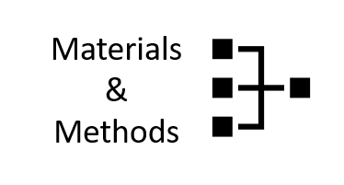
Results
Conclusion
Future Scope

Slide 19
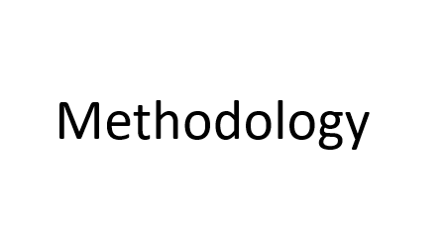
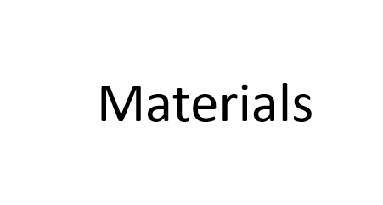
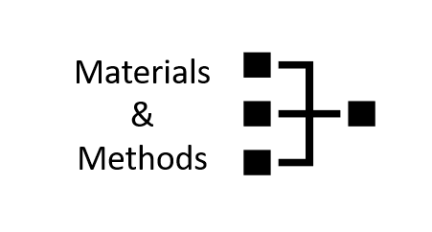
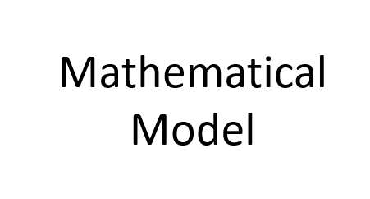

Slide 20

Green LED
Not majorly absorbed by blood components
No large DC shifts
Closer representation of pressure wave electronically
MCP604
APDS9008
Low cost, high accuracy, linear op-amp
Single supply voltage operable
Low cost analog -output ambient light photo sensor
Arduino Nano
Small, complete, with Mini-B USB
Easily programmable

Slide 21

Pulse from Finger
Pulse from Finger
Pulse from Finger
Pulse from Finger
Diagnosis
Python Filtering
Python Filtering
ANN
DAQ
DAQ
DAQ
DAQ
Hardware Filtering
Hardware Filtering
Hardware Filtering
Hardware Filtering
Hardware
Software
Results

Slide 22
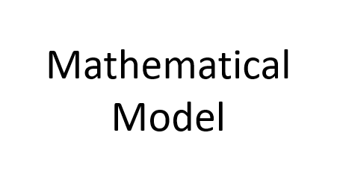
Signal is stored as series of nos. in text file using Arduino, which are then read by Python to convert into list.
Bidirectional double filtration using Recursive Butterworth Filter and added to a new list to find feature points, which are then stored in a separate list.
Mean, Median, Max & Min are calculated for these feature points and appended in a sequence to feature in CSV file, which is an input vector to ML algorithm along with the classes for training purpose.
20% of data is withheld from the algorithm during training for testing, which is then followed by K-fold stratified cross validation, and weighted average of K was returned.
Learning curves are generated. Trained model was saved as .SAV file. When a new piece of data is received, it’s passed as query and the data is classified.

Slide 23
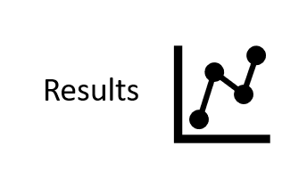
Conclusion
Future Scope

Slide 24
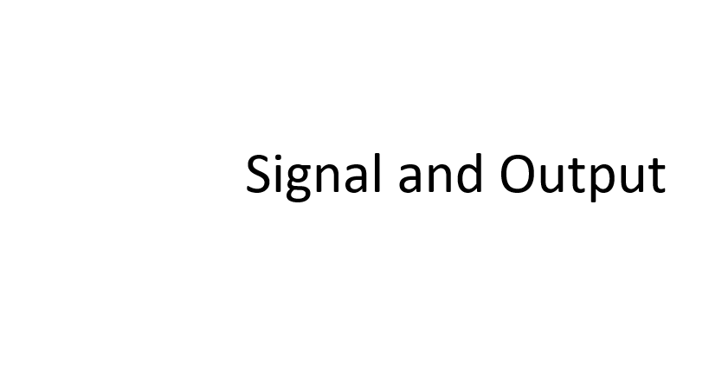
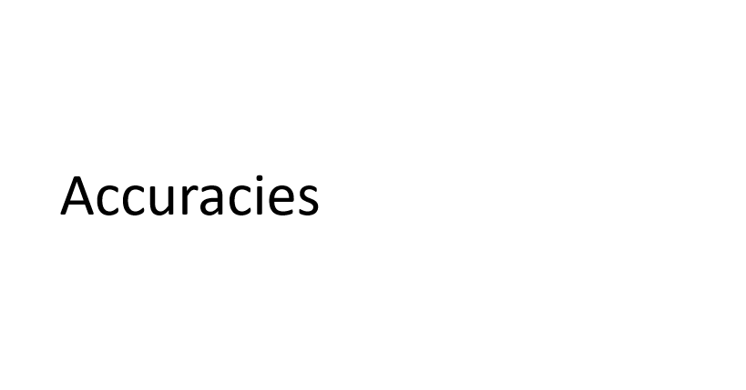
Results
Learning Curves

Slide 25
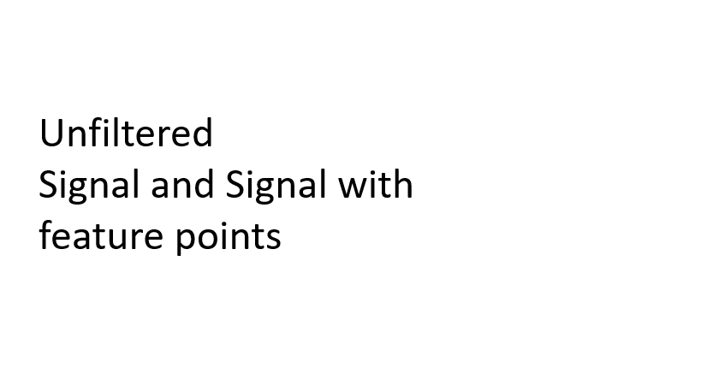
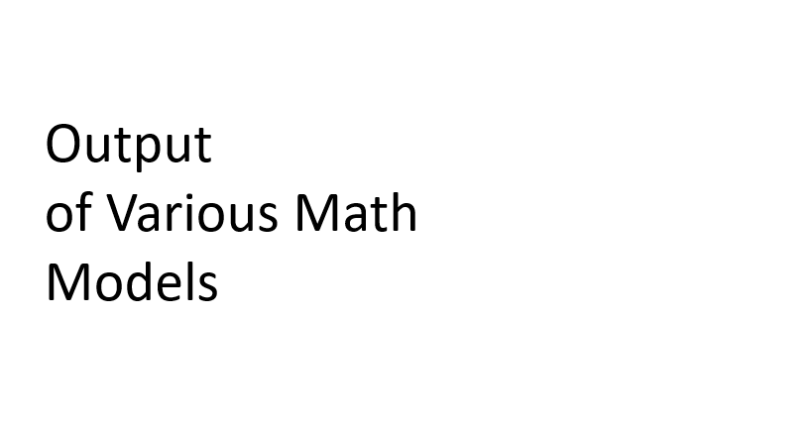
Signal and Output

Slide 26
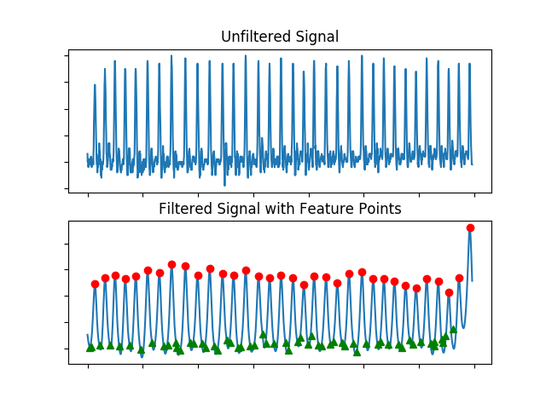
Unfiltered
Signal and Signal with feature points

Slide 27


Output
of Various Math
Models

Slide 28
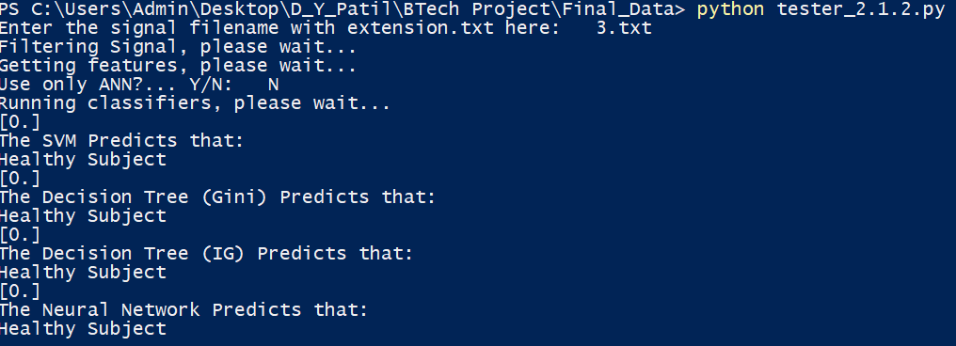

Slide 29
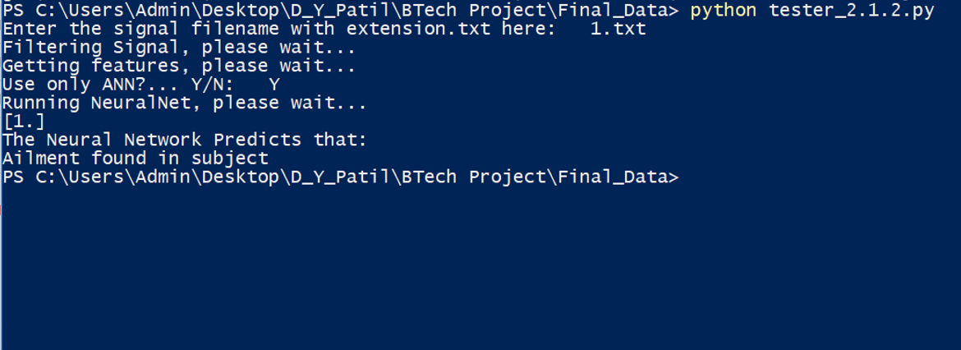

Slide 30
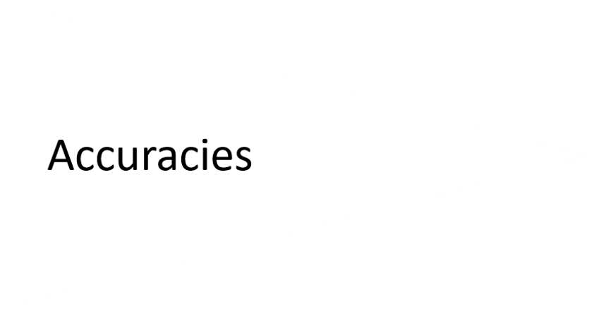
Results
Learning Curves

Slide 31
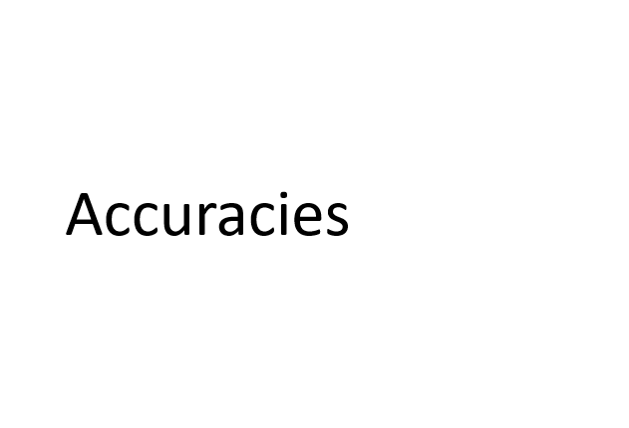

Slide 32
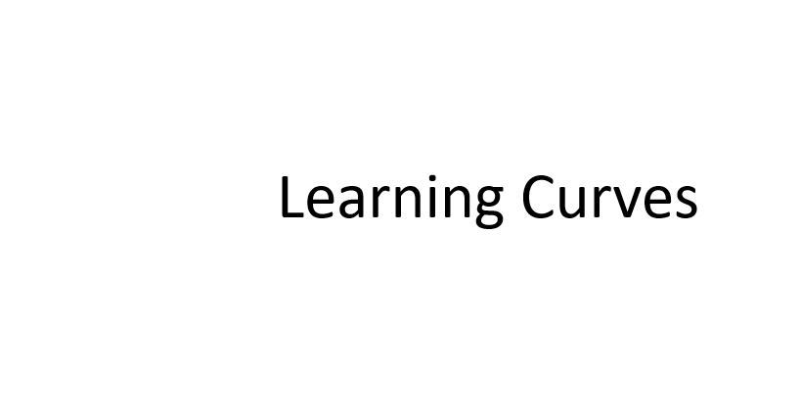
Signal and Output
Results

Slide 33
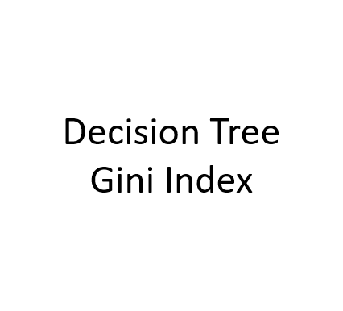
MLP Neural Network Classifier
Learning Curves
Decision Tree Information Gain

Slide 34
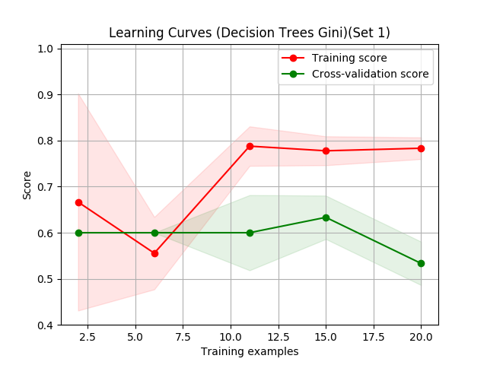
Decision Tree Gini Index

Slide 35

Decision Tree Information Gain

Slide 36
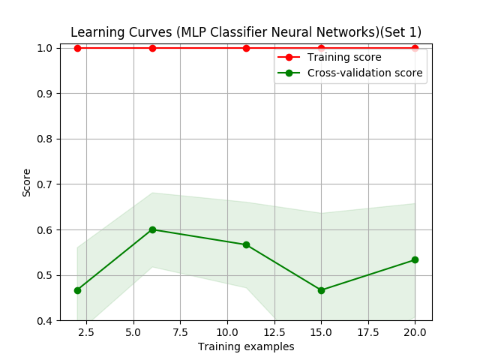
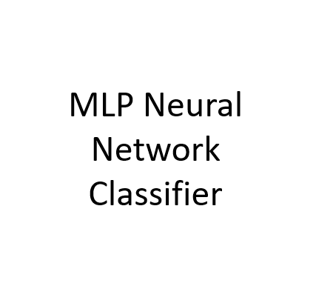

Slide 37
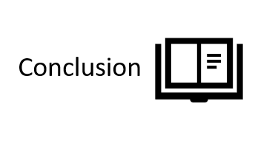
Future Scope

Slide 38

The mathematical model validates the presence or absence of ailments in the subject.
Validation was performed using four AI agents, in order to minimize over-reliance on any particular architecture.
The current iteration was carried out with 120 samples. The dataset was split into 70:20:10 training - test – validation ratio.

Slide 39
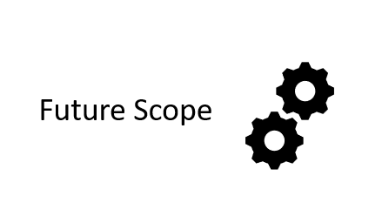

Slide 40
Centralized Database
Frequency Domain Features
Deep Learning
Future Scope

Slide 41
THANK YOU!!!

