Slide 1

How to automatically compare two Power BI reports?
Ilija Tavchioski
prof. dr. Erik Štrumbelj Vid Smrke (In516ht)
31 May 2023
Ljubljana, Slovenia

Slide 2

Introduction
Data migration
Completeness check
Data sampling
In516ht proposal

Slide 3
What is a Power BI report?
A software for creating interactive and dynamic visualizations of data
Features such as: filtering, calculating measurements, slicing data
The dataset is queried of the database
Each visualization is created of the calculations from the data

Slide 4
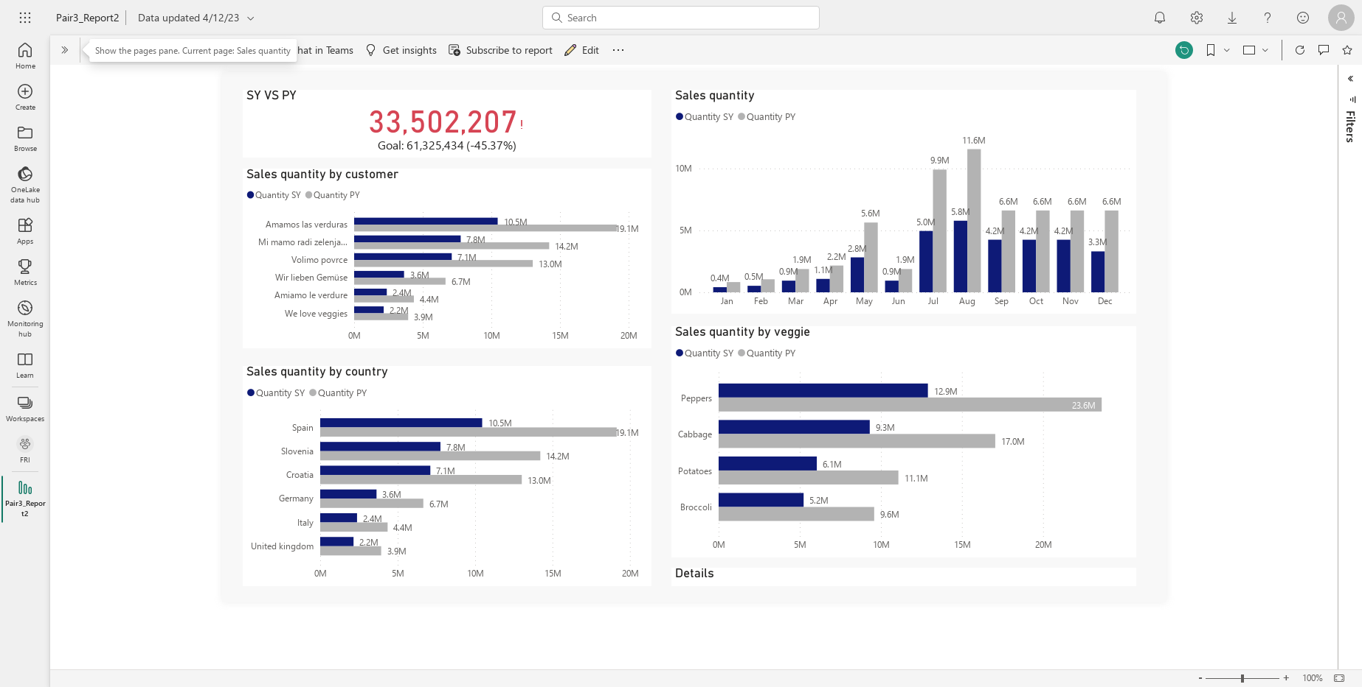

Slide 5
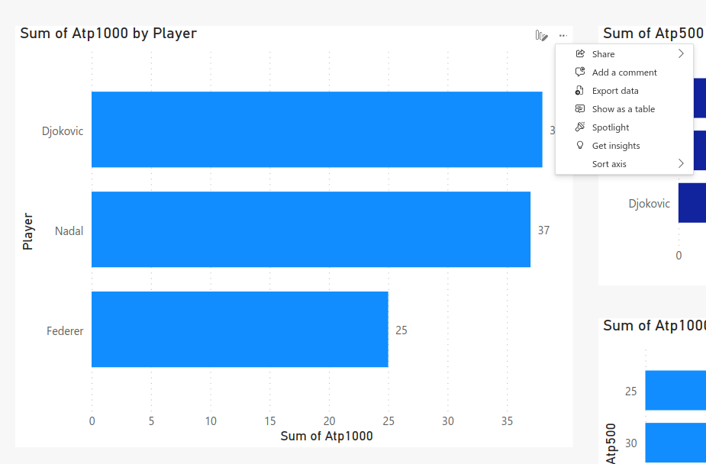
Data visualization
More options
Export data
Downloaded CS file

Slide 6
Problem description
How to extract the data?
Power BI API
Power BI Desktop
Python crawler
How to compare the data?
Unknown key value!
Permuted rows or columns are not interpreted as difference

Slide 7
Software development
Two reports
Username, Password, WorkspaceId, ReportId, DataFolder
Data extraction
Data comparison
Generating comparison report in Excel

Slide 8
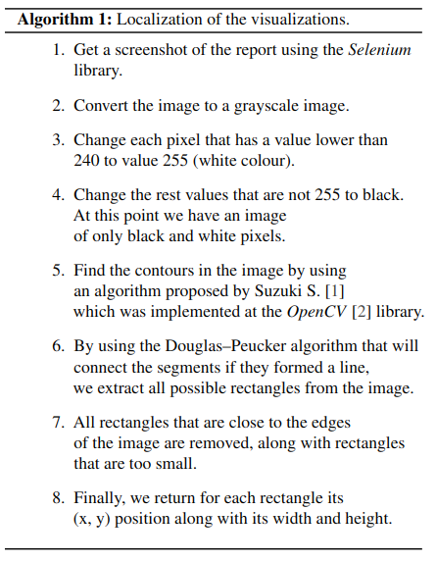
Data extraction
Image localization
Assumptions about the colouring of the report

Slide 10
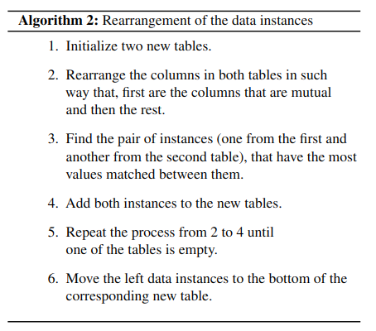
Data comparison
Rearrangement of the data instances
What is interpreted as a difference?
Difference in values
One of the values is NaN
Both of the values are NaN
Different string values
Equal string values

Slide 11
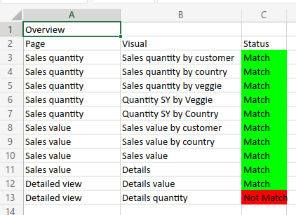
Results output
Overview
Report
Number of rows
Number of columns
Difference in values

Slide 12
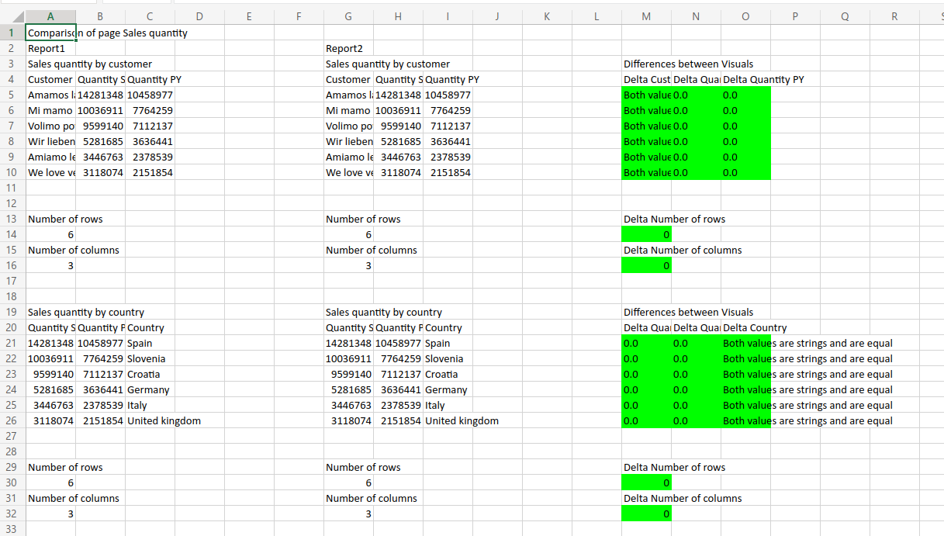

Slide 13
Discussion
What was achieved?
Limitations
Assumption about the colour of the visualizations and the report’s background
Time complexity of the rearrangement algorithm
Time complexity of the rearrangement algorithm
Further improvements
Deep Learning for image segmentation
Extract the data directly from Power BI Desktop

