Slide 1
Orbital
Guardian
Demo Day walkthrough
Matt Topham - September 8, 2026
Reconstructed from the Demo Day walkthrough
Presented live through Chrome Remote Desktop.
Matt Topham / Demo Day reconstruction
1
Notes:
Reconstructed from the Demo Day walkthrough, September8,2026. Matt Topham reported presenting a live Chrome Remote Desktop walkthrough of older and current Unity projects, inspecting code, then explaining the recorded demonstration as it played. No slide deck was used in class. This PDF/PPTX records that delivered sequence afterward. The assignment allotted8minutes plus up to2minutes of questions. This reconstruction does not assert a measured live duration or a future17:30 schedule.
Reconstructed from the Demo Day walkthrough. Author: Matt Topham.

Slide 2
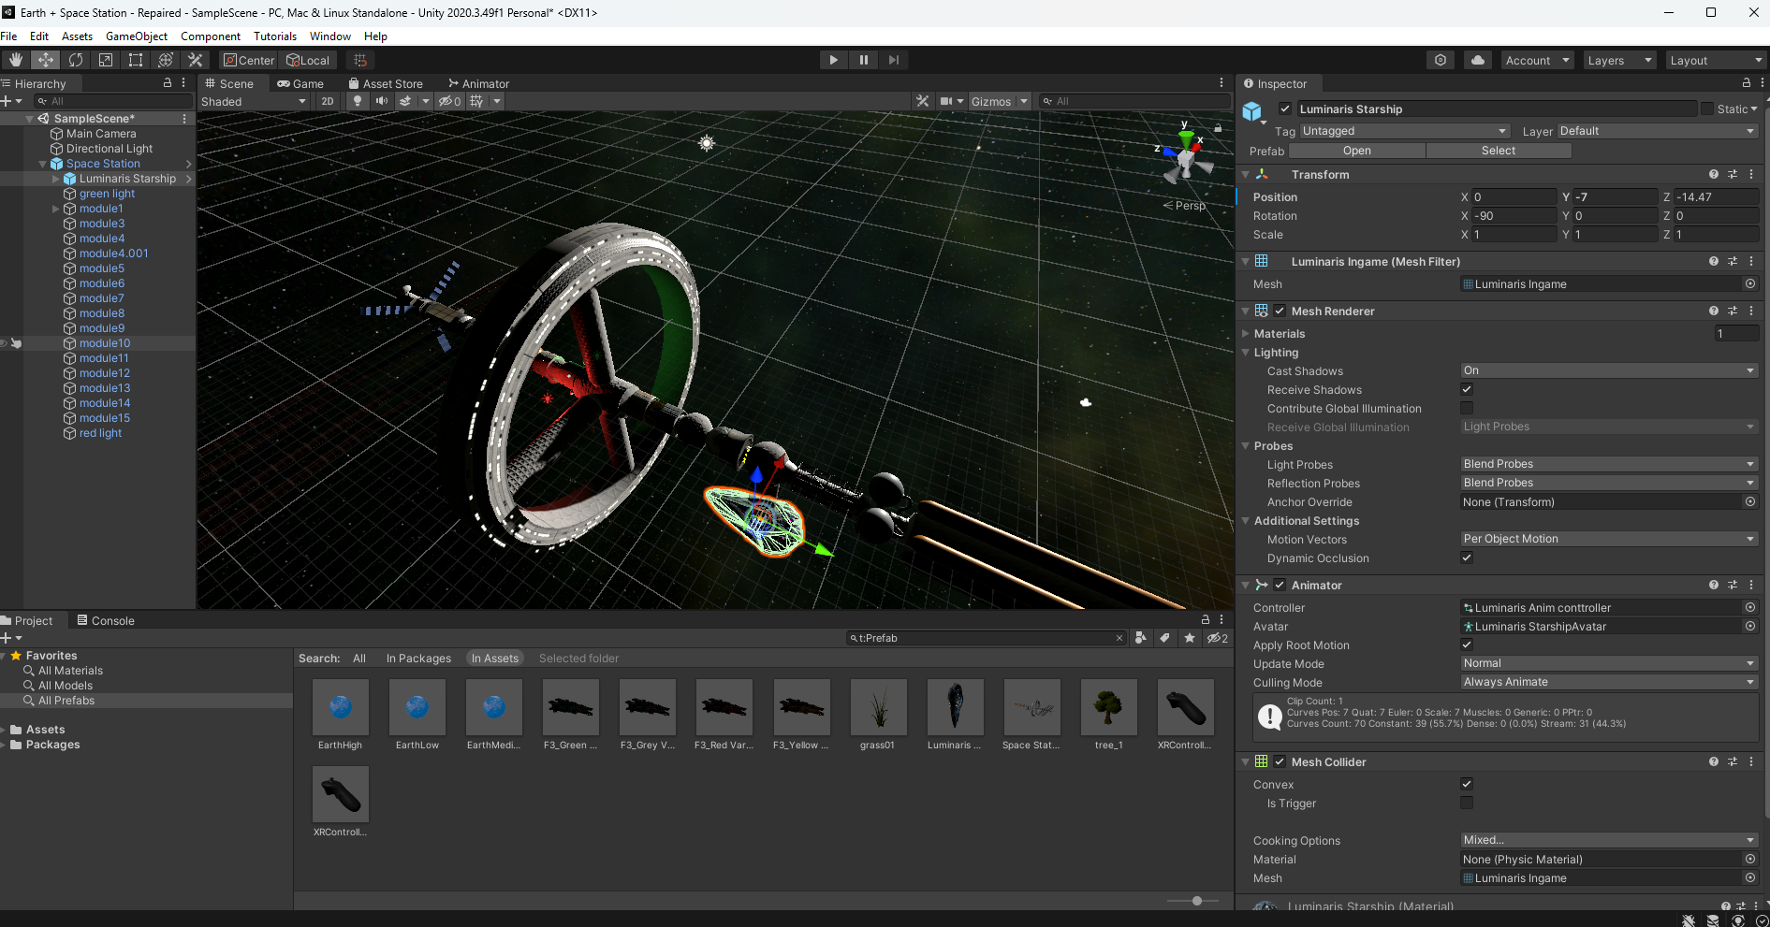
The original station project
Matt began with the rotating station from his earlier Unity work, started around 2020-2021.
Matt Topham / Demo Day reconstruction
Notes:
Matt described the original station project as work begun around2020-2021. The supplied screenshot shows Earth + Space Station - Repaired in Unity2020.3.49f1, including the rotating station and Luminaris Starship selection. Screenshot file: codex-clipboard-961516e5-9f25-431e-ab9b-c60a711eecd6.png. This is a screenshot supplied after the presentation, not a timestamped screen recording of the live classroom walkthrough. Existing station and spacecraft art retain their original vendor authorship.
Reconstructed from the Demo Day walkthrough. Author: Matt Topham.

Slide 3
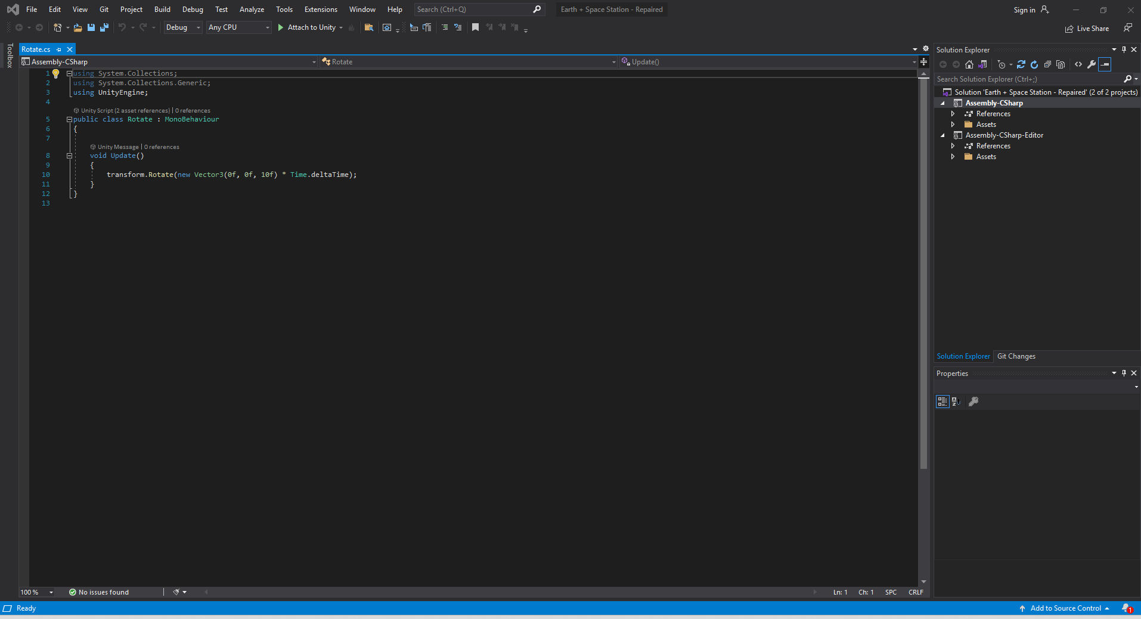
The station rotation script
10 degrees per second
void Update()
{
transform.Rotate(
new Vector3(0f, 0f, 10f)
* Time.deltaTime);
}
The script rotates the local Z axis.
Time.deltaTime scales the step by the elapsed frame time.
Rotate.cs in the original station project.
Matt Topham / Demo Day reconstruction
Notes:
The supplied Rotate.cs screenshot shows Update() calling transform.Rotate(new Vector3(0f,0f,10f) * Time.deltaTime). The exact visible statement is reproduced as editable text with line breaks only. It rotates the local Z axis at10degrees per second, corresponding to36seconds per full revolution. Source: codex-clipboard-d45f0c02-d309-4a74-a63f-b8b163598608.png. Do not claim that the recent StationRotation class is the historical script shown here.
Reconstructed from the Demo Day walkthrough. Author: Matt Topham.

Slide 4
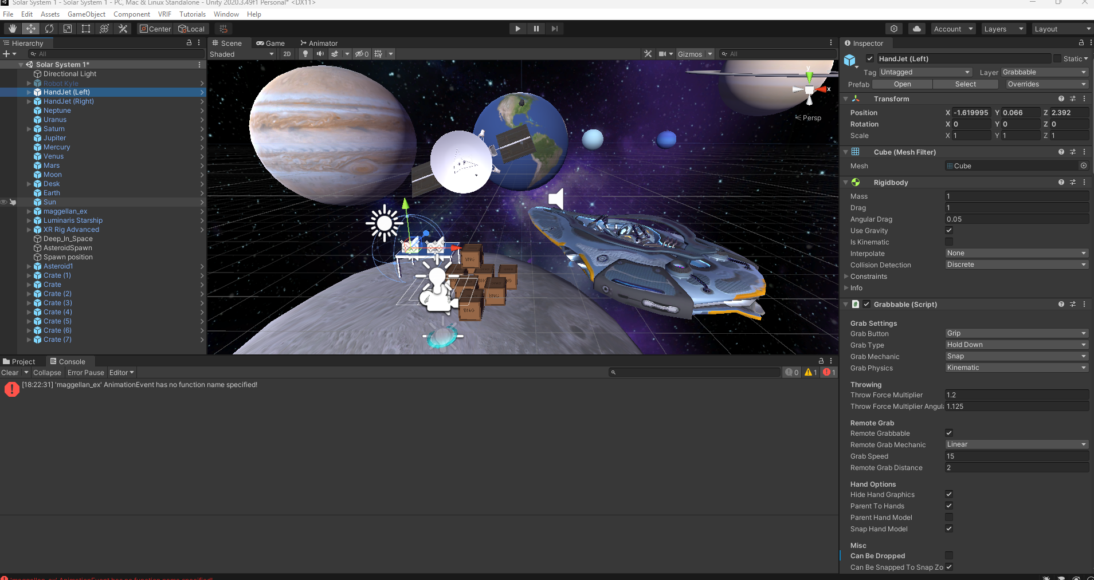
The Solar System prototype
The next project added planets, a VR rig, handjets, spacecraft, and grabbable objects.
Matt Topham / Demo Day reconstruction
Notes:
The supplied Solar System1 screenshot shows Unity2020.3.49f1, planet objects, XR Rig Advanced, HandJet(Left/Right), spacecraft, and crates. Matt described this as the next evolution of the project and discussed BNG-based interaction. The screenshot also retains a visible Magellan AnimationEvent warning in its Console. Source: codex-clipboard-d179a065-47cd-4973-88ba-0cafe09019fb.png.
Reconstructed from the Demo Day walkthrough. Author: Matt Topham.

Slide 5
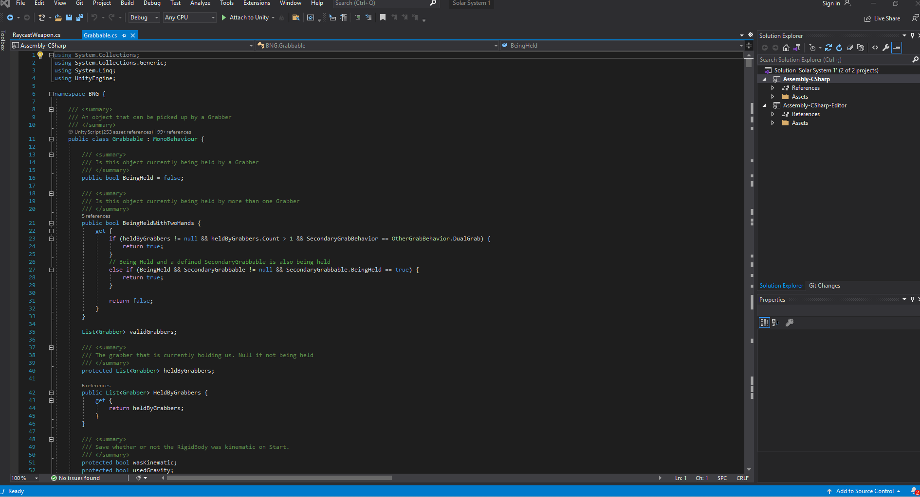
BNG interaction and weapon foundations
Existing VR framework
public bool BeingHeld = false;
BeingHeldWithTwoHands
The visible Grabbable.cs code tracks held state.
Matt discussed raycasting and weapons. RaycastWeapon.cs is another open tab.
BNG supplies the interaction and weapon foundation. The screenshot shows Grabbable.cs.
Matt Topham / Demo Day reconstruction
Notes:
The active file is BNG Grabbable.cs. Its visible code includes public bool BeingHeld=false, BeingHeldWithTwoHands, and HeldByGrabbers. RaycastWeapon.cs is visible as an inactive editor tab. Matt discussed raycasting and weapons during the walkthrough, but this screenshot does not display the raycast implementation. BNG is a supplied framework dependency, not code newly authored by Matt or Codex. Source: codex-clipboard-51f39470-58e2-44a7-a423-bb525530b0f6.png.
Reconstructed from the Demo Day walkthrough. Author: Matt Topham.

Slide 6
Repair and integration in 2026
After time away, Codex helped repair and combine the older projects in Unity 6.
Earlier project work
Matt assembled the station and Solar System prototypes.
Breakable boxes led to asteroid fracture and respawn experiments.
Supplied systems
BNG provided the VR rig, grabbing, and weapon foundation.
Planet, station, and spacecraft assets retain their original authorship.
Recent integration
Codex assisted with repairs and merging the scenes.
The integrated experience adds mission feedback, score and timer logic, and ship controls.
Matt Topham / Demo Day reconstruction
Notes:
The contribution split follows Matt's post-presentation account: older project work and scene assembly by Matt, including breakable-box experiments that led to asteroid fracture and respawn; supplied BNG and environment/spacecraft/station assets; recent Codex-assisted repairs and integration, including gameplay HUD, score/timer state, and ship controls. Specific implementation details and validation evidence belong in the updated written report. This slide does not attribute vendor assets or the complete BNG framework to Codex.
Reconstructed from the Demo Day walkthrough. Author: Matt Topham.

Slide 7
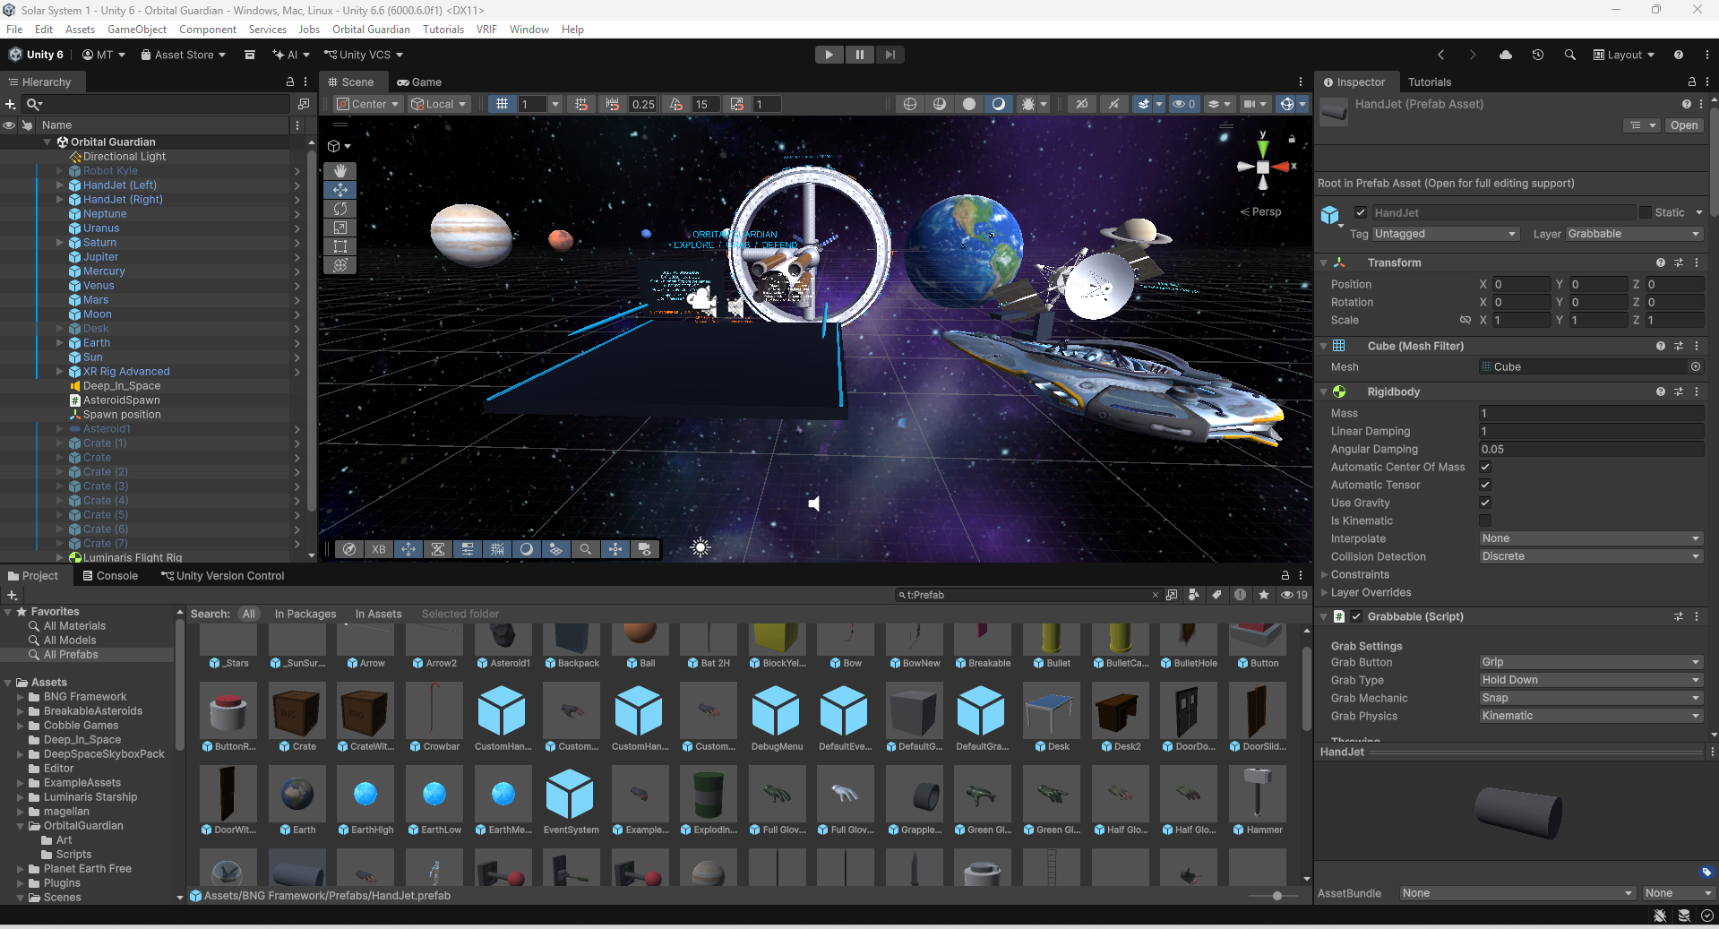
Orbital Guardian in Unity 6
The integrated scene brings the station, planets, dock, hand tools, and spacecraft together.
Matt Topham / Demo Day reconstruction
Notes:
The supplied current scene screenshot shows Unity6.6(6000.6.0f1) and the Orbital Guardian scene with the station, planet layout, dock and instruction panels, hand tools, and spacecraft. The inspector displays the HandJet prefab asset. Source: codex-clipboard-ab09629c-5d99-4fa6-bff0-77e12f5ae29a.png. This is the integrated state included in the walkthrough reconstruction.
Reconstructed from the Demo Day walkthrough. Author: Matt Topham.

Slide 8
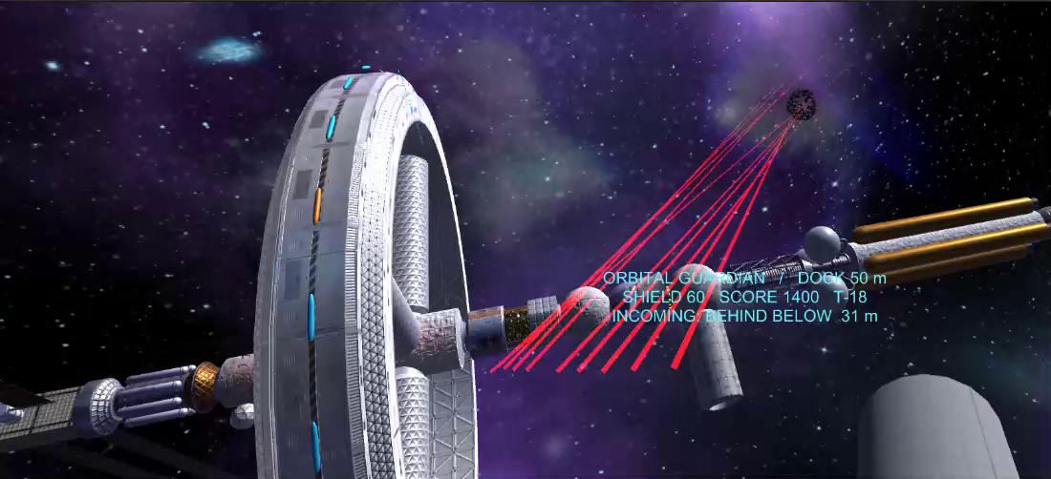
Recorded gameplay demonstration
Matt explained the recorded demonstration as it played.
Available recording: 6:12 https://www.youtube.com/watch?v=-C2nF0jtC0Q
Matt Topham / Demo Day reconstruction
Notes:
Matt stated that he explained the recorded demonstration as it played during the live presentation. The available upload is CSCI4616UnityDemo by thetopham: https://www.youtube.com/watch?v=-C2nF0jtC0Q . The supplied MP4 is371.818646seconds, approximately6:12. That file duration does not establish the precise amount of class time spent playing it. The still is from the same recording at02:06 and shows shield60, score1400, T-18. The clip includes station defense and later movement/ship travel; it does not demonstrate planet resizing or a colony visit. An adjacent MP4 is also included in the submission package.
Reconstructed from the Demo Day walkthrough. Author: Matt Topham.

Slide 9
Related experiences
Supporting context added after Demo Day.
Matt identified Lone Echo and Lone Echo II as inspiration.
Lone Echo
A mining station near Saturn supports hands-on exploration and interaction with equipment.
Its space setting is a reference for embodied interaction.
Lone Echo II
The sequel extends exploration through zero-gravity controls, tools, and abilities.
Movement remains part of interacting with the world.
Orbital Guardian
Matt identified both games as inspiration for zero-gravity movement and interaction around a space station.
Matt Topham / Demo Day reconstruction
Notes:
Matt explicitly identified Lone Echo and Lone Echo II as inspiration. Supporting context added after Demo Day; this is not a claim that a related-work slide appeared during the live walkthrough. Official sources: Lone Echo https://www.meta.com/experiences/pcvr/lone-echo/1368187813209608/ describes a mining station near Saturn, interactive equipment, and hands-on exploration. Lone Echo II https://www.meta.com/experiences/pcvr/lone-echo-ii/1711938725528735/ describes zero-gravity controls and additional tools and abilities. These comparisons do not imply copied assets or code, or establish comfort or scientific-learning results.
Reconstructed from the Demo Day walkthrough. Author: Matt Topham.

