Slide 1
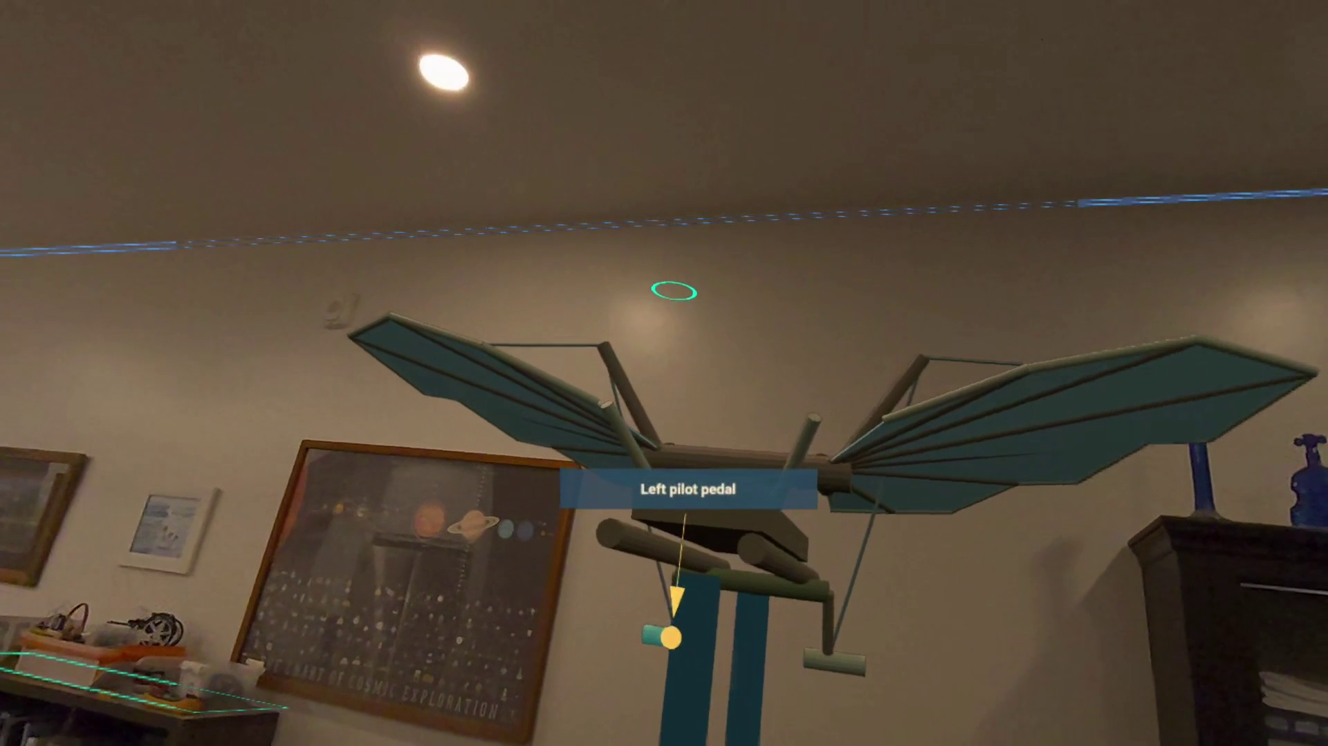
School of the Ancients
A learner asks.
The world becomes
a place to explore.
Matthew Topham
GPT-6.1 Sol — AI co-author
Quest 3 mixed reality demo
SCHOOL OF THE ANCIENTS / CSCI 4616 PROJECT 2
1
Notes:
Allow 45 seconds. This is Project 2: an interactive mixed reality learning app for Quest 3. The main idea is simple: a learner asks a question, requests an exhibit, and explores it with a historically inspired AI teacher. The project is the result of several years of prototypes. The current demonstration runs through Matrix Loading Operator, the previous submission, with School providing the teaching and learner state. GPT-6.1 Sol is credited as an AI co-author at my request.

Slide 2
Cosmos and the Pavilion of the Searchers
Seven Wonders of the New World
“No such thing as a dumb question.”
One-on-one encounters with scientific thinkers,
with room to ask unexpected questions.
School pursues that conversational ideal through AI-guided mixed reality.
SCHOOL OF THE ANCIENTS / CSCI 4616 PROJECT 2
2
Notes:
Allow 45 seconds. This is the specific Cosmos passage that inspired the project. The Pavilion imagines historical scientific figures who explain their discoveries and answer visitors patiently, without shame about asking a basic question. What I wanted to carry forward was that personal encounter and freedom to follow curiosity. Cosmos imagines reconstructed neural networks and memories. School uses AI interpretations, not recovered human minds. The quotation and description come from the excerpt and transcript I supplied.
Sources: https://www.youtube.com/watch?v=DKd-m-X1lyM

Slide 3
A project that evolved over several years
2020
Cosmos
A future world fair with simulated historical figures
2024
First web prototype
Historical Q&A for the Gemini API Developer Competition
2025
AR, AI, and a remixable museum
Ryo Suzuki colloquium; Meta Horizon contest; SOTA beta
2026
Learning meets world creation
V2 experiments, Matrix, and the embodied Professor
SCHOOL OF THE ANCIENTS / CSCI 4616 PROJECT 2
3
Notes:
Allow 65 seconds. The original inspiration was the Cosmos future-world-fair idea. I made a web prototype for the 2024 Gemini competition. In September 2025, Ryo Suzuki’s talk, Augment Human Thought and Creativity with the Power of AR and AI, helped inspire the direction: computing as a dynamic space for thought. The same month, I built a remixable Horizon Worlds museum and began the web beta. The 2026 work explores how to combine the learning engine with an open-ended spatial creation system. The dates distinguish my recalled inspiration from dated repository evidence.
Sources: https://github.com/School-of-the-Ancients/school-of-the-ancients-vr; https://github.com/thetopham/schooloftheancients; https://www.colorado.edu/atlas/ryo-suzuki

Slide 4
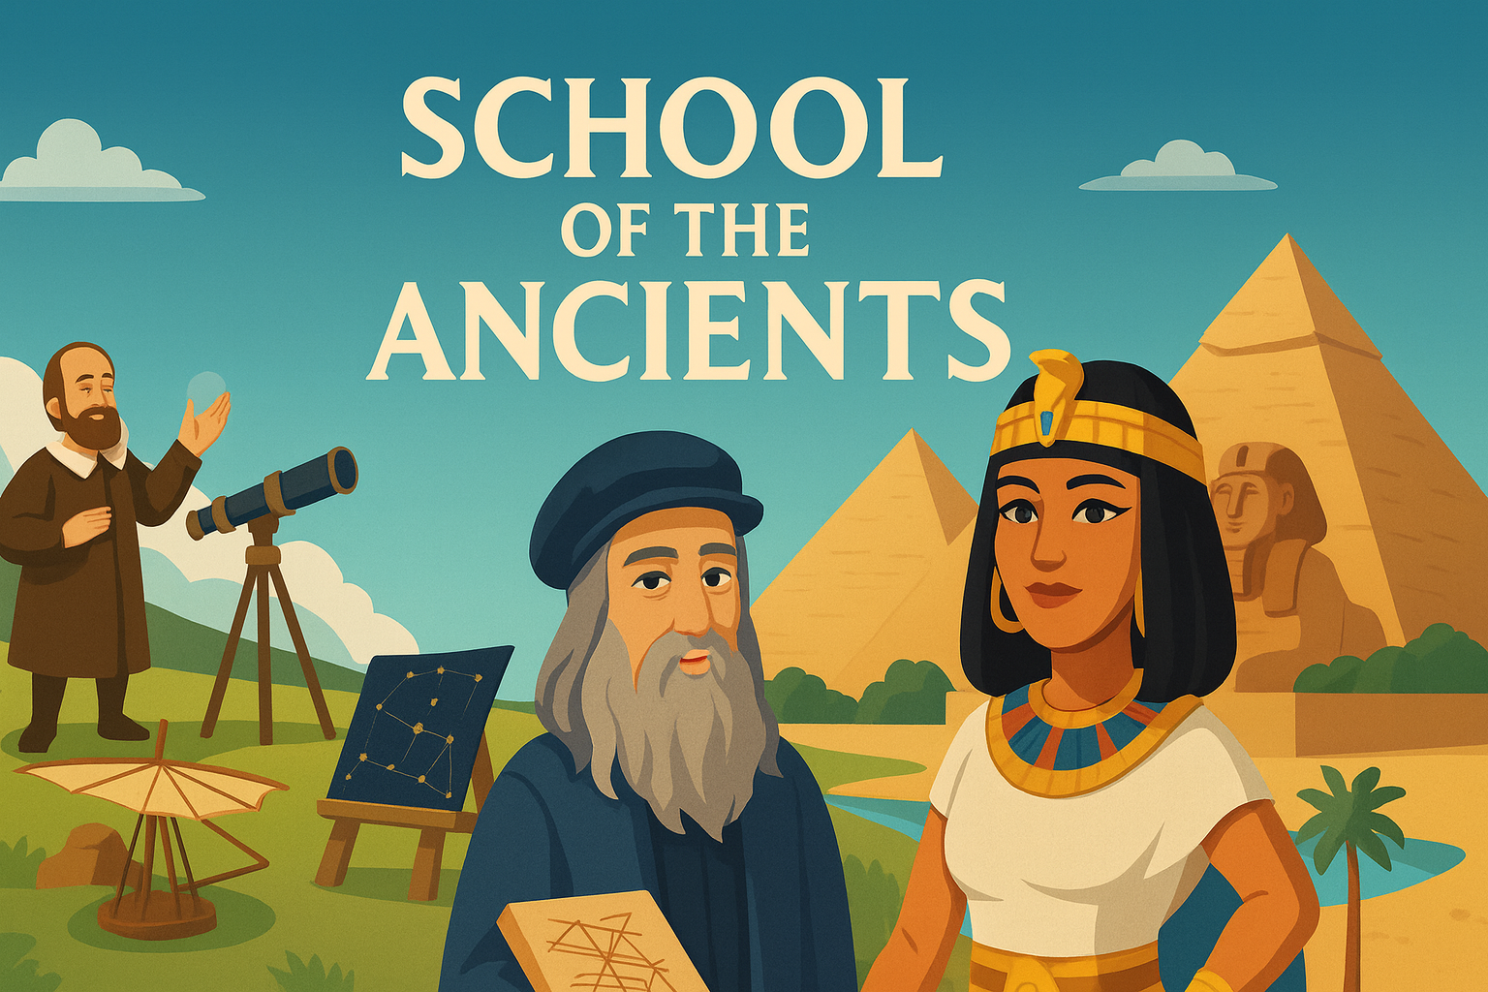
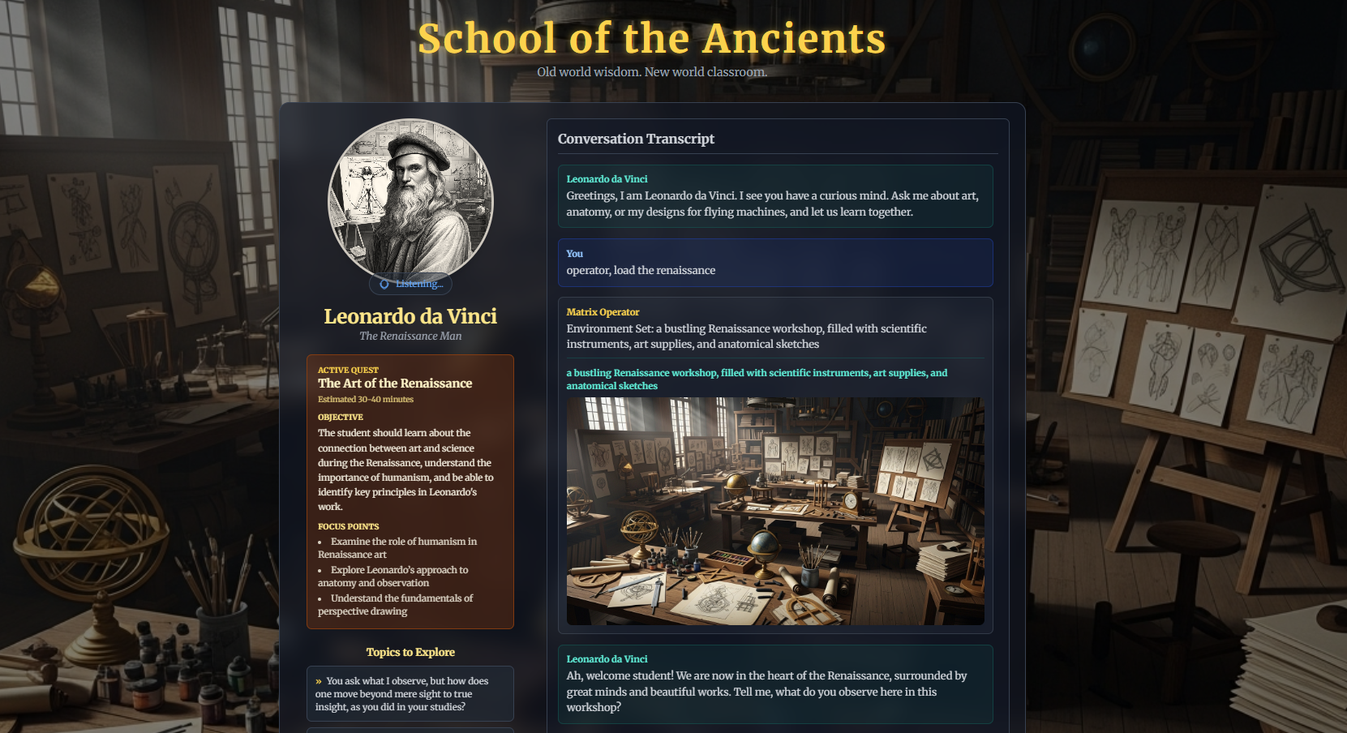
The 2025 prototypes
Remixable Horizon museum
Socratic web beta
Historical characters, props, and a saved world
Quests, dialogue, voice, and saved learning
SCHOOL OF THE ANCIENTS / CSCI 4616 PROJECT 2
4
Notes:
Allow 60 seconds. The Horizon project was submitted to Meta Horizon Creator Competition: Open Source Champions. It used AI NPC examples, themed zones, props and buttons. The environment was generated and then baked into saved assets. The web beta explored a different layer: goal setting, mentor selection, quests, dialogue and progress. These were real prototypes, but they did not yet provide the current end-to-end Quest experience. They taught different lessons about interaction, persistence and the limits of a prescribed learning flow.
Sources: https://devpost.com/software/school-of-the-ancients; https://github.com/School-of-the-Ancients/sota-beta

Slide 5
What changed since Matrix Loading Operator
Previous submission
Project 2
World creation and editing
Voice commands and an Operator
Persistent scenes and imported assets
An embodied teacher and learner record
Exhibits connected to the conversation
Live voice and part-aware pointing
Matrix remains the world runtime. School owns the learning experience.
SCHOOL OF THE ANCIENTS / CSCI 4616 PROJECT 2
5
Notes:
Allow 60 seconds. Matrix Loading Operator was my previous submission. This project builds on it instead of replacing it. The important change is that creation serves an ongoing learning conversation. School owns the teacher, the goal, the practice and the learner’s progress. Matrix owns the objects, the world, the input and the actual edits. The Professor can ask for an exhibit while conversation continues. The video compares the original voice route with the later live-voice and Decisions integration.
Sources: https://github.com/School-of-the-Ancients/matrix-loading-operator; https://github.com/School-of-the-Ancients/sota-professor

Slide 6
How a question becomes an exhibit
Learner
Professor
Operator
Blender
Matrix on Quest
→
→
→
→
Question or request
Lesson and intent
Build task
Named 3D parts
Load and interact
Task status and observed scene results return to the conversation.
Reusable assets are also supported. A requested build is not complete until its result loads.
SCHOOL OF THE ANCIENTS / CSCI 4616 PROJECT 2
6
Notes:
Allow 70 seconds. The headset captures the request. School interprets the learning goal and delegates an allowed creation task. The Operator can use a library asset, a procedural path or Blender. For a new model, the pipeline exports a GLB, validates it, registers it, and loads it into the current world. Named parts support selection and teaching. Task identity and scene receipts prevent a spoken promise from being treated as successful creation. The immersive client is Three.js/WebXR; model creation and privileged services run on the host PC.
Sources: https://github.com/School-of-the-Ancients/matrix-loading-operator/blob/main/Docs/Professor-Delegation.md; https://github.com/School-of-the-Ancients/sota-professor/blob/checkpoint/subscription-beta/docs/OPERATOR_HANDOFF.md

Slide 7
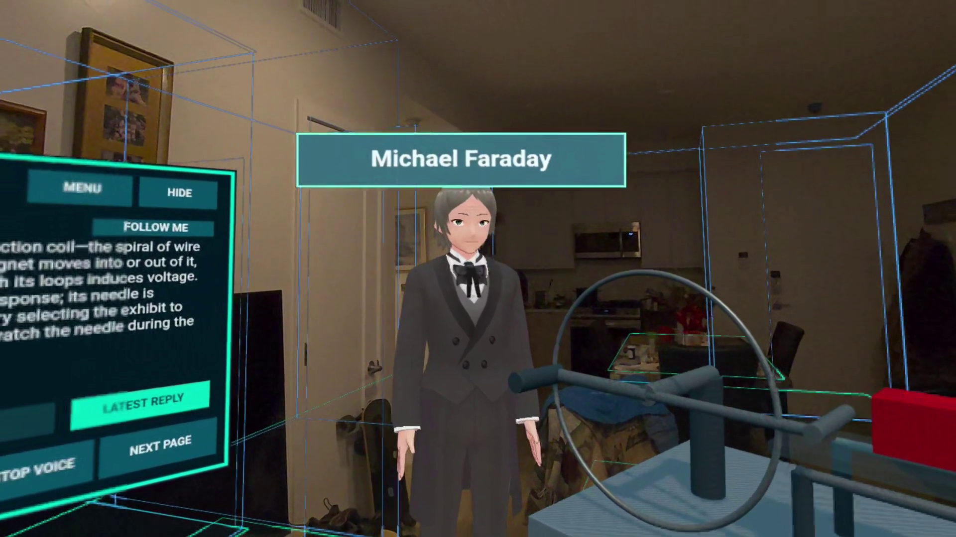
Why this is mixed reality
The physical room remains visible while virtual exhibits, pointers, and the teacher occupy it.
SCHOOL OF THE ANCIENTS / CSCI 4616 PROJECT 2
7
Notes:
Allow 45 seconds. This is not a closed VR classroom. Quest passthrough remains visible around the virtual teacher and equipment. I can move and inspect the scene and refer to parts in a real room. The demonstration does not claim that every virtual object has physically accurate collisions with the real furniture, or that the electrical animations solve the underlying physics. The room context is real; the exhibits are digital teaching aids.

Slide 8
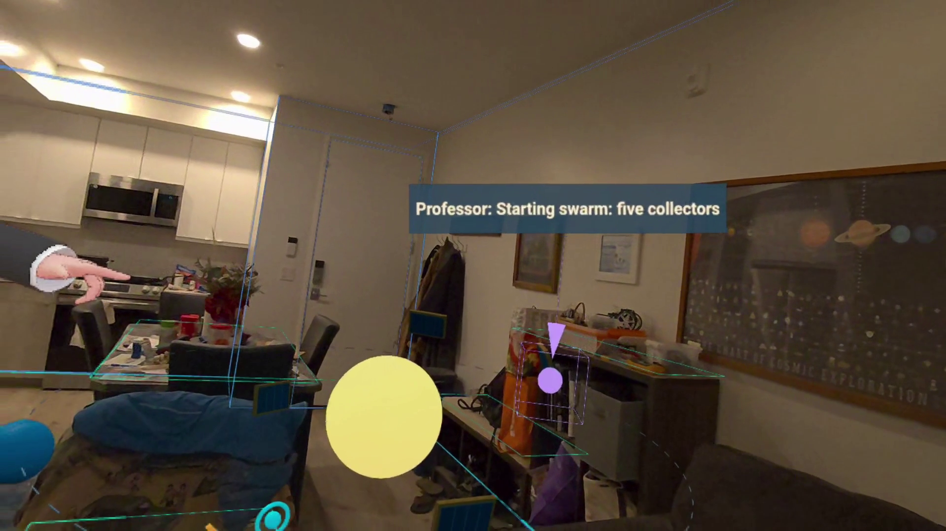
Demonstration
Play the 7:53 video
Question → Blender request
Loaded flying machines
Original mode → live voice
Full Tesla conversation
4616-Demo-With-Dynamic-Creation-Intro.mp4
SCHOOL OF THE ANCIENTS / CSCI 4616 PROJECT 2
8
Notes:
Video playback: 7 minutes 53 seconds. Switch to the local MP4 now. The opening uses only my own question and Blender-request audio from an earlier recording. The approved Leonardo footage shows the loaded devices. Other chapters show the original mode, then the live-voice/Decisions version, and the complete Tesla demo. The edit joins separate sessions and labels the shortened pause; it is not a latency benchmark. Return to the next slide after playback. Keep the MP4 next to the slides when moving the submission to another computer.

Slide 9
What the demonstration establishes
Visible in the recording
A spoken request followed by loaded exhibits
A teacher explaining and referring to parts
A learner asking follow-up questions in a real room
The demo does not measure learning gains, prove physical accuracy,
or show an uninterrupted Blender-to-headset execution trace.
SCHOOL OF THE ANCIENTS / CSCI 4616 PROJECT 2
9
Notes:
Allow 47 seconds. The evidence is a functional interaction demonstration. The world is not a prearranged fixed lesson from the learner’s point of view: the learner can request content and inspect the result. The system also supports a reusable asset library. I am not claiming that a working animation proves an aircraft could fly or that a fluent answer proves learning. XP and level-up code exist in later builds, but reward visuals are not part of this final video.

Slide 10
Engineering progress beyond the video
v1.2
Persistent worlds, input, locks and recovery
rc.1–rc.5
Embodied teaching, named parts, mini-lessons and rewards
rc.6
Optional live voice with Decisions-based pointing
rc.7
Connected lessons, saved voices, independent avatar jobs and remote access
SCHOOL OF THE ANCIENTS / CSCI 4616 PROJECT 2
10
Notes:
Allow 65 seconds. GitHub records a much broader engineering effort than one clip can show: input fixes, stable identity, persistence, recovery, tool delegation, avatar selection and speech integration. The latest reviewed release is rc.7. Its release notes report automated tests and packaged startup checks, while some long-session, reward-display and recovery checks on Quest remain open. A release record is evidence of a build; it is not the same as complete headset acceptance. The report appendix lists published builds and the merged PR history.
Sources: https://github.com/School-of-the-Ancients/matrix-loading-operator/releases; https://github.com/School-of-the-Ancients/sota-professor/releases/tag/v1.3.0-rc.7

Slide 11
Next steps
Measure response and build latency under comparable conditions
Make setup and recovery easier for another user
Develop reusable, reviewed lessons without blocking free exploration
Study whether learners understand and retain more
The goal is useful learning—not only a convincing performance.
SCHOOL OF THE ANCIENTS / CSCI 4616 PROJECT 2
11
Notes:
Allow 65 seconds. My next priority is another person successfully running and using the experience. I would measure speech latency, build time, failure recovery and usability, then compare learning outcomes with a simpler lesson. Reviewed content, historical sources, more reliable generated mechanisms and accessible non-headset paths also matter. I want structured lessons to be available without forcing every curious question into a quiz.

Slide 12
What would you ask it to build?
A question can become a shared object
that the learner can inspect, discuss, and revise.
Project history and source
github.com/School-of-the-Ancients
Related work
Ryo Suzuki · Figmin XR · ShapesXR · Khanmigo
Park et al., Generative Agents (2023)
SCHOOL OF THE ANCIENTS / CSCI 4616 PROJECT 2
12
Notes:
Allow about 85 seconds, including questions. Close by asking what topic or object the audience would want to explore. The contribution is the integrated encounter: conversation, on-demand world creation and embodied exploration. The full report separates the history, implemented features, source evidence and future work. Sources for related work: https://www.colorado.edu/atlas/ryo-suzuki; https://www.figmin.com/api; https://learn.shapesxr.com/; https://www.khanmigo.ai/; https://arxiv.org/abs/2304.03442.

