Slide 1
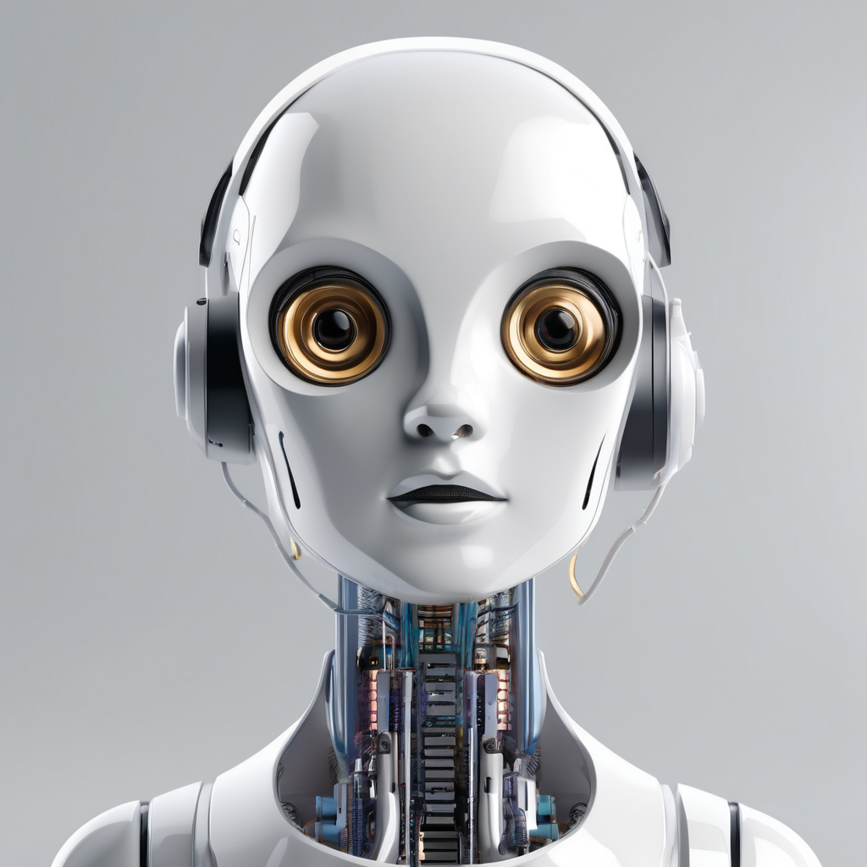
Generative AI Chatbot for St.Clair College

Slide 2
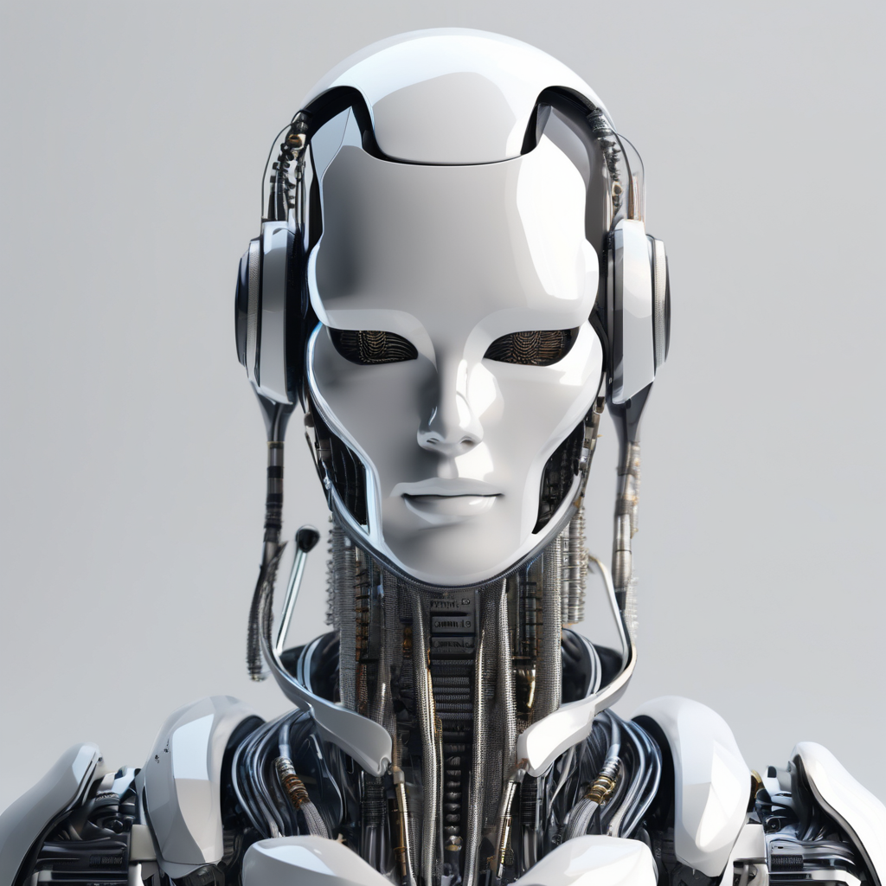
Introduction & SCOPE
The generative AI chatbot project for St.Clair College aims to implement an advanced chatbot system using state-of-the-art technologies and techniques. This chatbot will provide an interactive and personalized experience for students, staff, and visitors.
The scope is:
Develop a chatbot that can understand and respond to user queries in a natural and human-like manner.
Provide accurate and relevant information about various college services, programs, and events.
Enhance user experience by offering personalized recommendations and suggestions.
Improve accessibility and availability of information for students, staff, and visitors.

Slide 3
Background of Generative AI Chatbots
Generative AI chatbots are designed to simulate human-like conversations and provide automated responses to user queries. These chatbots utilize advanced natural language processing (NLP) algorithms and machine learning techniques to understand and generate human-like text.
Purpose
Enhance User Experience: Generative AI chatbots aim to provide seamless and personalized user experiences by offering instant and accurate responses to user queries.
Improve Efficiency: By automating customer support and service, generative AI chatbots can handle a large volume of inquiries simultaneously, reducing the workload on human agents.
Capabilities
Natural Language Understanding: Generative AI chatbots can comprehend and interpret user input in natural language, allowing them to understand context and respond appropriately.
Contextual Conversations: These chatbots can maintain context and carry on meaningful and coherent conversations with users over multiple interactions.
Learning and Adaptation: Generative AI chatbots can continuously learn from user interactions and adapt their responses to improve accuracy and relevance.
Multilingual Support: Many generative AI chatbots are capable of understanding and responding in multiple languages, enabling global reach and accessibility.

Slide 4
Benefits of Generative AI Chatbots
💻 Improved Customer Service
Generative AI chatbots provide instant and accurate responses to customer queries, enhancing the overall customer experience. They can handle multiple inquiries simultaneously, reducing wait times and improving customer satisfaction.
📈 Scalability
Generative AI chatbots can handle a large volume of customer inquiries without the need for additional human resources. This scalability allows businesses to provide prompt support to a growing customer base without compromising on quality.
💸 Cost Savings
By automating customer service interactions, generative AI chatbots can significantly reduce labor costs associated with customer support. Businesses can allocate resources more efficiently and redirect human agents to handle more complex or specialized tasks.

Slide 5
Hyper Parameter Testing
What is Hyper Parameter Testing?
Hyperparameter testing is the process of exploring different values for the hyperparameters in a machine learning model.
This testing is the process of systematically adjusting the hyper parameters of a generative AI chatbot model in order to enhance its performance.
Importance of Hyper Parameter Testing
Hyper parameter testing is crucial for fine-tuning the chatbot model to achieve the desired level of performance and accuracy.

Slide 6
LLAMA 2 Model from Hugging Face
What is LLAMA 2?
LLAMA 2 is a state-of-the-art language model developed by Hugging Face. It is designed to generate human-like text responses based on given prompts.
Relevance to the Generative AI Chatbot
The implementation of the generative AI chatbot at St.Clair College utilizes the LLAMA 2 model to provide intelligent and context-aware responses to user queries.
Benefits of LLAMA 2
Natural Language Generation: LLAMA 2 can generate text that is fluent and coherent, making it ideal for conversational applications like chatbots.
Contextual Understanding: LLAMA 2 has the ability to understand and respond to user queries based on the given context, resulting in more accurate and relevant responses.
Training on Diverse Data: LLAMA 2 has been trained on a large and diverse dataset, enabling it to handle a wide range of topics and conversation styles.

Slide 7
Implementation of Generative AI Chatbot at St.Clair College
1. Planning and Requirements Gathering
Identified the goals and objectives for the chatbot implementation, as well as the specific use cases and functionalities it should support.
2. Data Collection and Preprocessing
Collected and preprocessed a large dataset of student queries, responses, and relevant information to train the chatbot model.
3. Model Selection and Training
Selected the LLAMA 2 model from Hugging Face as the base model for the chatbot and trained it on the preprocessed dataset.
4. Integration with College Systems
Integrated the chatbot with existing college systems and databases to access relevant student information and provide personalized responses.
5. Testing and Evaluation
Conducted extensive testing and evaluation of the chatbot's performance, including accuracy, response time, and user satisfaction.
6. Deployment and User Training
Deployed the chatbot on the college website and other relevant platforms, and provided training to staff and students on how to interact with the chatbot.
7. Ongoing Maintenance and Updates
Established a maintenance plan to regularly update and improve the chatbot based on user feedback and changing requirements.

Slide 8
Challenges Faced
1. Data Availability and Quality
Obtaining a sufficient amount of high-quality training data was a challenge, as it required collecting and preprocessing a diverse range of student queries and responses.
2. Natural Language Understanding
Ensuring the chatbot accurately understands and interprets user queries, including handling variations in language, slang, and context, was a complex task.
3. Integration Complexity
Integrating the chatbot with existing college systems and databases required navigating technical complexities and ensuring data security and privacy.
4. Acceptance and Trust
Gaining user acceptance and trust in the chatbot as a reliable and helpful resource was a challenge, as some users were initially skeptical of relying on an AI system.
5. Continuous Improvement
Maintaining and continuously improving the chatbot's performance and accuracy over time required ongoing monitoring, feedback analysis, and model updates.

Slide 9
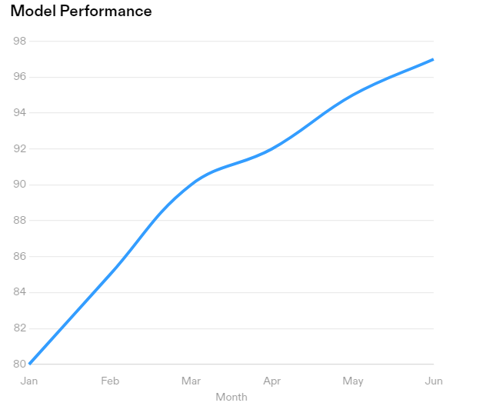
Evaluation and Results
Positive Experience: Tests found the chatbot to be helpful and user-friendly, providing accurate and relevant responses.
Improved Efficiency: The chatbot significantly reduced response time, allowing users to quickly obtain the information they needed.
Increased Engagement: Users appreciated the interactive nature of the chatbot, leading to higher engagement and satisfaction.

Slide 10
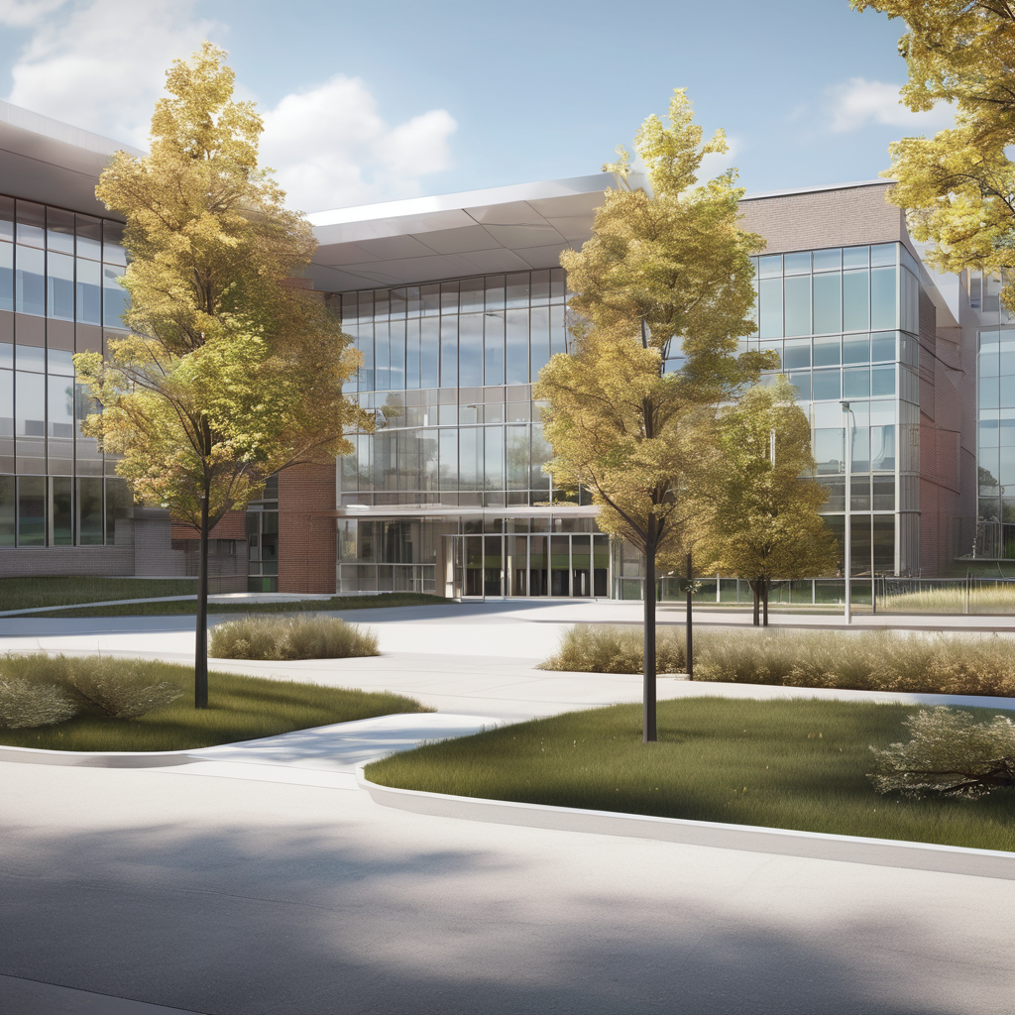
CONCLUSION
In conclusion, the implementation of the generative AI chatbot at St.Clair College has been a resounding success. The key points of the presentation are:
The LLAMA 2 model from Hugging Face was used to develop the chatbot, providing advanced natural language processing capabilities.
The chatbot has improved the student experience by providing instant and accurate responses to their queries.
The chatbot has reduced the workload of college staff by handling routine inquiries, allowing them to focus on more complex tasks.
The chatbot has been well-received by students, who appreciate the convenience and efficiency it offers.
Overall, the generative AI chatbot has proven to be a valuable addition to St.Clair College, enhancing communication and streamlining processes.

