Slide 1
Steel City Bed and Breakfast
Kyriakos Mantzouridis Jeff Palmieri

Slide 2
Intro
Our goal is to create a Bed and Breakfast web page that has two user types: Customer and Admin

Slide 3
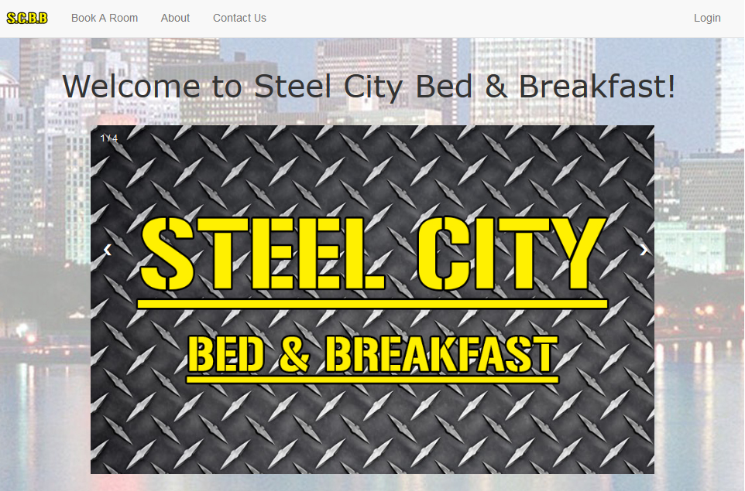

Slide 4
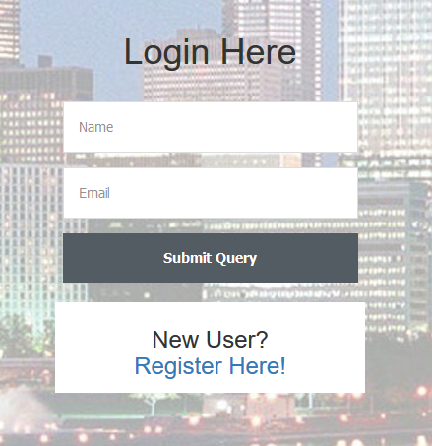
Login/Register
On this page users can login or create an account

Slide 5
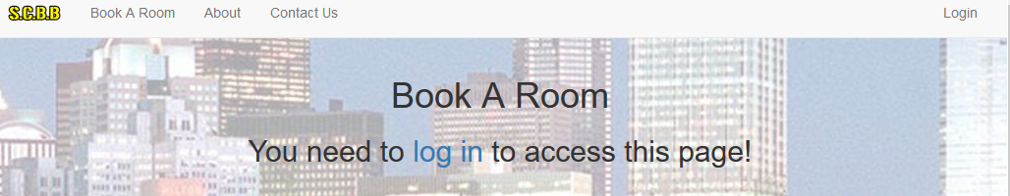
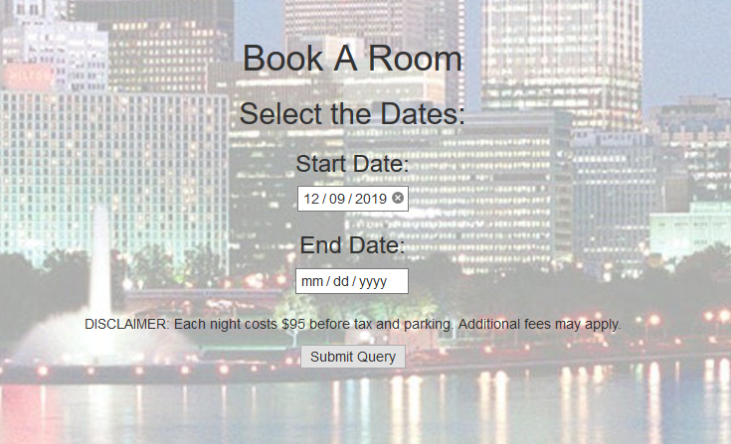
Book a Room
In order to access the Book A Room Page you need to have an account or make one
Once logged in users can Book a room by selecting Start and End Dates

Slide 6
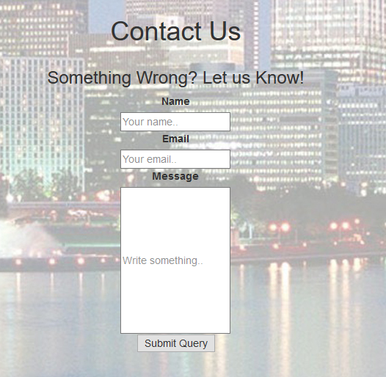
Contact Us
On this page users can fill in their name, email and leave us a message

Slide 7
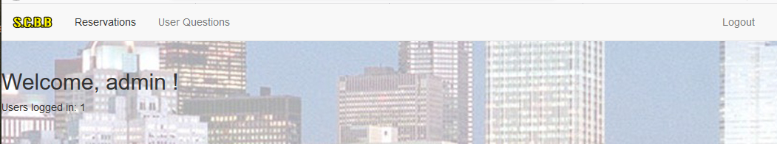
Admin
The admin account has a different view
The admin can check reservations and any user questions

Slide 8
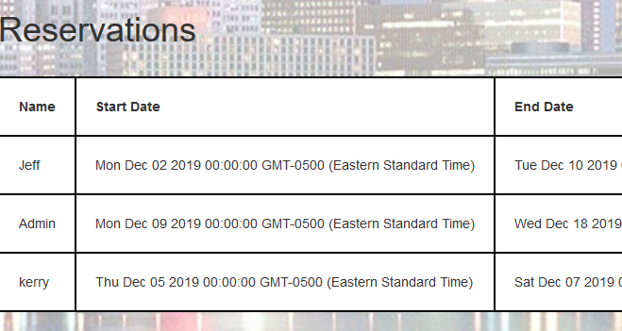
Reservations
On the reservation tab admins can view what users have reservations and their start and end dates

Slide 9
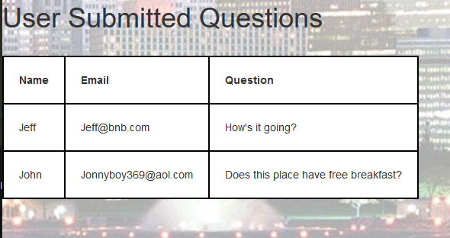
Question page
On this page the Admin can see any questions from users

