Slide 1


Slide 2
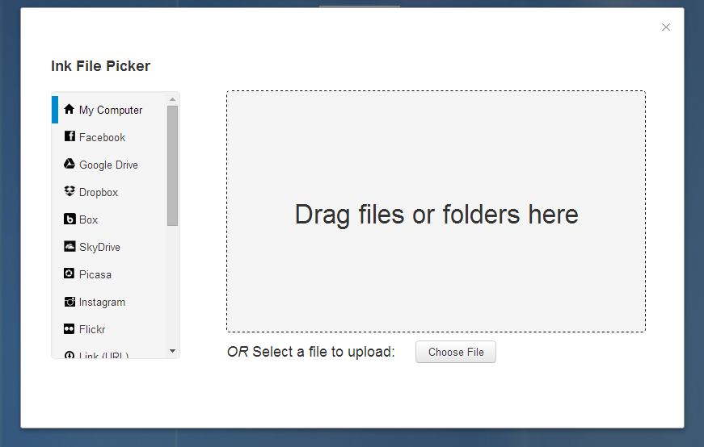

What it is
Something
Anything
Another thing

Slide 3

How it can be useful
Cause of this
And that
And that other thing

Slide 4
Summary

