Slide 1
REGIME-AWARE FORECASTING · HONOURS PROJECT
01 / 14
HMM-Derived Regime Information
and Weekly Market Context
for Stock Direction Prediction
Research question
To what extent can HMM-derived regime information and weekly market-context features improve LSTM-based prediction of next-week stock direction for AAPL, IBM, and MSFT?
AAPL
IBM
MSFT
HONOURS PROJECT · HMM-LSTM STOCK DIRECTION PREDICTION
SLIDE 01 / 14

Slide 2
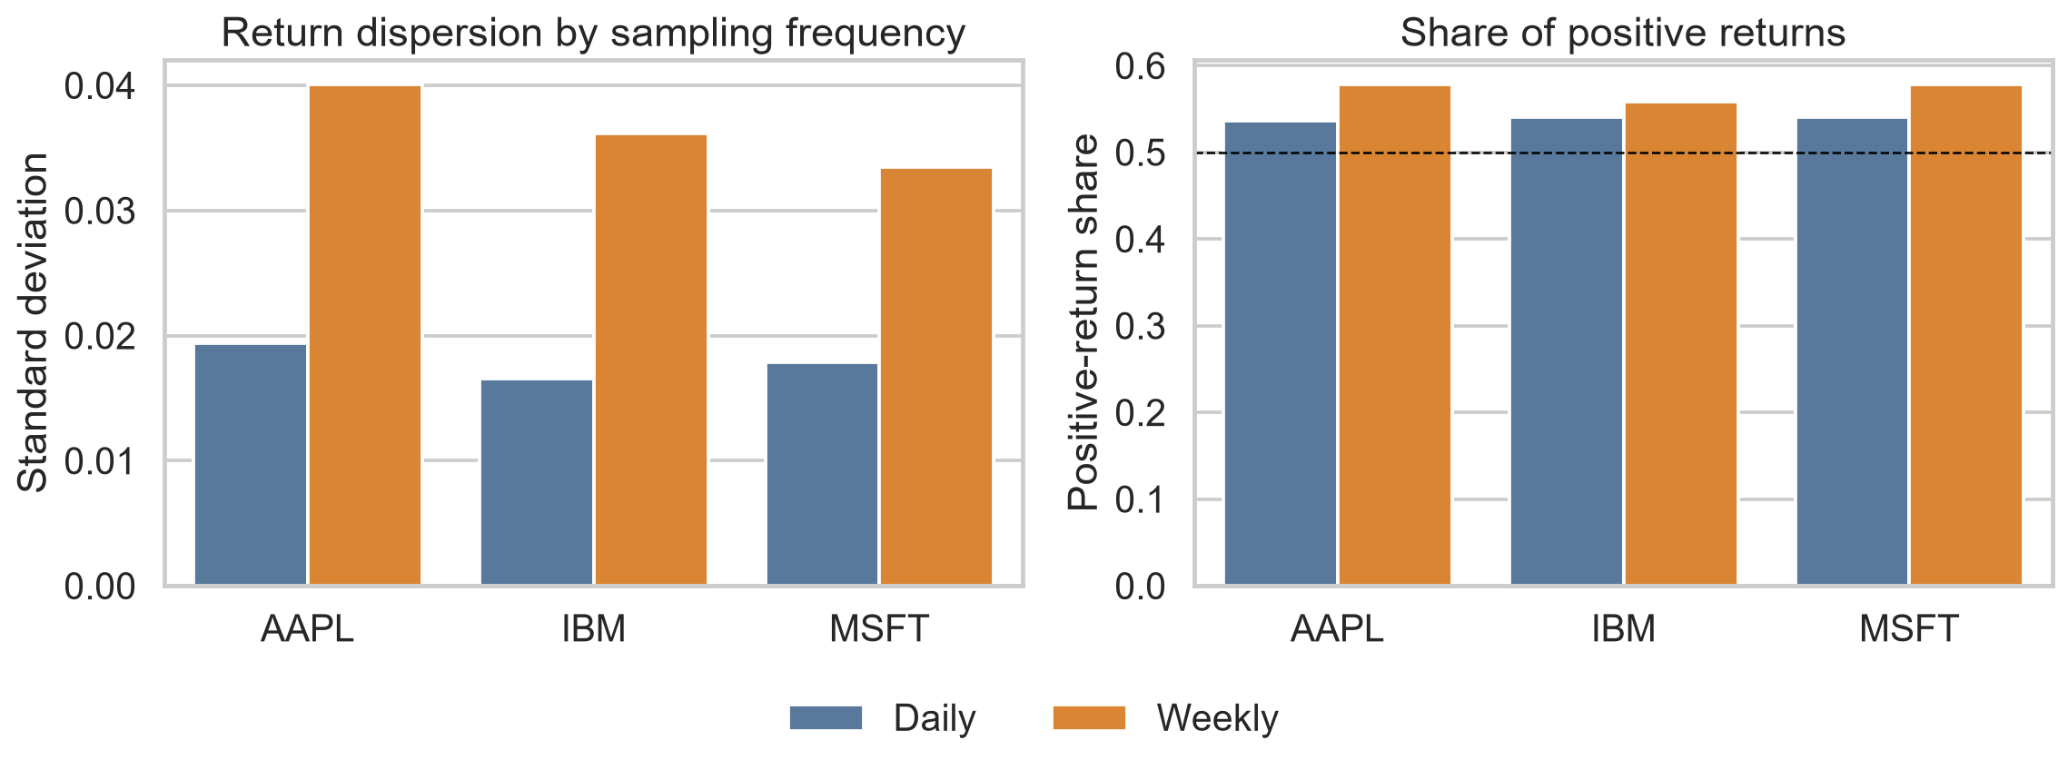
PROBLEM
02 / 14
Daily stock-return prediction is noisy
The first LSTM regression framing struggled to beat simple baselines.
Pivot in the project
A standard daily-return LSTM struggled to beat simple benchmarks, so the task moved to weekly direction classification.
Why weekly?
Weekly aggregation reduces short-horizon noise and turns the problem into a more interpretable bullish/bearish classification task.
HONOURS PROJECT · HMM-LSTM STOCK DIRECTION PREDICTION
SLIDE 02 / 14

Slide 3
TASK
03 / 14
Final prediction task
Next-week stock direction for AAPL, IBM, and MSFT.
Target
Tickers
yₜ₊₁ = 1 if next-week return > 0
AAPL
Input
IBM
Past weekly stock features → predict next-week bullish / bearish direction
MSFT
HONOURS PROJECT · HMM-LSTM STOCK DIRECTION PREDICTION
SLIDE 03 / 14

Slide 4
PIPELINE
04 / 14
Method overview
Daily prices become weekly features, then regime/context signals feed the LSTM.
Daily OHLCV
Weekly features
HMM probabilities
LSTM classifier
Direction
Open, high, low, close, volume
→
Returns, volatility, momentum, drawdown
→
One-step regime / up probabilities
→
Lookback windows: 4, 8, 12, 26
→
Next-week bullish or bearish
HONOURS PROJECT · HMM-LSTM STOCK DIRECTION PREDICTION
SLIDE 04 / 14

Slide 5
REGIME MODEL
05 / 14
HMM model
A two-state latent regime model fitted on weekly returns.
State labelling
rₜ | zₜ = k ~ N( μₖ , σ²ₖ )
The state with higher training mean return is labelled bullish; the other is labelled bearish.
Feature handoff
HMM output is converted into next-week regime and positive-return probabilities, then appended to selected LSTM inputs.
HONOURS PROJECT · HMM-LSTM STOCK DIRECTION PREDICTION
SLIDE 05 / 14

Slide 6
REGIME DIAGNOSTIC
06 / 14
What HMM found
The regimes were interpretable, but closer to calm/stress than pure bull/bear.
Interpretation
Bullish regimes had higher return and lower volatility; bearish regimes had lower return and higher volatility.
Ticker | Bullish μ/σ | Bearish μ/σ
AAPL | 0.010 / 0.022 | -0.003 / 0.053
IBM | 0.002 / 0.017 | -0.003 / 0.055
MSFT | 0.006 / 0.021 | -0.004 / 0.065
HONOURS PROJECT · HMM-LSTM STOCK DIRECTION PREDICTION
SLIDE 06 / 14

Slide 7
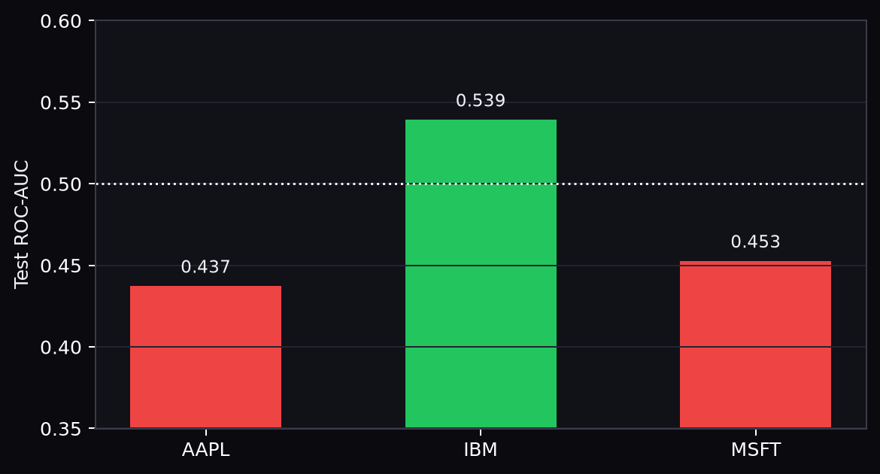
BENCHMARK
07 / 14
HMM-only benchmark
HMM alone was diagnostic, but not consistently predictive.
AAPL
Weak standalone ROC-AUC: 0.437
IBM
Some signal: HMM-only ROC-AUC 0.539
MSFT
Weak standalone ROC-AUC: 0.453
HONOURS PROJECT · HMM-LSTM STOCK DIRECTION PREDICTION
SLIDE 07 / 14

Slide 8
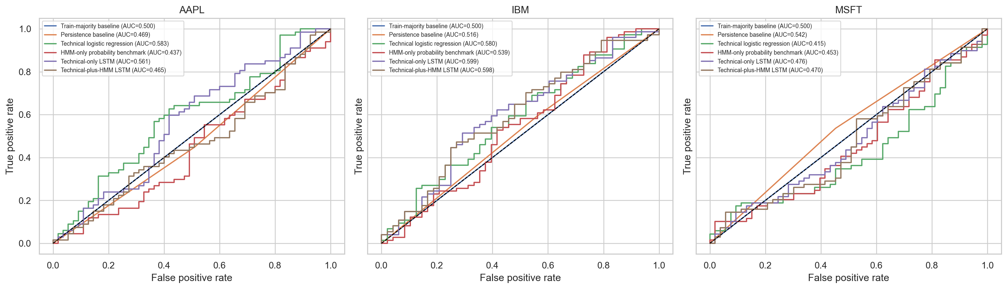
CONTROLLED TEST
08 / 14
Controlled comparison
HMM did not consistently improve the technical-only LSTM.
HONOURS PROJECT · HMM-LSTM STOCK DIRECTION PREDICTION
SLIDE 08 / 14

Slide 9
INCREMENTAL TEST
09 / 14
HMM incremental value
The HMM effect was ticker-dependent, not universal.
Ticker | Technical LSTM | Technical + HMM | HMM effect
AAPL | 0.531 | 0.470 | -0.061 · worsened
IBM | 0.583 | 0.585 | +0.002 · tiny gain
MSFT | 0.476 | 0.474 | -0.003 · no gain
Main sentence
HMM value is ticker-dependent: it was harmful for AAPL in the controlled setting, almost neutral for IBM, and did not improve MSFT.
HONOURS PROJECT · HMM-LSTM STOCK DIRECTION PREDICTION
SLIDE 09 / 14

Slide 10
CONTEXT
10 / 14
Weekly market-context features
After testing HMM directly, broader context was added to the LSTM input.
Volatility context
Market context
Relative context
VIX/VXN levels, changes, z-scores
QQQ weekly return, volume, momentum, moving-average gaps
Stock return, momentum, and volatility versus QQQ
HMM probabilities
Stacked model
Lookbacks
Stock regime and next-week positive-return probabilities
Additional architecture capacity
4, 8, 12, and 26 weeks
Market context and HMM context were tested separately, then combined.
HONOURS PROJECT · HMM-LSTM STOCK DIRECTION PREDICTION
SLIDE 10 / 14

Slide 11
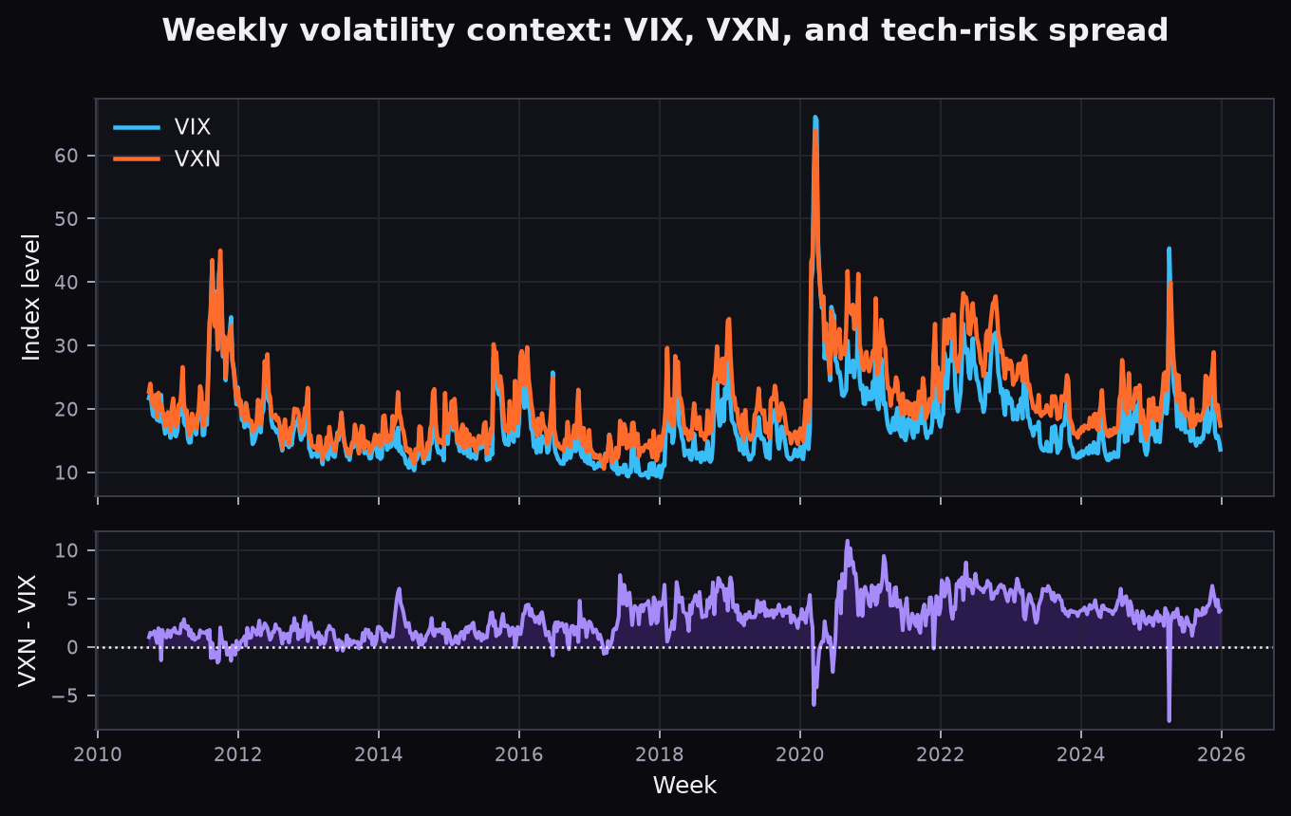
CONTEXT
10 / 14
Weekly market-context features
After testing HMM directly, broader context was added to the LSTM input.
Why VIX?
VIX measures broad S&P 500 implied volatility, so it acts as a market-wide fear and uncertainty proxy.
Why VXN?
VXN measures Nasdaq-100 implied volatility, giving a technology-heavy risk signal that is closer to AAPL and MSFT.
Why the spread?
VXN minus VIX captures when technology risk rises relative to the broader market.
HONOURS PROJECT · HMM-LSTM STOCK DIRECTION PREDICTION
SLIDE 10 / 14

Slide 12
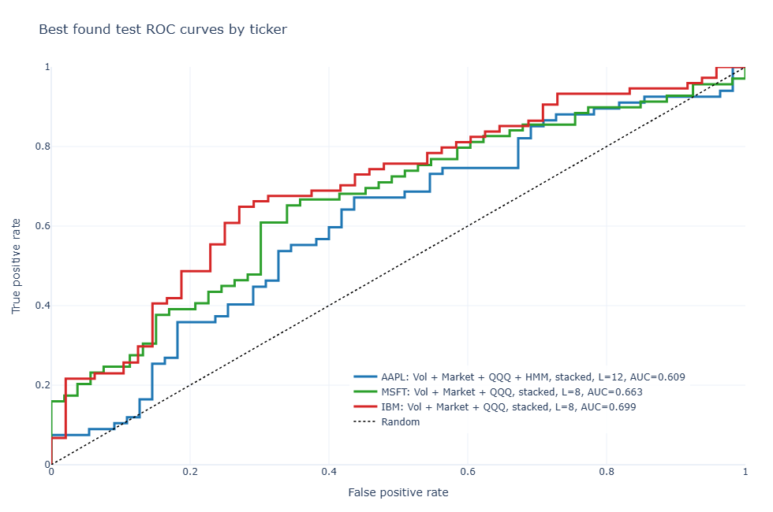
BEST FOUND
11 / 14
Best-found enriched models
Exploratory best test ROC-AUC values improved, especially for IBM and MSFT.
HMM appears in the best AAPL model only; IBM and MSFT peak with market-context LSTMs.
HONOURS PROJECT · HMM-LSTM STOCK DIRECTION PREDICTION
SLIDE 11 / 14

Slide 13
ANSWER
12 / 14
Answer to the research question
Regimes help understanding; market context helps prediction more robustly.
HMM contribution
Market context
HMM-derived regime information improves interpretability and sometimes helps prediction, but it does not consistently improve LSTM performance across all tickers.
Weekly market-context features, especially QQQ and volatility/market variables, provide more robust improvements.
Overall
Prediction remains ticker-dependent and benchmark-sensitive; the strongest results should be interpreted as best-found exploratory evidence.
HONOURS PROJECT · HMM-LSTM STOCK DIRECTION PREDICTION
SLIDE 12 / 14

Slide 14
LIMITS
13 / 14
Limitations
The results are useful, but the forecasting claim should stay cautious.
— Only three stocks were studied.
— Weekly test samples are small.
— Stock direction remains noisy and benchmark-sensitive.
— Best-found models need careful validation.
— HMM regimes are descriptive, not always predictive.
Best-found ≠ universal forecasting edge
HONOURS PROJECT · HMM-LSTM STOCK DIRECTION PREDICTION
SLIDE 13 / 14

Slide 15
FINAL CONCLUSION
14 / 14
The main finding is that HMM regimes are useful for understanding market states, while weekly market-context features are more useful for prediction.
The HMM-LSTM framework provides partial evidence of improvement, but not a universal forecasting advantage.
HONOURS PROJECT · HMM-LSTM STOCK DIRECTION PREDICTION
SLIDE 14 / 14

