Slide 1
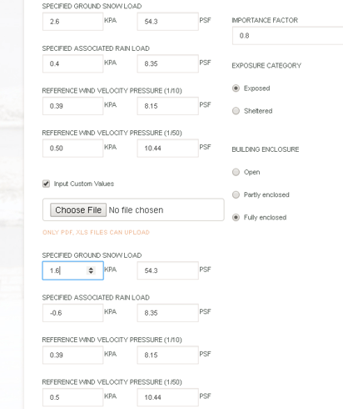
OES Snag Report – Adjusting Values - Increments
23.July.2018
Adjusting the snow load values with the down arrow takes the number down from 2.6 kPa to 1.6.
Should take the unit up or down in 0.1 increments. i.e. 2.6 down to 2.5 kPa.

