Slide 1
Single Spikes SNR and Spike Shape

Slide 2
Four measures of signal to noise ratio
The mean standard deviation across all 16 time points in the snippets.
The amp/sd at the absolute maximum
The (Max amp – Min Amp)/Average sd at max and min (obtained by averaging the variances).
The mean amp^2/var for all points in the snippets (mean SNR)

Slide 3
Cells visually organized by FT
Clear multi-unit: multi-unit files that are made of multiple single units (usually 2 or 3 clearly sortable).
Single units obtained from multi-unit above.
Large single units – the amplitude of these cells is so large that I wanted to look at them separately.
Isolated units: Single units that did not need spike sorting - these are very clear single units in our recordings, where the amplitude is clearly above threshold…
Noise units: units that I had labeled as being noise.
M code: SnipsSNRGrouped and list_files. List files was made by selecting units from :
h52Sort_FET_Done.odt. Mat files: meanSnipsNS.mat and meanSnipsAll.mat made by running getMeanSnipsNS (non sorted) and getMeanSnipsSS (spike sorted).

Slide 4
Example of FT Classification

Slide 5
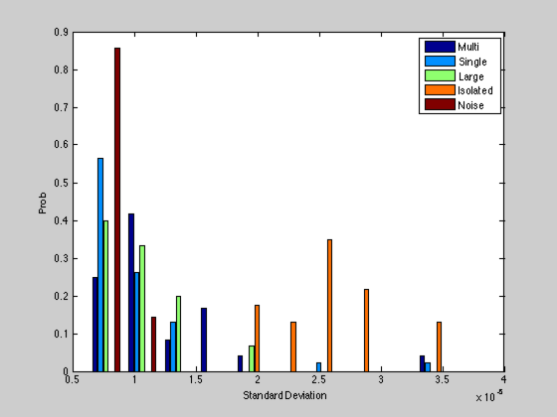
Standard Deviation does not work: e.g. Isolated spikes…

Slide 6
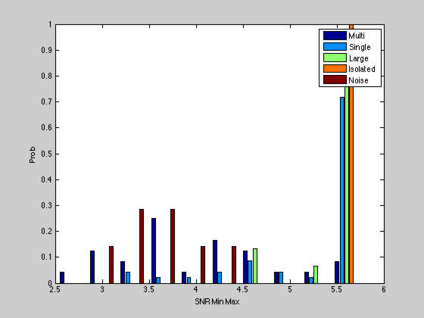
Max-Min SNR works well with a threshold of 5!
I chose this to define well isolate single units!

Slide 7
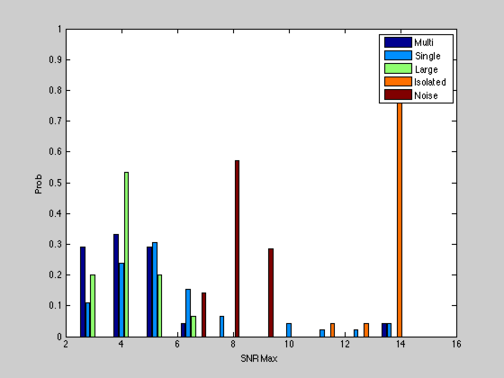
SNR max has issues with noise, single and large…

Slide 8
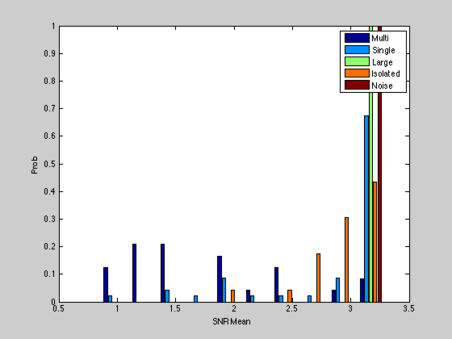
Noise has high SNR Mean

Slide 9
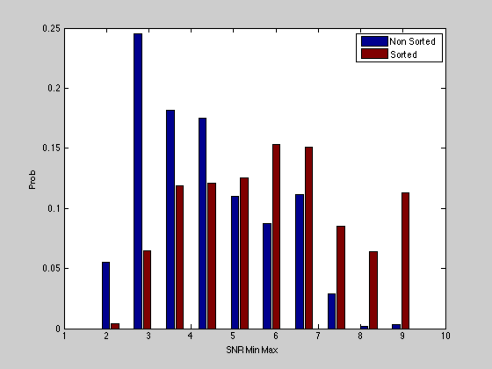
Comparing Sorted vs Non Sorted
Number of non sorted units with Min Max SNR > 5 177/583 or 30.4%
Number of sorted units with Min Max SNR > 5 914/1401 or 65.2%
Notes:
Use SnipsSNRSortedvsNot.

Slide 10
Spike Shape Sorting
I only used the spikes that had a min-max SNR greater than 5.
I also labeled some spikes by hand as: wide, large or narrow. This is a bit of a dangerous game but helps understanding the clusters.
I used a k-means on the power spectrum of the spikes (which deals nicely with phase differences, etc) with 4 groups to get clearly narrow, wide and large spikes – the fourth group is labeled unclassified but I think that they are mostly narrow spikes…
The annotation is done with annSpikeShape2.m
The sort is done with spikeShapePCA4

Slide 11
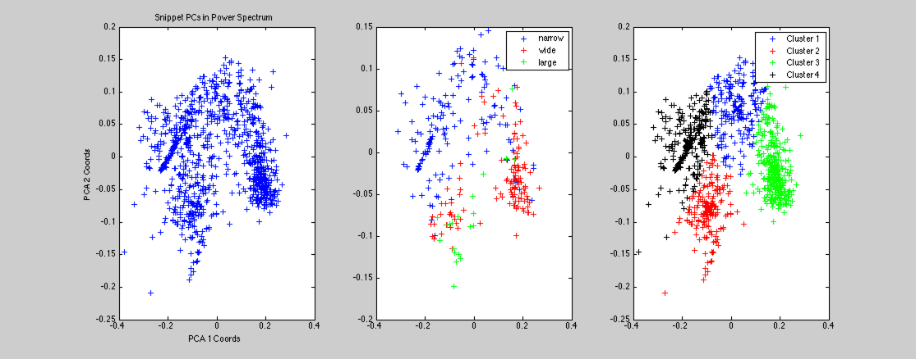
PC1 vs PC2
All Spikes
My Annotation
K-Means Clustering
Notes:
Figure 2 of spikeShapePCA4.m

Slide 12
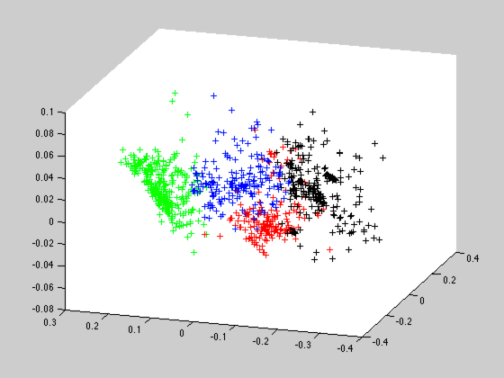
The third PC adds a bit more separation…

Slide 13
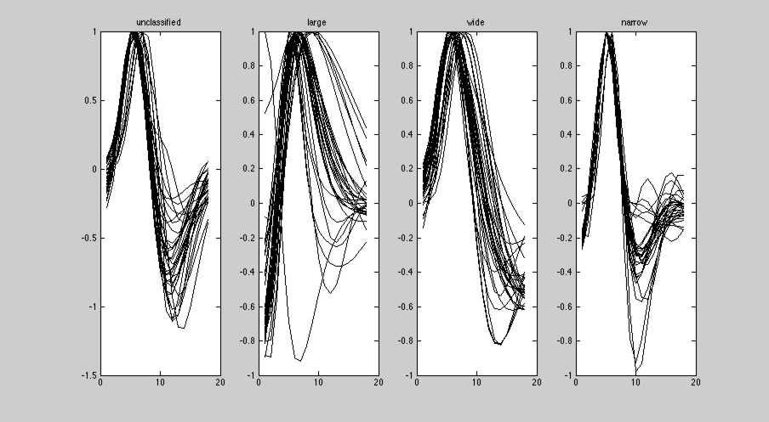
30 random spikes from each group from the k-means…
It looks great and it would look even better after lining up the peaks in time!
Notes:
The unclassiffied might be narrow spikes or their own group (there are more symmetric in up vs down)

Slide 14
Average Spike widths after sorting in ms. Measured at half maximum
Unclassified 0.21 +- 0.002 sd: 0.030
Large 0.30 +- 0.008 sd: 0.105
Wide 0.27 +- 0.002 sd: 0.038
Narrow 0.18 +- 0.001 sd: 0.020
The anova is highly significant:
Source SS df MS F Prob>F
--------------------------------------------------------
Groups 2.04526 3 0.68175 239.37 1.78913e-114
Error 2.5918 910 0.00285
Total 4.63706 913
Notes:
The number after the =- is one sem.

Slide 15
spikeShapeResult
Results for Julie call data base are saved in spikeShapeResults.mat:
allMeansSnips: the mean snip profile for all 1401 sorted units.
snrMinMaxUnits: the snr value for all snips obtained for one of those 1401 units.
indL5: index (length 487) of all units with SNR < 5.
indG5: : index (length 914) of all units with SNR >= 5.
allNames: cell array (length 1401) of the name of the unit
allSortType: the sort type given during spike sorting to that unit (noise, multi, single). Not super reliable since different sorters used different strategies (e.g. Hedi called everything single).
spikeType: the spike type obtained from the spikeShapeClustering. This is an array of size 914 – which is the number of units with indG5 == 1. To get the unit type for any unit in the dataset: if j is the index of the unit, the type is spikeType(find(indG5==j)) – as long as j is in the G5 group.
spikeWidth: the average width of the spike snippets.

