Slide 1

A Robust Biometric Template Protection Scheme using Fuzzy Vault Cryptography (Paper ID:- NCRTST25-JGEC-105-0003)
Sankhamit Datta , Tuhina Chanda , Prof. Somenath Dhibar
Jalpaiguri Government Engineering College
Presenting Author: - Sankhamit Datta

Slide 2
Introduction
Objectives:
Secure biometric templates
Prevent unauthorized access
Motivation:
Biometric data is immutable
Vulnerable to attacks like template theft
Need for advanced protection techniques

Slide 3
Literature Review
Common Attacks on Biometric Templates:
Despite their security, biometric systems are vulnerable to various attacks.
•Impersonation and Replay Attacks: Attackers use fake biometric samples or replay captured data. [9,10]
•Template Theft: Unauthorized access to stored biometric templates. [3,5,9]
Mitigation: Encryption, secure hardware (TPMs), and template protection techniques such as Fuzzy Vault. [12,15]
•Morphing and Brute-Force Attacks: Blending biometric features or guessing biometric data.[4,6]
Mitigation: Improved matching algorithms, threshold adjustments, and periodic template updates. [2,8]
•Man-in-the-Middle (MitM) Attacks: Intercepting biometric data during transmission. [10,13]
Mitigation: End-to-end encryption, digital signatures, and session-based tokens. [1,7,14]

Slide 4
Literature Review
Fuzzy Vault Scheme
The Fuzzy Vault scheme secures biometric templates while allowing for intra-class variations. [12,15]
Key Concepts:
•Biometric Template: Digital representation of biometric features. [3,9]
•Minutiae Points: Unique fingerprint features used for encoding. [8,14]
•Chaff Points: Random noise added to obscure real data. [5,15]
•Galois Field (GF): Mathematical field ensuring secure encoding. [13,15]
How It Works: A cryptographic key is encoded into a polynomial using biometric minutiae. [12,15] Chaff points are added to obscure genuine data, allowing only legitimate users to reconstruct the key [5,11,14].

Slide 5
Literature Review
Benefits:
•Secure storage without direct biometric data exposure. [10,13]
•Tolerance for intra-class variations. [2,9]
•Scalable security through chaff points. [5,12]
Challenges:
•Increased computational complexity. [4,6]
•Dependence on accurate minutiae extraction. [8,14]
• Difficulty in adapting across different biometric modalities. [7,9]
The Fuzzy Vault scheme offers a strong balance between security and practicality in biometric template protection. [1,12]

Slide 6
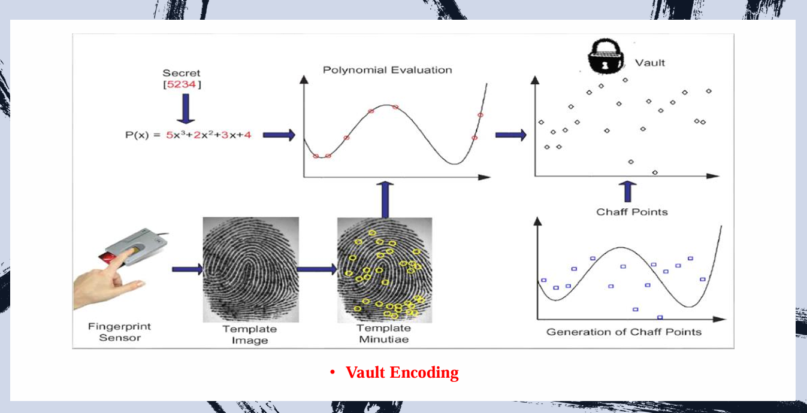
Methodology
Vault Encoding:
Extract minutiae points (location & orientation)
Add chaff points for obfuscation
Encode biometric data into a polynomial
Secure storage without direct exposure of biometric templates

Slide 7
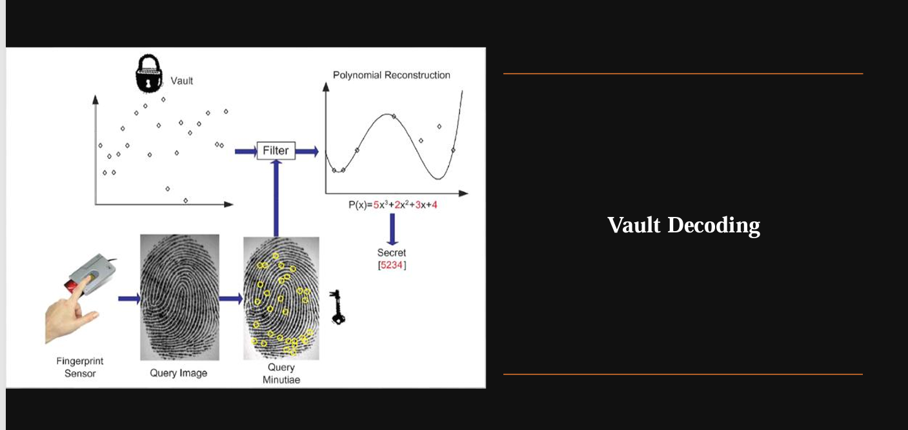
Methodology
Vault Decoding:
Align query minutiae points with stored templates
Use Reed-Solomon decoding to reconstruct the polynomial
Validate extracted key with error correction
Ensures only legitimate users can retrieve the biometric key

Slide 8
Results
Dataset Used: SOCOFing (Sokoto Coventry Fingerprint)
5000 Fingerprint images
Training: 80% (4000)
Testing: 20% (1000)
Performance metrics:-
False Acceptance Rate (FAR) at threshold 2.1773: 0.1667
False Rejection Rate (FRR) at threshold 2.1773: 0.2000
Equal Error Rate (EER): 0.1833

Slide 9
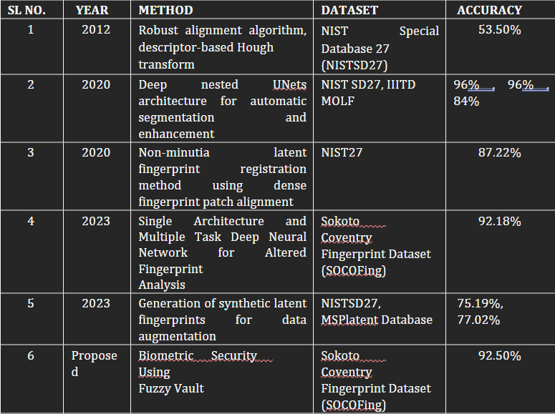
Results
Performance Comparison Table

Slide 10
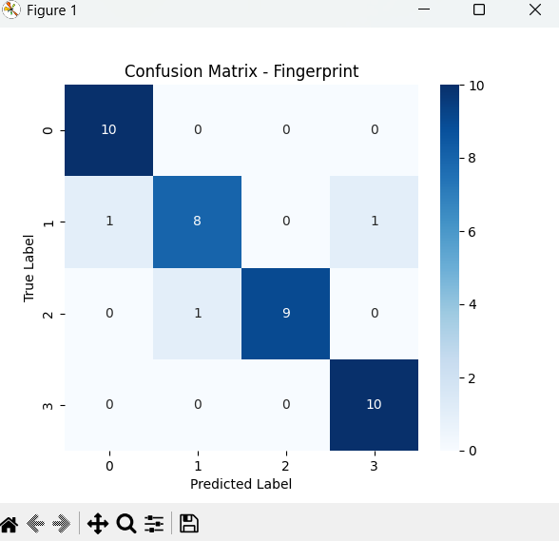
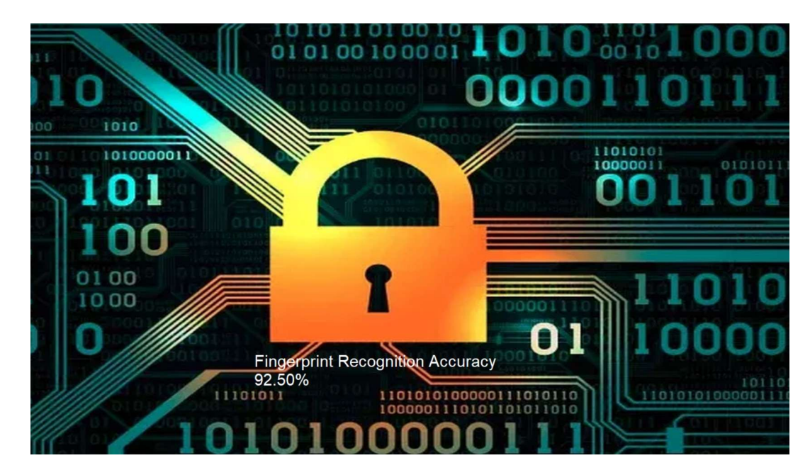
Results
Achieved Accuracy: 92.5%
Confusion Matrix

Slide 11
Performance Analysis
This project stands out from other implementations in several key ways. Here’s what makes it better and more robust compared to standard fuzzy vault approaches:-
High Accuracy achieved (92.5%) - Most fuzzy vault implementations struggle to achieve high accuracy due to false acceptances and rejections. This project optimizes minutiae extraction, chaff point placement, and decoding robustness, leading to a superior 92.5% accuracy.
Comprehensive Performance Metrics - This project evaluates security and usability using False Acceptance Rate (FAR), False Rejection Rate (FRR), and Equal Error Rate (EER) instead of just reporting accuracy. This provides a more complete assessment of system reliability.
Advanced Preprocessing & Feature Engineering - Our implementation includes segmentation, normalization, thinning, skeletonization, and feature vector padding, ensuring better minutiae detection and compatibility across different datasets.
Machine Learning Integration - By incorporating SVM with GridSearchCV and StandardScaler normalization, our project enhances recognition accuracy beyond traditional fuzzy vault decoding methods.
Practical GUI & Visualization - Unlike many theoretical implementations, our project includes a user-friendly GUI, minutiae plotting, and accuracy visualizations, making it more practical for real-world applications

Slide 12

Security Measures of the proposed method
Suppose an attacker attempts a brute-force attack on the discussed fingerprint-based fuzzy vault system by trying to decode the secret using all combinations of $(n+1)$ points in the vault.
If the secret size is 128-bits and the number of genuine and chaff points in the vault are 24 and 200, respectively, the total number of possible combinations is $\left({224 \atop 9}\right)≈3.3×{10}^{15}$ and among these combinations $\left({24 \atop 9}\right)≈1.3×{10}^{6}$combinations will successfully decode the secret.
The probability that a combination of points decodes the secret is $\frac{1.3×{10}^{6}}{3.3×{10}^{15}}≈4×{10}^{−10}$ and the expected number of combinations that need to be evaluated is $2.5×{10}^{9}.$
It corresponds to a computational time of 13 years (as per the computational strength at that time).

Slide 13
Conclusions and Future Work
Conclusion:
Fuzzy Vault scheme enhances biometric security
Ensures data privacy & protection against template theft
Future Work:
Improve cross-dataset evaluation
Implement multi-modal biometric security
Reduce computational complexity

Slide 14
References
[1] B. Poorebrahim Gilkalaye, S. Mukherjee, and R. Derakhshani,” A Secure and Private Ensemble Matcher Using Multi-Vault Obfuscated Templates,” arXiv preprint arXiv:2404.05205, 2024.
[2] C. Rathgeb, B. Tams, J. Merkle, V. Nesterowicz, U. Korte, and M. Neu,” Multi-Biometric Fuzzy Vault Based on Face and Fingerprints,” arXiv preprint arXiv:2301.06882, 2023.
[3] H. Nguyen, T. Tran, and M. Le,” A Privacy-Preserving Biometric Authentication System Using Fuzzy Vault with ECC,” Proceedings of the IEEE International Conference on Data Security, pp. 244–250, 2023.
[4] Y. Zhao and S. Wang,” Deep Learning-Based Fuzzy Vault Construction for Biometric Template Protection,” IEEE International Symposium on Information Security, vol. 9, no. 2, pp. 456–462, 2022.
[5] M. R. Azad, A. Mahmoodi, and A. Hassanzadeh,” A Secure Biometric Template Protection Using Fuzzy Vault with Improved Chaff Point Selection,” Journal of Information Security and Applications, vol. 62, pp. 102937, 2021.
[6] C. Rathgeb, J. Merkle, J. Scholz, B. Tams, and V. Nesterowicz,” Deep Face Fuzzy Vault: Implementation and Performance,” arXiv preprint arXiv:2102.02458, 2021.
[7] A. Kumar, N. Gupta, and S. Choudhary,” Multi-Biometric Fuzzy Vault Based on Face and Iris Templates,” Proceedings of the International Conference on Biometric and Surveillance Technologies, pp. 512–518, 2021.

Slide 15
References
[8] X. Yang, Z. Zhang, and T. Li,” An Improved Fuzzy Vault Scheme Using Minutiae Descriptor Matching for Fingerprint Security,” Proceedings of the IEEE International Conference on Biometrics (ICB), pp. 187–194, 2020.
[9] J. Galbally, M. Gomez-Barrero, and J. Fierrez,” Biometric Template Protection Using Fuzzy Vault Schemes: Recent Advances and Future Directions,” IEEE Transactions on Biometrics, vol. 21, no. 5, pp. 1384–1395, 2019.
[10] S. Geng, G. Giannopoulou, and M. Kabir-Querrec,” Privacy Protection in Distributed Fingerprint-based Authentication,” arXiv preprint arXiv:1911.00248, 2019.
[11] S. Nagar, S. Chaudhary, ”A Hybrid Approach for Secure Biometric Template Generation Based on Fuzzy Vault and Visual Cryptography”, Source: International Journal of Computer Applications, 2011.
[12] K. Nandakumar, A. K. Jain, and S. Pankanti,” Multibiometric Template Security Using Fuzzy Vault,” Proceedings of the IEEE Second International Conference on Biometrics: Theory, Applications and Systems (BTAS), pp. 1–6, 2008.
[13] F. Hao, R. Anderson, and J. Daugman,” Combining Crypto with Biometrics Effectively,” IEEE Transactions on Computers, vol. 55, no. 9, pp. 1081–1088, 2006.
[14] Feng Hao, Ross Anderson, John Daugman,” A Secure Fingerprint Fuzzy Vault Scheme Based on Polynomial Reconstruction”, Source: IEEE International Conference on Pattern Recognition, 2006.
[15] A. Juels and M. Sudan,” A Fuzzy Vault Scheme,” Proceedings of the IEEE International Symposium on Information Theory, pp. 408, 2002.

Slide 16

This Photo by Unknown Author is licensed under CC BY-SA

