Slide 1
ENPM 808A-Final Project
Suriya Suresh

Slide 2
Contents
Problem Statement
Data Preprocessing
Models
The Best Model
Hyper-Parameters
Conclusion

Slide 3
Problem Statement
Given Laser Range Data and associated linear and angular velocity , predict linear and angular velocity of the car using a machine-learning algorithm.

Slide 4
Data Preprocessing
Given 1080 Columns of Laser Data, taking field of view as 30, the number of features become 9.
Similarly , the quaternion components qr and qk of current robot position, local and final goal was summed up , reducing features from 12 to 9, giving a total of 18 features.

Slide 5
Models Chosen
Linear Regression and Decision Tree Regressor are chosen and taken from the python package Sklearn.
A neural network from keras was also chosen.

Slide 6
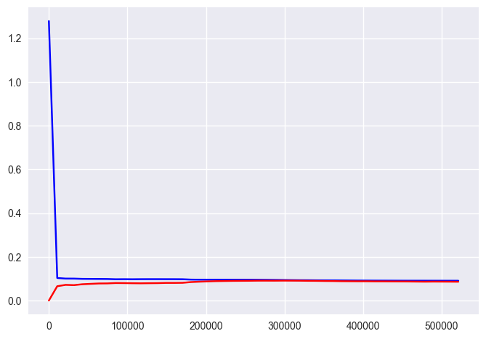
Linear Regression
The error is a bit high. The model will not fit any better after closer to about 20000 points.
Hence giving more points does not help with error.

Slide 7
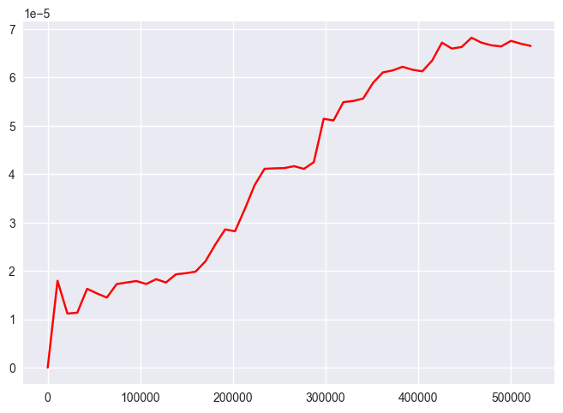
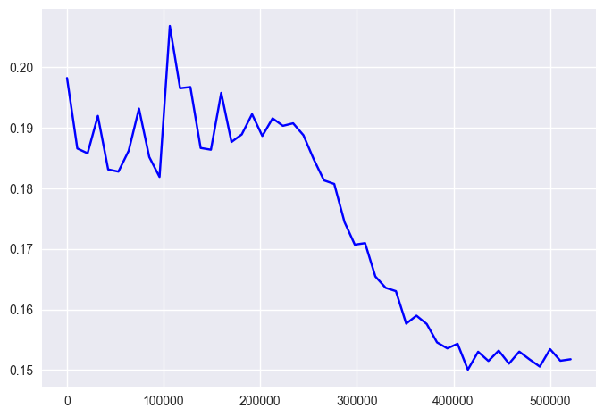
Decision Tree Regressor
No arguments were passed to the model

Slide 8
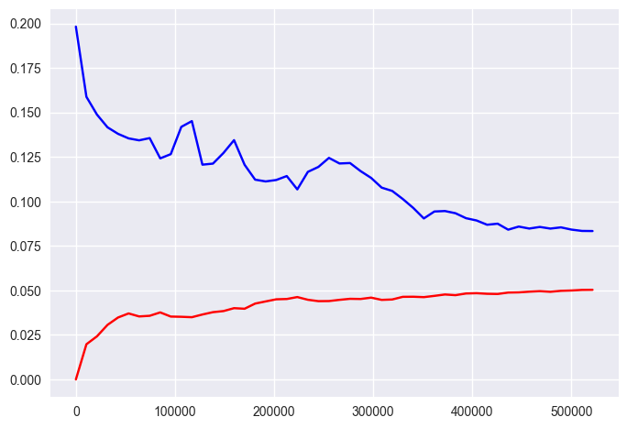
Decision Tree Regressor
Max_depth=10
The curves would converge if more datapoints are given.

Slide 9
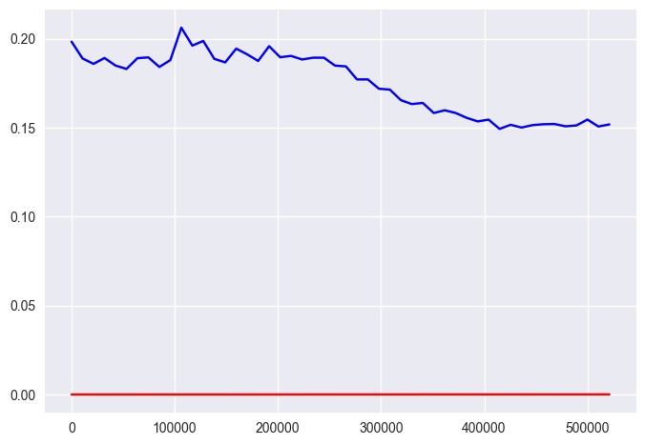
Decision Tree Regressor
Max_depth=100
The model is overfitting.

Slide 10
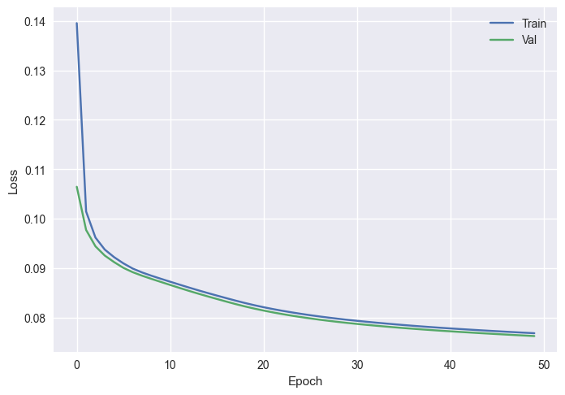
Neural Network
The neural network has decent performance, and it seems to have a good fit.

Slide 11
The Best Model
Decision Tree Regression was chosen as the final model of choice as the E_val value was the lowest.
Decision trees are faster and easier to tune hyper parameters and regularize for this project.
They offered a good balance of E_val value and resource use.

Slide 12
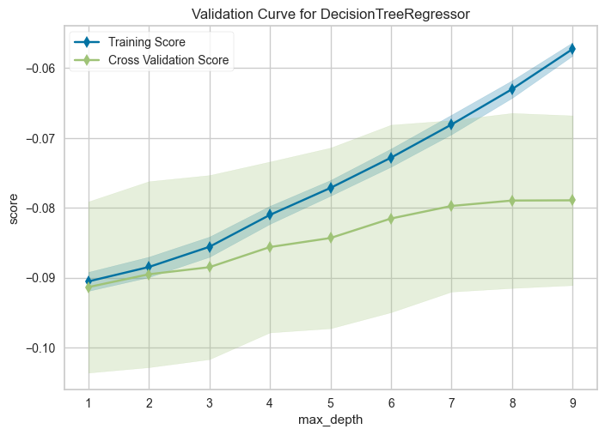
Hyperparameters and Regularization
Decision tree has a few hyperparameters to tune but for this model , tuning the max_depths parameter offered the best results.
The plot has the best fit when the parameter max_depth=7.
Overfitting is controlled by regulating max_depth compared to regularization techniques used for other models.

Slide 13
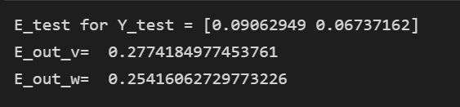
Conclusion
The Decision Tree Regressor with max_depth=7 was chosen as the model of choice and allowed to predict values on the Test dataset
The Test Error and out-of-sample error obtained for tolerance taken as 0.1 is:

