Slide 1
US ACCIDENTS CAPSTONE
Predicting Accident Severity
Before It Happens
Using weather, time, location and road features to help traffic safety agencies anticipate severe crashes
Jackson Theuri Mururi
CRISP-DM Methodology • 500,000-Record Sample

Slide 2
The Business Problem
Road accidents strain emergency services and transport agencies. Knowing which conditions tend to produce severe crashes lets stakeholders prioritize before, not after, the fact.
DOT
TSA
ERC
Four Guiding Questions
1
Which weather conditions are associated with severe accidents?
State Departments
of Transportation
Traffic Safety
Authorities
Emergency
Response Centers
2
Does accident severity change during the day?
3
Which states experience the largest number of severe crashes?
4
Which road features appear most in serious accidents?
Methodology: CRISP-DM — Business Understanding → Data Understanding → Preparation → Modelling → Evaluation
01
US Accidents Capstone

Slide 3
The Dataset at a Glance
A representative sample drawn from the US Accidents (2016–2023) database, cleaned and enriched before any analysis began.
500,000
46 → 51
49
0.9%
Accident Records
Original → Engineered Columns
States Represented
Records Missing Weather Data
Engineered features created before analysis:
Hour
Month
Day of Week
Season
Is Night
Every one of these is derived only from information available before or at the moment of the crash — no lookahead into outcomes that happen afterward.
02
US Accidents Capstone

Slide 4
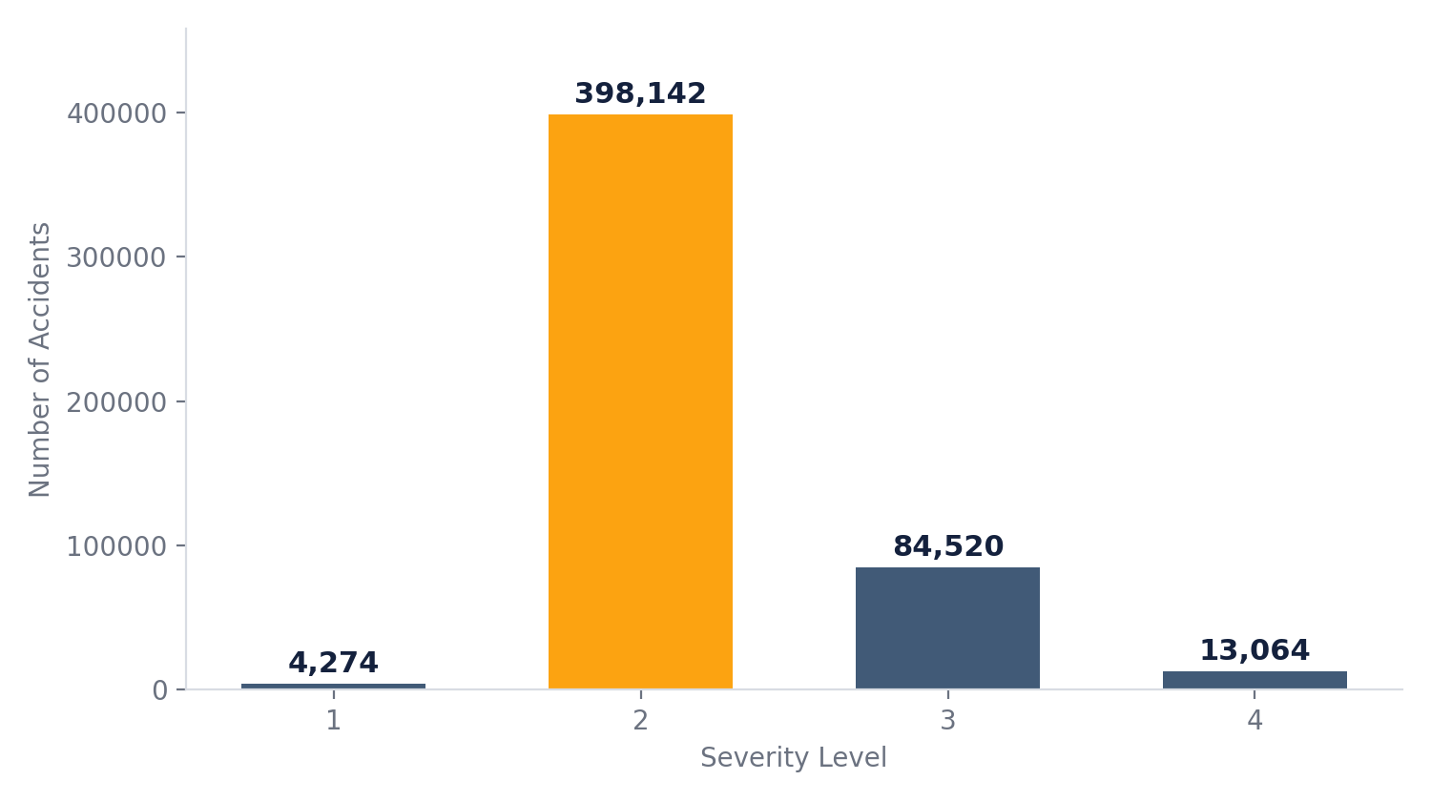
A Heavily Imbalanced Target
79.6%
of all accidents are rated Severity 2 — a “moderate” crash
Only 2.6% of accidents reach Severity 4 — but these are exactly the ones emergency planning cares most about.
Why it matters for Phase 2:
A model could reach ~80% accuracy just by always guessing “Severity 2” — and still be operationally useless. This is why accuracy alone can't be trusted here.
03
US Accidents Capstone

Slide 5
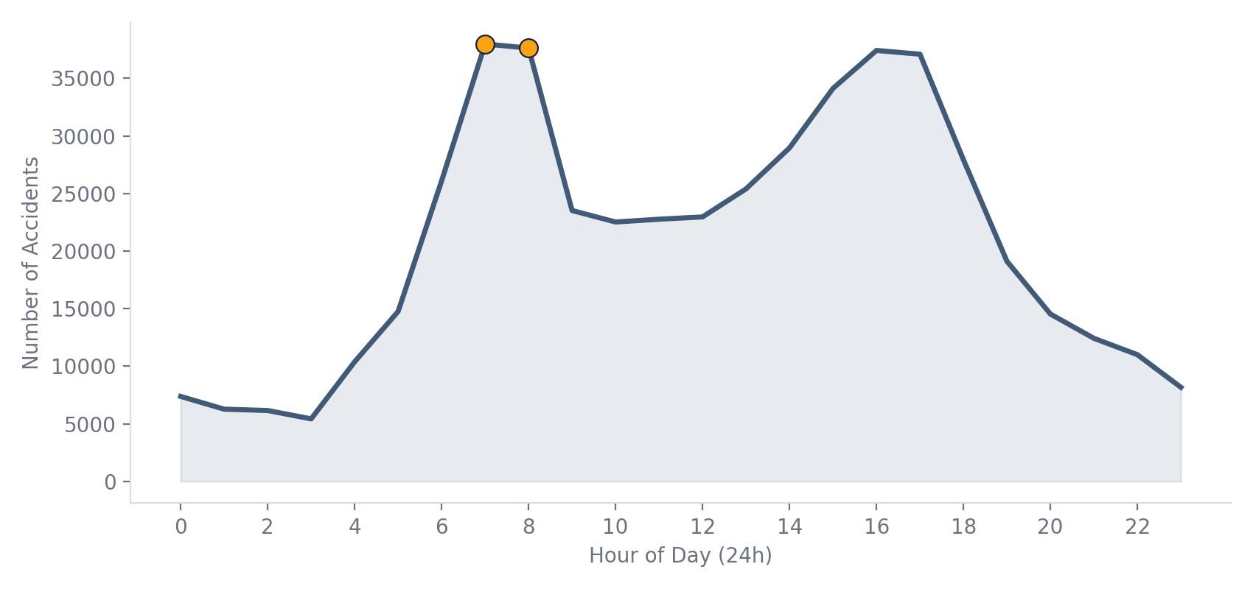
When Do Accidents Happen?
Rush-hour periods stand out clearly — busier roads mean more opportunities for collisions.
7–8 AM
Morning peak: ~38,000 accidents each hour
4–5 PM
Evening peak: ~37,000 accidents each hour
04
US Accidents Capstone

Slide 6
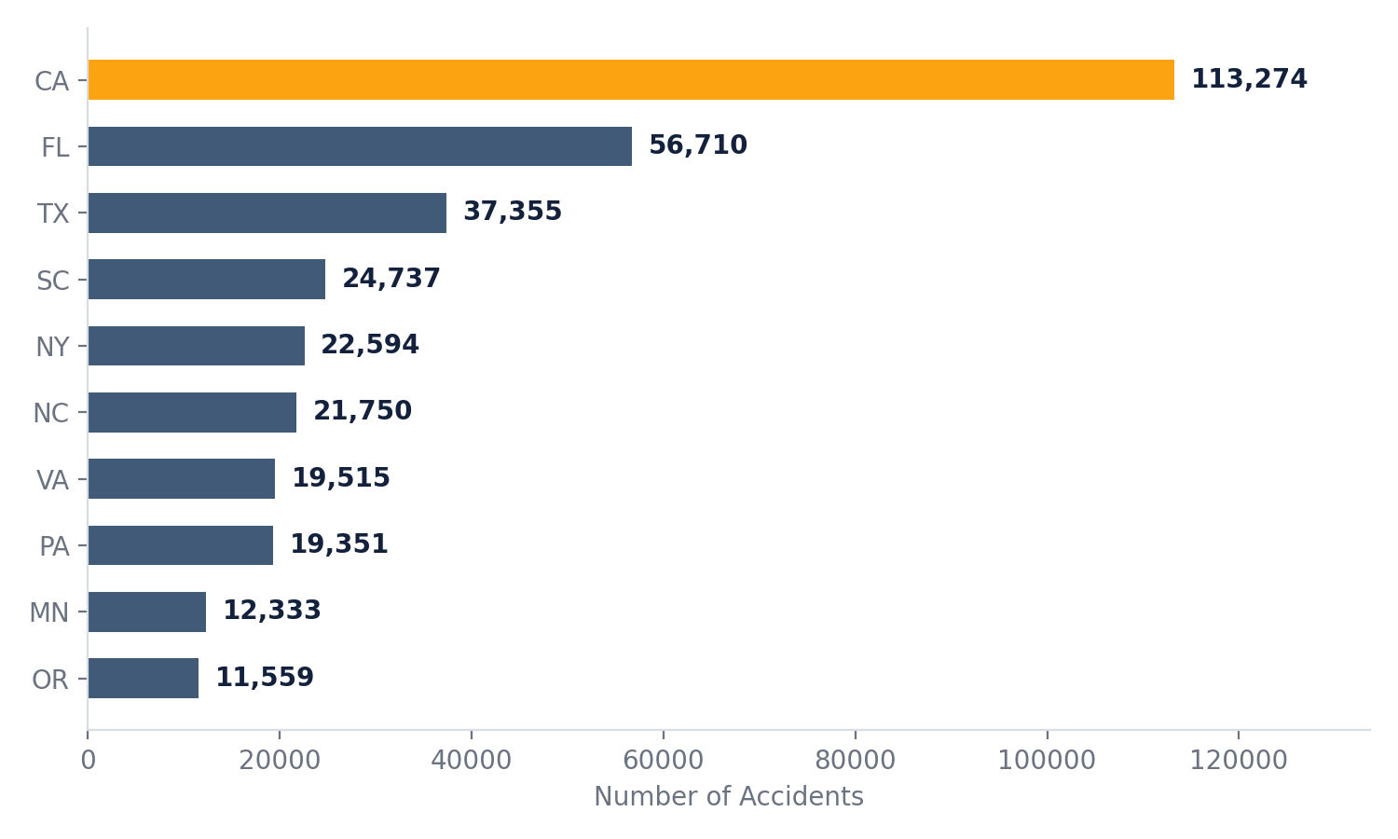
Where Do They Concentrate?
Some states consistently record far higher accident volumes than others — a case for location-specific, not one-size-fits-all, interventions.
California
113,274
accidents — more than double the next state
05
US Accidents Capstone

Slide 7
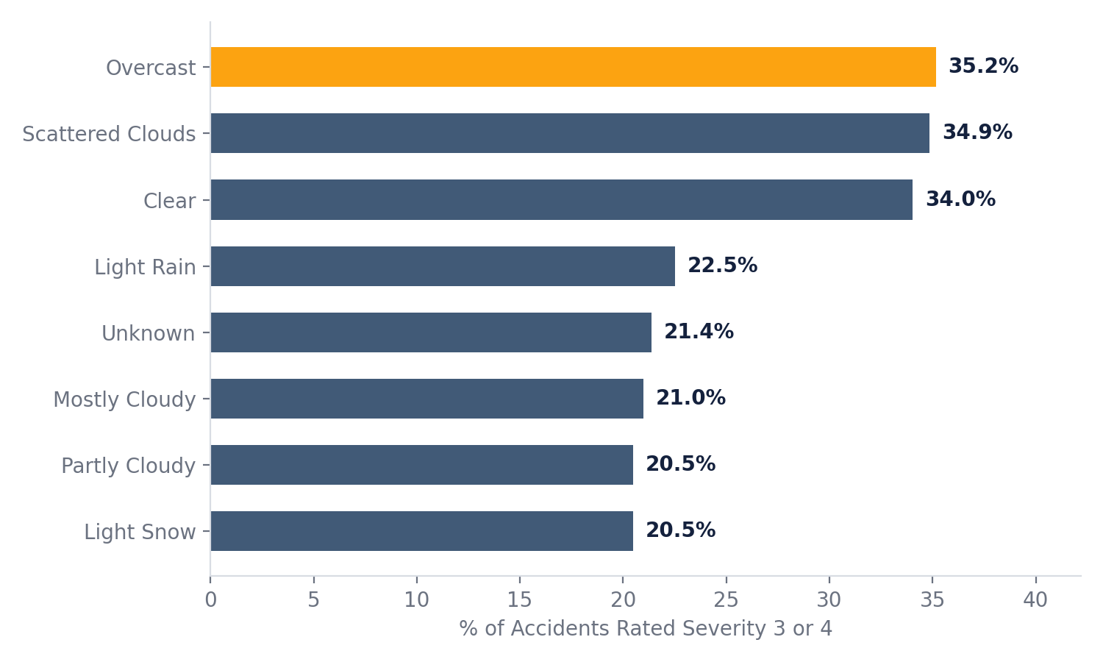
Weather's Role in Severity
Counter-intuitively, calmer-sounding conditions carry the highest share of severe crashes — likely because they coincide with higher speeds and less caution.
Statistical Validation
Chi-Square Test
Weather Condition × Severity
χ² = 22,454.97
p < 0.001
ANOVA Test
Visibility across Severity groups
F = 38.5 | p < 0.001
Both relationships are statistically significant — weather and visibility are genuinely linked to severity, not coincidence.
06
US Accidents Capstone

Slide 8
From Insight to Prediction
Phase 1 showed that weather, time and location relate to severity. Phase 2 tests whether they can predict it for a new accident.
THE TASK
FEATURES USED
HOW IT'S BUILT
Multi-class
Classification
• Temperature
80/20 stratified split
• Visibility
before any preprocessing is fit
• Humidity
Target: Severity (1–4)
• Wind Speed
Numeric features
• Weather Condition
median-imputed, then scaled
Metric: Weighted F1-score, chosen specifically because accuracy would reward always predicting the majority class (Severity 2).
• State
• Hour & Month
Categorical features
• Traffic Signal
most-frequent imputed, one-hot encoded
• Junction
Two models compared
Chosen because every one is known before or during the crash — no leakage from after-the-fact information.
Logistic Regression vs. Random Forest
07
US Accidents Capstone

Slide 9
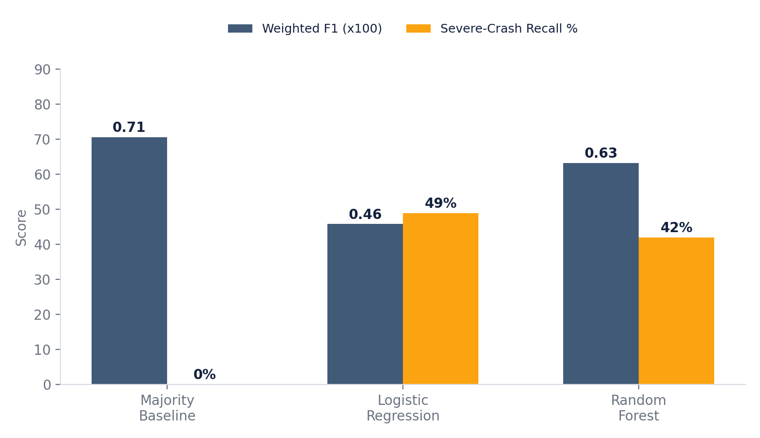
The Baseline Trap
A model that never predicts a severe crash can still look strong on paper. This is exactly why Weighted F1 alone isn't enough.
0%
of severe crashes (Sev. 3 & 4) caught by the majority baseline — despite its high Weighted F1 of 0.706
42–49%
of severe crashes caught by the Logistic Regression and Random Forest models — a real, usable signal the baseline completely misses
08
US Accidents Capstone

Slide 10
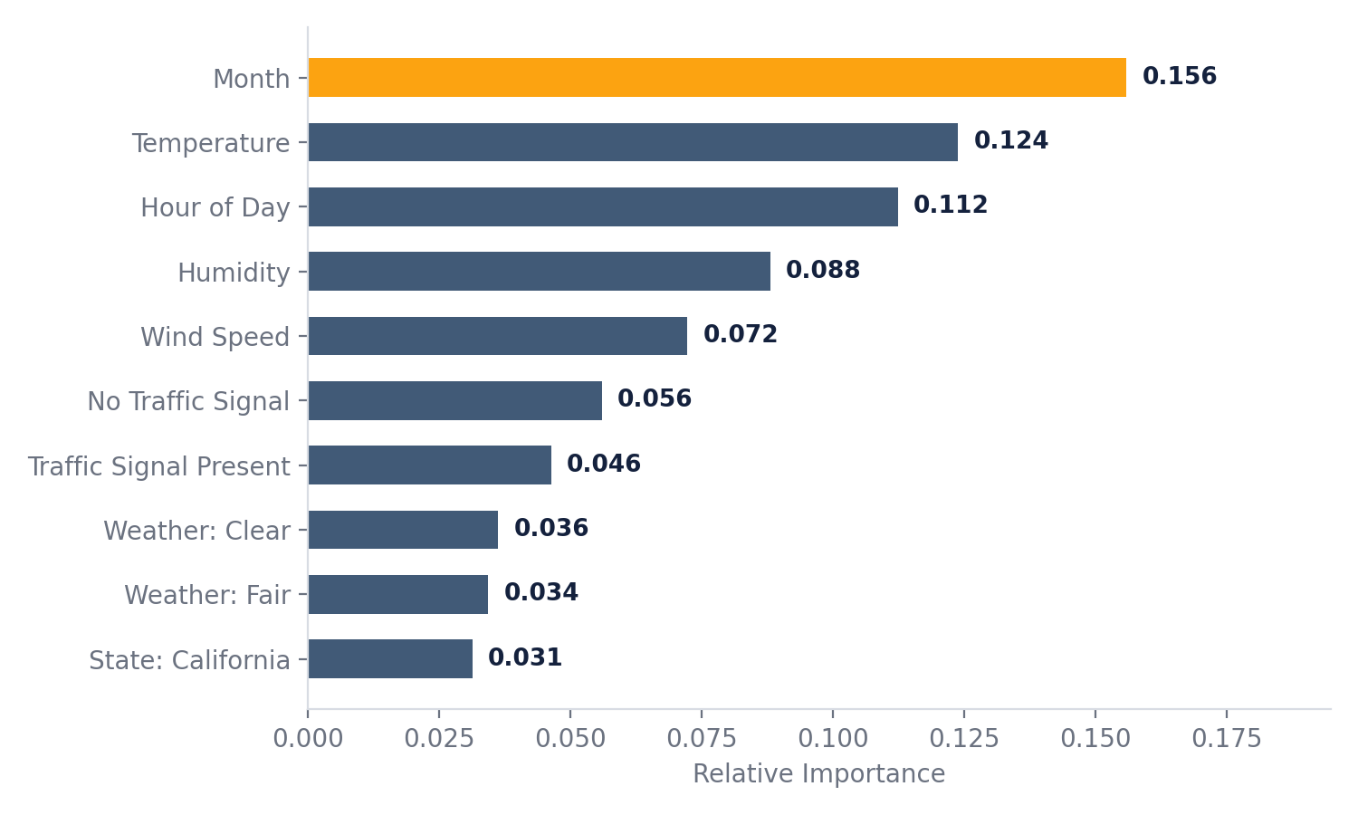
What Drives the Predictions?
Random Forest lets us look inside the model. Time-based and weather features dominate over any single state or road feature.
Reading the result
Month and Hour together outrank any single weather category — timing matters as much as conditions.
Traffic signal presence is the top road-feature signal, ahead of state identity.
No single feature dominates — severity is genuinely multi-factor.
09
US Accidents Capstone

Slide 11
Business Impact
Treated as a decision-support tool — not a replacement for human judgment — this model can plug into real workflows.
1
2
3
4
Prioritize Dispatch
Trigger Warnings
Plan Resources
Target Locations
Flag likely-severe incidents so emergency response can be positioned faster.
Surface high-risk weather + time combinations to drivers before conditions worsen.
Align staffing and equipment with peak-risk hours identified in the data.
Direct infrastructure investment toward the states and corridors carrying the heaviest load.
“The model should be treated as a decision-support tool rather than an automatic decision-maker.”
10
US Accidents Capstone

Slide 12
Limitations & What's Next
Limitations
What's Next
Severity classes are heavily imbalanced
Interactive Tableau Dashboard
Bringing Phase 1's insights out of the notebook so DOTs and response centers can filter by state, weather and time themselves.
Some weather variables contain missing values
A sampled dataset may not fully represent the national picture
Phase 3 — Text Classification
Nearly every record includes a free-text accident Description. Phase 3 will test whether the narrative alone can predict severity, evaluated with Accuracy, Precision, Recall and F1-score.
Statistical association is not proof of causation
Missing context: traffic density, road geometry, driver behavior
Together, the three phases move from understanding → predicting → explaining in natural language.
11
US Accidents Capstone

Slide 13
Thank You
Questions and discussion welcome
Jackson Theuri Mururi
US Accidents Capstone • CRISP-DM

