Slide 1

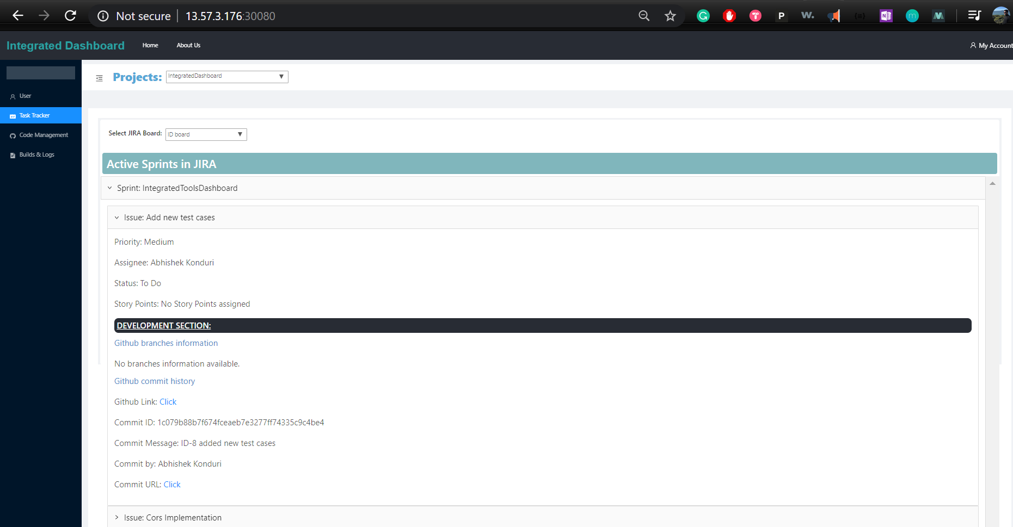
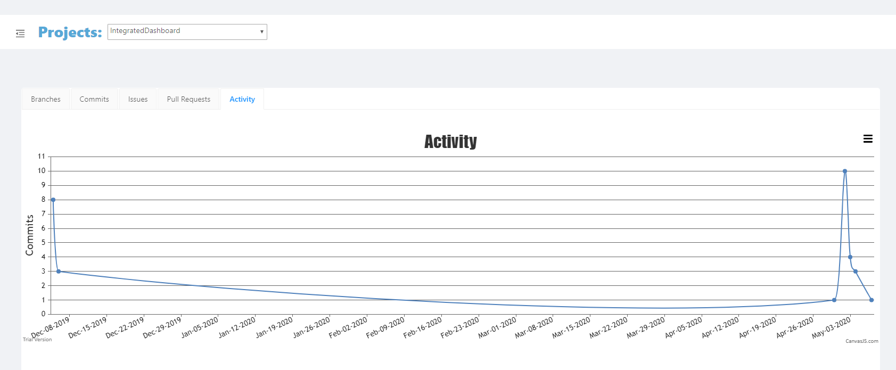
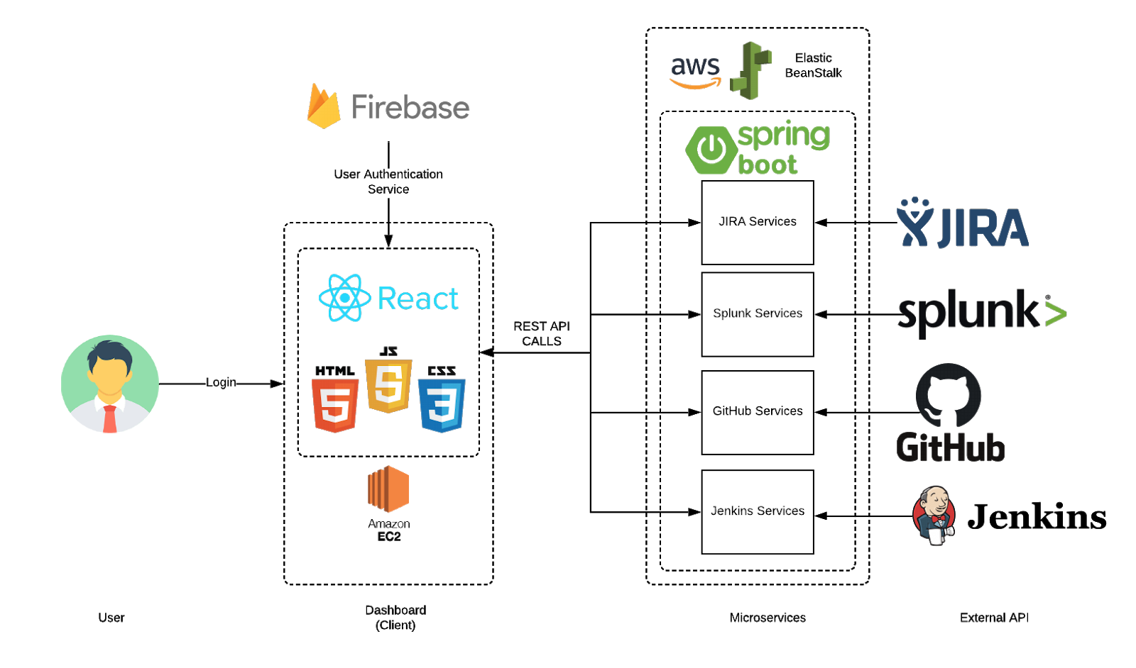
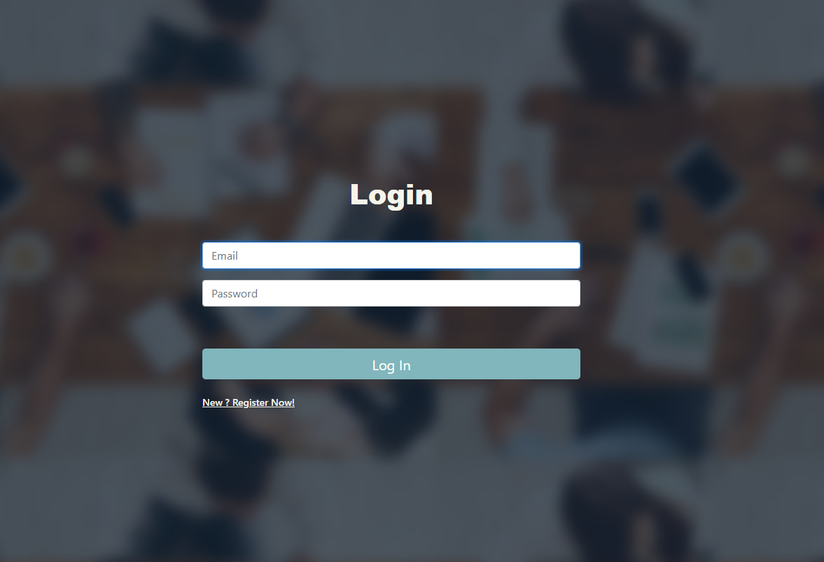
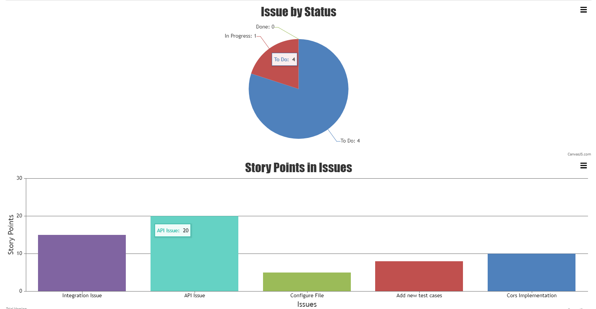
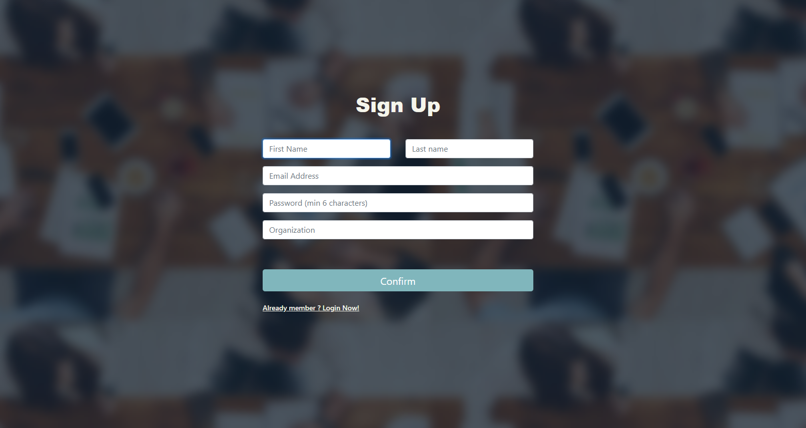
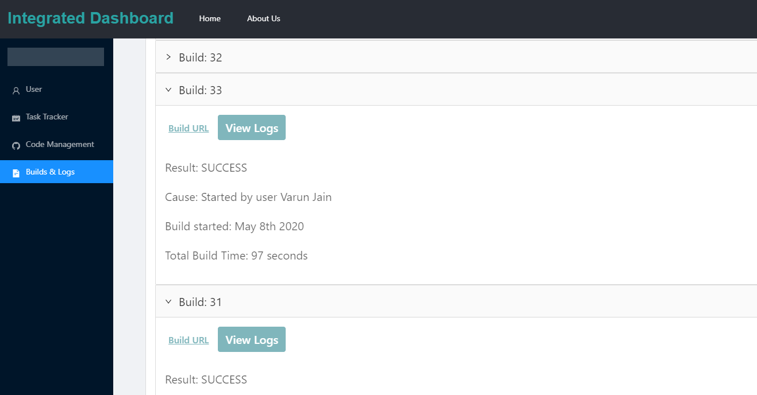
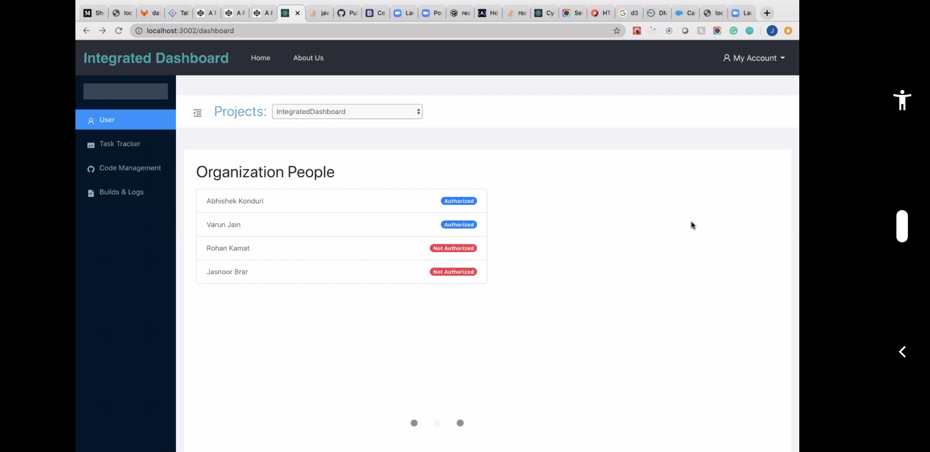
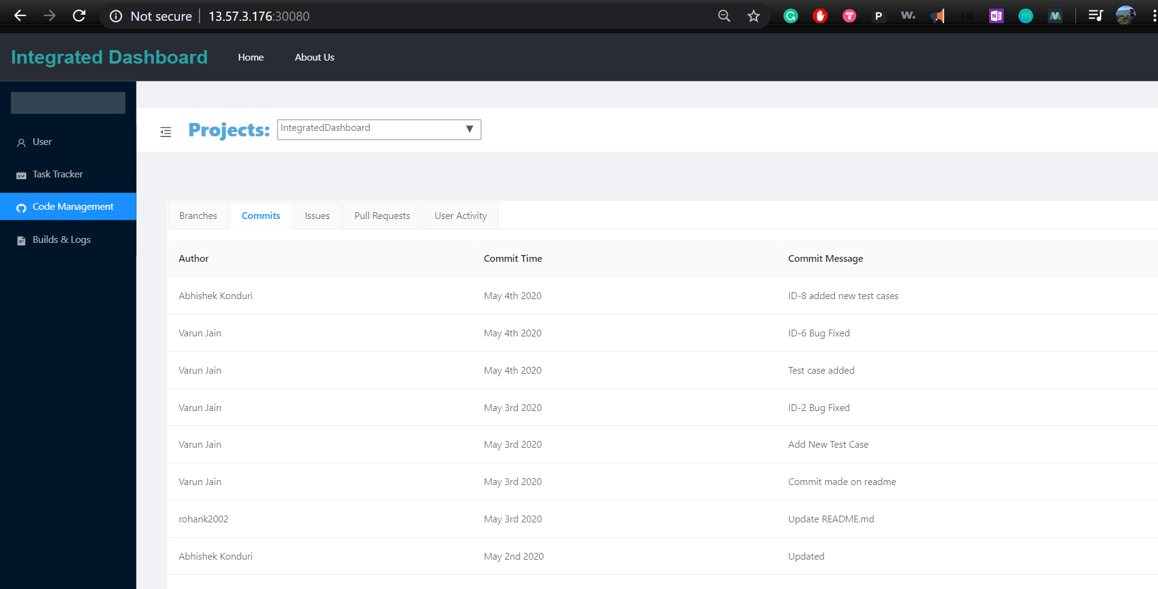
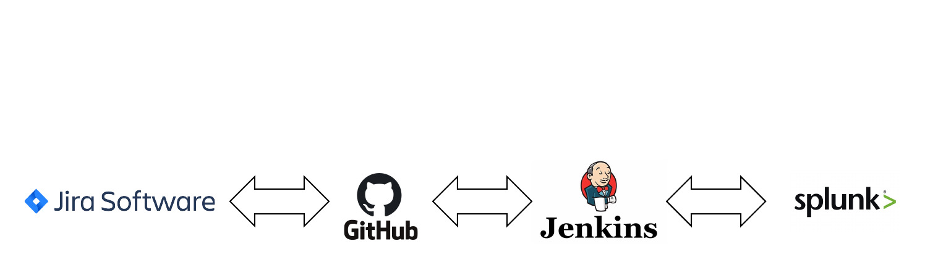
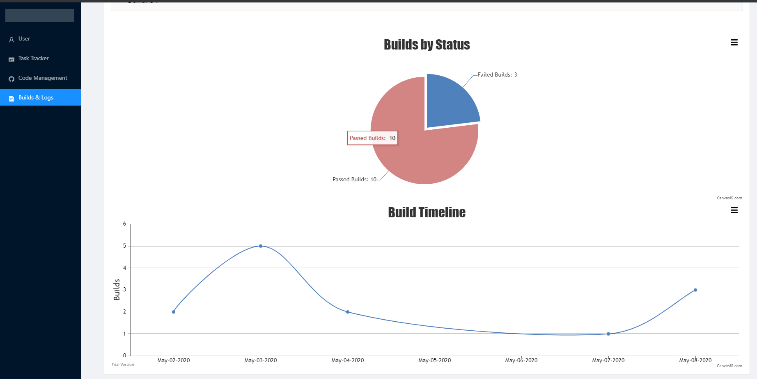
Computer Engineering Department
Integrated Tools Platform
Project Advisor: Dan Harkey
Brar, Jasnoor (MS Software Engineering)
Jain, Varun (MS Computer Engineering)
Kamat, Rohan (MS Software Engineering)
Konduri, Abhishek (MS Software Engineering)
Introduction
Project Architecture
Working in an industry, especially Software Development, we use several tools while working on projects. What if all these tools are integrated into a single environment? That’s what Integrated Tools Platform is, we have automated major interdependent tools and brought them together into one platform.
Build and Logs (Splunk + Jenkins)
The user can view build details and get the logs associated to a build in this pane. The analyses of the logs and builds are also presented to the user using interactive graphical visualizations. Hyperlink to application is also embedded in case, a user wants to get to the original log or job.
Summary/Conclusions
We conclude that this project aims at implementing an application that effectively solves the challenges of integrating various software applications used in a company. The project also aims at saving most programmers’ precious time and make it simple and accessible to function.
Code Management (GitHub)
Git is a Version Control System to maintain track of all iterations of changes made to the software and GitHub is website that hosts Git. The user can get details about the repository like commits, issues, activity and pull requests from the dashboard. The dashboard can handle multiple repositories.
Key References
[1] Wray, Stacy. “Integrating JIRA, GitHub, Jenkins, and Slack in your workflow” Acquia, Acquia Inc., 27 September 2019 https://support.acquia.com/hc/en-us/articles/360005167214-Integrating-JIRA-GitHub-Jenkins-and-Slack-in-your-workflow [2] Zadrozny P., Kodali R. (2013) Getting Data into Splunk. In: Big Data Analytics Using Splunk. Apress, Berkeley, CA, https://doi-org.libaccess.sjlibrary.org/10.1007/978-1-4302-5762-2_2 [3] Kulshrestha, Saurabh. “What is Jenkins? | Jenkins For Continuous Integration | Edureka” edureka, Brain4ce Education Solutions Pvt. Ltd, 22 May 2019, https://www.edureka.co/blog/what-is-jenkins/
Tools
Acknowledgements
Task Tracker (JIRA)
As per Atlassian’s official website, Jira is a very useful progress tracking and issue-ticketing tool for project management and agile software development. The user can track sprints, get details and insights from the dashboard.
The author are deeply indebted to Dan Harkey We would like to express our special thanks of gratitude to our Project advisor Professor Dan Harkey who always gave us his in-depth advice on certain components and the overall structure of the project which helped us in successfully moving forward with our design and implementation.

